Slide 1

27 Super Global: $_COOKIE and $_SESSION
Peter H. Chen

Slide 2
27 Super Global: $_COOKIE and $_SESSION
https://www.youtube.com/watch?v=jort8_4U-88&list=PL0eyrZgxdwhwBToawjm9faF1ixePexft-&index=27
Super Global: $_COOKIE and $_SESSION
Cookie saves information on the user side meaning inside the browser.
Session saves information on the user inside the server side.
Once we logged in, we are in sessions.
We can go to other page, the website still remember who we are.
Hacker can easier time going into your cookie rather than session.
Cookie saved on your computer somewhere where hackers can gain access to it.
Session is close when your browser closed, i.e., when I closed chrome or Firefox, the session closed.
Cookie, on the other hand, it has a time limit, e.g., we can set cookie for 30 days.
If you close the chrome, the information still left in your chrome.
How to create a cookie? setcookie().

Slide 3
27.1 Code

Slide 4
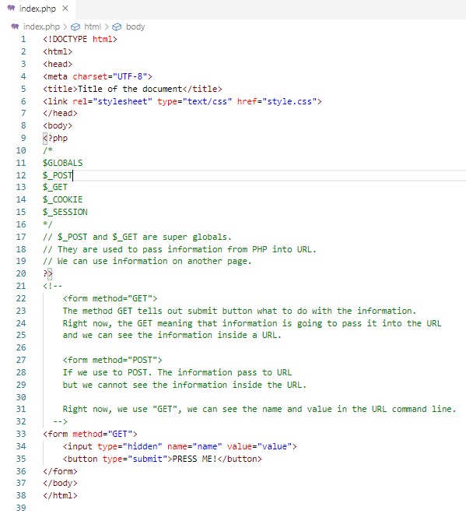
27.1 Code
https://www.youtube.com/watch?v=jort8_4U-88&list=PL0eyrZgxdwhwBToawjm9faF1ixePexft-&index=27
Code

Slide 5
27.2 Verify

Slide 6
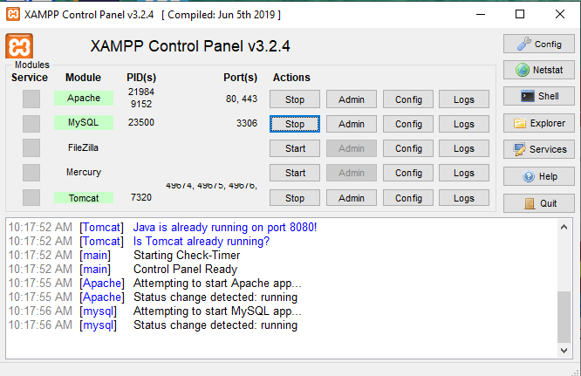
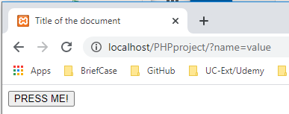
27.2 Verify
https://www.youtube.com/watch?v=jort8_4U-88&list=PL0eyrZgxdwhwBToawjm9faF1ixePexft-&index=27
Verify:
You can see information displayed in URL in super global $_GET.

Slide 7
End of Chapter

