Slide 1

23 Include Document
Peter H. Chen

Slide 2
23 Include Document
https://www.youtube.com/watch?v=fMTvi3Rys-o&list=PL0eyrZgxdwhwBToawjm9faF1ixePexft-&index=23
Include Document

Slide 3
23.1 Code

Slide 4
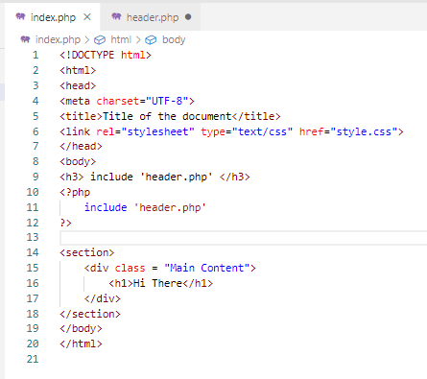
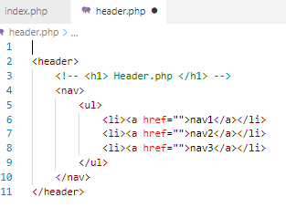
23.1 Code
https://www.youtube.com/watch?v=fMTvi3Rys-o&list=PL0eyrZgxdwhwBToawjm9faF1ixePexft-&index=23
Code

Slide 5
23.2 Verify

Slide 6
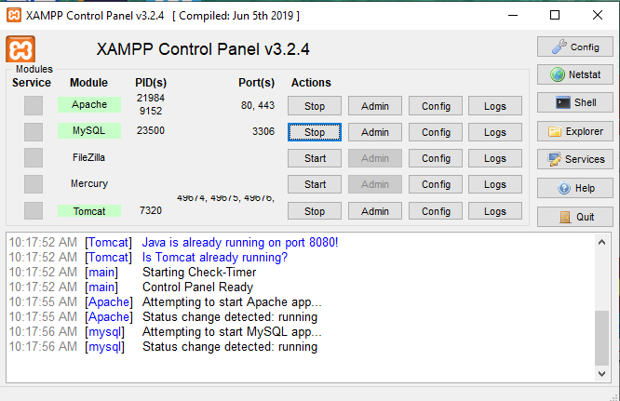
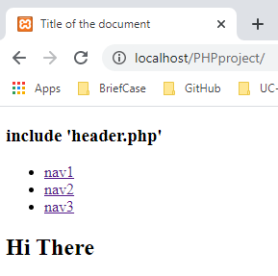
23.2 Verify
https://www.youtube.com/watch?v=fMTvi3Rys-o&list=PL0eyrZgxdwhwBToawjm9faF1ixePexft-&index=23
Verify:

Slide 7
End of Chapter

