Slide 1

14 Switch Statement
Peter H. Chen

Slide 2
14 Switch Statement
https://www.youtube.com/watch?v=91nge6hHAq8&list=PL0eyrZgxdwhwBToawjm9faF1ixePexft-&index=14
Switch Statement

Slide 3
14.1 Code

Slide 4
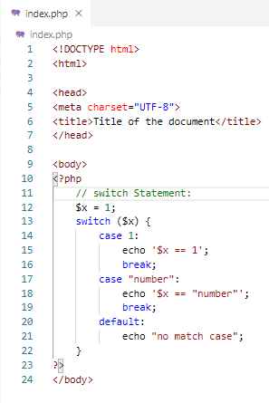
14.1 Code
https://www.youtube.com/watch?v=91nge6hHAq8&list=PL0eyrZgxdwhwBToawjm9faF1ixePexft-&index=14
Code

Slide 5
14.2 Verify

Slide 6
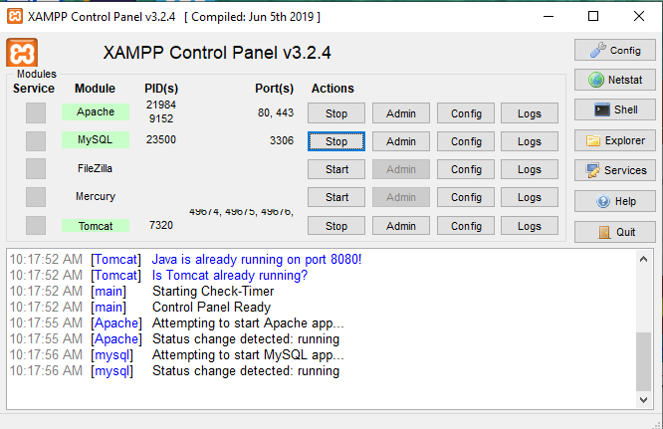
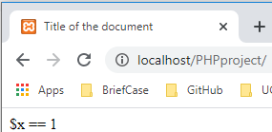
14.2 Verify
https://www.youtube.com/watch?v=91nge6hHAq8&list=PL0eyrZgxdwhwBToawjm9faF1ixePexft-&index=14
Verify

Slide 7
End of Chapter

