Slide 1

4 Variable
Peter H. Chen

Slide 2
4 Variable
https://www.youtube.com/watch?v=CoorcqbkpI0&list=PL0eyrZgxdwhwBToawjm9faF1ixePexft-&index=4
Variable
Declare variable $name.
Use <form> and method GET to get the name attribute “person”.

Slide 3
3.1 Code

Slide 4
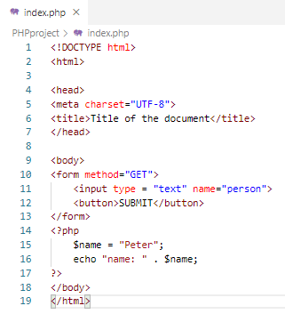
2.1 Code
https://www.youtube.com/watch?v=CoorcqbkpI0&list=PL0eyrZgxdwhwBToawjm9faF1ixePexft-&index=4
Code
Add HTML and PHP Code.

Slide 5
3.2 Verify

Slide 6
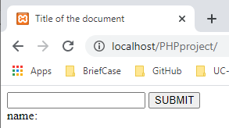
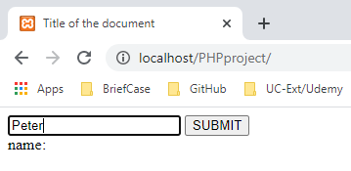
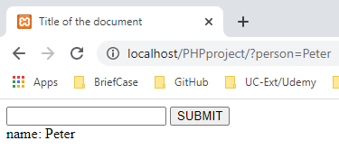
3.2 Verify
https://www.youtube.com/watch?v=CoorcqbkpI0&list=PL0eyrZgxdwhwBToawjm9faF1ixePexft-&index=4
Verify
Enter “Peter”
…./?person=Peter

Slide 7
End of Chapter

