Slide 1

11 Increment/Decrement Operator
Peter H. Chen

Slide 2
11 Increment/Decrement Operator
https://www.youtube.com/watch?v=QqADjSVYcnk&list=PL0eyrZgxdwhwBToawjm9faF1ixePexft-&index=11
Increment/Decrement Operator
We discuss Increment/Decrement operator inside PHP.

Slide 3
3.1 Code

Slide 4
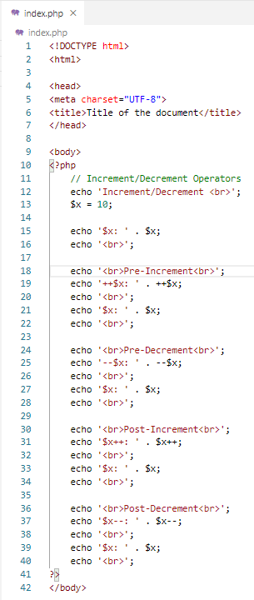
2.1 Code
https://www.youtube.com/watch?v=QqADjSVYcnk&list=PL0eyrZgxdwhwBToawjm9faF1ixePexft-&index=11
Code

Slide 5
3.2 Verify

Slide 6
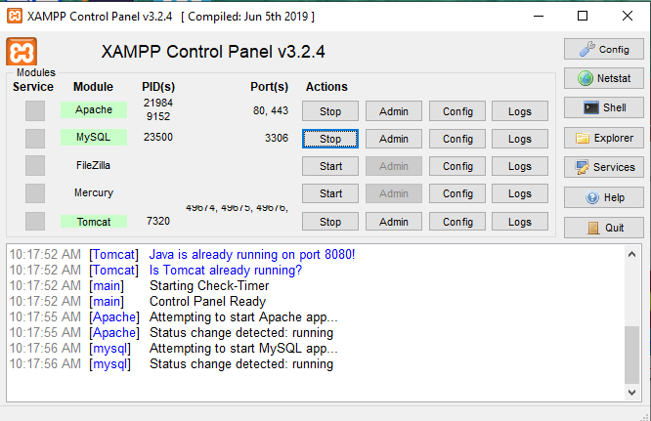
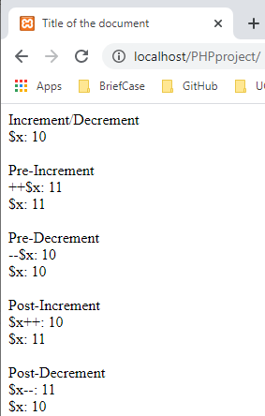
3.2 Verify
https://www.youtube.com/watch?v=QqADjSVYcnk&list=PL0eyrZgxdwhwBToawjm9faF1ixePexft-&index=11
Verify

Slide 7
End of Chapter

