Slide 1

16 Display Date Style
Peter H. Chen

Slide 2
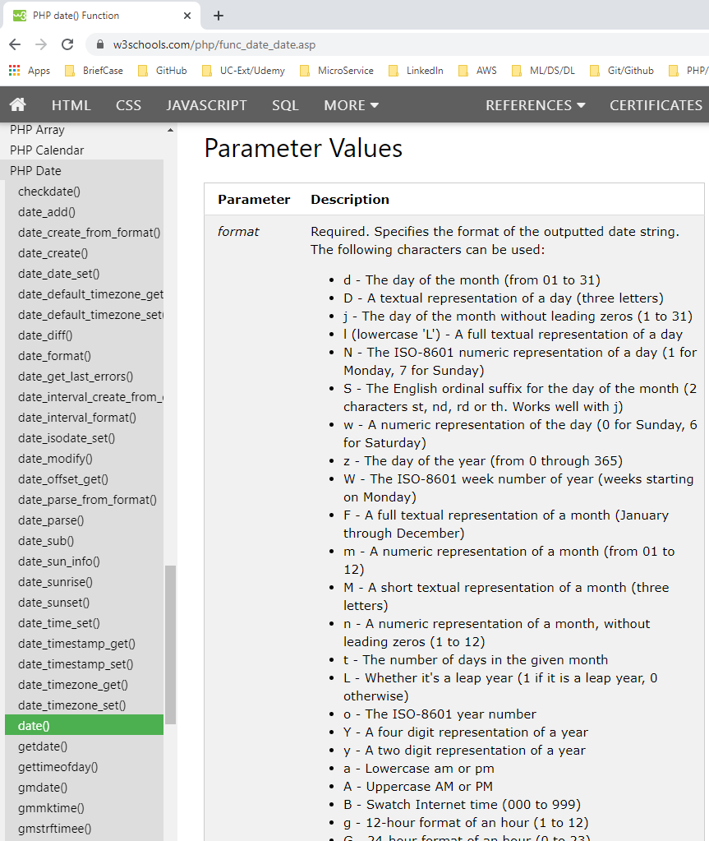
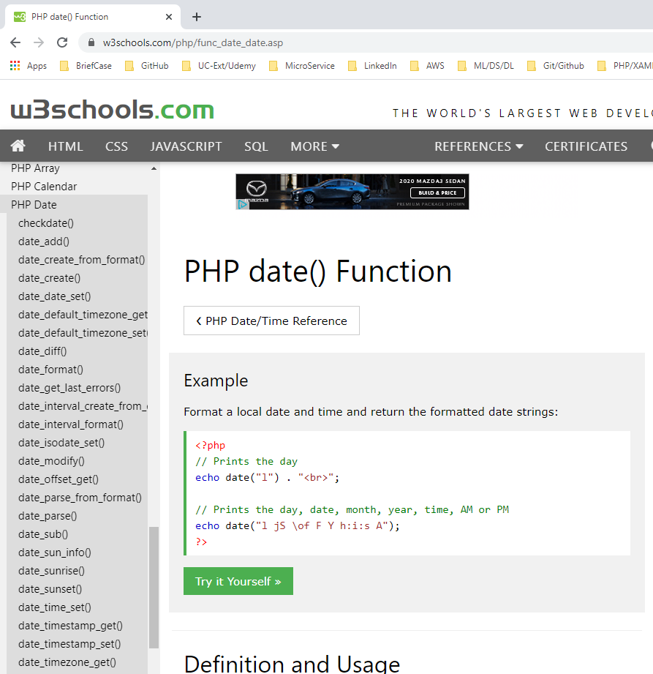
16 Display Date Style
https://www.youtube.com/watch?v=ZFEAwdxH5xM&list=PL0eyrZgxdwhwBToawjm9faF1ixePexft-&index=16
PHP Date() function
https://www.w3schools.com/php/func_date_date.asp

Slide 3
16.1 Code

Slide 4
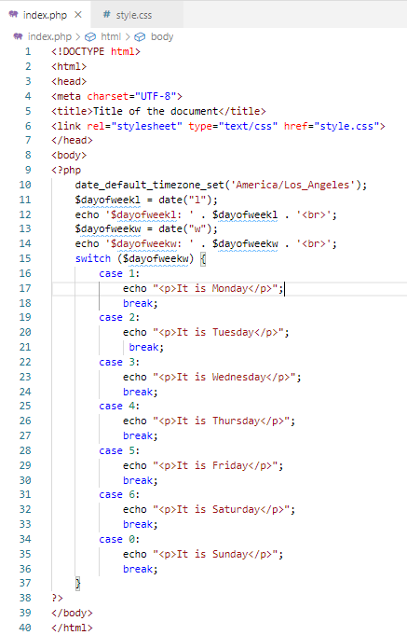
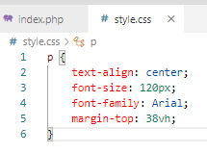
16.1 Code
https://www.youtube.com/watch?v=ZFEAwdxH5xM&list=PL0eyrZgxdwhwBToawjm9faF1ixePexft-&index=16
Code
https://www.w3schools.com/tags/att_link_href.asp

Slide 5
16.2 Verify

Slide 6
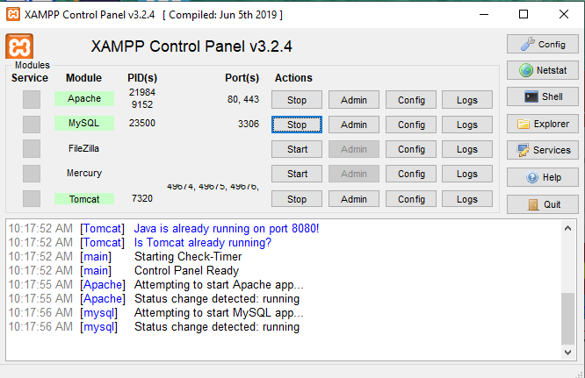
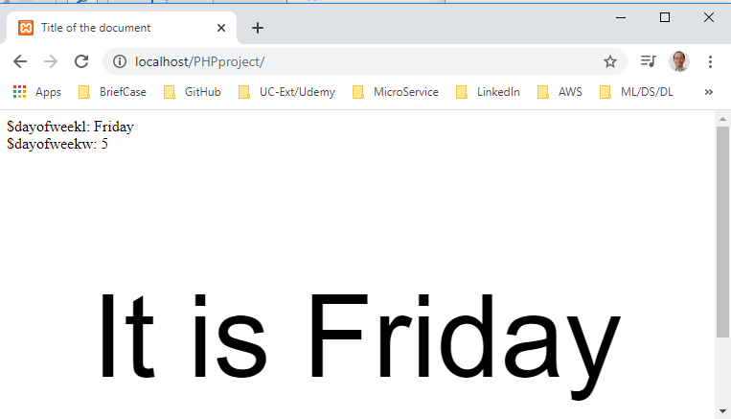
16.2 Verify
https://www.youtube.com/watch?v=ZFEAwdxH5xM&list=PL0eyrZgxdwhwBToawjm9faF1ixePexft-&index=16
Verify:
Display Day of week by style.css

Slide 7
End of Chapter

