Slide 1

20 Foreach Loop
Peter H. Chen

Slide 2
20 Foreach Loop
https://www.youtube.com/watch?v=9gfrJfY5IFw&list=PL0eyrZgxdwhwBToawjm9faF1ixePexft-&index=20
Foreach Loop

Slide 3
20.1 Code

Slide 4
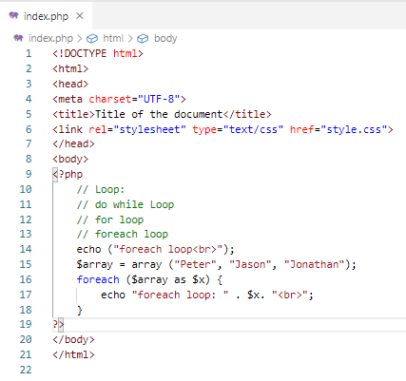
20.1 Code
https://www.youtube.com/watch?v=9gfrJfY5IFw&list=PL0eyrZgxdwhwBToawjm9faF1ixePexft-&index=20
Code

Slide 5
20.2 Verify

Slide 6
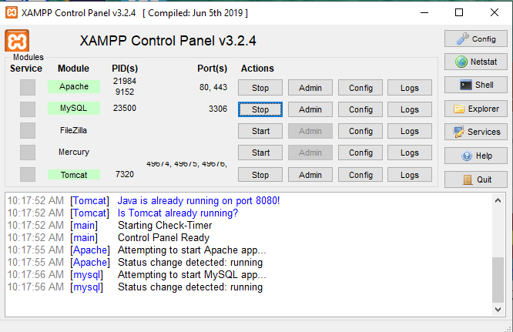
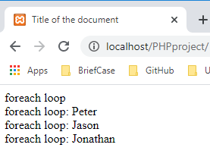
20.2 Verify
https://www.youtube.com/watch?v=9gfrJfY5IFw&list=PL0eyrZgxdwhwBToawjm9faF1ixePexft-&index=20
Verify:

Slide 7
End of Chapter

