Slide 1

15 Calculator
Peter H. Chen

Slide 2
15 Calculator
https://www.youtube.com/watch?v=d6dnCQS8DCk&list=PL0eyrZgxdwhwBToawjm9faF1ixePexft-&index=15
Calculator

Slide 3
15.1 Code

Slide 4
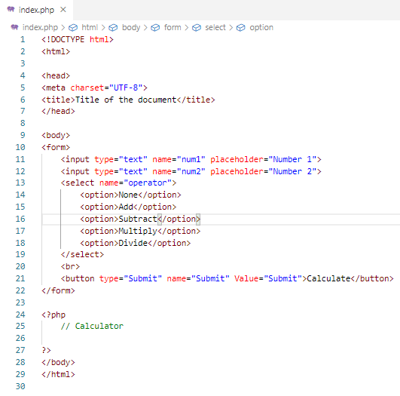
15.1 Code
https://www.youtube.com/watch?v=d6dnCQS8DCk&list=PL0eyrZgxdwhwBToawjm9faF1ixePexft-&index=15
Code

Slide 5
15.2 Verify

Slide 6
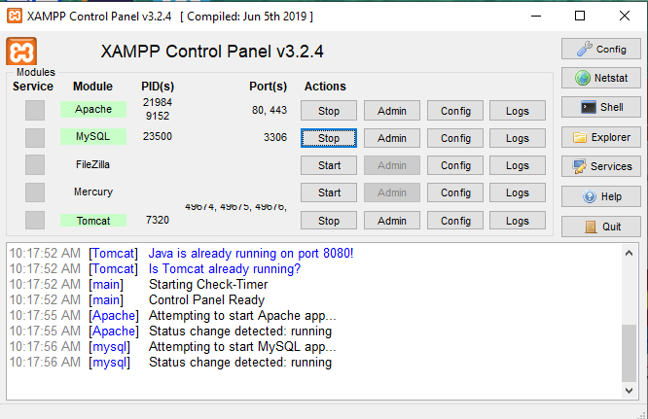
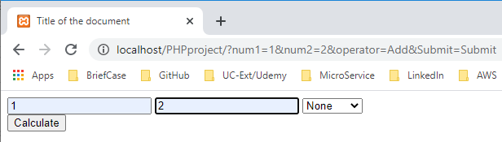
15.2 Verify
https://www.youtube.com/watch?v=d6dnCQS8DCk&list=PL0eyrZgxdwhwBToawjm9faF1ixePexft-&index=15
Verify:
?num1=1&num2=2&operator=Add&Submit=Submit
This is how we pass information from HTML to PHP.

Slide 7
15.3 PHP Code

Slide 8
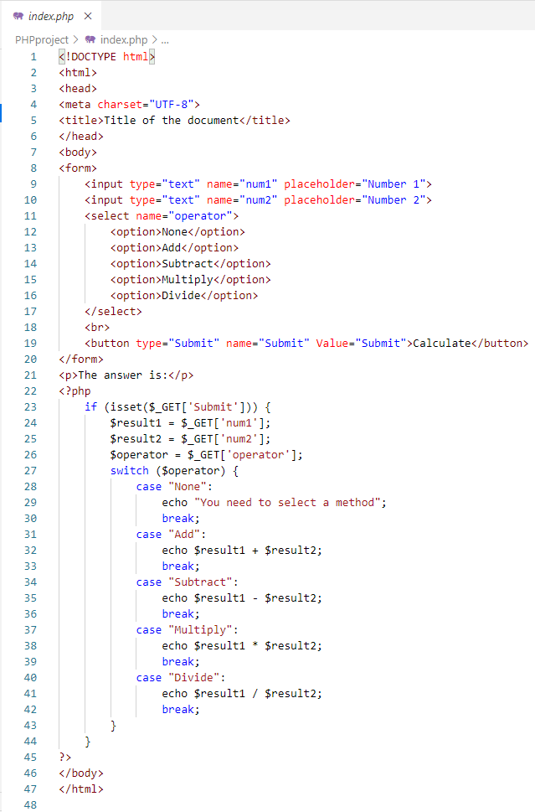
15.3 PHP Code
https://www.youtube.com/watch?v=d6dnCQS8DCk&list=PL0eyrZgxdwhwBToawjm9faF1ixePexft-&index=15
PHP Code:
?num1=1&num2=2&operator=Add&Submit=Submit
below is how we pass information from HTML to PHP.
$result1 = $_GET[‘num1’];
$result2 = $_GET[‘num2’];
$operator = $_GET[‘operator’];

Slide 9
15.4 Verify Calculation

Slide 10
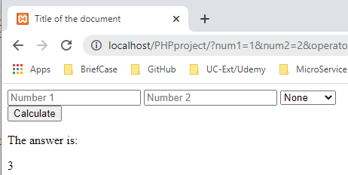
15.4 Verify Calculation
https://www.youtube.com/watch?v=d6dnCQS8DCk&list=PL0eyrZgxdwhwBToawjm9faF1ixePexft-&index=15
Verify:
Enter 1, 2, Add
Click Calculate

Slide 11
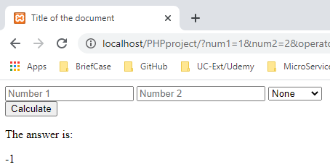
15.4 Verify Calculation
https://www.youtube.com/watch?v=d6dnCQS8DCk&list=PL0eyrZgxdwhwBToawjm9faF1ixePexft-&index=15
Verify:
Enter 1, 2, Subtract
Click Calculate

Slide 12
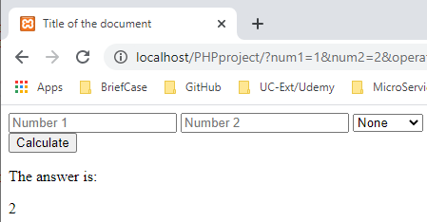
15.4 Verify Calculation
https://www.youtube.com/watch?v=d6dnCQS8DCk&list=PL0eyrZgxdwhwBToawjm9faF1ixePexft-&index=15
Verify:
Enter 1, 2, Multiply
Click Calculate

Slide 13
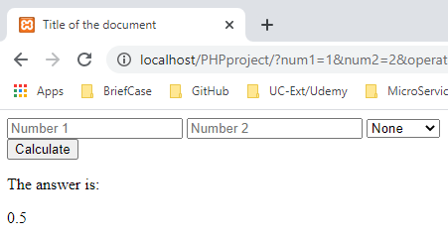
15.4 Verify Calculation
https://www.youtube.com/watch?v=d6dnCQS8DCk&list=PL0eyrZgxdwhwBToawjm9faF1ixePexft-&index=15
Verify:
Enter 1, 2, Divide
Click Calculate

Slide 14
15.5 Summary

Slide 15
15.5 Summary
https://www.youtube.com/watch?v=d6dnCQS8DCk&list=PL0eyrZgxdwhwBToawjm9faF1ixePexft-&index=15
Summary:
We build a calculator by HTML and PHP.

Slide 16
End of Chapter

