Slide 1

7 Data Type
Peter H. Chen

Slide 2
7 Data Type
https://www.youtube.com/watch?v=ZPM8M9jzjjc&list=PL0eyrZgxdwhwBToawjm9faF1ixePexft-&index=7
Data Type
String
Integer
Float
Boolean
Array

Slide 3
3.1 Code

Slide 4
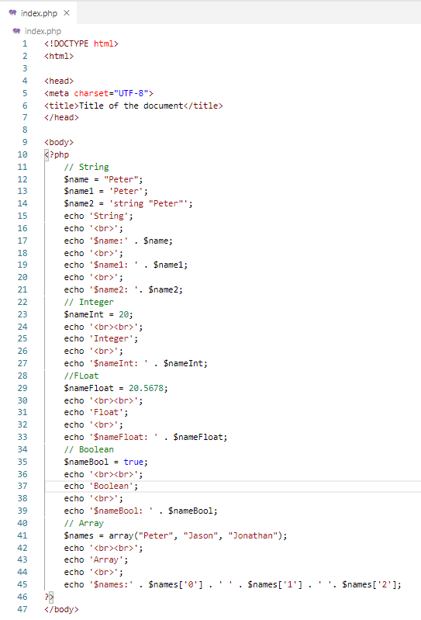
2.1 Code
https://www.youtube.com/watch?v=ZPM8M9jzjjc&list=PL0eyrZgxdwhwBToawjm9faF1ixePexft-&index=7
Code

Slide 5
3.2 Verify

Slide 6
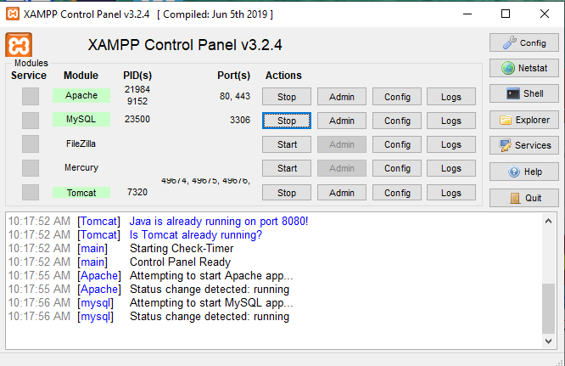
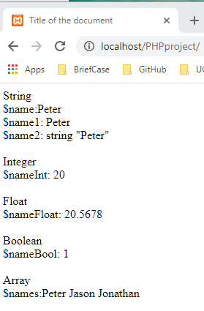
3.2 Verify
https://www.youtube.com/watch?v=ZPM8M9jzjjc&list=PL0eyrZgxdwhwBToawjm9faF1ixePexft-&index=7
Verify

Slide 7
End of Chapter

