Slide 1

5 Comment
Peter H. Chen

Slide 2
5 Comment
https://www.youtube.com/watch?v=pHxBA2ZbHis&list=PL0eyrZgxdwhwBToawjm9faF1ixePexft-&index=5
Comment
How to comment in PHP?

Slide 3
5.1 Code

Slide 4
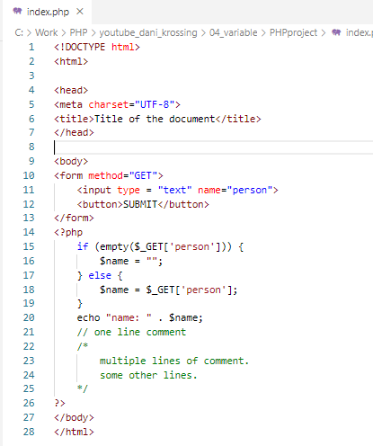
5.1 Code
https://www.youtube.com/watch?v=pHxBA2ZbHis&list=PL0eyrZgxdwhwBToawjm9faF1ixePexft-&index=5
Code

Slide 5
5.2 Verify

Slide 6
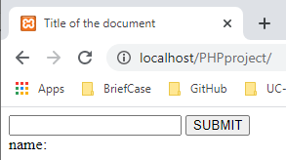
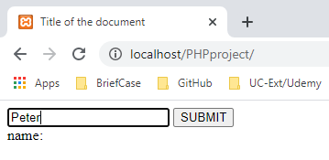
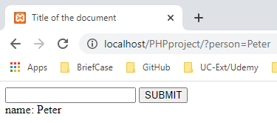
5.2 Verify
https://www.youtube.com/watch?v=pHxBA2ZbHis&list=PL0eyrZgxdwhwBToawjm9faF1ixePexft-&index=5
Verify
Enter “Peter”
…./?person=Peter

Slide 7
End of Chapter

