Slide 1

6 Function
Peter H. Chen

Slide 2
6 Function
https://www.youtube.com/watch?v=kByr0ifju4k&list=PL0eyrZgxdwhwBToawjm9faF1ixePexft-&index=6
Function
Predefined or Internal function by PHP.
User defined function
In this section, we discuss the Redefined or Internal function.

Slide 3
6.1 Code

Slide 4
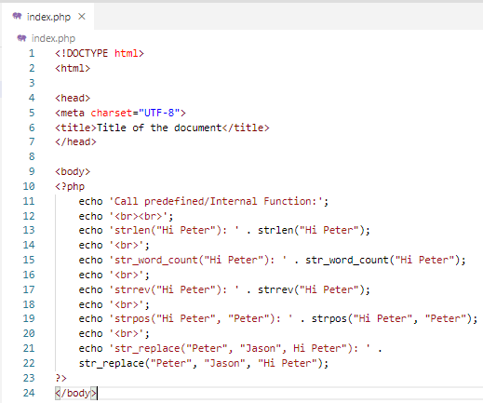
6.1 Code
https://www.youtube.com/watch?v=kByr0ifju4k&list=PL0eyrZgxdwhwBToawjm9faF1ixePexft-&index=6
Code

Slide 5
6.2 Verify

Slide 6
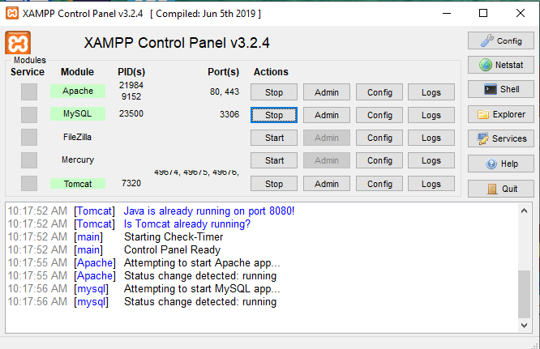
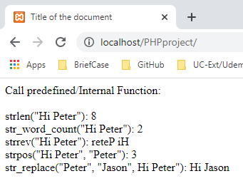
6.2 Verify
https://www.youtube.com/watch?v=kByr0ifju4k&list=PL0eyrZgxdwhwBToawjm9faF1ixePexft-&index=6
Verify

Slide 7
End of Chapter

