Slide 1

12 Logical Operator
Peter H. Chen

Slide 2
12 Logical Operator
https://www.youtube.com/watch?v=mx-1opTTnlk&list=PL0eyrZgxdwhwBToawjm9faF1ixePexft-&index=12
Logical Operator

Slide 3
12.1 Code

Slide 4
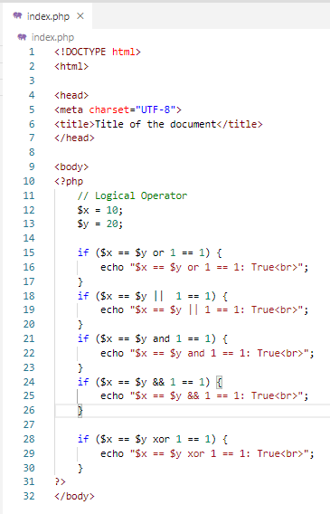
12.1 Code
https://www.youtube.com/watch?v=mx-1opTTnlk&list=PL0eyrZgxdwhwBToawjm9faF1ixePexft-&index=12
Code

Slide 5
12.2 Verify

Slide 6
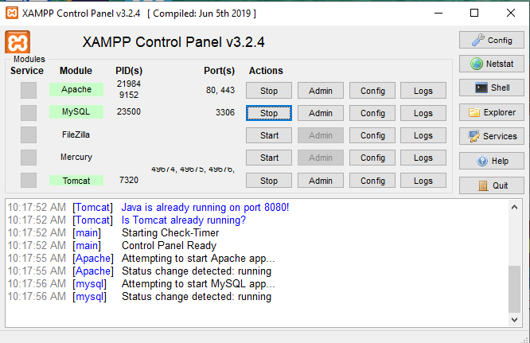
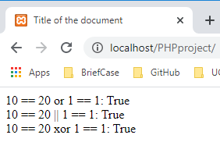
12.2 Verify
https://www.youtube.com/watch?v=mx-1opTTnlk&list=PL0eyrZgxdwhwBToawjm9faF1ixePexft-&index=12
Verify

Slide 7
End of Chapter

