Slide 1

13 Conditional Statement
Peter H. Chen

Slide 2
13 Conditional Statement
https://www.youtube.com/watch?v=K2GYoa1ds7E&list=PL0eyrZgxdwhwBToawjm9faF1ixePexft-&index=13
Logical Operator

Slide 3
13.1 Code

Slide 4
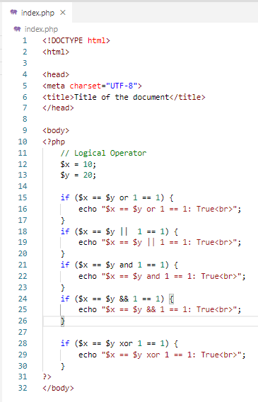
13.1 Code
https://www.youtube.com/watch?v=K2GYoa1ds7E&list=PL0eyrZgxdwhwBToawjm9faF1ixePexft-&index=13
Code

Slide 5
13.2 Verify

Slide 6
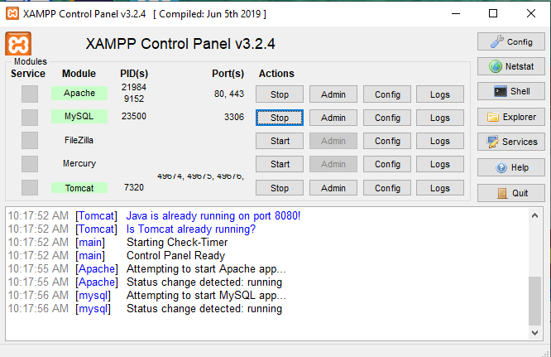
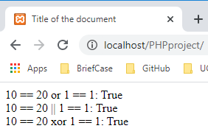
13.2 Verify
https://www.youtube.com/watch?v=K2GYoa1ds7E&list=PL0eyrZgxdwhwBToawjm9faF1ixePexft-&index=13
Verify

Slide 7
End of Chapter

