Slide 1

28 Super Global: $_SESSION
Peter H. Chen

Slide 2
28 Super Global: $_SESSION
https://www.youtube.com/watch?v=3CS-eQdcMLU&list=PL0eyrZgxdwhwBToawjm9faF1ixePexft-&index=28
Super Global: $_SESSION
Session is different from cookie. Cookie exited before the expiration time.
Session are variable shared by different pages when user switch pages. When chrome closed, the session automatically ended.
The example below create two pages, the first page index.php which assign the session variable. The second page contact.php display the session variable assigned by index.php.

Slide 3
28.1 Code

Slide 4
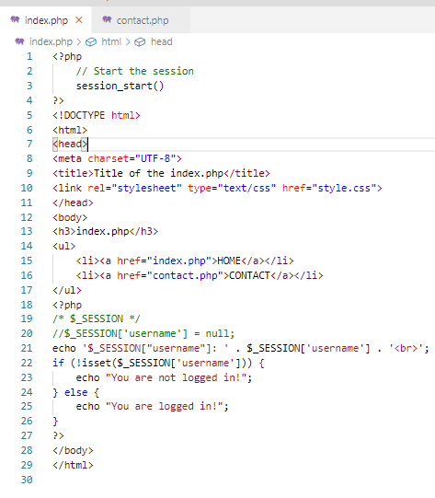
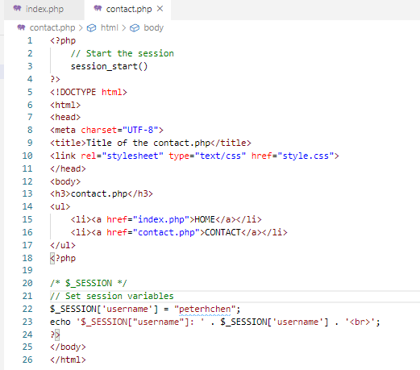
28.1 Code
https://www.youtube.com/watch?v=3CS-eQdcMLU&list=PL0eyrZgxdwhwBToawjm9faF1ixePexft-&index=28
Code: First time HOME page, session variable is null. Click the contact page to assign the session variable. The variable is there until the session is closed.

Slide 5
28.2 Verify

Slide 6
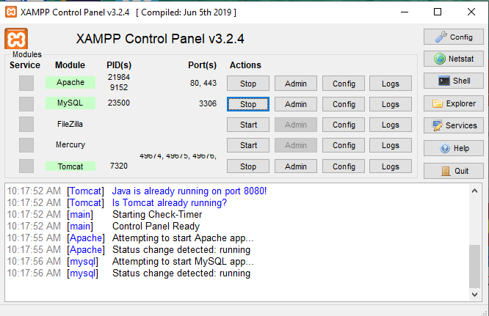
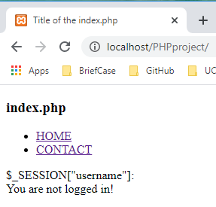
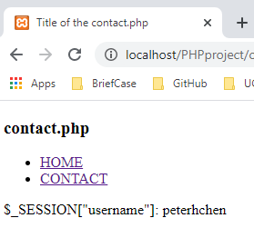
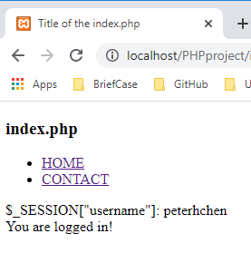
28.2 Verify
https://www.youtube.com/watch?v=3CS-eQdcMLU&list=PL0eyrZgxdwhwBToawjm9faF1ixePexft-&index=28
Verify:
Initially, session variable is empty. After contact.php assign the variable, index.php display the non-empty variable.

Slide 7
End of Chapter

