Slide 1

29 TensorBoard (Part 2)
Peter H. Chen

Slide 2
29 TensorBoard (Part 2)
https://www.youtube.com/watch?v=pSexXMdruFM&list=PLZbbT5o_s2xrfNyHZsM6ufI0iZENK9xgG&index=29
TensorBoard
We discuss how to use TensorBoard to visualize metrics of our CNN during the neural network training process.
We finished our network through the training process.
Now, we want to get more metrics about this process.
Outline of where we are:
Prepare the data
Build the model
Train the model
Analyze the model's results
Use TensorBoard

Slide 3
29.1 Visualization Toolkit

Slide 4
29.1 Visualization Toolkit
https://www.youtube.com/watch?v=pSexXMdruFM&list=PLZbbT5o_s2xrfNyHZsM6ufI0iZENK9xgG&index=29
TensorBoard: TensorFlow's Visualization Toolkit
TensorBoard provides the visualization and tooling needed for machine learning experimentation:
Tracking and visualizing metrics such as loss and accuracy
Visualizing the model graph (ops and layers)
Viewing histograms of weights, biases, or other tensors as they change over time
Projecting embeddings to a lower dimensional space
Displaying images, text, and audio data
Profiling TensorFlow programs
And much more

Slide 5
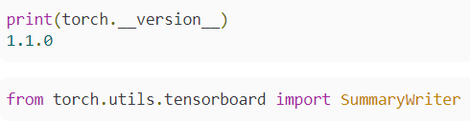
29.1 Visualization Toolkit
https://www.youtube.com/watch?v=pSexXMdruFM&list=PLZbbT5o_s2xrfNyHZsM6ufI0iZENK9xgG&index=29
TensorBoard: TensorFlow's Visualization Toolkit
As of PyTorch version 1.1.0, PyTorch has added a tensorboard utility package that enables us to use TensorBoard with PyTorch.

Slide 6

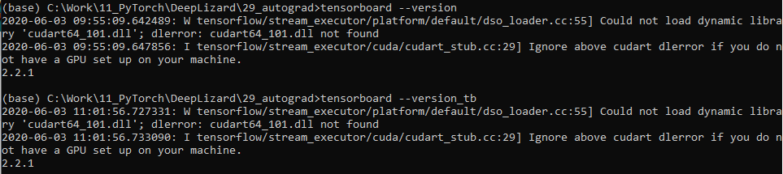
29.1 Visualization Toolkit
https://www.youtube.com/watch?v=pSexXMdruFM&list=PLZbbT5o_s2xrfNyHZsM6ufI0iZENK9xgG&index=29
Installing TensorBoard For PyTorch
To install TensorBoard for PyTorch, use the following steps:
Verify that you are running PyTorch version 1.1.0 or greater.
Verify that you are running TensorBoard version 1.15 (Below is 2.2.1) or greater.
Note that the TensorBoard that PyTorch uses is the same TensorBoard that was created for TensorFlow. Check the version of TensorBoard installed on your system using the this command:

Slide 7

29.1 Visualization Toolkit
https://www.youtube.com/watch?v=pSexXMdruFM&list=PLZbbT5o_s2xrfNyHZsM6ufI0iZENK9xgG&index=29
Installing TensorBoard For PyTorch
Install TensorBoard using the following command.
After getting TensorBoard version 1.15 (Ours is 2.2.1) or greater installed, we're ready to go!

Slide 8
29.1 Visualization Toolkit
https://www.youtube.com/watch?v=pSexXMdruFM&list=PLZbbT5o_s2xrfNyHZsM6ufI0iZENK9xgG&index=29
Getting Started With TensorBoard For PyTorch
TensorBoard is a front-end web interface that essentially reads data from a file and displays it.
To use TensorBoard our task is to get the data we want displayed saved to a file that TensorBoard can read.
To make this easy for us, PyTorch has created a utility class called SummaryWriter.
To get access to this class we use the following import:
Once we have imported the class, we can create an instance of the class that we'll then use to get the data out of our program and onto the file system where it can then be consumed by TensorBoard.

Slide 9
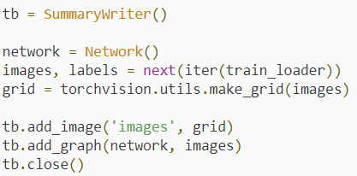
29.1 Visualization Toolkit
https://www.youtube.com/watch?v=pSexXMdruFM&list=PLZbbT5o_s2xrfNyHZsM6ufI0iZENK9xgG&index=29
Network Graph And Training Set Images
The SummaryWriter class comes with a bunch of method that we can call to selectively pick and choose which data we want to be available to TensorBoard.
We'll start by first by passing our network and a batch of images to the writer.

Slide 10
29.1 Visualization Toolkit
https://www.youtube.com/watch?v=pSexXMdruFM&list=PLZbbT5o_s2xrfNyHZsM6ufI0iZENK9xgG&index=29
Network Graph And Training Set Images
This code creates a SummaryWriter instance called tb for TensorBoard.
Then, creates an instance of our PyTorch network and unpacks a batch of images and labels from our PyTorch data loader object.
Then, the images and the network are added to the file that TensorBoard will consume.
Effectively, we can say that the network graph and the batch of images have both been added to TensorBoard.

Slide 11

29.2 Run TensorBoard
https://www.youtube.com/watch?v=pSexXMdruFM&list=PLZbbT5o_s2xrfNyHZsM6ufI0iZENK9xgG&index=29
Running TensorBoard
To launch TensorBoard, we need to run the tensorboard command at our terminal. This will launch a local server that will serve the TensorBoard UI and the the data our SummaryWriter wrote to disk.
By default, the PyTorch SummaryWriter object writes the data to disk in a directory called ./runs that is created in the current working directory.
When we run the tensorboard command, we pass an argument that tells tensorboard where the data is.
So it's like this:

Slide 12
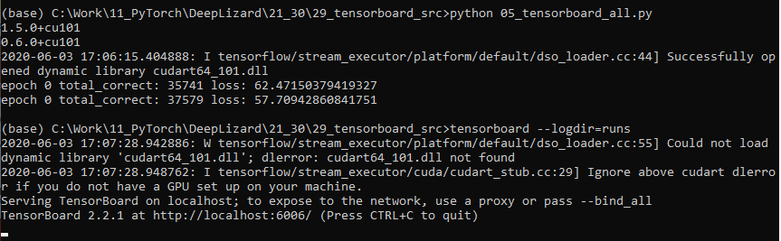
29.2 Run TensorBoard
https://www.youtube.com/watch?v=pSexXMdruFM&list=PLZbbT5o_s2xrfNyHZsM6ufI0iZENK9xgG&index=29
Running TensorBoard
> python 05_tensorbard_all.py
> tensorboard –logdir=runs

Slide 13
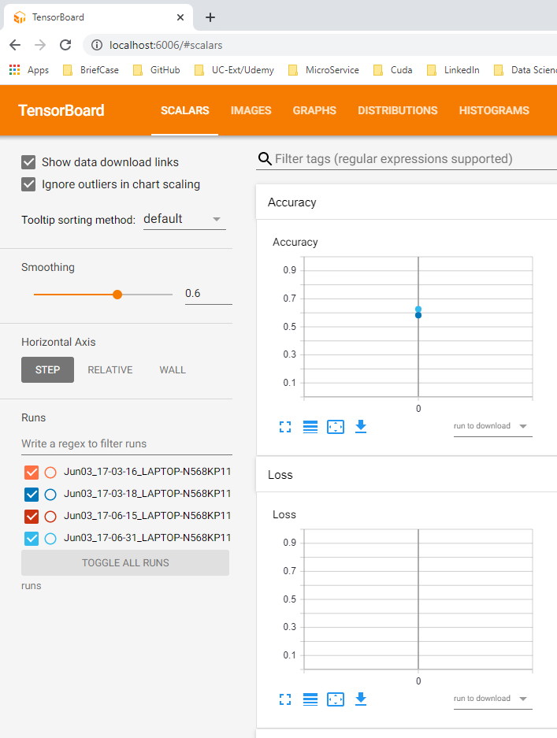
29.2 Run TensorBoard
https://www.youtube.com/watch?v=pSexXMdruFM&list=PLZbbT5o_s2xrfNyHZsM6ufI0iZENK9xgG&index=29
Running TensorBoard
> http:localhost:6006

Slide 14
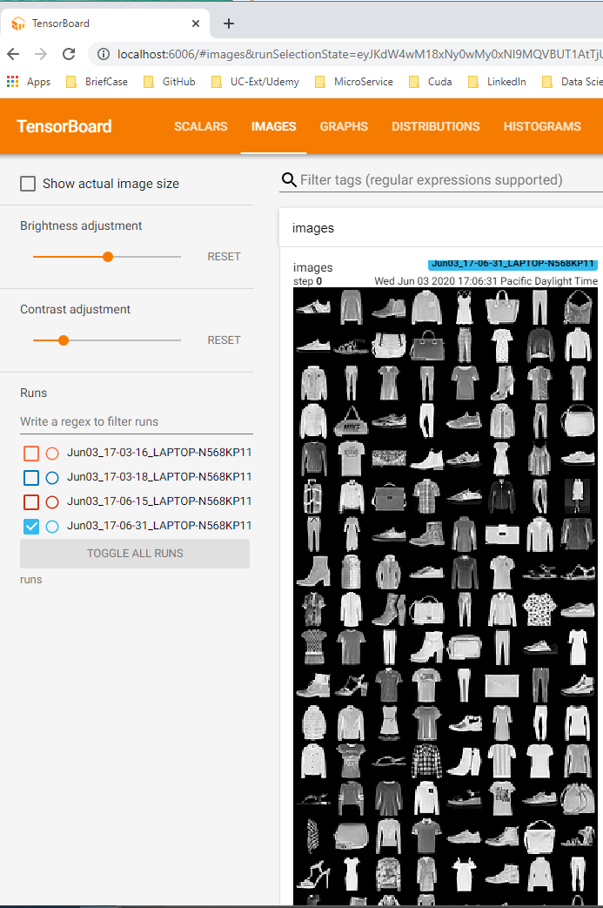
29.2 Run TensorBoard
https://www.youtube.com/watch?v=pSexXMdruFM&list=PLZbbT5o_s2xrfNyHZsM6ufI0iZENK9xgG&index=29
Running TensorBoard
> http:localhost:6006

Slide 15
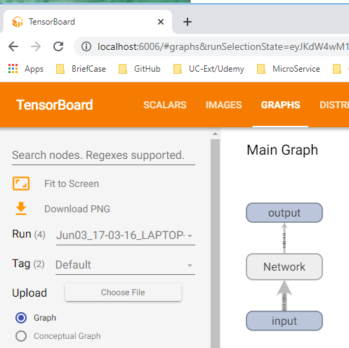
29.2 Run TensorBoard
https://www.youtube.com/watch?v=pSexXMdruFM&list=PLZbbT5o_s2xrfNyHZsM6ufI0iZENK9xgG&index=29
Running TensorBoard
> http:localhost:6006

Slide 16
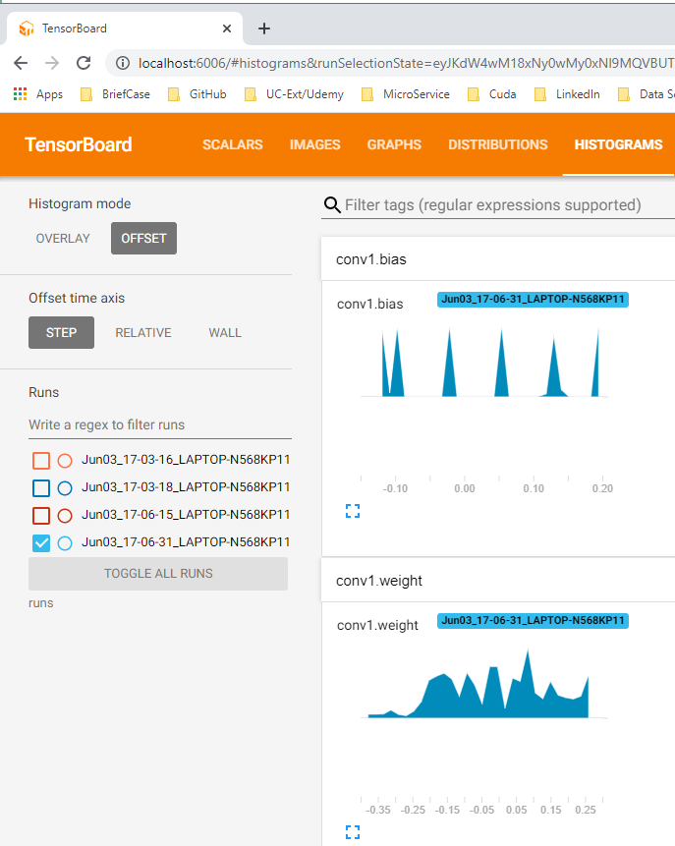
29.2 Run TensorBoard
https://www.youtube.com/watch?v=pSexXMdruFM&list=PLZbbT5o_s2xrfNyHZsM6ufI0iZENK9xgG&index=29
Running TensorBoard
> http:localhost:6006

Slide 17
29.2 Histogram and Scalar

Slide 18
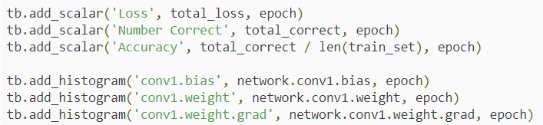
29.2 Histogram and Scalar
https://www.youtube.com/watch?v=pSexXMdruFM&list=PLZbbT5o_s2xrfNyHZsM6ufI0iZENK9xgG&index=29
TensorBoard Histograms And Scalars
The next import types of data we can add to TensorBoard is numerical data.
We can add scalar values that will be displayed over time or over epoch.
We can also add values to histograms to see frequency distributions of values.
To add scalars and histograms we use the corresponding methods provided by the PyTorch SummaryWriter class.
Here is an example of the calls:

Slide 19
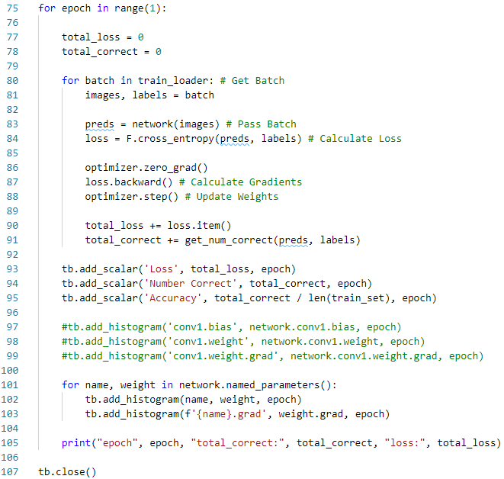
29.2 Histogram and Scalar
https://www.youtube.com/watch?v=pSexXMdruFM&list=PLZbbT5o_s2xrfNyHZsM6ufI0iZENK9xgG&index=29
TensorBoard Histograms And Scalars
And here is an example of where we would place these calls inside our training loop:

Slide 20
29.2 Histogram and Scalar
https://www.youtube.com/watch?v=pSexXMdruFM&list=PLZbbT5o_s2xrfNyHZsM6ufI0iZENK9xgG&index=29
TensorBoard Histograms And Scalars
This will add these values to TensorBoard. The values even update in real-time as the network trains.
It is helpful to see the loss and accuracy values over time. However, we might need to admit that TensorBoard really isn't needed for this.
The real power of TensorBoard is its out-of-the-box capability of comparing multiple runs.
This allows us to rapidly experiment by varying the hyperparameter values and comparing runs to see which parameters are working best.

Slide 21
29.3 Quiz

Slide 22
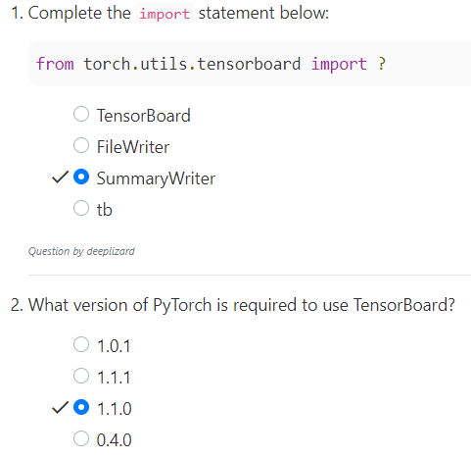
29.3 Quiz
https://www.youtube.com/watch?v=pSexXMdruFM&list=PLZbbT5o_s2xrfNyHZsM6ufI0iZENK9xgG&index=29
Quiz

Slide 23
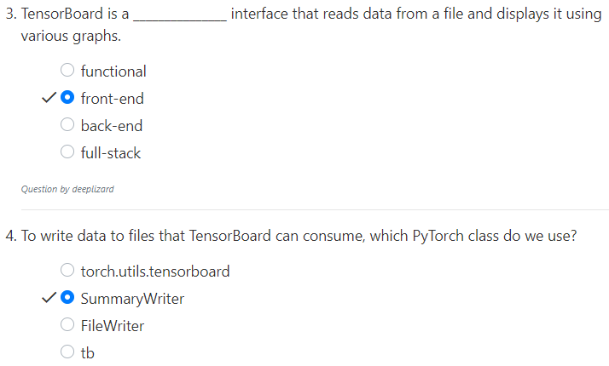
29.3 Quiz
https://www.youtube.com/watch?v=pSexXMdruFM&list=PLZbbT5o_s2xrfNyHZsM6ufI0iZENK9xgG&index=29
Quiz

Slide 24
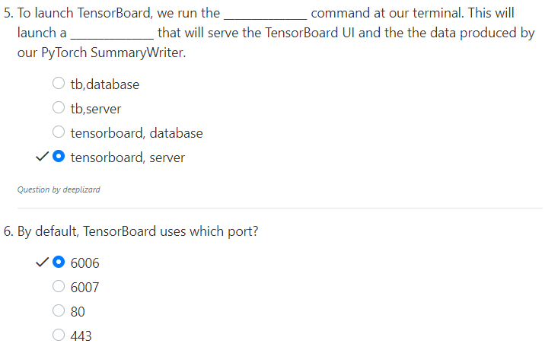
29.3 Quiz
https://www.youtube.com/watch?v=pSexXMdruFM&list=PLZbbT5o_s2xrfNyHZsM6ufI0iZENK9xgG&index=29
Quiz

Slide 25
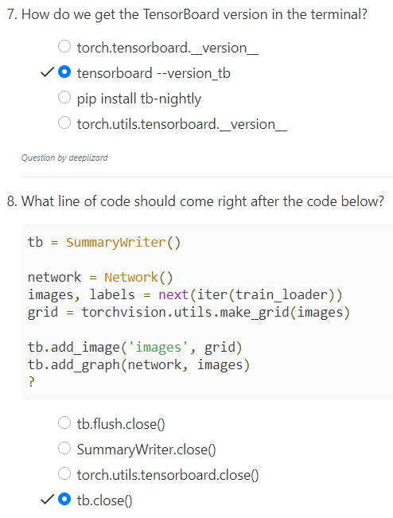
29.3 Quiz
https://www.youtube.com/watch?v=pSexXMdruFM&list=PLZbbT5o_s2xrfNyHZsM6ufI0iZENK9xgG&index=29
Quiz

Slide 26
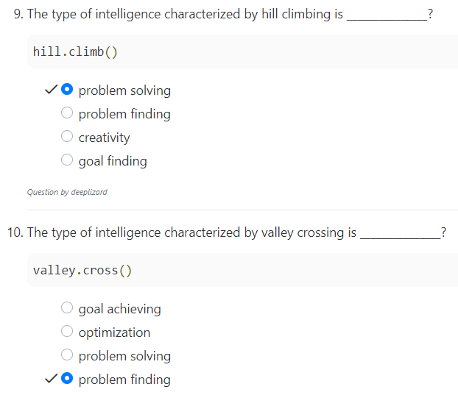
29.3 Quiz
https://www.youtube.com/watch?v=pSexXMdruFM&list=PLZbbT5o_s2xrfNyHZsM6ufI0iZENK9xgG&index=29
Quiz

Slide 27
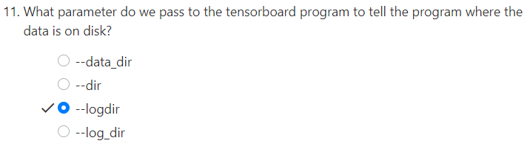
29.3 Quiz
https://www.youtube.com/watch?v=pSexXMdruFM&list=PLZbbT5o_s2xrfNyHZsM6ufI0iZENK9xgG&index=29
Quiz

Slide 28
End of Chapter

