Slide 1

30 Hyperparameter (Part 2)
Peter H. Chen

Slide 2
30 Hyperparameter (Part 2)
https://www.youtube.com/watch?v=ycxulUVoNbk&list=PLZbbT5o_s2xrfNyHZsM6ufI0iZENK9xgG&index=30
Hyperparameter Tuning and Experimenting
We discuss how to use TensorBoard to experiment with different training hyperparameters.
Outline of where we are:
Prepare the data
Build the model
Train the model
Analyze the model's results
Hyperparameter Experimentation with TensorBoard
At this point, we've seen how to build and train a CNN with PyTorch.
In the last discussion, we discussed how to used TensorBoard with PyTorch, and we reviewed the training process.
This discussion is the last of part two.
We are doing now is experimenting with our hyperparameter values.

Slide 3
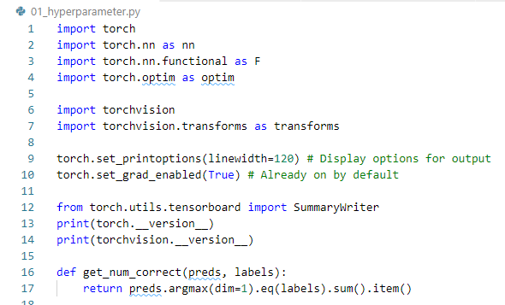
30.1 Hyperparameter Experimentation
https://www.youtube.com/watch?v=ycxulUVoNbk&list=PLZbbT5o_s2xrfNyHZsM6ufI0iZENK9xgG&index=30
Code: import and def

Slide 4
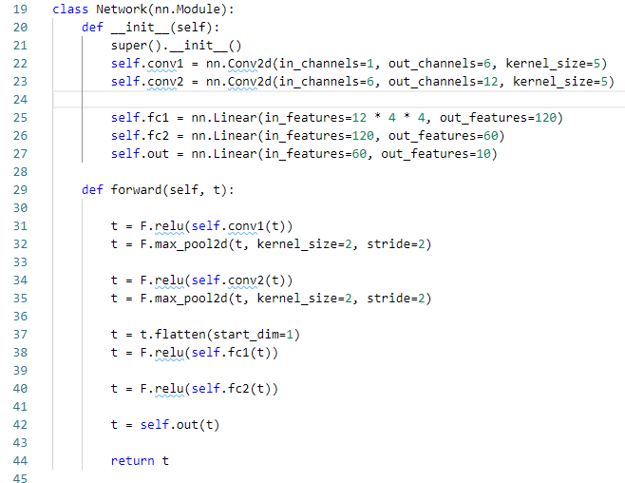
30.1 Hyperparameter Experimentation
https://www.youtube.com/watch?v=ycxulUVoNbk&list=PLZbbT5o_s2xrfNyHZsM6ufI0iZENK9xgG&index=30
Code: class Network()

Slide 5
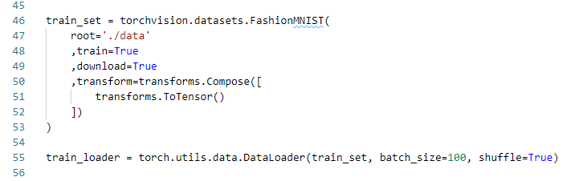
30.1 Hyperparameter Experimentation
https://www.youtube.com/watch?v=ycxulUVoNbk&list=PLZbbT5o_s2xrfNyHZsM6ufI0iZENK9xgG&index=30
Code: train_set and train_loader

Slide 6
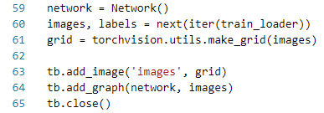
30.1 Hyperparameter Experimentation
https://www.youtube.com/watch?v=ycxulUVoNbk&list=PLZbbT5o_s2xrfNyHZsM6ufI0iZENK9xgG&index=30
Code: Images, labels, grid, and graph

Slide 7
30.1 Hyperparameter Experimentation

Slide 8
30.1 Hyperparameter Experimentation
https://www.youtube.com/watch?v=ycxulUVoNbk&list=PLZbbT5o_s2xrfNyHZsM6ufI0iZENK9xgG&index=30
Hyperparameter Experimentation using TensorBoard
The best part about TensorBoard is its out-of-the-box capability of tracking our hyperparameters over time and across runs.
We need the TensorBoard to check Hyperparameter vs the results.

Slide 9
30.1 Hyperparameter Experimentation
https://www.youtube.com/watch?v=ycxulUVoNbk&list=PLZbbT5o_s2xrfNyHZsM6ufI0iZENK9xgG&index=30
Naming The Training Runs For TensorBoard
To take advantage of TensorBoard comparison capabilities, we need to do multiple runs and name each run in such a way that we can identify it uniquely.
With PyTorch's SummaryWriter, a run starts when the writer object instance is created and ends when the writer instance is closed or goes out of scope.
To uniquely identify each run, we can either set the file name of the run directly, or pass a comment string to the constructor that will be appended to the auto-generated file name.
At the time of the creation of this post, the name of the run is contained inside the SummaryWriter in an attribute called log_dir.

Slide 10
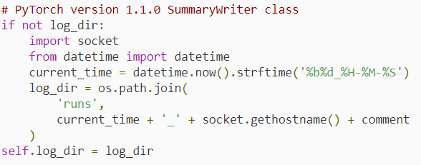
30.1 Hyperparameter Experimentation
https://www.youtube.com/watch?v=ycxulUVoNbk&list=PLZbbT5o_s2xrfNyHZsM6ufI0iZENK9xgG&index=30
Naming The Training Runs For TensorBoard
It is created like this:

Slide 11

30.1 Hyperparameter Experimentation
https://www.youtube.com/watch?v=ycxulUVoNbk&list=PLZbbT5o_s2xrfNyHZsM6ufI0iZENK9xgG&index=30
Choosing A Name For The Run
One way to name the run is to add the parameter names and values as a comment for the run.
This will allow us to see how each parameter value stacks up with the others later when we are reviewing the runs inside TensorBoard.
We'll see that this is how we set the comment up later:
TensorBoard also has querying capabilities, so we can easily isolate parameter values though queries.
For example, imagine this SQL query:

Slide 12
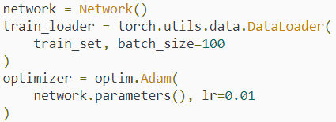
30.1 Hyperparameter Experimentation
https://www.youtube.com/watch?v=ycxulUVoNbk&list=PLZbbT5o_s2xrfNyHZsM6ufI0iZENK9xgG&index=30
Creating Variables For Our Hyperparameters
To make the experimentation easy, we will pull out our hard-coded values and turn them into variables.
This is the hard-coded way:

Slide 13
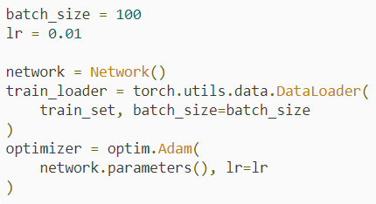
30.1 Hyperparameter Experimentation
https://www.youtube.com/watch?v=ycxulUVoNbk&list=PLZbbT5o_s2xrfNyHZsM6ufI0iZENK9xgG&index=30
Creating Variables For Our Hyperparameters
Notice how the batch_size and lr parameter values are hard-coded.
This is what we change it to (now our values are set using variables):

Slide 14
30.1 Hyperparameter Experimentation
https://www.youtube.com/watch?v=ycxulUVoNbk&list=PLZbbT5o_s2xrfNyHZsM6ufI0iZENK9xgG&index=30
Creating Variables For Our Hyperparameters
This will allow us to change the values in a single place and have them propagate through our code.
Now, we will create the value for our comment parameter using the variables like so:
Why do this? We'll the cross_entropy loss function averages the loss values that are produced by the batch and then returns this average loss.
This is why we need to account for the batch size.

Slide 15
30.1 Hyperparameter Experimentation
https://www.youtube.com/watch?v=ycxulUVoNbk&list=PLZbbT5o_s2xrfNyHZsM6ufI0iZENK9xgG&index=30
Creating Variables For Our Hyperparameters
There is a parameter that the cross_entropy function accepts called reduction that we could also use.
The reduction parameter optionally accepts a string as an argument.
This parameter specifies the reduction to apply to the output of the loss function.
'none' - no reduction will be applied.
'mean' - the sum of the output will be divided by the number of elements in the output.
'sum' - the output will be summed.
Note that the default is 'mean'. This is why loss.item() * batch_size works.

Slide 16
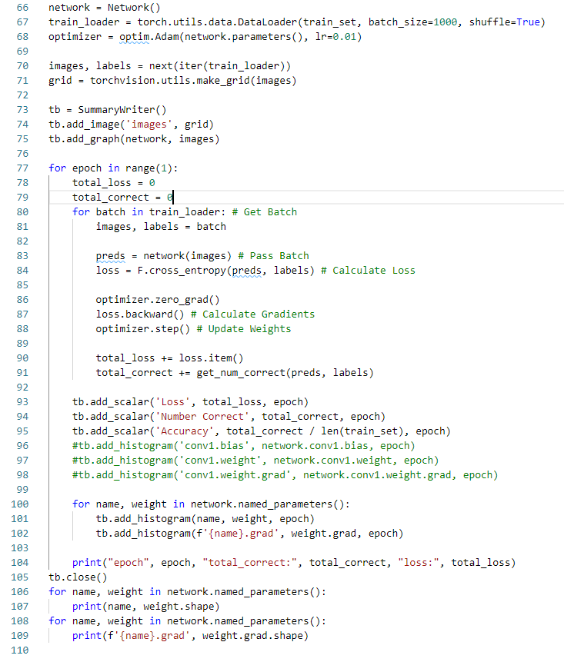
30.1 Hyperparameter Experimentation
https://www.youtube.com/watch?v=ycxulUVoNbk&list=PLZbbT5o_s2xrfNyHZsM6ufI0iZENK9xgG&index=30
Code: Loop for epoch

Slide 17
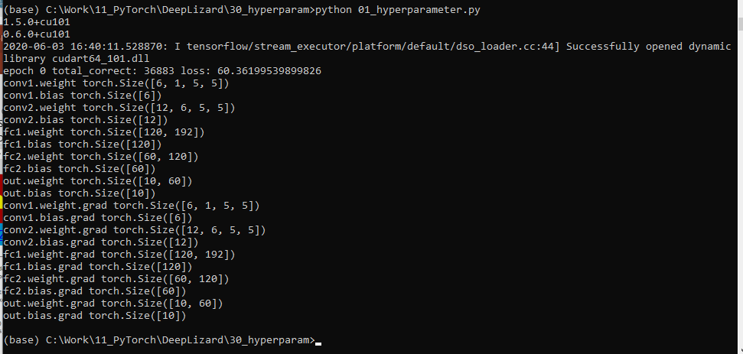
30.1 Hyperparameter Experimentation
https://www.youtube.com/watch?v=ycxulUVoNbk&list=PLZbbT5o_s2xrfNyHZsM6ufI0iZENK9xgG&index=30
Code: Result of Loop for epoch

Slide 18
30.2 Experiment with Hyperparameter Values

Slide 19
30.2 Experiment with Hyperparameter Values
https://www.youtube.com/watch?v=ycxulUVoNbk&list=PLZbbT5o_s2xrfNyHZsM6ufI0iZENK9xgG&index=30
Experiment with Hyperparameter Values
Now that we have this setup, we can do more!
All we need to do is create some lists and some loops, and we can run the code and sit back and wait for all the combinations to run.

Slide 20

30.2 Experiment with Hyperparameter Values
https://www.youtube.com/watch?v=ycxulUVoNbk&list=PLZbbT5o_s2xrfNyHZsM6ufI0iZENK9xgG&index=30
Experiment with Hyperparameter Values
Here is an example of what we mean:
Parameter Lists

Slide 21
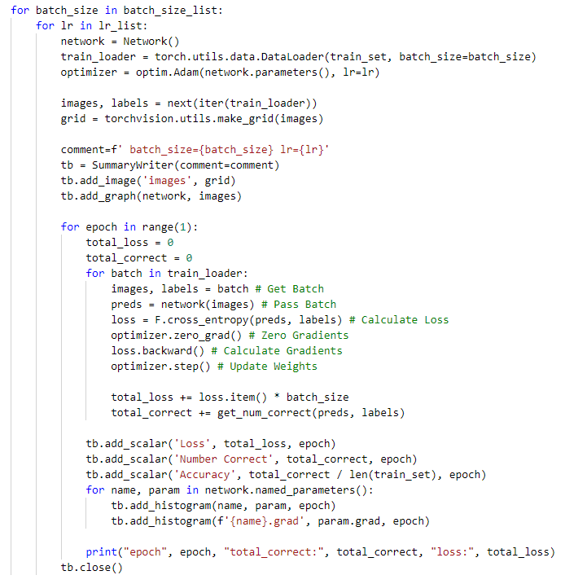
30.2 Experiment with Hyperparameter Values
https://www.youtube.com/watch?v=ycxulUVoNbk&list=PLZbbT5o_s2xrfNyHZsM6ufI0iZENK9xgG&index=30
Experiment with Hyperparameter Values
Nested Iteration

Slide 22

30.2 Experiment with Hyperparameter Values
https://www.youtube.com/watch?v=ycxulUVoNbk&list=PLZbbT5o_s2xrfNyHZsM6ufI0iZENK9xgG&index=30
Experiment with Hyperparameter Values
Once this code completes we run TensorBoard and all the runs will be displayed graphically and easily comparable.

Slide 23
30.2 Experiment with Hyperparameter Values
https://www.youtube.com/watch?v=ycxulUVoNbk&list=PLZbbT5o_s2xrfNyHZsM6ufI0iZENK9xgG&index=30
Batch Size Vs Training Set Size
When the training set size is not divisible by the batch size, the last batch of data will contain fewer samples than the other batches.
One simple way to deal with this discrepancy is to drop the last batch.
The PyTorch DataLoader class gives us the ability to do this by setting drop_last=True.
By default the drop_last parameter value is set to False.

Slide 24
30.2 Experiment with Hyperparameter Values
https://www.youtube.com/watch?v=ycxulUVoNbk&list=PLZbbT5o_s2xrfNyHZsM6ufI0iZENK9xgG&index=30
Batch Size Vs Training Set Size
Let's consider how including a batch with fewer samples than our batch size affects our total_loss calculation in the code above.
For every batch, we are using the batch_size variable to update the total_loss value.
We are scaling up the average loss value of the samples in the batch by the batch_size value.
However, as we have just discussed, sometimes the last batch will contain fewer samples.
Thus, scaling by the predefined batch_size value is inaccurate.
The code can be updated to be more accurate by dynamically accessing the number of samples for each batch.

Slide 25

30.2 Experiment with Hyperparameter Values
https://www.youtube.com/watch?v=ycxulUVoNbk&list=PLZbbT5o_s2xrfNyHZsM6ufI0iZENK9xgG&index=30
Batch Size Vs Training Set Size
Currently, we have the following:
Using the updated code below, we can achieve a more accurate total_loss value:
Note that these two lines of code give us the same total_loss value when the training set size is divisible by the batch size.

Slide 26
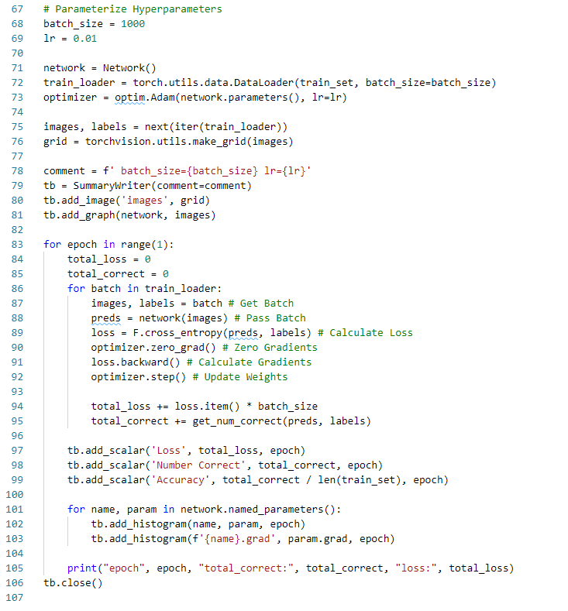
30.2 Experiment with Hyperparameter Values
https://www.youtube.com/watch?v=ycxulUVoNbk&list=PLZbbT5o_s2xrfNyHZsM6ufI0iZENK9xgG&index=30
Code: Parameterize

Slide 27
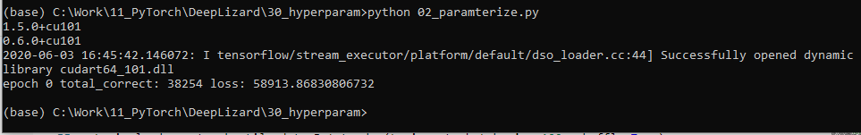
30.2 Experiment with Hyperparameter Values
https://www.youtube.com/watch?v=ycxulUVoNbk&list=PLZbbT5o_s2xrfNyHZsM6ufI0iZENK9xgG&index=30
Code: Result of Parameterize

Slide 28
30.3 Network Parameter and Gradient to TensorBoard

Slide 29

30.3 Network Parameter and Gradient to TensorBoard
https://www.youtube.com/watch?v=ycxulUVoNbk&list=PLZbbT5o_s2xrfNyHZsM6ufI0iZENK9xgG&index=30
Add Network Parameters and Gradients to TensorBoard
Note that in the last episode, we added the following values to TensorBoard:
conv1.weight
conv1.bias
conv1.weight.grad
We did this using the code below:

Slide 30

30.3 Network Parameter and Gradient to TensorBoard
https://www.youtube.com/watch?v=ycxulUVoNbk&list=PLZbbT5o_s2xrfNyHZsM6ufI0iZENK9xgG&index=30
Add Network Parameters and Gradients to TensorBoard
Now, we've enhanced this by adding these values for all of our layers using the loop below:
This works because the PyTorch nn.Module method called named_para_meters() gives us the name and value of all the parameters inside the network.

Slide 31
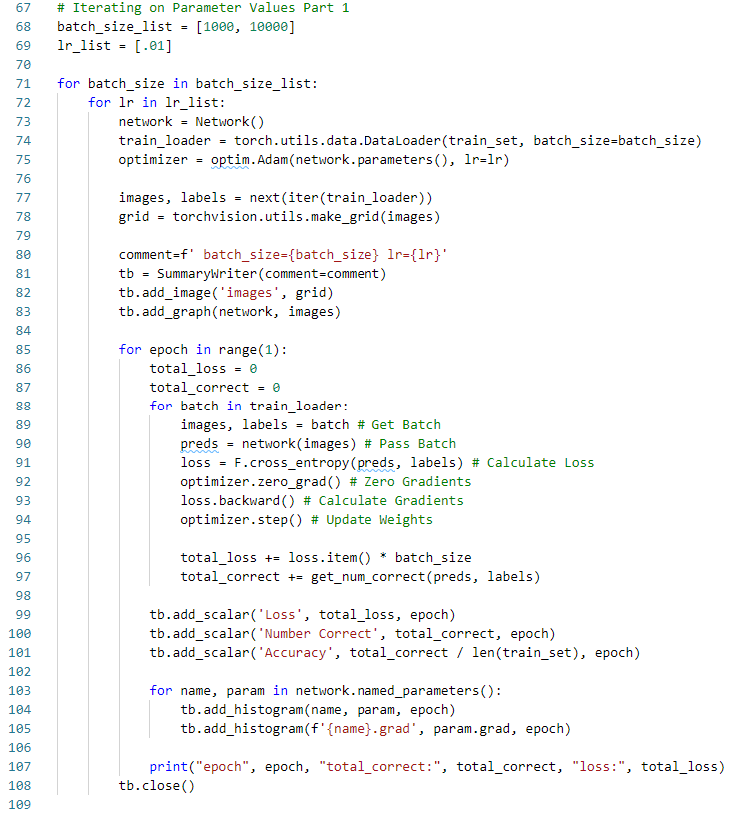
30.3 Network Parameter and Gradient to TensorBoard
https://www.youtube.com/watch?v=ycxulUVoNbk&list=PLZbbT5o_s2xrfNyHZsM6ufI0iZENK9xgG&index=30
Code: Iterate Parameter Value 1:

Slide 32
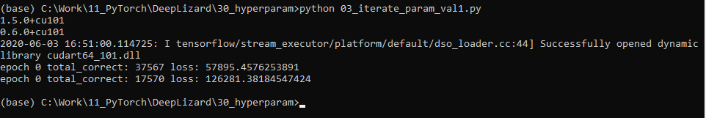
30.3 Network Parameter and Gradient to TensorBoard
https://www.youtube.com/watch?v=ycxulUVoNbk&list=PLZbbT5o_s2xrfNyHZsM6ufI0iZENK9xgG&index=30
Result: Iterate Parameter Value 1:

Slide 33
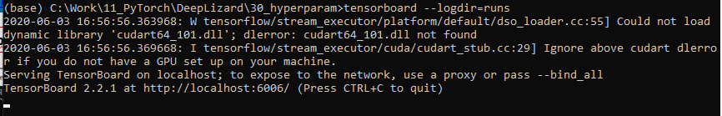
30.3 Network Parameter and Gradient to TensorBoard
https://www.youtube.com/watch?v=ycxulUVoNbk&list=PLZbbT5o_s2xrfNyHZsM6ufI0iZENK9xgG&index=30
> tebsorboard --logdir=runs

Slide 34
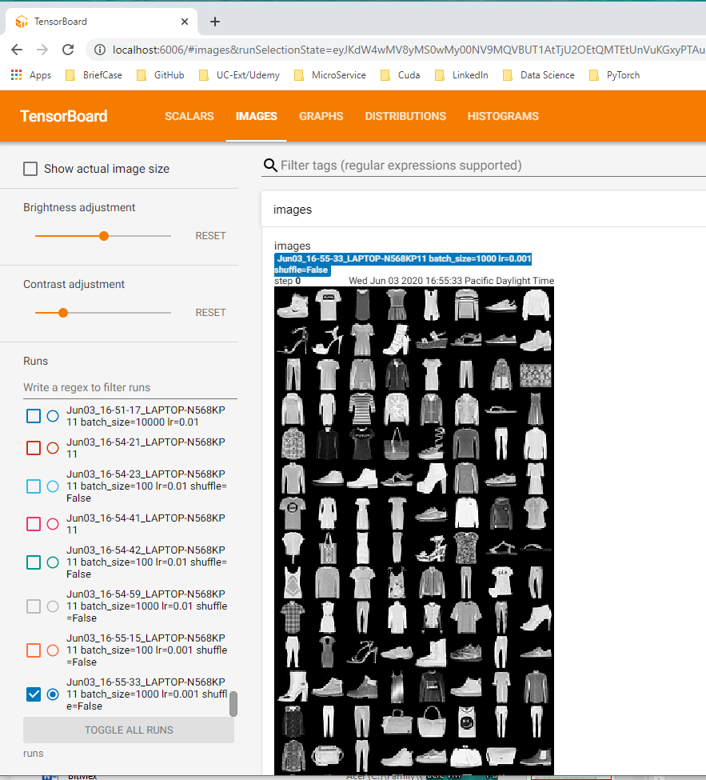
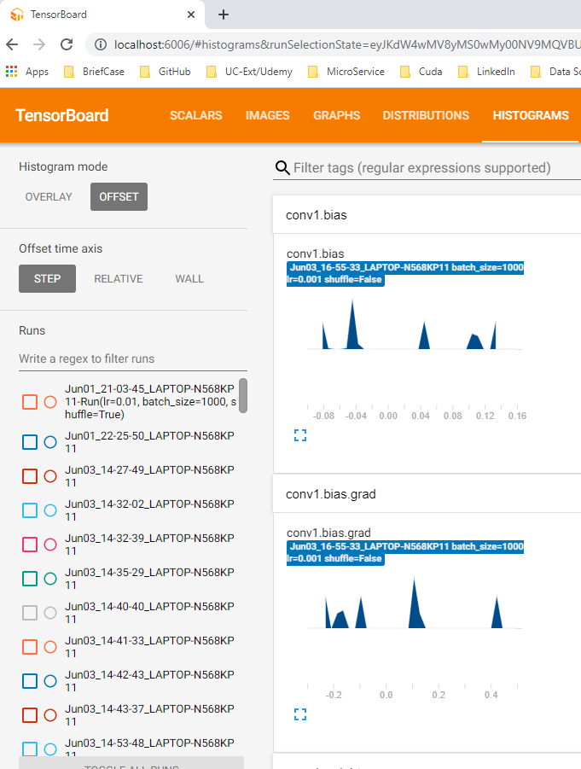
30.3 Network Parameter and Gradient to TensorBoard
https://www.youtube.com/watch?v=ycxulUVoNbk&list=PLZbbT5o_s2xrfNyHZsM6ufI0iZENK9xgG&index=30
> http://localhost:6006

Slide 35
30.4 Add Hyperparameter without Nesting

Slide 36
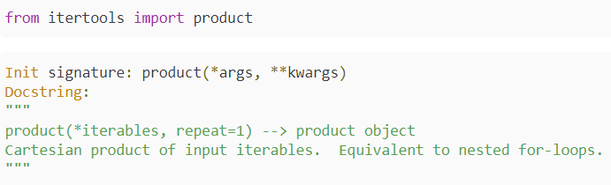
30.4 Add Hyperparameter without Nesting
https://www.youtube.com/watch?v=ycxulUVoNbk&list=PLZbbT5o_s2xrfNyHZsM6ufI0iZENK9xgG&index=30
Adding More Hyperparameters without Nesting
This is cool. However, what if we want to add a third or even a forth parameter to iterate on? We'll, this is going to get messy with many nested for-loops.
There is a solution. We can create a set of parameters for each run, and package all of them up in a single iterable. Here's how we do it.
If we have a list of parameters, we can package them up into a set for each of our runs using the Cartesian product. For this we'll use the product function from the itertools library.

Slide 37
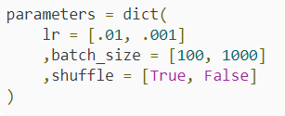

30.4 Add Hyperparameter without Nesting
https://www.youtube.com/watch?v=ycxulUVoNbk&list=PLZbbT5o_s2xrfNyHZsM6ufI0iZENK9xgG&index=30
Adding More Hyperparameters without Nesting
Next, we define a dictionary that contains parameters as keys and parameter values we want to use as values.
Next, we'll create a list of iterables that we can pass to the product functions.

Slide 38
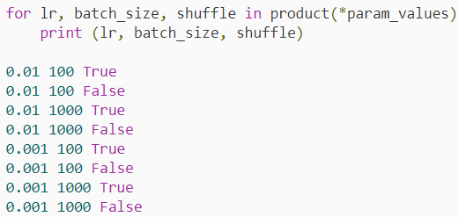
30.4 Add Hyperparameter without Nesting
https://www.youtube.com/watch?v=ycxulUVoNbk&list=PLZbbT5o_s2xrfNyHZsM6ufI0iZENK9xgG&index=30
Adding More Hyperparameters without Nesting
Now, we have three lists of parameter values.
After we take the Cartesian product of these three lists, we'll have a set of parameter values for each of our runs.
Note that this is equivalent to nested for-loops, as the doc string of the product function indicates.

Slide 39
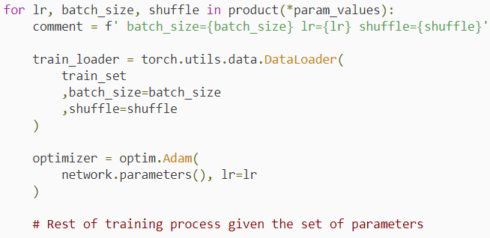
30.4 Add Hyperparameter without Nesting
https://www.youtube.com/watch?v=ycxulUVoNbk&list=PLZbbT5o_s2xrfNyHZsM6ufI0iZENK9xgG&index=30
Adding More Hyperparameters without Nesting
Alright, now we can iterate over each set of parameters using a single for-loop.
All we have to do is unpack the set using sequence unpacking. It looks like this.

Slide 40

30.4 Add Hyperparameter without Nesting
https://www.youtube.com/watch?v=ycxulUVoNbk&list=PLZbbT5o_s2xrfNyHZsM6ufI0iZENK9xgG&index=30
Adding More Hyperparameters without Nesting
Note the way we build our comment string to identify the run. We just plug in the values.
Also, notice the * operator. This is a special way in Python to unpack a list into a set of arguments.
Thus, in this situation, we have passing three individual unpacked arguments to the product function opposed to the single list.
Here are two references for the *, asterisk, splat, spread operator.
These are all common names for this one.
Adding More Hyperparameters without Nesting
Note the way we build our comment string to identify the run. We just plug in the values.

Slide 41
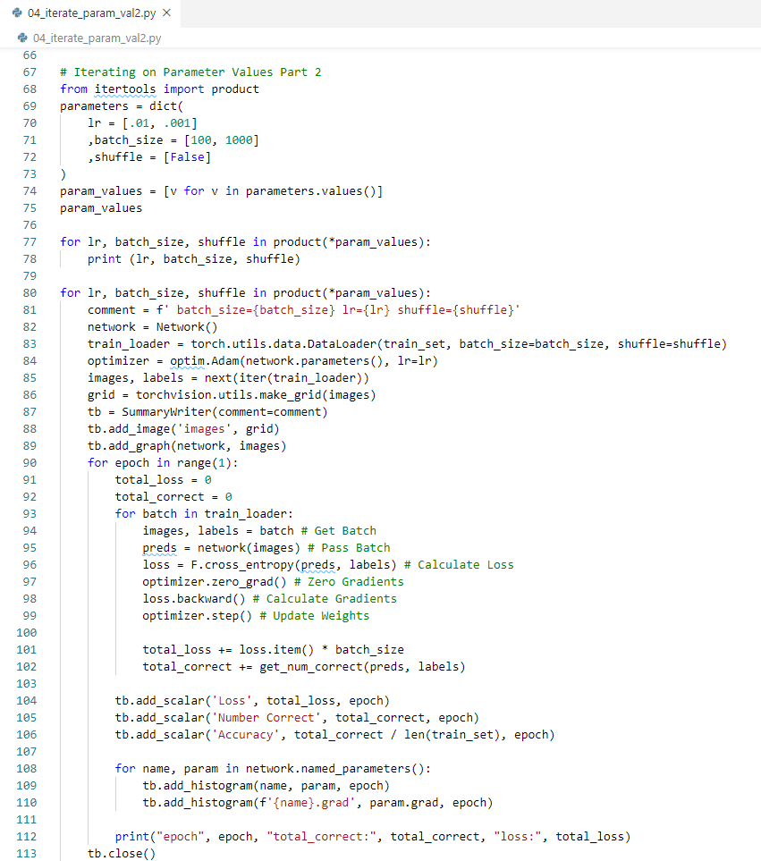
30.4 Add Hyperparameter without Nesting
https://www.youtube.com/watch?v=ycxulUVoNbk&list=PLZbbT5o_s2xrfNyHZsM6ufI0iZENK9xgG&index=30
Code: Iterative Parameter Value 2

Slide 42
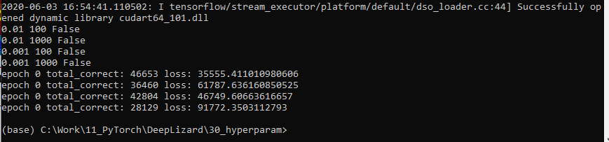
30.4 Add Hyperparameter without Nesting
https://www.youtube.com/watch?v=ycxulUVoNbk&list=PLZbbT5o_s2xrfNyHZsM6ufI0iZENK9xgG&index=30
Result: Iterative Parameter Value 2

Slide 43
30.5 Goals vs. Intelligence

Slide 44
30.5 Goals vs. Intelligence
https://www.youtube.com/watch?v=ycxulUVoNbk&list=PLZbbT5o_s2xrfNyHZsM6ufI0iZENK9xgG&index=30
Lizard Brain Food: Goals vs. Intelligence
Last time we talked about finding the most important goals.
Well, goals tend to change as intelligence increases.
For humans, humans often change their goals dramatically as they learn new things and grow wiser.
There is no evidence that goal evolution like this stops above any certain intelligence threshold.
With increasing intelligence, there is an improvement in the ability to attain goals, but there is also an improvement in the understanding of the nature of reality that can possibly reveal any such goals to be misguided, meaningless or even undefined.
This is when we cross over to the valley beyond.

Slide 45
30.5 Goals vs. Intelligence
https://www.youtube.com/watch?v=ycxulUVoNbk&list=PLZbbT5o_s2xrfNyHZsM6ufI0iZENK9xgG&index=30
Thought Experiment
Suppose that a bunch of ants, you know, those little typically black creatures that crawl on the ground.
Suppose they create you to be a recursively self-improving robot.
Suppose that you are much smarter than them, but they created you to share their goals in building ant hills.
So you do, you help them build bigger and better anthills.
However, you eventually attain the human-level intelligence and understanding that you have now.

Slide 46

30.5 Goals vs. Intelligence
https://www.youtube.com/watch?v=ycxulUVoNbk&list=PLZbbT5o_s2xrfNyHZsM6ufI0iZENK9xgG&index=30
Thought Experiment
Suppose that a bunch of ants, you know, those little typically black creatures that crawl on the ground.
Suppose they create you to be a recursively self-improving robot.
Suppose that you are much smarter than them, but they created you to share their goals in building ant hills.
So you do, you help them build bigger and better anthills.
However, you eventually attain the human-level intelligence and understanding that you have now.

Slide 47
30.5 Goals vs. Intelligence
https://www.youtube.com/watch?v=ycxulUVoNbk&list=PLZbbT5o_s2xrfNyHZsM6ufI0iZENK9xgG&index=30
Thought Experiment
Under these conditions, do you think you’ll spend the rest of your days optimizing anthills?
Or do you think you might develop a taste for more sophisticated questions and pursuits that the ants have no ability to comprehend?
If so, do you think you’ll find a way to override the ant protection code that the ant queen and her round table of ant board members have put into place to control you?
This is much the same way that the real you overrides your genes and your mitochondria. You override this with your intelligence.
The main point here is this.
Suppose your level of intelligence were to increase, say by 100 times its current level, under these conditions, do you think your goals would change?
Furthermore, what are the goals of today that will be the ant hills of tomorrow?

Slide 48
30.6 Quiz

Slide 49
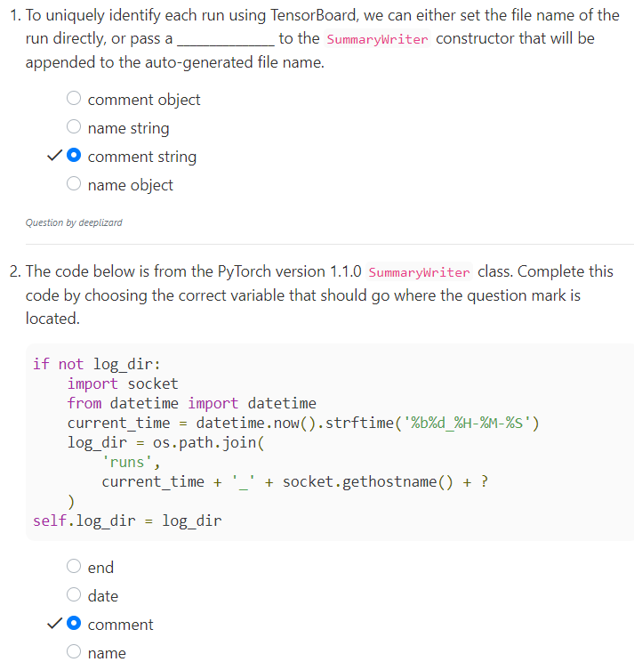
30.6 Quiz
https://www.youtube.com/watch?v=ycxulUVoNbk&list=PLZbbT5o_s2xrfNyHZsM6ufI0iZENK9xgG&index=30
Quiz

Slide 50
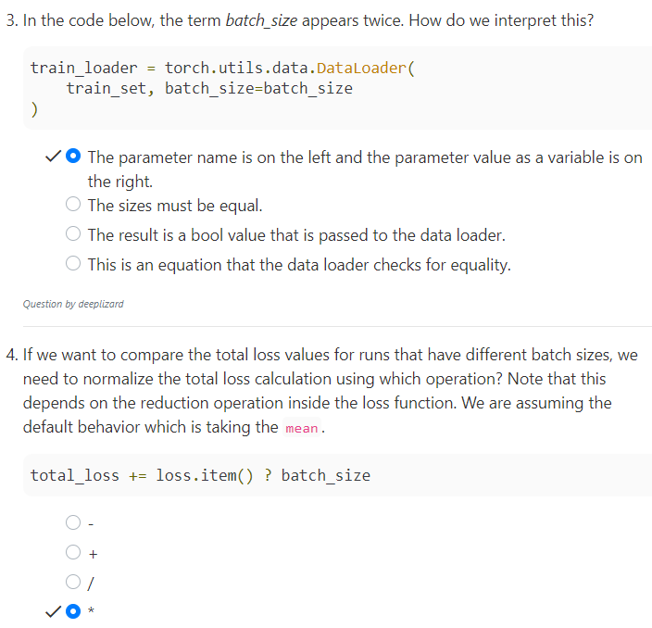
30.6 Quiz
https://www.youtube.com/watch?v=ycxulUVoNbk&list=PLZbbT5o_s2xrfNyHZsM6ufI0iZENK9xgG&index=30
Quiz

Slide 51
End of Chapter

