Slide 1

34 Num Workers (Part 3)
Peter H. Chen

Slide 2
34 Num Workers (Part 3)
https://www.youtube.com/watch?v=kWVgvsejXsE&list=PLZbbT5o_s2xrfNyHZsM6ufI0iZENK9xgG&index=33
Num Workers
We discuss how to speed up the training process nu multiple Process Capability pf PyTroch DataLoader class.

Slide 3
33.1 Speed up Training Process

Slide 4
33.1 Speed up Training Process
https://www.youtube.com/watch?v=kWVgvsejXsE&list=PLZbbT5o_s2xrfNyHZsM6ufI0iZENK9xgG&index=33
Clean up Training Loop and Extract Class
To speed up the training process, we will make use of the num_workers optional attribute of the DataLoader class.
The num_workers attribute tells the data loader instance how many sub-processes to use for data loading.
By default, the num_workers value is set to zero, and a value of zero tells the loader to load the data inside the main process.
This means that the training process will work sequentially inside the main process. After a batch is used during the training process and another one is needed, we read the batch data from disk.
Now, if we have a worker process, we can make use of the fact that our machine has multiple cores. This means that the next batch can already be loaded and ready to go by the time the main process is ready for another batch. This is where the speed up comes from. The batches are loaded using additional worker processes and are queued up in memory.

Slide 5
33.1 Speed up Training Process
https://www.youtube.com/watch?v=kWVgvsejXsE&list=PLZbbT5o_s2xrfNyHZsM6ufI0iZENK9xgG&index=33
Optimal Value For The num_workers Attribute
The natural questiona that arises is, how many worker processes should we add? There are a lot of factors that can affect the optimal number here, so the best way to find out is to test

Slide 6
33.2 Quiz

Slide 7
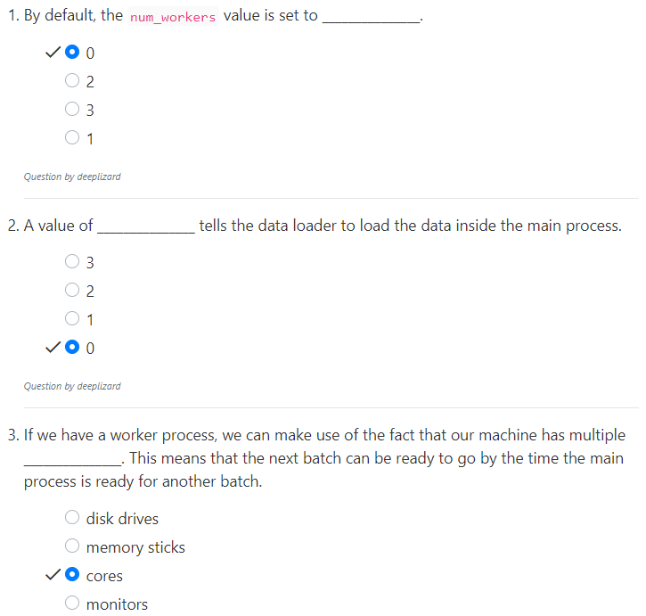
33.2 Quiz
https://www.youtube.com/watch?v=kWVgvsejXsE&list=PLZbbT5o_s2xrfNyHZsM6ufI0iZENK9xgG&index=33
Quiz

Slide 8
End of Chapter

