Slide 1

32 Simultaneous Hyperparameter Test (Part 3)
Peter H. Chen

Slide 2
32 Simultaneous Hyperparameter Test (Part 3)
https://www.youtube.com/watch?v=ozpv_peZ894&list=PLZbbT5o_s2xrfNyHZsM6ufI0iZENK9xgG&index=32
Simultaneous Hypermeter Test
We discuss how to use large numbers of hyperparameter values easily while still keeping our training loop and our results organized.

Slide 3
32.1 Clean Up Train Loop and Extract Class

Slide 4
32.1 Clean Up Train Loop and Extract Class
https://www.youtube.com/watch?v=ozpv_peZ894&list=PLZbbT5o_s2xrfNyHZsM6ufI0iZENK9xgG&index=32
Clean up Training Loop and Extract Class
When we left off with our training loop a couple of episodes back, we built out quite a lot of functionality that allowed us to experiment with many different parameters and values, and we also made the calls need inside our training loop that would get our results into TensorBoard.
All of this work has helped, but our training loop is pretty crowded now. In this episode, we're going to clean up our training loop and set the stage for more experimentation up by using the RunBuilder class that we built last time and by building a new class called RunManager.
Our goal is to be able to add parameters and values at the top, and have all the values tested or tried during multiple training runs.

Slide 5

32.1 Clean Up Train Loop and Extract Class
https://www.youtube.com/watch?v=ozpv_peZ894&list=PLZbbT5o_s2xrfNyHZsM6ufI0iZENK9xgG&index=32
Clean up Training Loop and Extract Class
For example, in this case, we are saying that we want to use two parameters, lr and batch_size, and for the batch_size we want to try two different values.
This gives us a total of two training runs. Both runs will have the same learning rate while the batch size varies.

Slide 6
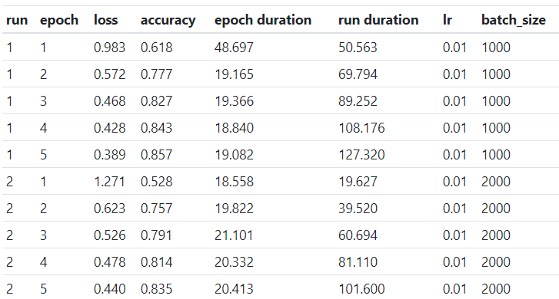
32.1 Clean Up Train Loop and Extract Class
https://www.youtube.com/watch?v=ozpv_peZ894&list=PLZbbT5o_s2xrfNyHZsM6ufI0iZENK9xgG&index=32
Clean up Training Loop and Extract Class
For the results, we'd like to see and be able to compare the both runs.

Slide 7

32.1 Clean Up Train Loop and Extract Class
https://www.youtube.com/watch?v=ozpv_peZ894&list=PLZbbT5o_s2xrfNyHZsM6ufI0iZENK9xgG&index=32
Two Classes We Will Build
To do this, we need to build two new classes.
We built the first class called RunBuilder in the last discussion.
It's being called at the top.
Now, we need to build this RunManager class that will allow us to manage each run inside our run loop.
The RunManager instance will allow us to pull out a lot of the tedious TensorBoard calls and allow us to add additional functionality as well.
We'll see that as our number of parameters and runs get larger, TensorBoard will start to breakdown as a viable solution for reviewing our results.

Slide 8
32.1 Clean Up Train Loop and Extract Class
https://www.youtube.com/watch?v=ozpv_peZ894&list=PLZbbT5o_s2xrfNyHZsM6ufI0iZENK9xgG&index=32
Two Classes We Will Build
The RunManager will be invoked at different stages inside each of our runs.
We'll have calls at the start and end of both the run and the epoch phases.
We'll also have calls to track the loss and the number of correct predictions inside each epoch.
Finally, at the end, we'll save the run results to disk.
Let's see how to build this RunManager class.

Slide 9
32.2 Build RunManger

Slide 10
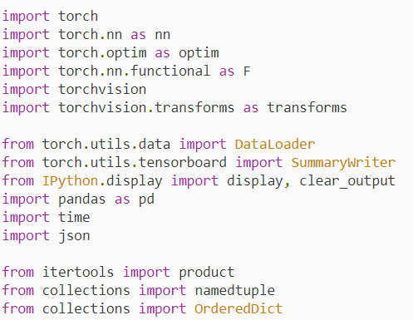
32.2 Build RunManger
https://www.youtube.com/watch?v=ozpv_peZ894&list=PLZbbT5o_s2xrfNyHZsM6ufI0iZENK9xgG&index=32
Build the RunManager for Training Loop Runs
Let's kick things off with our imports:

Slide 11

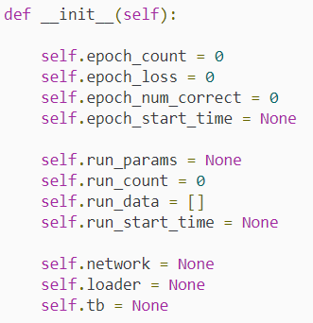
32.2 Build RunManger
https://www.youtube.com/watch?v=ozpv_peZ894&list=PLZbbT5o_s2xrfNyHZsM6ufI0iZENK9xgG&index=32
Build the RunManager for Training Loop Runs
First, we declare the class using the class keyword.
Next, we'll define the class constructor.

Slide 12
32.2 Build RunManger
https://www.youtube.com/watch?v=ozpv_peZ894&list=PLZbbT5o_s2xrfNyHZsM6ufI0iZENK9xgG&index=32
Build the RunManager for Training Loop Runs
Next, we have attributes to track the run_count, and the run_data.
The run_count gives us the run number and the run_data is a list we'll use to keep track of the parameter values and the results of each epoch for each run, and so we'll see that we add a value to this list for each epoch.
Then, we have the run start time which will be used to calculate the run duration.
Alright, next we will save the network and the data loader that are being used for the run, as well as a SummaryWriter that we can use to save data for TensorBoard.

Slide 13
32.2 Build RunManger
https://www.youtube.com/watch?v=ozpv_peZ894&list=PLZbbT5o_s2xrfNyHZsM6ufI0iZENK9xgG&index=32
Build the RunManager for Training Loop Runs
For now, we'll take no arguments in the constructor, and we'll just define some attributes that will enable us to keep track of data across runs and across epochs.
We'll track the following:
The number of epochs.
The running loss for an epoch.
The number of correct predictions for an epoch.
The start time of the epoch.
Remember we saw that the RunManager class has two methods with epoch in the name. We have begin_epoch() and end_epoch(). These two methods will allow us to manage these values across the epoch lifecycle.
Now, next we have some attributes for the runs. We have an attribute called run_params. This is the run definition in terms for the run parameters. It's value will be one of the runs returned by the RunBuilder class.

Slide 14
32.2 Build RunManger
https://www.youtube.com/watch?v=ozpv_peZ894&list=PLZbbT5o_s2xrfNyHZsM6ufI0iZENK9xgG&index=32
What are Code Small?
Do you smell that? There's something that doesn't smell right about this code.
Have you heard of code smells before? Have you smelled them? A code smell is a term used to describe a condition where something about the code in front of our eyes doesn't seem right. It's like a gut feeling for software developers.
A code smell doesn't mean that something is definitely wrong. A code smell does not mean the code is incorrect. It just means that there is likely a better way. In this case, the code smell is the fact that we have several variable names that have a prefix. The use of the prefix here indicates that the variables somehow belong together.
Anytime we see this, we need to be thinking about removing these prefixes. Data that belongs together should be together. This is done by encapsulating the data inside of a class. After all, if the data belongs together, object oriented languages give us the ability to express this fact using classes.

Slide 15
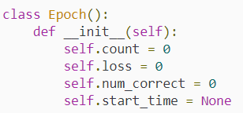
32.2 Build RunManger
https://www.youtube.com/watch?v=ozpv_peZ894&list=PLZbbT5o_s2xrfNyHZsM6ufI0iZENK9xgG&index=32
Refactoring By Extracting A Class
It's fine to leave this code in now, but later we might want to refactor this code by doing what is referred to as extracting a class.
This is a refactoring technique where we remove these prefixes and create a class called Epoch, that has these attributes, count, loss, num_correct, and start_time.
Then, we'll replace these class variable with an instance of the Epoch class.
We might even change the count variable to have a more intuitive name, like say number or id.
The reason we can leave this now is because refactoring is an iterative process, and this is our first iteration.

Slide 16
32.2 Build RunManger
https://www.youtube.com/watch?v=ozpv_peZ894&list=PLZbbT5o_s2xrfNyHZsM6ufI0iZENK9xgG&index=32
Extracting Classes Creates Layers of Abstraction
Actually, what we are doing now by building this class is extracting a class from our main training loop program. The code smell that we were addressing is the fact that our loop was becoming cluttered and beginning to appear overly complex.
When we write a main program and then refactor it, we can think of this creating layers of abstraction that make the main program more and more readable and easier to understand. Each part of the program should be very easy to understand in its own right.
When we extract code into its own class or method, we are creating additional layers of abstraction, and if we want to understand the implementation details of any of the layers, we dive in so to speak.
In an iterative way, we can think of starting with one single program, and then, later extracting the code that creates deeper and deeper layers. The process can be view as a branching tree-like structure.

Slide 17
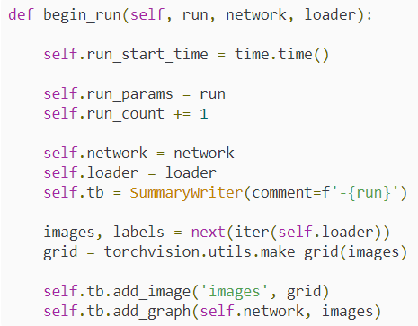
32.2 Build RunManger
https://www.youtube.com/watch?v=ozpv_peZ894&list=PLZbbT5o_s2xrfNyHZsM6ufI0iZENK9xgG&index=32
Begin a Training Loop Run
Anyway, let's look at the first method of this class which extracts the code needed to begin a run.

Slide 18

32.2 Build RunManger
https://www.youtube.com/watch?v=ozpv_peZ894&list=PLZbbT5o_s2xrfNyHZsM6ufI0iZENK9xgG&index=32
Begin a Training Loop Run
First, we capture the start time for the run. Then, we save the passed in run parameters and increment the run count by one. After this, we save our network and our data loader, and then, we initialize a SummaryWriter for TensorBoard. Notice how we are passing our run as the comment argument. This will allow us to uniquely identify our run inside TensorBoard.
Alright, next we just have some TensorBoard calls that we made in our training loop before. These calls add our network and a batch of images to TensorBoard.
When we end a run, all we have to do is close the TensorBoard handle and set the epoch count back to zero to be ready for the next run.

Slide 19
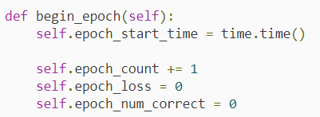
32.2 Build RunManger
https://www.youtube.com/watch?v=ozpv_peZ894&list=PLZbbT5o_s2xrfNyHZsM6ufI0iZENK9xgG&index=32
Begin a Training Loop Run
For starting an epoch, we first save the start time. Then, we increment the epoch_count by one and set the epoch_loss and epoch_number_correct to zero.

Slide 20
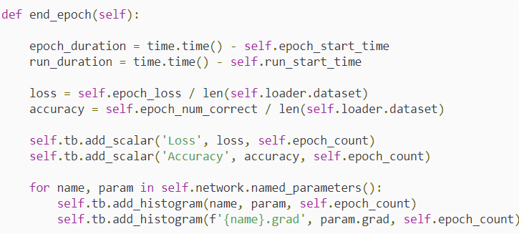
32.2 Build RunManger
https://www.youtube.com/watch?v=ozpv_peZ894&list=PLZbbT5o_s2xrfNyHZsM6ufI0iZENK9xgG&index=32
Begin a Training Loop Run
Now, let's look at where the bulk of the action occurs which is ending an epoch.

Slide 21
32.2 Build RunManger
https://www.youtube.com/watch?v=ozpv_peZ894&list=PLZbbT5o_s2xrfNyHZsM6ufI0iZENK9xgG&index=32
Begin a Training Loop Run
We start by calculating the epoch duration and the run duration. Since we are at the end of an epoch, the epoch duration is final, but the run duration here represents the running time of the current run. The value will keep running until the run ends. However, we'll still save it with each epoch.
Next, we compute the epoch_loss and accuracy, and we do it relative to the size of the training set. This gives us the average loss per sample.
Then, we pass both of these values to TensorBoard.
Next, we pass our network's weights and gradient values to TensorBoard like we did before.

Slide 22
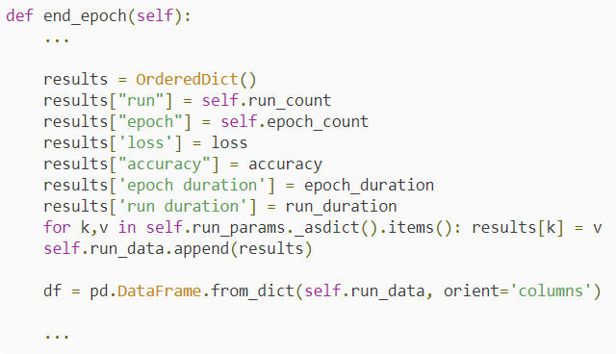
32.2 Build RunManger
https://www.youtube.com/watch?v=ozpv_peZ894&list=PLZbbT5o_s2xrfNyHZsM6ufI0iZENK9xgG&index=32
Tracking Our Training Loop Performance
We're ready now for what's new in this processing. This is the part that we are adding to give us additional insight when we preform large numbers of runs. We're going to save all of the data ourselves so we can analyze it outsize of TensorBoard.

Slide 23

32.2 Build RunManger
https://www.youtube.com/watch?v=ozpv_peZ894&list=PLZbbT5o_s2xrfNyHZsM6ufI0iZENK9xgG&index=32
Tracking Our Training Loop Performance
Here, we are building a dictionary that contains the keys and values we care about for our run. We add in the run_count, the epoch_count, the loss, the accuracy, the epoch_duration, and the run_duration.
Then, we iterate over the keys and values inside our run parameters adding them to the results dictionary. This will allow us to see the parameters that are associated with the performance results.
Finally, we append the results to the run_data list.
Once the data is added to the list, we turn the data list into a pandas data frame so we can have formatted output.
The next two lines are specific to Jupyter notebook. We clear the current output and display the new data frame.

Slide 24
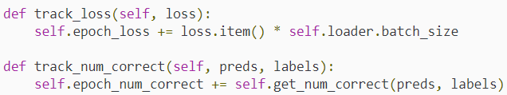
32.2 Build RunManger
https://www.youtube.com/watch?v=ozpv_peZ894&list=PLZbbT5o_s2xrfNyHZsM6ufI0iZENK9xgG&index=32
Tracking Our Training Loop Performance
Alright, that ends an epoch. One thing you may be wondering is how the epoch_loss and epoch_num_correct values were tracked.
We'll we have two methods just below for that.
We have a method called track_loss() and a method called track_num_correct(). These methods are called inside the training loop after each batch. The loss is passed into the track_loss() method and the predictions and labels are passed into the track_num_correct() method.

Slide 25

32.2 Build RunManger
https://www.youtube.com/watch?v=ozpv_peZ894&list=PLZbbT5o_s2xrfNyHZsM6ufI0iZENK9xgG&index=32
Tracking Our Training Loop Performance
To calculate the number of correct predictions, we are using the same get_num_correct() function that we defined in previous episodes. The difference here is that the function is now encapsulated inside our RunManager class.
Lastly, we have a method called save() that saves the run_data in two formats, json and csv.
This output goes to disk and makes it available for other apps to consume.

Slide 26
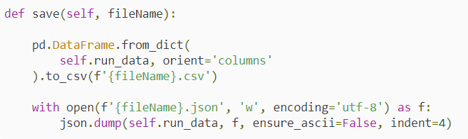
32.2 Build RunManger
https://www.youtube.com/watch?v=ozpv_peZ894&list=PLZbbT5o_s2xrfNyHZsM6ufI0iZENK9xgG&index=32
Tracking Our Training Loop Performance
For example, we can open the csv file in excel or we can even build our own even better TensorBoard with the data.

Slide 27
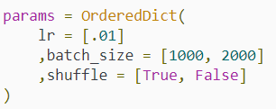
32.2 Build RunManger
https://www.youtube.com/watch?v=ozpv_peZ894&list=PLZbbT5o_s2xrfNyHZsM6ufI0iZENK9xgG&index=32
Tracking Our Training Loop Performance
That's it. Now, we can use this RunManager class inside our training loop.
If we use the following parameters below:

Slide 28
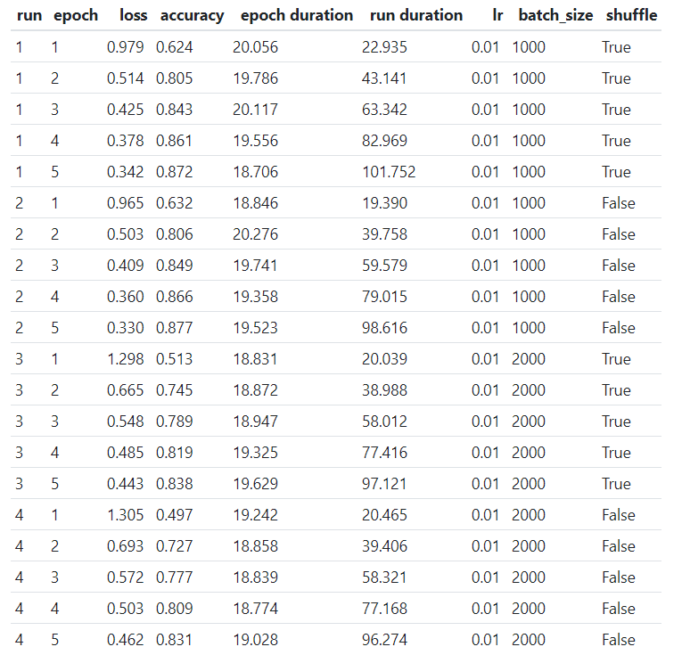
32.2 Build RunManger
https://www.youtube.com/watch?v=ozpv_peZ894&list=PLZbbT5o_s2xrfNyHZsM6ufI0iZENK9xgG&index=32
Tracking Our Training Loop Performance
These are the results we get:

Slide 29
32.3 Quiz

Slide 30
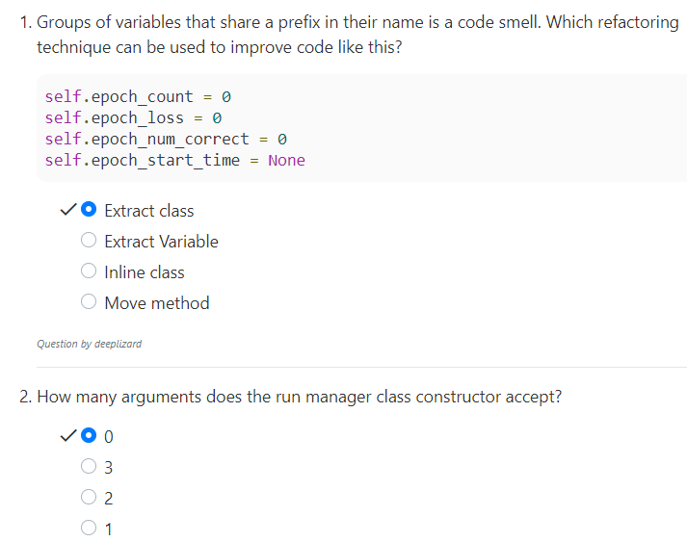
32.3 Quiz
https://www.youtube.com/watch?v=ozpv_peZ894&list=PLZbbT5o_s2xrfNyHZsM6ufI0iZENK9xgG&index=32
Quiz

Slide 31
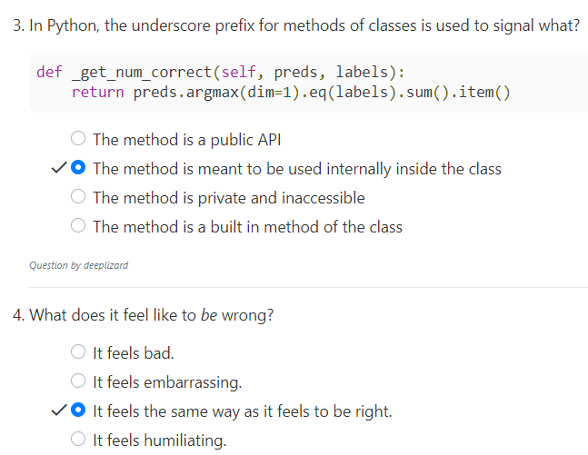
32.3 Quiz
https://www.youtube.com/watch?v=ozpv_peZ894&list=PLZbbT5o_s2xrfNyHZsM6ufI0iZENK9xgG&index=32
Quiz

Slide 32
End of Chapter

