Slide 1

25 Train Code (Part 2)
Peter H. Chen

Slide 2
25 Train Code (Part 2)
https://www.youtube.com/watch?v=0VCOG8IeVf8&list=PLZbbT5o_s2xrfNyHZsM6ufI0iZENK9xgG&index=25
CNN Train Process
In this discussion, we will learn the steps needed to train a convolutional neural network.
High-Level Overview Of Our Process
So far in this series, we learned about Tensors, and we've learned all about PyTorch neural networks. We are now ready to begin the training process.
Prepare the data
Build the model
Train the model
Calculate the loss, the gradient, and update the weights
Analyze the model's results

Slide 3
25 Train Code (Part 2)
https://www.youtube.com/watch?v=0VCOG8IeVf8&list=PLZbbT5o_s2xrfNyHZsM6ufI0iZENK9xgG&index=25
Training: What We Do After The Forward Pass
During training, we do a forward pass, but then what?
We'll suppose we get a batch and pass it forward through the network.
Once the output is obtained, we compare the predicted output to the actual labels, and once we know how close the predicted values are from the actual labels, we tweak the weights inside the network in such a way that the values the network predicts move closer to the true values (labels).
All of this is for a single batch, and we repeat this process for every batch until we have covered every sample in our training set.
After we've completed this process for all of the batches and passed over every sample in our training set, we say that an epoch is complete.
We use the word epoch to represent a time period in which our entire training set has been covered.

Slide 4
25 Train Code (Part 2)
https://www.youtube.com/watch?v=0VCOG8IeVf8&list=PLZbbT5o_s2xrfNyHZsM6ufI0iZENK9xgG&index=25
Training: What We Do After The Forward Pass
During the entire training process, we do as many epochs as necessary to reach our desired level of accuracy. With this, we have the following steps:
Get batch from the training set.
Pass batch to network.
Calculate the loss (difference between the predicted values and the true values).
Calculate the gradient of the loss function w.r.t the network's weights.
Update the weights using the gradients to reduce the loss.
Repeat steps 1-5 until one epoch is completed.
Repeat steps 1-6 for as many epochs required to reach the minimum loss.
We already know exactly how to do steps 1 and 2.
If you've already covered the deep learning fundamentals series, then you know that we use a loss function to perform step 3, and you know that we use backpropagation and an optimization algorithm to perform step 4 and 5.
Steps 6 and 7 are just standard Python loops (the training loop). Let's see how this is done in code.

Slide 5
25.1 Gradient Tracking

Slide 6
25.1 Gradient Tracking
https://www.youtube.com/watch?v=0VCOG8IeVf8&list=PLZbbT5o_s2xrfNyHZsM6ufI0iZENK9xgG&index=25
Training Process: Gradient Tracking
Since we disabled PyTorch's gradient tracking feature in a previous discussion, we need to be sure to turn it back on (it is on by default).

Slide 7
25.2 Prepare For the Forward Pass

Slide 8
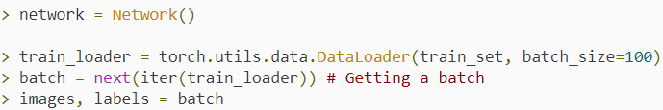
25.2 Prepare For the Forward Pass
https://www.youtube.com/watch?v=0VCOG8IeVf8&list=PLZbbT5o_s2xrfNyHZsM6ufI0iZENK9xgG&index=25
Preparing For The Forward Pass
We already know how to get a batch and pass it forward through the network. Let's see what we do after the forward pass is complete.
We'll begin by:
Creating an instance of our Network class.
Creating a data loader that provides batches of size 100 from our training set.
Unpacking the images and labels from one of these batches.

Slide 9
25.2 Prepare For the Forward Pass
https://www.youtube.com/watch?v=0VCOG8IeVf8&list=PLZbbT5o_s2xrfNyHZsM6ufI0iZENK9xgG&index=25
Preparing For The Forward Pass
Next, we are ready to pass our batch of images forward through the network and obtain the output predictions.
Once we have the prediction tensor, we can use the predictions and the true labels to calculate the loss.

Slide 10
25.3 Calculate Loss

Slide 11
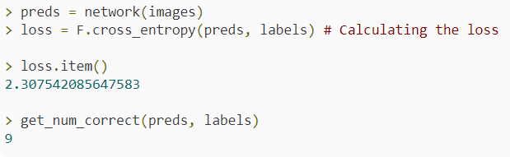
25.3 Calculate Loss
https://www.youtube.com/watch?v=0VCOG8IeVf8&list=PLZbbT5o_s2xrfNyHZsM6ufI0iZENK9xgG&index=25
Calculate Loss
To do this we will use the cross_entropy() loss function that is available in PyTorch’s nn.functional API.
Once we have the loss, we can print it, and also check the number of correct predictions using the function we created a previous discussion.

Slide 12
25.3 Calculate Loss
https://www.youtube.com/watch?v=0VCOG8IeVf8&list=PLZbbT5o_s2xrfNyHZsM6ufI0iZENK9xgG&index=25
Calculate Loss
The cross_entropy() function returned a scalar valued tenor, and so we used the item() method to print the loss as a Python number.
We got 9 out of 100 correct, and since we have 10 prediction classes, this is what we'd expect by guessing at random.

Slide 13
25.4 Calculate Gradient

Slide 14

25.4 Calculate Gradient
https://www.youtube.com/watch?v=0VCOG8IeVf8&list=PLZbbT5o_s2xrfNyHZsM6ufI0iZENK9xgG&index=25
Calculate Gradient
Calculating the gradients is very easy using PyTorch.
Since our network is a PyTorch nn.Module, PyTorch has created a computation graph under the hood.
As our tensor flowed forward through our network, all of the computations where added to the graph.
The computation graph is then used by PyTorch to calculate the gradients of the loss function with respect to the network's weights.
Before we calculate the gradients, let's verify that we currently have no gradients inside our conv1 layer.
The gradients are tensors that are accessible in the grad (short for gradient) attribute of the weight tensor of each layer.

Slide 15


25.4 Calculate Gradient
https://www.youtube.com/watch?v=0VCOG8IeVf8&list=PLZbbT5o_s2xrfNyHZsM6ufI0iZENK9xgG&index=25
Calculate Gradient
To calculate the gradients, we call the backward() method on the loss tensor, like so:
Now, the gradients of the loss function have been stored inside weight tensors.
These gradients are used by the optimizer to update the respective weights.
To create our optimizer, we use the torch.optim package that has many optimization algorithm implementations that we can use.
We'll use Adam for our example.

Slide 16

25.4 Calculate Gradient
https://www.youtube.com/watch?v=0VCOG8IeVf8&list=PLZbbT5o_s2xrfNyHZsM6ufI0iZENK9xgG&index=25
Update Weights
To the Adam class constructor, we pass the network parameters (this is how the optimizer is able to access the gradients), and we pass the learning rate .
Finally, all we have to do to update the weights is to tell the optimizer to use the gradients to step in the direction of the loss function's minimum.

Slide 17
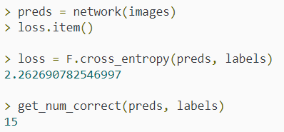
25.4 Calculate Gradient
https://www.youtube.com/watch?v=0VCOG8IeVf8&list=PLZbbT5o_s2xrfNyHZsM6ufI0iZENK9xgG&index=25
Update Weights
When the step() function is called, the optimizer updates the weights using the gradients that are stored in the network's parameters.
This means that we should expect our loss to be reduced if we pass the same batch through the network again.
Checking this, we can see that this is indeed the case:

Slide 18
25.5 Train By Single Batch

Slide 19
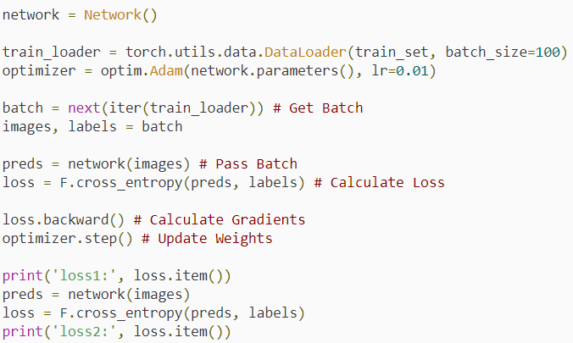
25.5 Train By Single Batch
https://www.youtube.com/watch?v=0VCOG8IeVf8&list=PLZbbT5o_s2xrfNyHZsM6ufI0iZENK9xgG&index=25
Train by a Single Batch
We can summarize the code for training with a single batch in the following way:

Slide 20

25.5 Train By Single Batch
https://www.youtube.com/watch?v=0VCOG8IeVf8&list=PLZbbT5o_s2xrfNyHZsM6ufI0iZENK9xgG&index=25
Train by a Single Batch
Output:

Slide 21
25.6 Summary

Slide 22
25.6 Summary
https://www.youtube.com/watch?v=0VCOG8IeVf8&list=PLZbbT5o_s2xrfNyHZsM6ufI0iZENK9xgG&index=25
Summary
We should now have a good understanding of the training process.
In the next discussion, we'll see how these ideas are extended by completing the process by constructing the training loop.

Slide 23
25.7 Quiz

Slide 24
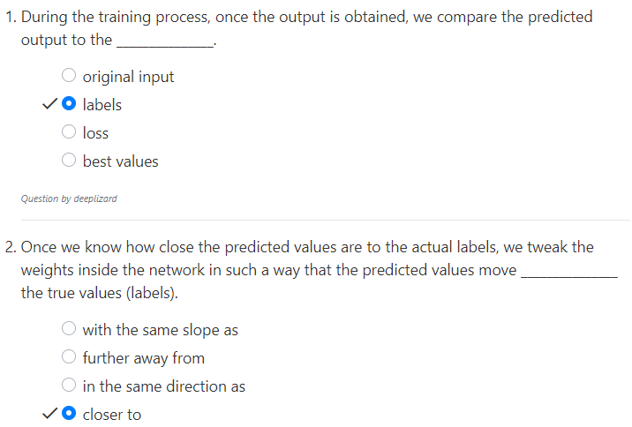
25.7 Quiz
https://www.youtube.com/watch?v=0VCOG8IeVf8&list=PLZbbT5o_s2xrfNyHZsM6ufI0iZENK9xgG&index=25
Quiz

Slide 25
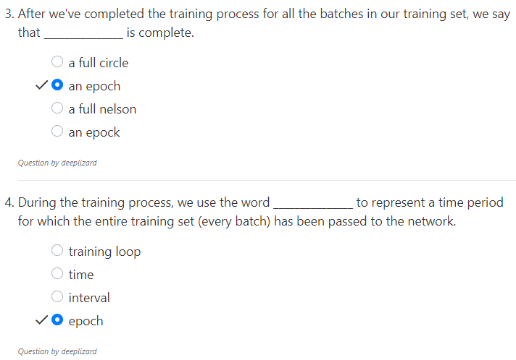
25.7 Quiz
https://www.youtube.com/watch?v=0VCOG8IeVf8&list=PLZbbT5o_s2xrfNyHZsM6ufI0iZENK9xgG&index=25
Quiz

Slide 26
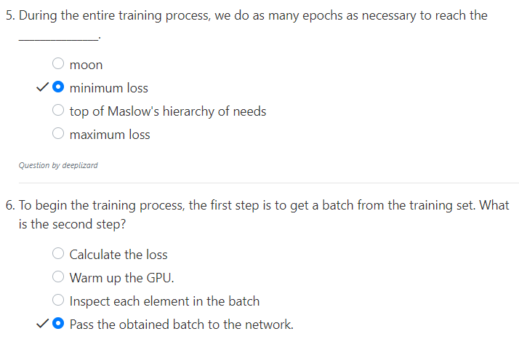
25.7 Quiz
https://www.youtube.com/watch?v=0VCOG8IeVf8&list=PLZbbT5o_s2xrfNyHZsM6ufI0iZENK9xgG&index=25
Quiz

Slide 27
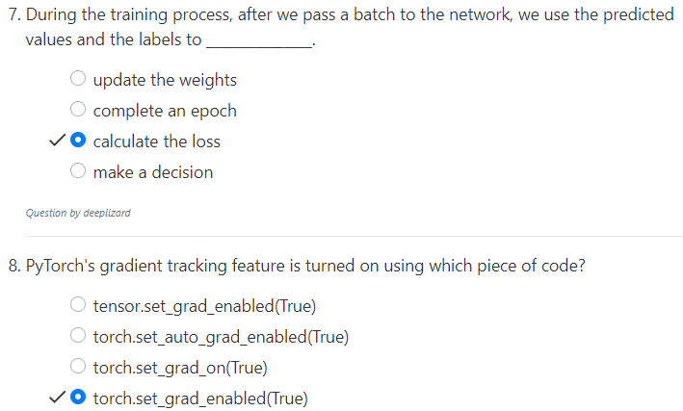
25.7 Quiz
https://www.youtube.com/watch?v=0VCOG8IeVf8&list=PLZbbT5o_s2xrfNyHZsM6ufI0iZENK9xgG&index=25
Quiz

Slide 28
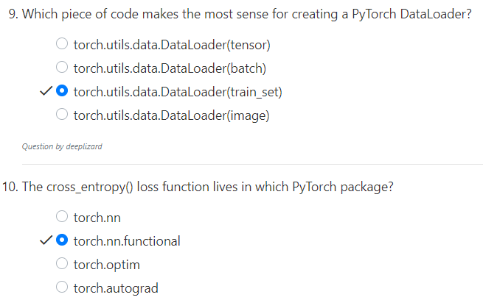
25.7 Quiz
https://www.youtube.com/watch?v=0VCOG8IeVf8&list=PLZbbT5o_s2xrfNyHZsM6ufI0iZENK9xgG&index=25
Quiz

Slide 29
End of Chapter

