Slide 1

31 Run Builder (Part 3)
Peter H. Chen

Slide 2
31 Run Builder (Part 3)
https://www.youtube.com/watch?v=ycxulUVoNbk&list=PLZbbT5o_s2xrfNyHZsM6ufI0iZENK9xgG&index=30
Training Loop with Run Builder
We discuss how to use Run Builder class to generate multiple runs.

Slide 3
31.1 Using RunBuilder Class

Slide 4

31.1 Using RunBuilder Class
https://www.youtube.com/watch?v=ycxulUVoNbk&list=PLZbbT5o_s2xrfNyHZsM6ufI0iZENK9xgG&index=30
Using The RunBuilder Class
We discussed how to efficiently run the training process.
We will expand the hyperparameter experimentation.
We are going to build a class called RunBuilder.
Before we look at how to build the class, we import the required libraries.
We import OrderedDict and namedtuple from collections.
We import a function called product from itertools.
This product() function is the one we saw last time that computes a Cartesian product given multiple list inputs.

Slide 5
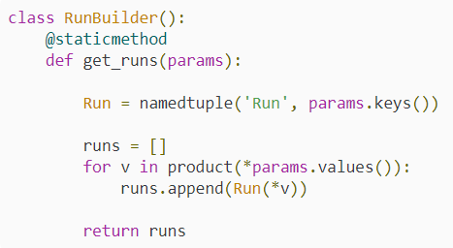
31.1 Using RunBuilder Class
https://www.youtube.com/watch?v=ycxulUVoNbk&list=PLZbbT5o_s2xrfNyHZsM6ufI0iZENK9xgG&index=30
Using The RunBuilder Class
Alright.
This is the RunBuilder class that will build sets of parameters that define our runs.
We will see how it works after we see how to use it.

Slide 6
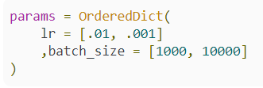
31.1 Using RunBuilder Class
https://www.youtube.com/watch?v=ycxulUVoNbk&list=PLZbbT5o_s2xrfNyHZsM6ufI0iZENK9xgG&index=30
Using The RunBuilder Class
The main thing to note about using this class is that it has a static method called get_runs().
This method will get the runs for us that it builds based on the parameters we pass in.
Note: Static method are like class method, are methods that are bound to a class rather than its object.
Let’s define some parameters now.
Here, we defined a set of parameters and values inside an dictionary.
We have a set of learning rates and a set of batch sizes we want to try out.
When we say try out, we mean that we want to do a training run for each learning rate and each batch size in the dictionary.

Slide 7
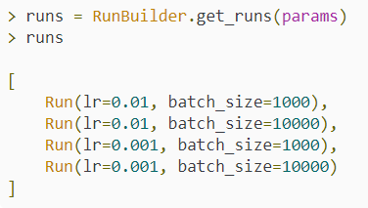
31.1 Using RunBuilder Class
https://www.youtube.com/watch?v=ycxulUVoNbk&list=PLZbbT5o_s2xrfNyHZsM6ufI0iZENK9xgG&index=30
Using The RunBuilder Class
To get these runs, we just call the get_runs() function of the RunBuilder class, passing in the parameters we’d like to use.

Slide 8

31.1 Using RunBuilder Class
https://www.youtube.com/watch?v=ycxulUVoNbk&list=PLZbbT5o_s2xrfNyHZsM6ufI0iZENK9xgG&index=30
Using The RunBuilder Class
Great, we can see that the RunBuilder class has built and returned a list of four runs.
Each of these runs has a learning rate and a batch size that defines the run.
We can access an individual run by indexing into the list like so:

Slide 9

31.1 Using RunBuilder Class
https://www.youtube.com/watch?v=ycxulUVoNbk&list=PLZbbT5o_s2xrfNyHZsM6ufI0iZENK9xgG&index=30
Using The RunBuilder Class
Notice the string representation of the run output.
This string representation was automatically generated for us by the Run tuple class, and this string can be used to uniquely identify the run if we want to write out run statistics to disk for TensorBoard or any other visualization program.
Additionally, because the run is object is a tuple with named attributes, we can access the values using dot notation like so:

Slide 10


31.1 Using RunBuilder Class
https://www.youtube.com/watch?v=ycxulUVoNbk&list=PLZbbT5o_s2xrfNyHZsM6ufI0iZENK9xgG&index=30
Using The RunBuilder Class
Finally, since the list of runs is a Python iterable, we can iterate over the runs cleanly like so:
Output:

Slide 11
31.1 Using RunBuilder Class
https://www.youtube.com/watch?v=ycxulUVoNbk&list=PLZbbT5o_s2xrfNyHZsM6ufI0iZENK9xgG&index=30
Using The RunBuilder Class
All we have to do to add additional values is to add them to the original parameter list, and if we want to add an additional type of parameter, all we have to do is add it.
The new parameter and its values will automatically become available to be consumed inside the run.
The string output for the run also updates as well.

Slide 12
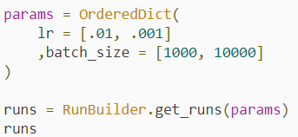
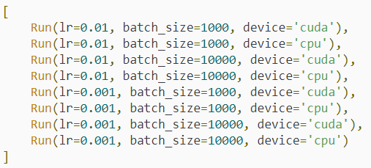
31.1 Using RunBuilder Class
https://www.youtube.com/watch?v=ycxulUVoNbk&list=PLZbbT5o_s2xrfNyHZsM6ufI0iZENK9xgG&index=30
Using The RunBuilder Class
Two parameters:
Output:

Slide 13
31.1 Using RunBuilder Class
https://www.youtube.com/watch?v=ycxulUVoNbk&list=PLZbbT5o_s2xrfNyHZsM6ufI0iZENK9xgG&index=30
Using The RunBuilder Class
This functionality will allow us to have greater control as we experiment with different values during training.
Let’s sees how to build this RunBuilder class.

Slide 14
31.2 Coding RunBuilder Class

Slide 15



31.2 Coding RunBuilder Class
https://www.youtube.com/watch?v=ycxulUVoNbk&list=PLZbbT5o_s2xrfNyHZsM6ufI0iZENK9xgG&index=30
Coding The RunBuilder Class
The first thing we need to have is a dictionary of parameters and values we’d like to try.
Next, we get a list of keys from the dictionary.
Then, we get a list of values from the dictionary..

Slide 16


31.2 Coding RunBuilder Class
https://www.youtube.com/watch?v=ycxulUVoNbk&list=PLZbbT5o_s2xrfNyHZsM6ufI0iZENK9xgG&index=30
Coding The RunBuilder Class
Once we have both of these, we just make sure we understand both of them by inspecting their output.
Once we do, we use these keys and values for what comes next. We’ll start with the keys.
This line creates a new tuple subclass called Run that has named fields.
This Run class is used to encapsulate the data for each of our runs.
The field names of this class are set by the list of names passed to the constructor.
First, we are passing the class name. Then, we are passing the field names, and in our case, we are passing the list of keys from our dictionary.
Now that we have a class for our runs, we are ready to create some.

Slide 17
31.2 Coding RunBuilder Class
https://www.youtube.com/watch?v=ycxulUVoNbk&list=PLZbbT5o_s2xrfNyHZsM6ufI0iZENK9xgG&index=30
Coding The RunBuilder Class
First we create a list called runs. Then, we use the product() function from itertools to create the Cartesian product using the values for each parameter inside our dictionary.
This gives us a set of ordered pairs that define our runs. We iterate over these adding a run to the runs list for each one.
For each value in the Cartesian product we have an ordered tuples.
The Cartesian product gives us every ordered pair so we have all possible order pairs of learning rates and batch sizes.
When we pass the tuple to the Run constructor, we use the * operator to tell the constructor to accept the tuple values as arguments opposed to the tuple itself.

Slide 18
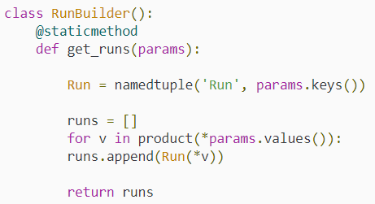
31.2 Coding RunBuilder Class
https://www.youtube.com/watch?v=ycxulUVoNbk&list=PLZbbT5o_s2xrfNyHZsM6ufI0iZENK9xgG&index=30
Coding The RunBuilder Class
Finally, we wrap this code in our RunBuilder class.

Slide 19
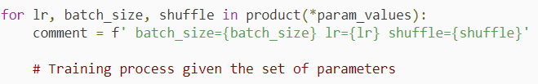
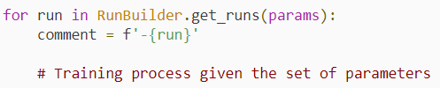
31.2 Coding RunBuilder Class
https://www.youtube.com/watch?v=ycxulUVoNbk&list=PLZbbT5o_s2xrfNyHZsM6ufI0iZENK9xgG&index=30
Coding The RunBuilder Class
Since the get_runs() method is static, we can call it using the class itself. We don’t need an instance of the class.
Now, this allow us to update our training code in the following way:
Before:
After:

Slide 20
31.3 Cartesian Product

Slide 21

31.3 Cartesian Product
https://www.youtube.com/watch?v=ycxulUVoNbk&list=PLZbbT5o_s2xrfNyHZsM6ufI0iZENK9xgG&index=30
Cartesian Product
Do you know about the Cartesian product? Like many things in life, the Cartesian product is a mathematical concept.
The Cartesian product is a binary operation.
The operation takes two sets as arguments and returns a third set as an output.
Let's look at a general mathematical example.
Suppose that X is a set.
Suppose that Y is a set.
The Cartesian product between two sets is denoted as, X×Y.
The Cartesian product between the sets X and the set Y is defined to be the set of all ordered pairs (x,y), such that, x ∈ X and y ∈ Y.
This can be expressed in the following way:

Slide 22
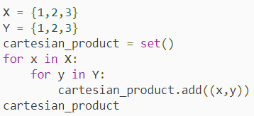
31.3 Cartesian Product
https://www.youtube.com/watch?v=ycxulUVoNbk&list=PLZbbT5o_s2xrfNyHZsM6ufI0iZENK9xgG&index=30
Cartesian Product
Notice how powerful the mathematical code is. It covers all cases. Maybe you noticed that this can be achieved using for-loop iteration like so:
Output:

Slide 23
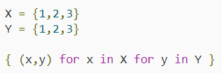
31.3 Cartesian Product
https://www.youtube.com/watch?v=ycxulUVoNbk&list=PLZbbT5o_s2xrfNyHZsM6ufI0iZENK9xgG&index=30
Cartesian Product
To compute X×Y we do the following:
For every x ∈ X and for every y ∈ Y, we collect the corresponding pair (x,y).
The resulting collection gives us the set of all ordered pairs little (x,y), such that, x ∈ X and y ∈ Y.
Here is a concrete example expressed in Python:
Output:

Slide 24
31.4 Summary

Slide 25
31.4 Summary
https://www.youtube.com/watch?v=ycxulUVoNbk&list=PLZbbT5o_s2xrfNyHZsM6ufI0iZENK9xgG&index=30
Summary
We discuss how to use Run Builder class to generate multiple runs.

Slide 26
31.5 Quiz

Slide 27
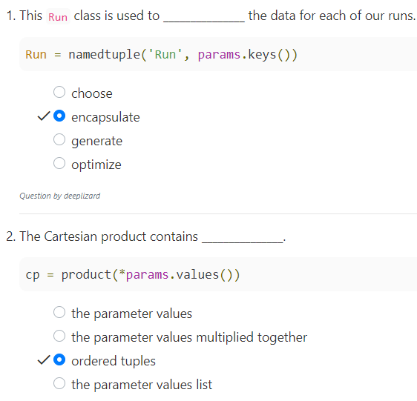
31.5 Quiz
https://www.youtube.com/watch?v=ycxulUVoNbk&list=PLZbbT5o_s2xrfNyHZsM6ufI0iZENK9xgG&index=30
Quiz

Slide 28
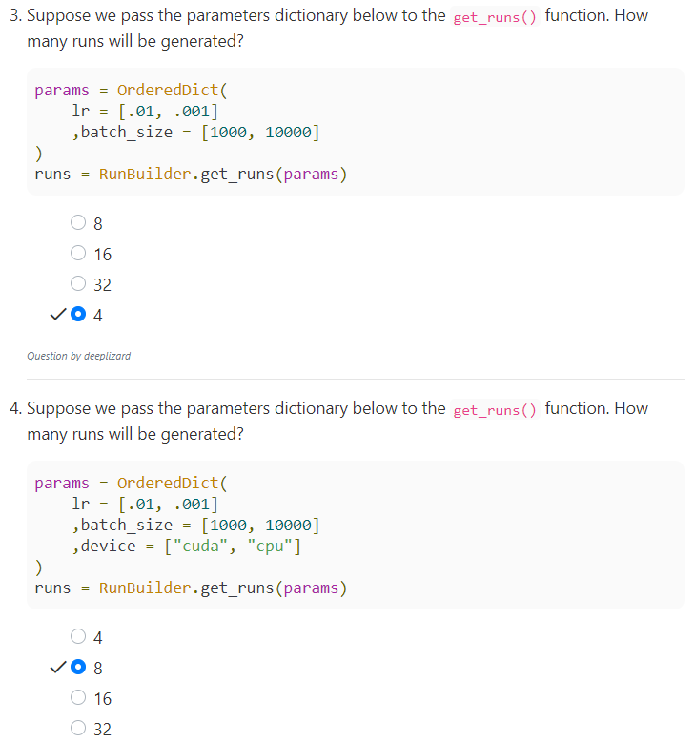
31.5 Quiz
https://www.youtube.com/watch?v=ycxulUVoNbk&list=PLZbbT5o_s2xrfNyHZsM6ufI0iZENK9xgG&index=30
Quiz

Slide 29
End of Chapter

