Slide 1

27 Confusion Matrix (Part 2)
Peter H. Chen

Slide 2
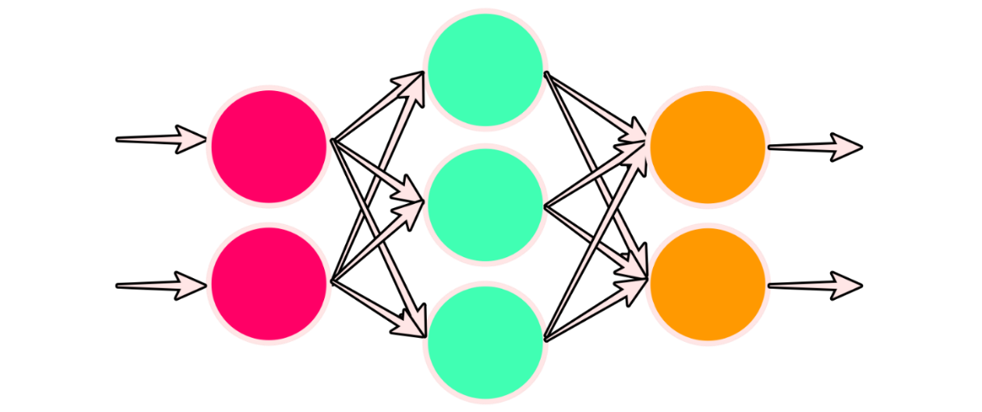
27 Confusion Matrix (Part 2)
https://www.youtube.com/watch?v=0LhiS6yu2qQ&list=PLZbbT5o_s2xrfNyHZsM6ufI0iZENK9xgG&index=27
Create a Confusion Matrix with PyTorch
In this discussion, we're going to build some functions that will allow us to get a prediction tensor for every sample in our training set.
Then, we'll see how we can take this prediction tensor, along with the labels for each sample, to create a confusion matrix.
This confusion matrix will allow us to see which categories our network is confusing with one another.

Slide 3
27 Confusion Matrix (Part 2)
https://www.youtube.com/watch?v=0LhiS6yu2qQ&list=PLZbbT5o_s2xrfNyHZsM6ufI0iZENK9xgG&index=27
Create a Confusion Matrix with PyTorch
High-Level Overview Of Our Process
Where are we now?
Prepare the data
Build the model
Train the model
Analyze the model's results
Build, plot, and interpret a confusion matrix

Slide 4


27 Confusion Matrix (Part 2)
https://www.youtube.com/watch?v=0LhiS6yu2qQ&list=PLZbbT5o_s2xrfNyHZsM6ufI0iZENK9xgG&index=27
Confusion Matrix Requirement
To create a confusion matrix for our entire dataset, we need to have a prediction tensor with a single dimension that has the same length as our training set.
This prediction tensor will contain ten predictions for each sample from our training set (one for each category of clothing).
After we have obtained this tensor, we can use the labels tensor to generate a confusion matrix.

Slide 5
27 Confusion Matrix (Part 2)
https://www.youtube.com/watch?v=0LhiS6yu2qQ&list=PLZbbT5o_s2xrfNyHZsM6ufI0iZENK9xgG&index=27
Confusion Matrix Requirement
A confusion matrix will show us where the model is getting confused.
To be more specific, the confusion matrix will show us which categories the model is predicting correctly and which categories the model is predicting incorrectly.
For the incorrect predictions, we will be able to see which category the model predicted, and this will show us which categories are confusing the model.

Slide 6
27 Confusion Matrix (Part 2)
https://www.youtube.com/watch?v=0LhiS6yu2qQ&list=PLZbbT5o_s2xrfNyHZsM6ufI0iZENK9xgG&index=27
Get Prediction for the Entire Training Set
To get the predictions for all the training set samples, we need to pass all of the samples forward through the network.
To do this, it is possible to create a DataLoader that has batch_size=1.
This will pass a single batch to the network at once and will give us the desired prediction tensor for all the training set samples.
However, depending on the computing resources and the size of the training set if we were training on a different data set, we need a way to prediction on smaller batches and collect the results.
To collect the results, we'll use the torch.cat() function to concatenate the output tensors together to obtain our single prediction tensor.
Let's build a function to do this.

Slide 7
27.1 Predict with Gradient Computation

Slide 8
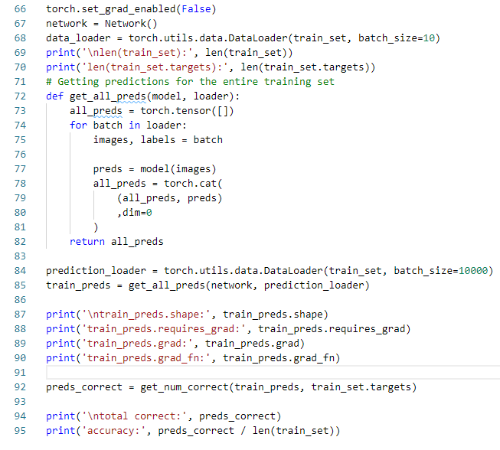
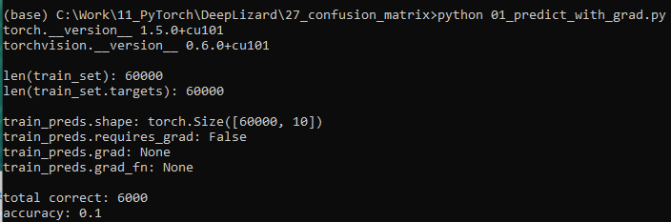
27.2 Predict with Gradient Computation
https://www.youtube.com/watch?v=0LhiS6yu2qQ&list=PLZbbT5o_s2xrfNyHZsM6ufI0iZENK9xgG&index=27
Prediction with Gradient Computation
With Gradient Computation consumes more memories than without Gradient Computation.

Slide 9
27.2 Predict without Gradient Computation

Slide 10
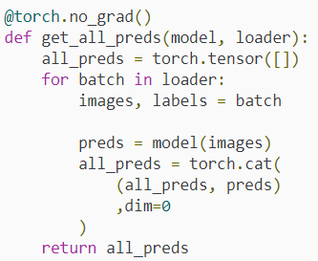
27.2 Predict without Gradient Computation
https://www.youtube.com/watch?v=0LhiS6yu2qQ&list=PLZbbT5o_s2xrfNyHZsM6ufI0iZENK9xgG&index=27
Build a Function to Predict All Samples
We'll create a function called get_all_preds(), and we'll pass a model and a data loader.
The model will be used to obtain the predictions, and the data loader will be used to provide the batches from the training set.
All the function needs to do is iterate over the data loader passing the batches to the model and concatenating the results of each batch to a prediction tensor that will returned to the caller.

Slide 11
27.2 Predict without Gradient Computation
https://www.youtube.com/watch?v=0LhiS6yu2qQ&list=PLZbbT5o_s2xrfNyHZsM6ufI0iZENK9xgG&index=27
Build a Function to Predict All Samples
The implantation of this function creates an empty tensor, all_preds to hold the output predictions.
Then, it iterates over the batches coming from the data loader, and concatenates the output predictions with the all_preds tensor.
Finally, all the predictions, all_preds, is returned to the caller.
Note at the top, we have annotated the function using the @torch.no_grad() PyTorch decoration.
The annotated function @torch.no_grad() is used to PyTord interpreter to execute without gradient tracking, i.e., omit gradient tracking.
The gradient tracking consumes memory, and during inference (getting predictions while not training) there is no need to keep track of the computational graph.
The decoration is used to turn off the gradient tracking feature while executing specific functions.

Slide 12
27.2 Predict without Gradient Computation
https://www.youtube.com/watch?v=0LhiS6yu2qQ&list=PLZbbT5o_s2xrfNyHZsM6ufI0iZENK9xgG&index=27
Locally Disabling PyTorch Gradient Tracking
We are ready now to make the call to obtain the predictions for the training set.
All we need to do is create a data loader with a reasonable batch size, and pass the model and data loader to the get_all_preds() function.
In a previous discussion, we saw how use turned off PyTorch's gradient tracking feature when it was not needed, and we turned it back on when we started the training process.
We specifically need the gradient calculation feature anytime we are going to calculate gradients using the backward() function.
Otherwise, it is a good idea to turn it off because having it off will reduce memory consumption for computations, e.g., when we are using networks for predicting (inference).

Slide 13
27.2 Predict without Gradient Computation
https://www.youtube.com/watch?v=0LhiS6yu2qQ&list=PLZbbT5o_s2xrfNyHZsM6ufI0iZENK9xgG&index=27
Locally Disabling PyTorch Gradient Tracking
We can disable gradient computations for specific or local spots in our code, e.g., like what we just saw with the annotated function.
There is another way to turn off gradient computation as below example.
We can use Python's with context manger keyword to specify that a specify block of code should exclude gradient computations.
with torch.no_grad():
prediction_loader = torch.utils.data.DataLoader(train_set, batch_size=10000)
train_preds = get_all_preds(network, prediction_loader)
Both decorator (@no_grade) and “with torch.no_grade()” are valid to turn off the gradient computation.

Slide 14
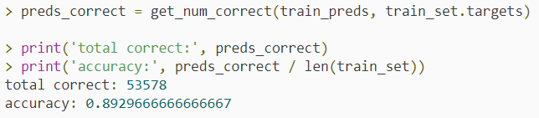
27.2 Predict without Gradient Computation
https://www.youtube.com/watch?v=0LhiS6yu2qQ&list=PLZbbT5o_s2xrfNyHZsM6ufI0iZENK9xgG&index=27
Use the Prediction Tensor
Now, that we have the prediction tensor, we can pass it to the get_num_correct() function that we created in a previous episode, along with the training set labels, to get the total number of correct predictions.
We can see the total number of correct predictions and print the accuracy by dividing by the number of samples in the training set.

Slide 15
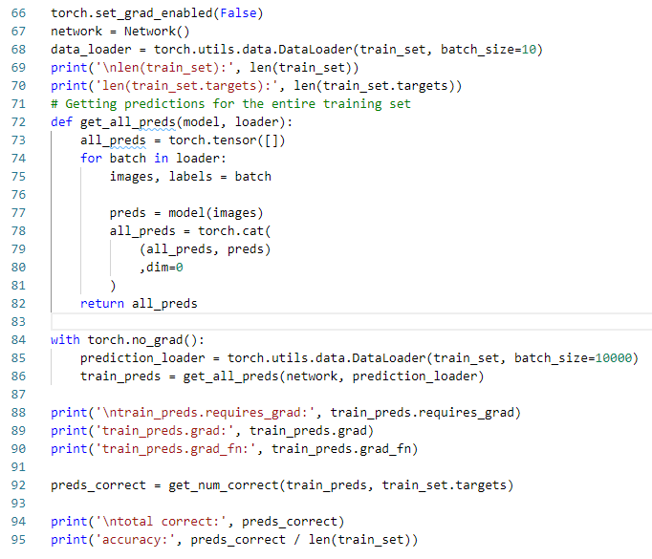
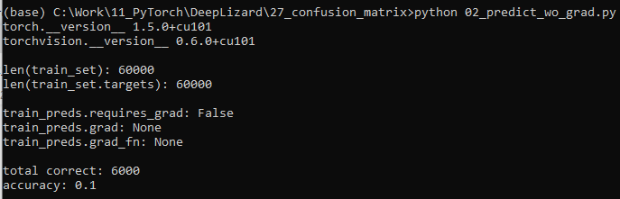
27.2 Predict without Gradient Computation
https://www.youtube.com/watch?v=0LhiS6yu2qQ&list=PLZbbT5o_s2xrfNyHZsM6ufI0iZENK9xgG&index=27
Use the Prediction Tensor
Now, that we have the prediction tensor, we can pass it to the get_num_correct() function that we created in a previous episode, along with the training set labels, to get the total number of correct predictions.

Slide 16
27.3 Build Confusion Matrix

Slide 17
27.3 Build Confusion Matrix
https://www.youtube.com/watch?v=0LhiS6yu2qQ&list=PLZbbT5o_s2xrfNyHZsM6ufI0iZENK9xgG&index=27
Build Confusion Matrix
Now, if we compare the two tensors element-wise, we can see if the predicted label matches the target.
Additionally, if we are counting the number of predicted labels vs the target labels, the values inside the two tensors act as coordinates for our matrix.
Let's stack these two tensors along the second dimension so we can have 60,000 ordered pairs.

Slide 18
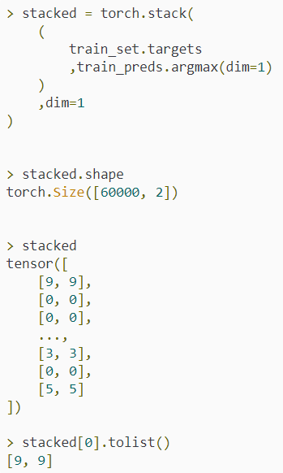
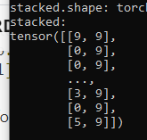
27.3 Build Confusion Matrix
https://www.youtube.com/watch?v=0LhiS6yu2qQ&list=PLZbbT5o_s2xrfNyHZsM6ufI0iZENK9xgG&index=27
Build Confusion Matrix
Our task in building the confusion matrix is to count the number of predicted values against the true values (targets).
This will create a matrix that acts as a heat map telling us where the predicted values fall relative to the true values.
To do this, we need to have the targets tensor and the predicted label from the train_preds tensor.

Slide 19
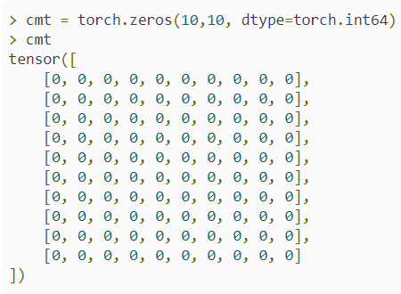
27.3 Build Confusion Matrix
https://www.youtube.com/watch?v=0LhiS6yu2qQ&list=PLZbbT5o_s2xrfNyHZsM6ufI0iZENK9xgG&index=27
Build Confusion Matrix
Now, we can iterate over these pairs and count the number of occurrences at each position in the matrix.
Let's create the matrix.
Since we have ten prediction categories, we'll have a ten by ten matrix.
Check here to learn about the stack() function.

Slide 20

27.3 Build Confusion Matrix
https://www.youtube.com/watch?v=0LhiS6yu2qQ&list=PLZbbT5o_s2xrfNyHZsM6ufI0iZENK9xgG&index=27
Build Confusion Matrix
Now, we'll iterate over the prediction-target pairs and add one to the value inside the matrix each time the particular position occurs.

Slide 21
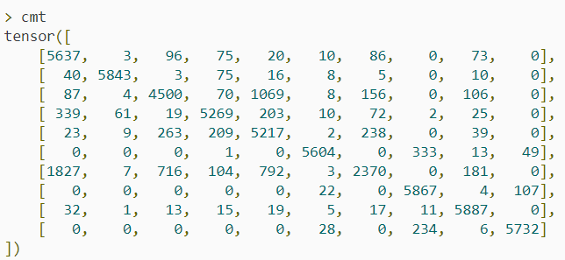
27.3 Build Confusion Matrix
https://www.youtube.com/watch?v=0LhiS6yu2qQ&list=PLZbbT5o_s2xrfNyHZsM6ufI0iZENK9xgG&index=27
Build Confusion Matrix
This gives us the following confusion matrix tensor.
Note that the example below will have different values because these two examples were created at different times.

Slide 22
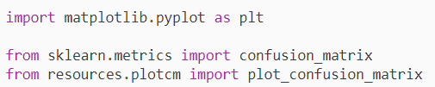
27.3 Build Confusion Matrix
https://www.youtube.com/watch?v=0LhiS6yu2qQ&list=PLZbbT5o_s2xrfNyHZsM6ufI0iZENK9xgG&index=27
Plot Confusion Matrix
To generate the actual confusion matrix as a numpy.ndarray, we use the confusion_matrix() function from the sklearn.metrics library.
Let's get this imported along with our other needed imports.
For the last import, note that plotcm is a file, plotcm.py that lives in a folder called resources in the current directory.
Inside the plotcm.py file, there is a function called plot_confusion_matrix() that we will call.
You'll need to implement this on your system.
We'll look at how to do this in a minute. First, let's generate the confusion matrix.

Slide 23
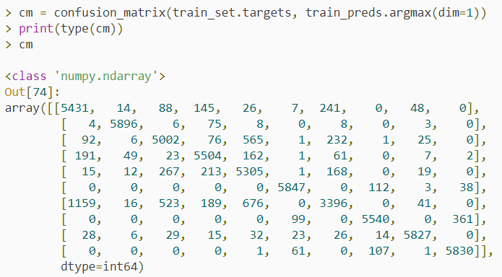
27.3 Build Confusion Matrix
https://www.youtube.com/watch?v=0LhiS6yu2qQ&list=PLZbbT5o_s2xrfNyHZsM6ufI0iZENK9xgG&index=27
Plot Confusion Matrix
We can generate the confusion matrix like so:

Slide 24
27.3 Build Confusion Matrix
https://www.youtube.com/watch?v=0LhiS6yu2qQ&list=PLZbbT5o_s2xrfNyHZsM6ufI0iZENK9xgG&index=27
Plot Confusion Matrix
PyTorch tensors are array-like Python objects, so we can pass them directly to the confusion_matrix() function.
We pass the training set labels tensor (targets) and the argmax with respect to the first dimension of the train_preds tensor, and this gives us the confusion matrix data structure.
To actually plot the confusion matrix, we need some custom code that I've put in a local file called plotcm.
The function is called plot_confusion_matrix().
The plotcm.py file need to contain the following contents and live inside the resources folder of the current directory.

Slide 25
27.3 Build Confusion Matrix
https://www.youtube.com/watch?v=0LhiS6yu2qQ&list=PLZbbT5o_s2xrfNyHZsM6ufI0iZENK9xgG&index=27
Plot Confusion Matrix
Note that you can also just copy this code into your notebook or whatever to avoid the import.

Slide 26
27.3 Build Confusion Matrix
https://www.youtube.com/watch?v=0LhiS6yu2qQ&list=PLZbbT5o_s2xrfNyHZsM6ufI0iZENK9xgG&index=27
import itertools
import numpy as np
import matplotlib.pyplot as plt
def plot_confusion_matrix(cm, classes, normalize=False, title='Confusion matrix', cmap=plt.cm.Blues):
if normalize:
cm = cm.astype('float') / cm.sum(axis=1)[:, np.newaxis]
print("Normalized confusion matrix")
else:
print('Confusion matrix, without normalization’)
print(cm)
plt.imshow(cm, interpolation='nearest', cmap=cmap)
plt.title(title)
plt.colorbar()
tick_marks = np.arange(len(classes))
plt.xticks(tick_marks, classes, rotation=45)
plt.yticks(tick_marks, classes)
fmt = '.2f' if normalize else 'd’
thresh = cm.max() / 2.
for i, j in itertools.product(range(cm.shape[0]), range(cm.shape[1])):
plt.text(j, i, format(cm[i, j], fmt), horizontalalignment="center", color="white" if cm[i, j] > thresh else "black")
plt.tight_layout()
plt.ylabel('True label’)
plt.xlabel('Predicted label')
plotcm.py

Slide 27

27.3 Build Confusion Matrix
https://www.youtube.com/watch?v=0LhiS6yu2qQ&list=PLZbbT5o_s2xrfNyHZsM6ufI0iZENK9xgG&index=27
For importing, we do it like this:

Slide 28
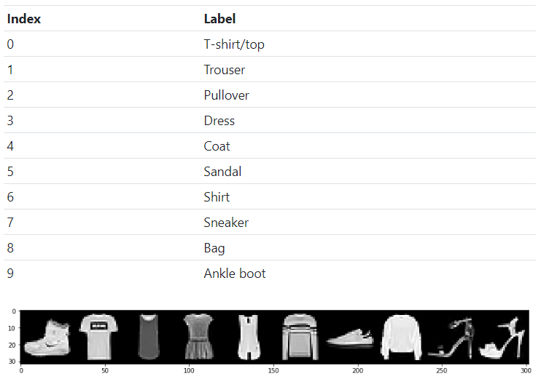
27.3 Build Confusion Matrix
https://www.youtube.com/watch?v=0LhiS6yu2qQ&list=PLZbbT5o_s2xrfNyHZsM6ufI0iZENK9xgG&index=27
We are ready to plot the confusion matrix, but first we need to create a list of prediction class names to pass to the plot_confusion_matrix() function.
Our prediction classes and their corresponding indexes are given by the table below:

Slide 29
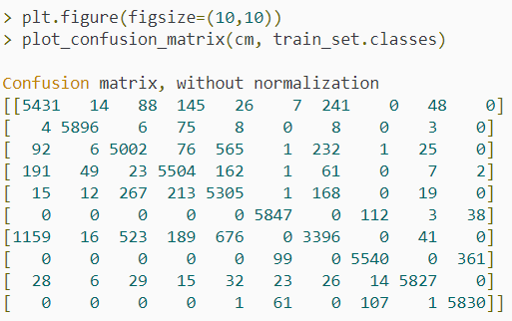
27.3 Build Confusion Matrix
https://www.youtube.com/watch?v=0LhiS6yu2qQ&list=PLZbbT5o_s2xrfNyHZsM6ufI0iZENK9xgG&index=27
This allows us to make the call to plot the matrix:

Slide 30
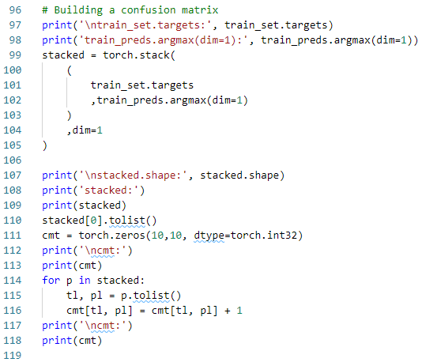
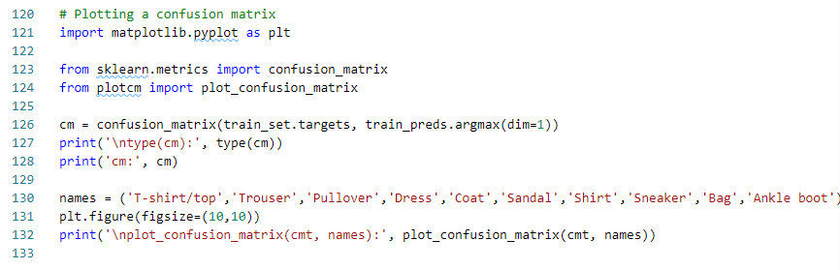
27.3 Build Confusion Matrix
https://www.youtube.com/watch?v=0LhiS6yu2qQ&list=PLZbbT5o_s2xrfNyHZsM6ufI0iZENK9xgG&index=27
Code:

Slide 31
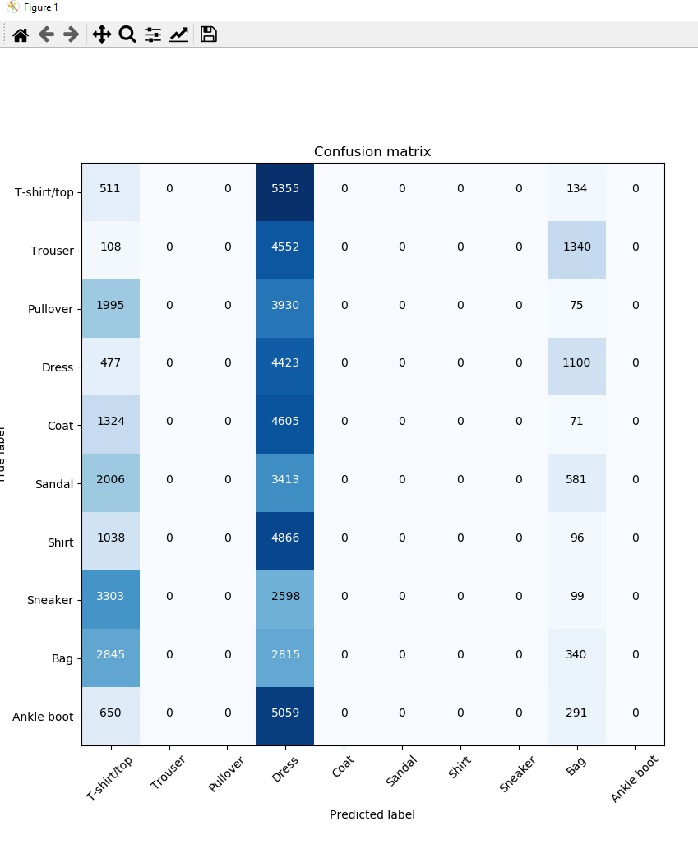
27.3 Build Confusion Matrix
https://www.youtube.com/watch?v=0LhiS6yu2qQ&list=PLZbbT5o_s2xrfNyHZsM6ufI0iZENK9xgG&index=27
Plot the matrix:

Slide 32
27.3 Build Confusion Matrix
https://www.youtube.com/watch?v=0LhiS6yu2qQ&list=PLZbbT5o_s2xrfNyHZsM6ufI0iZENK9xgG&index=27
Interpreting The Confusion Matrix
The confusion matrix has three axes:
Prediction label (class)
True label
Heat map value (color)
The prediction label and true labels show us which prediction class we are dealing with. The matrix diagonal represents locations in the matrix where the prediction and the truth are the same, so this is where we want the heat map to be darker.
Any values that are not on the diagonal are incorrect predictions because the prediction and the true label don't match. To read the plot, we can use these steps:
Choose a prediction label on the horizontal axis.
Check the diagonal location for this label to see the total number correct.
Check the other non-diagonal locations to see where the network is confused.

Slide 33
27.3 Build Confusion Matrix
https://www.youtube.com/watch?v=0LhiS6yu2qQ&list=PLZbbT5o_s2xrfNyHZsM6ufI0iZENK9xgG&index=27
Interpreting The Confusion Matrix
For example, the network is confusing a T-shirt/top with a shirt, but is not confusing the T-shirt/top with things like:
Ankle boot
Sneaker
Sandal
If we think about it, this makes pretty good sense. As our model learns, we will see the numbers that lie outside the diagonal become smaller and smaller.

Slide 34
27.4 Summary

Slide 35
27.4 Summary
https://www.youtube.com/watch?v=0LhiS6yu2qQ&list=PLZbbT5o_s2xrfNyHZsM6ufI0iZENK9xgG&index=27
Summary
At this point in the series, we have completed quite a lot of work on building and training a CNN in PyTorch.

Slide 36
27.5 Quiz

Slide 37
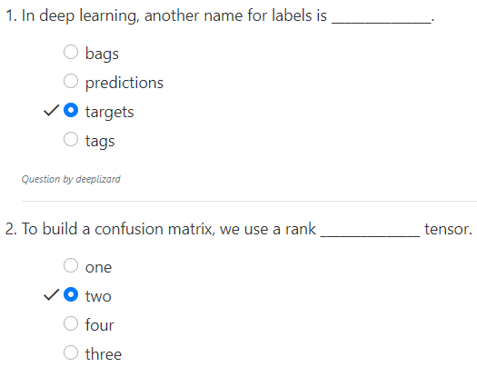
27.5 Quiz
https://www.youtube.com/watch?v=0LhiS6yu2qQ&list=PLZbbT5o_s2xrfNyHZsM6ufI0iZENK9xgG&index=27
Quiz

Slide 38
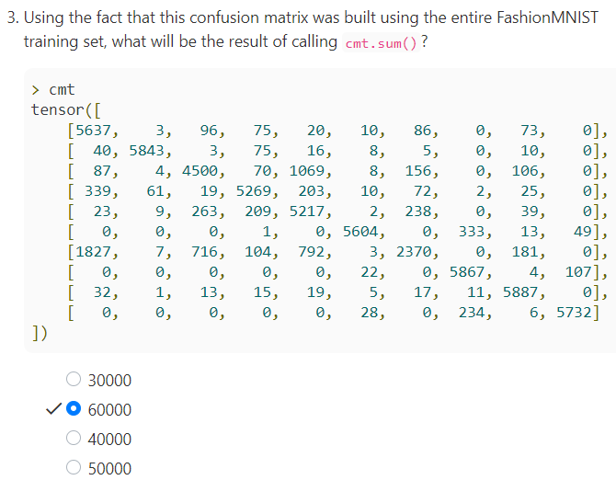
27.5 Quiz
https://www.youtube.com/watch?v=0LhiS6yu2qQ&list=PLZbbT5o_s2xrfNyHZsM6ufI0iZENK9xgG&index=27
Quiz

Slide 39
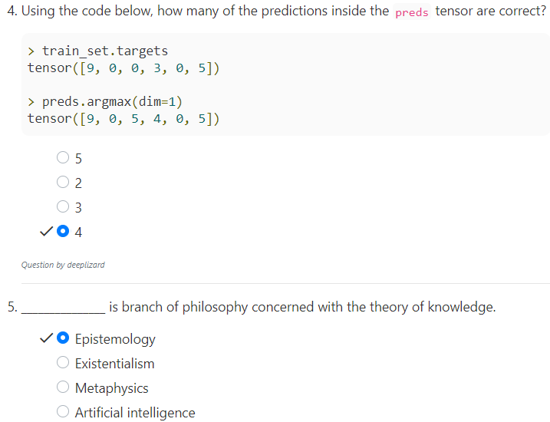
27.5 Quiz
https://www.youtube.com/watch?v=0LhiS6yu2qQ&list=PLZbbT5o_s2xrfNyHZsM6ufI0iZENK9xgG&index=27
Quiz
[9,0,0,30,5]
[9,0,5,4,0,5]
[c,c,i,i,c,c]
c: correct
i: incorrect
Quiz
Greek: “Epistem” means know.

Slide 40
End of Chapter

