Slide 1

8 Create Tensor
Peter H. Chen

Slide 2
8 Create Tensor
https://www.youtube.com/watch?v=jexkKugTg04&list=PLZbbT5o_s2xrfNyHZsM6ufI0iZENK9xgG&index=8
Create Tensor
Tensors are instances of the tensor class which lives in the top level torch package.
We can create a torch tensor using the class constructor.
> import torch
> import numpy as np
> t = torch.Tensor ()
> type(t)
We get the output of this code.
Note that we checked the type of our tensor t and it is an instance of the torch tensor type torch class and also at the top, we import troch and import numpy.
Make sure we have those two imports.
In this case, we created a tensor using no data. We will create tensor using data.
We want to study the tensor attributes.
We already seen tensor attributes, such as, rank, axes, and shape. Those are fundamentals of tensor.

Slide 3
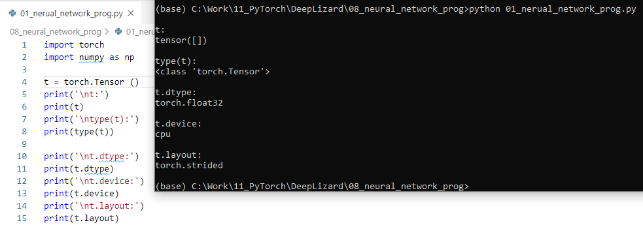
8 Create Tensor
https://www.youtube.com/watch?v=jexkKugTg04&list=PLZbbT5o_s2xrfNyHZsM6ufI0iZENK9xgG&index=8
The attributes we will see of tensor are: dtype, device, and layout
> print (t.dtype)
>> torch.float32
> print(t.device)
>> cpu
> print(t.layout)
>> torch.strided

Slide 4
8 Create Tensor
https://www.youtube.com/watch?v=jexkKugTg04&list=PLZbbT5o_s2xrfNyHZsM6ufI0iZENK9xgG&index=8
The attributes we will see of tensor are: dtype, device, and layout
> device = torch.device (‘duda:0’)
> print (device)

Slide 5
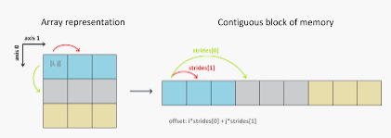
8 Create Tensor
https://www.youtube.com/watch?v=jexkKugTg04&list=PLZbbT5o_s2xrfNyHZsM6ufI0iZENK9xgG&index=8
What is Stride Array?
In computer programming, the stride of an array (also referred to as increment, pitch, or step size) is the number of locations in memory between beginnings of successive array elements, measured in bytes or in units of the size of the array's elements. Such arrays are sometimes said to have unit stride.

Slide 6
8.1 Create Tensor with Data

Slide 7
8.1 Create Tensor with Data
https://www.youtube.com/watch?v=jexkKugTg04&list=PLZbbT5o_s2xrfNyHZsM6ufI0iZENK9xgG&index=8
Tensor Attributes
Neural Network programmers need to be aware of the following:
Tensor contain data of a uniform type (dtype)
Tensor computations between tensors depend on the dtype and the device.
Common ways of creating tensors using data in PyTorch.
Create Tensors from Data
These are four primary ways of creating tensor objects (instance of torch.Tensor class) with data (array-like) in PyTroch:
torch.Tensor (data)
torch.tensor(data)
torch.as_tensor (data)
torch.from_numpy (data)

Slide 8
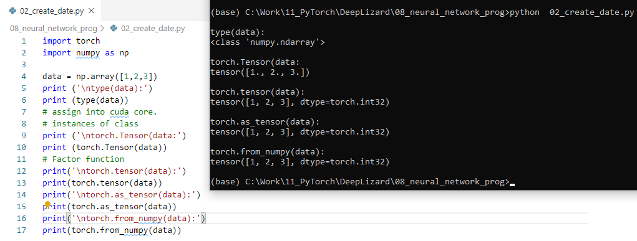
8.1 Create Tensor with Data
https://www.youtube.com/watch?v=jexkKugTg04&list=PLZbbT5o_s2xrfNyHZsM6ufI0iZENK9xgG&index=8
Create tensor with data

Slide 9
8.2 Create Tensor without Data

Slide 10
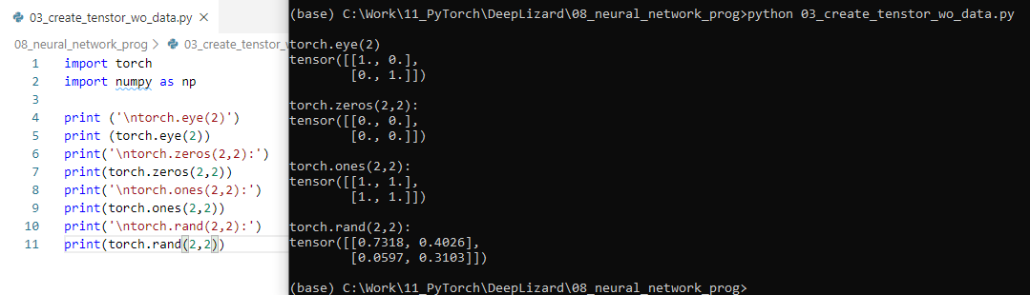
8.2 Create Tensor without Data
https://www.youtube.com/watch?v=jexkKugTg04&list=PLZbbT5o_s2xrfNyHZsM6ufI0iZENK9xgG&index=8
Create tensor without data

Slide 11
8.3 Quiz

Slide 12
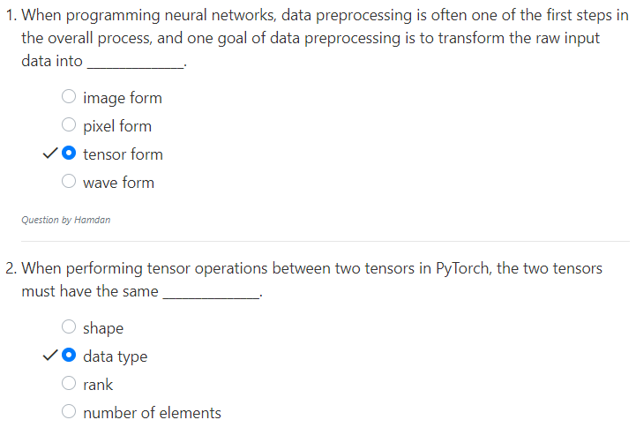
8.3 Quiz
https://www.youtube.com/watch?v=jexkKugTg04&list=PLZbbT5o_s2xrfNyHZsM6ufI0iZENK9xgG&index=8
Quiz

Slide 13
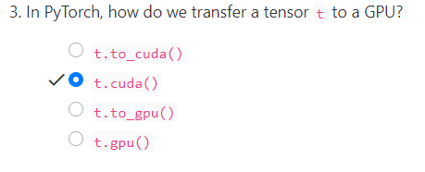


8.3 Quiz
https://www.youtube.com/watch?v=jexkKugTg04&list=PLZbbT5o_s2xrfNyHZsM6ufI0iZENK9xgG&index=8
Quiz
RuntimeError: Expected Object of type torch.LongTensor but found torch.cuda. LongTensor for argument #3 ‘Other’

Slide 14
End of Chapter

