Slide 1

11 Flatten Operation: Batch Process
Peter H. Chen

Slide 2
11 Flatten Operation: Batch Process
https://www.youtube.com/watch?v=mFAIBMbACMA&list=PLZbbT5o_s2xrfNyHZsM6ufI0iZENK9xgG&index=11
CNN Flatten Operation: Tensor Batch Process
We visualize a tensor flatten operation for grayscale image.
We can flatten specific axes within a tensor.
This type of selective flatten is often required because our tensors flow through our network as batches.

Slide 3
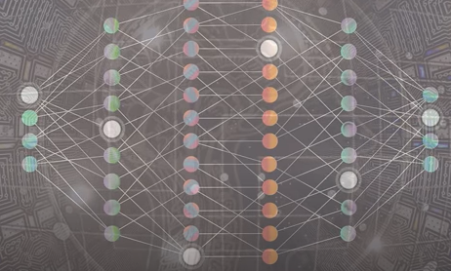
11 Flatten Operation: Batch Process
https://www.youtube.com/watch?v=mFAIBMbACMA&list=PLZbbT5o_s2xrfNyHZsM6ufI0iZENK9xgG&index=11
CNN Flatten Operation: Tensor Batch Process
The Tensor Flatten Operation is a common operation inside convolutional neural network.
The Convolutional Layer Outputs that are passed to fully connected layers must be flatten out before the fully connected layer will accept them as input.

Slide 4

11 Flatten Operation: Batch Process
https://www.youtube.com/watch?v=mFAIBMbACMA&list=PLZbbT5o_s2xrfNyHZsM6ufI0iZENK9xgG&index=11
CNN Flatten Operation: Tensor Batch Process
We discussed tensor shape operation, reshape operation, and flatten operation.
The flatten operation is a specific type of reshape operation where all the axes are smushed or squashed together.
If we want a flatten tensor, we need to have at least two axes.
For example, the handwritten image of an eight from the in the dataset.
This image has two distinct dimensions, height and width, are 18 by 18, respectively.

Slide 5
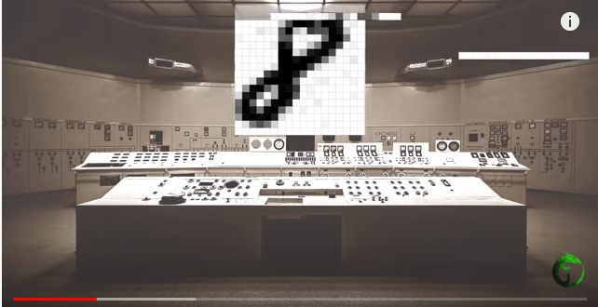
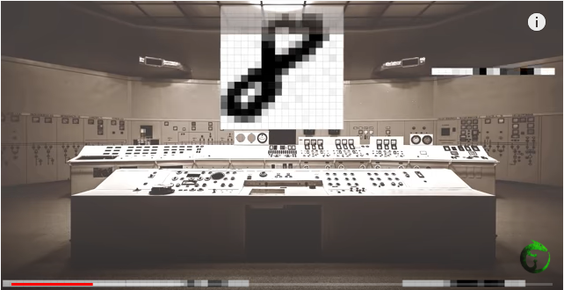
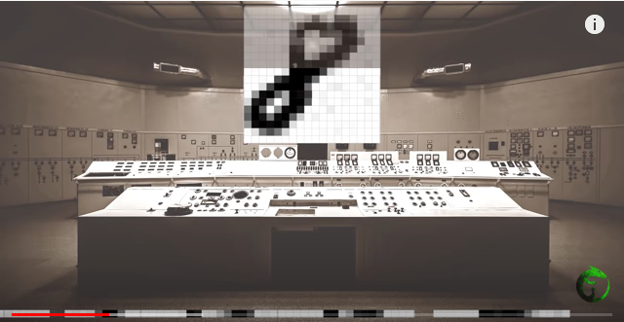
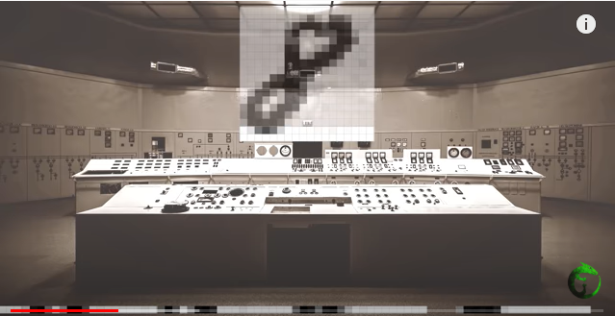
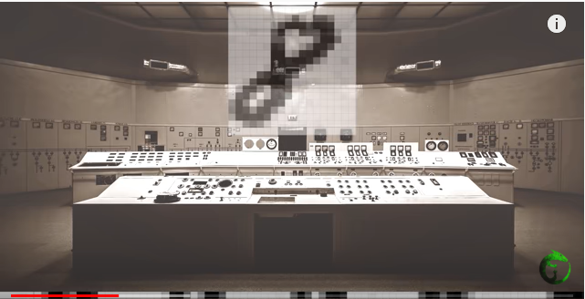
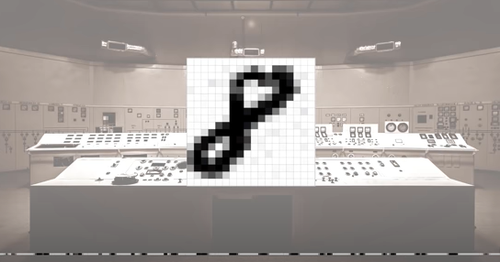
11 Flatten Operation: Batch Process
https://www.youtube.com/watch?v=mFAIBMbACMA&list=PLZbbT5o_s2xrfNyHZsM6ufI0iZENK9xgG&index=11
CNN Flatten Operation: Tensor Batch Process
These dimensions allow us to know that this particular image has been cropped (timed) because the eminence (significance) database contains 18 by 18 images.
These two axes of height and width are flattened out into a single axis of length 324 (= 18x18).

Slide 6
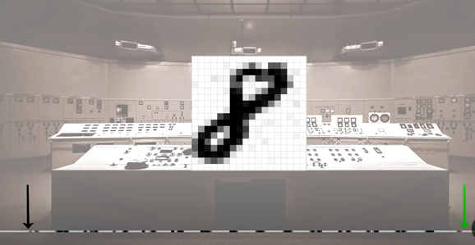

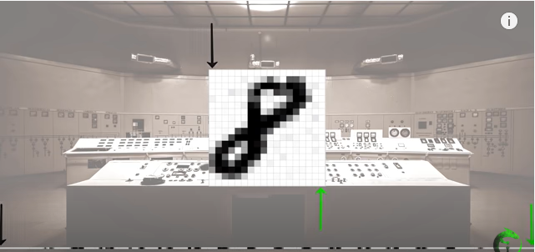
11 Flatten Operation: Batch Process
https://www.youtube.com/watch?v=mFAIBMbACMA&list=PLZbbT5o_s2xrfNyHZsM6ufI0iZENK9xgG&index=11
CNN Flatten Operation: Tensor Batch Process
This is the flatten output with a single axis of image 324.
The black and green on the flatten edges corresponds to the black and green at the top and the bottom of the image.

Slide 7
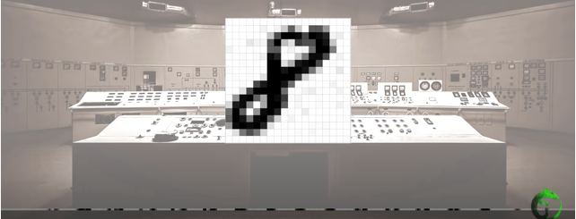
11 Flatten Operation: Batch Process
https://www.youtube.com/watch?v=mFAIBMbACMA&list=PLZbbT5o_s2xrfNyHZsM6ufI0iZENK9xgG&index=11
CNN Flatten Operation: Tensor Batch Process
Each node in the fully connected layer receives this flattened output as input.
In this particular example, we are flattening the entire image tensor.
What do we want to flatten specific axes within this tensor?
The flatten axis is required by CNN.

Slide 8
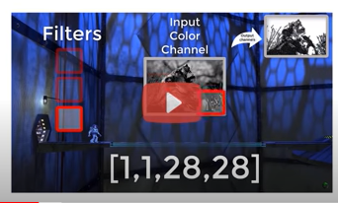
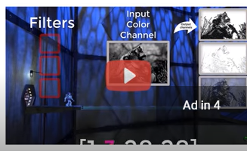
11 Flatten Operation: Batch Process
https://www.youtube.com/watch?v=mFAIBMbACMA&list=PLZbbT5o_s2xrfNyHZsM6ufI0iZENK9xgG&index=11
CNN Flatten Operation: Tensor Batch Process
We cannot just deal with a single tensor with single image.
We will deal with a tensor that contains multiple images.
In previous discussion, we discusses CNN.
There are three filter images [18x18] that convolve with a input batch grayscale image [1,1,28,28].
Typically, we have 4-axes [1,1,28,28]. One for the batch size, one for color channel, and one for height, and one for width.

Slide 9
11.1 Create Three Tensors

Slide 10
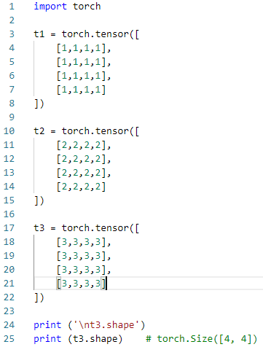
11.1 Create Three Tensors
https://www.youtube.com/watch?v=mFAIBMbACMA&list=PLZbbT5o_s2xrfNyHZsM6ufI0iZENK9xgG&index=11
CNN Flatten Operation: Tensor Batch Process
We construct a tensor to play around.
Suppose, we have the following three tensors.

Slide 11

11.1 Create Three Tensors
https://www.youtube.com/watch?v=mFAIBMbACMA&list=PLZbbT5o_s2xrfNyHZsM6ufI0iZENK9xgG&index=11
CNN Flatten Operation: Tensor Batch Process
Each tensor is [4, 4] and rank is 2 (2 dimensional with each dimension length is 4).
We have 3 tensors (images). Each tensor is 4 x 4 images.
We use them to create a batch that can be passed to a CNN.
Remember, a whole batch is represented using a single tensor.
We need to combine these three tensors into a single larger tensor that has three axes instead of two.
> t = torch.stack((t1,t2,t3))
> print (t.shape) # torch.Size([3, 4, 4])

Slide 12
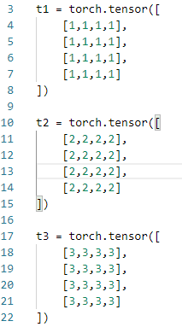

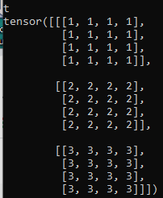
11.1 Create Three Tensors
https://www.youtube.com/watch?v=mFAIBMbACMA&list=PLZbbT5o_s2xrfNyHZsM6ufI0iZENK9xgG&index=11
CNN Flatten Operation: Tensor Batch Process
In this code, we use a stack function to concatenate the sequence of three tensors along a new axis.
Since we have three tensors along this new axis, we know the length of this new axis is three.

Slide 13
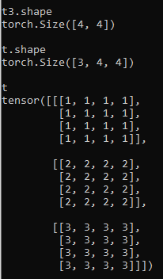
11.1 Create Three Tensors
https://www.youtube.com/watch?v=mFAIBMbACMA&list=PLZbbT5o_s2xrfNyHZsM6ufI0iZENK9xgG&index=11
CNN Flatten Operation: Tensor Batch Process
We can see the shape that we have three tensors.
Each tensor have height and width of 4.
The axis 3 represents the batch. The three tells us the batch size.
The axes of length four represent the height and width, respectively.

Slide 14
11.1 Create Three Tensors
https://www.youtube.com/watch?v=mFAIBMbACMA&list=PLZbbT5o_s2xrfNyHZsM6ufI0iZENK9xgG&index=11
CNN Flatten Operation: Tensor Batch Process
This is the output for this tensor representation of a batch looks like.
We have a rank three tensor that contains a batch of three 4x4 images, i.e., [3, 4, 4].
We need get this tensor into a form that a CNN expects, i.e., we need to add an axis for the color channel [Batch, Color, Height, Width] = [3, ?, 4, 4].

Slide 15
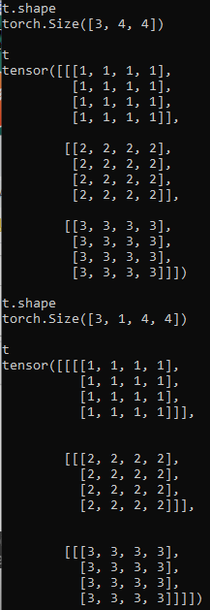
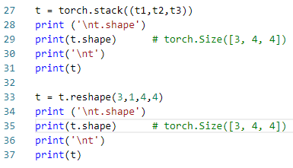
11.1 Create Three Tensors
https://www.youtube.com/watch?v=mFAIBMbACMA&list=PLZbbT5o_s2xrfNyHZsM6ufI0iZENK9xgG&index=11
CNN Flatten Operation: Tensor Batch Process
We have an implicit single color channel for each of these image tensors.
In practice, these would be grayscale images.
A CNN expect to see an explicit color channel axis.
We add channel by reshaping this tensor.
Note that how we specified an axis of length one right after the batch axis.
Then we follow by height and width 4x4.

Slide 16
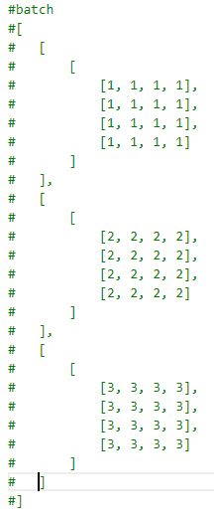
11.1 Create Three Tensors
https://www.youtube.com/watch?v=mFAIBMbACMA&list=PLZbbT5o_s2xrfNyHZsM6ufI0iZENK9xgG&index=11
CNN Flatten Operation: Tensor Batch Process
We reformat the output as follow:
The first axis has three elements.
Each element of the first axis represent an image.

Slide 17
11.1 Create Three Tensors
https://www.youtube.com/watch?v=mFAIBMbACMA&list=PLZbbT5o_s2xrfNyHZsM6ufI0iZENK9xgG&index=11
CNN Flatten Operation: Tensor Batch Process
For each image, we have a color channel axis which contain a single channel.

Slide 18
11.1 Create Three Tensors
https://www.youtube.com/watch?v=mFAIBMbACMA&list=PLZbbT5o_s2xrfNyHZsM6ufI0iZENK9xgG&index=11
CNN Flatten Operation: Tensor Batch Process
Within each channel, we have four arrays.

Slide 19
11.1 Create Three Tensors
https://www.youtube.com/watch?v=mFAIBMbACMA&list=PLZbbT5o_s2xrfNyHZsM6ufI0iZENK9xgG&index=11
CNN Flatten Operation: Tensor Batch Process
Within each array, we have four scalar components.

Slide 20
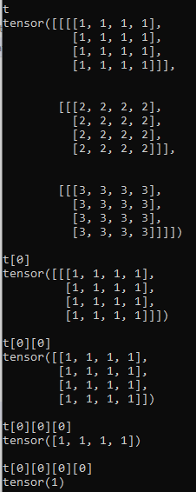
11.1 Create Three Tensors
https://www.youtube.com/watch?v=mFAIBMbACMA&list=PLZbbT5o_s2xrfNyHZsM6ufI0iZENK9xgG&index=11
CNN Flatten Operation: Tensor Batch Process
Examine the indexing of this tensor.
First image
> t[0]
First color channel in image
> t[0][0]
First row of pixels, first color channel of the image.
> t[0][0][0]
>> tensor ([1, 1, 1, 1])
We have the first pixel value, in the first row of the first color channel, of the firs timage.
> t[0][0][0][0]
>> tensor(1)

Slide 21
11.1 Create Three Tensors
https://www.youtube.com/watch?v=mFAIBMbACMA&list=PLZbbT5o_s2xrfNyHZsM6ufI0iZENK9xgG&index=11
CNN Flatten Operation: Tensor Batch Process
Let’s see how to flatten the images.
In this batch, the whole batch is a single tensor.
We passed this batch to the CNN.
We do not want to flat the whole thing.
We only want to flatten the image tensors within the batch tensor.

Slide 22
11.2 Check Flatten Tensor

Slide 23
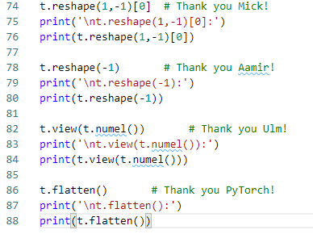
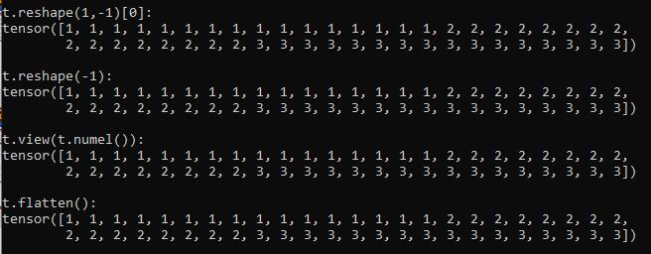
11.2 Check Flatten Tensor
https://www.youtube.com/watch?v=mFAIBMbACMA&list=PLZbbT5o_s2xrfNyHZsM6ufI0iZENK9xgG&index=11
CNN Flatten Operation: Tensor Batch Process
We start by flatten the whole thing first.
We can see there are four solutions from the last discussion.

Slide 24
11.2 Check Flatten Tensor
https://www.youtube.com/watch?v=mFAIBMbACMA&list=PLZbbT5o_s2xrfNyHZsM6ufI0iZENK9xgG&index=11
CNN Flatten Operation: Tensor Batch Process
We flatten all of the images together into a single axis.
We have one for the first images, and two for second image, and three for the third image.
This flatten will not work for CNN because all the images are flatten int one.
We need individual predictions for each image in the batch.
The solution here is to flatten each image while still maintaining the batch axis.
This means we want to flatten only part of the tensor.

Slide 25
11.3 Flatten Height and Width

Slide 26
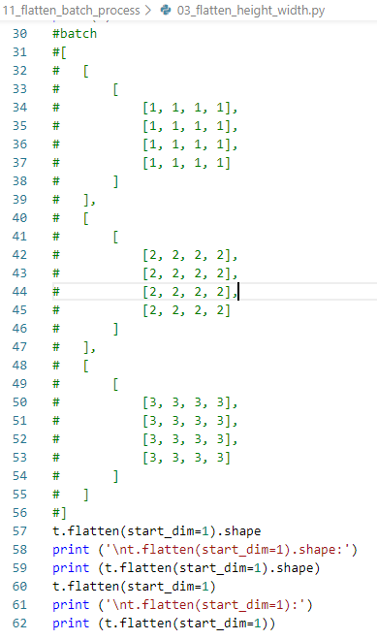
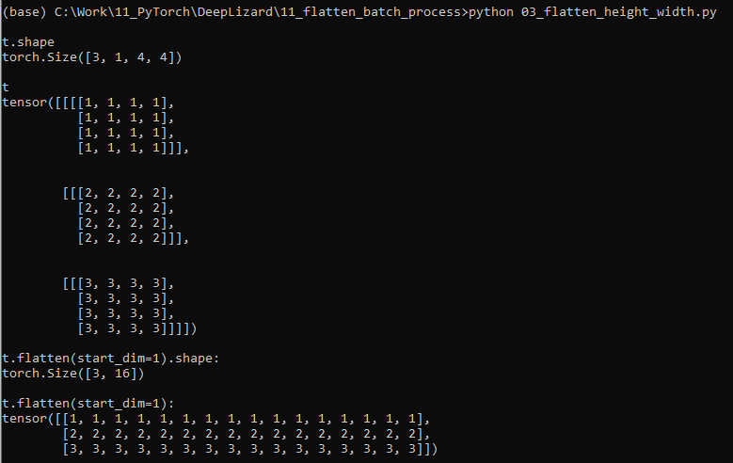
11.3 Flatten Height and Width
https://www.youtube.com/watch?v=mFAIBMbACMA&list=PLZbbT5o_s2xrfNyHZsM6ufI0iZENK9xgG&index=11
Flatten Height and Width
We want to flatten the color channel axis with the height and width axes.
This can be done with PyTorch built-in flatten method.
> t.flatten(start_dim=1).shape
>> torch.Size ([3, 16])
> t.flatten (start_dim=1)

Slide 27
11.3 Flatten Height and Width
https://www.youtube.com/watch?v=mFAIBMbACMA&list=PLZbbT5o_s2xrfNyHZsM6ufI0iZENK9xgG&index=11
Flatten Height and Width
In t.flatten (start_dim = 1), the 1 here is the second index. (0 is the first index)
The second axis is the color channel axis.
We skip over the batch axis. We leave the batch intact.
We can see that we have a rank two tensor with three single color channel images that have been flatten out into a single axis containing 16 pixel values for each image.

Slide 28
11.3 Flatten Height and Width
https://www.youtube.com/watch?v=mFAIBMbACMA&list=PLZbbT5o_s2xrfNyHZsM6ufI0iZENK9xgG&index=11
Flatten Height and Width
In this example, we use built-in flat method to achieve these results.
Here is a coding challenge for this discussion.
How can the same results be achieved by reshaping the batch tensor using the reshape method directly.

Slide 29
11.4 Summary

Slide 30
11.4 Summary
https://www.youtube.com/watch?v=mFAIBMbACMA&list=PLZbbT5o_s2xrfNyHZsM6ufI0iZENK9xgG&index=11
Summary
We visualize a tensor flatten operation for grayscale image.
We can flatten specific axes within a tensor.
This type of selective flatten is often required because our tensors flow through our network as batches.

Slide 31
11.5 Quiz

Slide 32
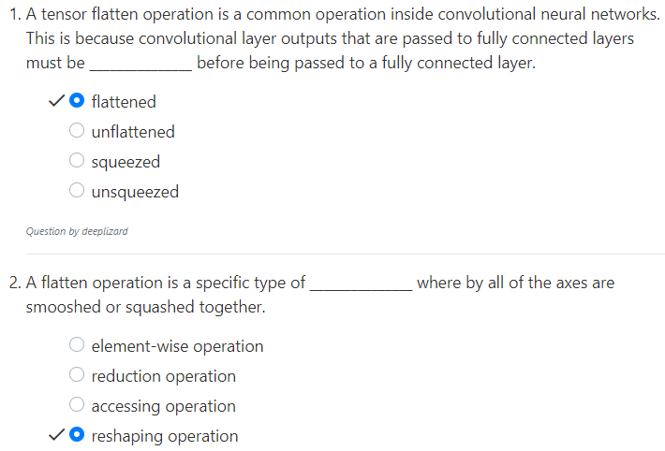
11.5 Quiz
https://www.youtube.com/watch?v=mFAIBMbACMA&list=PLZbbT5o_s2xrfNyHZsM6ufI0iZENK9xgG&index=11
Quiz

Slide 33
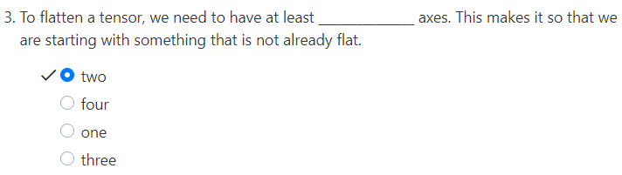
11.5 Quiz
https://www.youtube.com/watch?v=mFAIBMbACMA&list=PLZbbT5o_s2xrfNyHZsM6ufI0iZENK9xgG&index=11
Quiz

Slide 34
End of Chapter

