Slide 1

12 Broadcast and Element Operation
Peter H. Chen

Slide 2
12 Broadcast and Element Operation
https://www.youtube.com/watch?v=QscEWm0QTRY&list=PLZbbT5o_s2xrfNyHZsM6ufI0iZENK9xgG&index=12
Broadcast Element Operation
We discussed the beyond reshape operation about element-wise operations.
Element wise operations are extremely common operations with tensors and neural network programming.
What does element-wise mean?
An element-wise operation is an operation between two tensors that operate on corresponding elements within the respective tensors.
Definition of element-wise operation: An element-wise operation is an operation that operates on tensor elements that correspond on have the same index location within the tensor. We say that an element-wise operation operates on corresponding elements and two elements are said to be corresponding if the two elements occupy the same position within the tensor.
The position within the tensor is determined by the indices that are used to locate each element.

Slide 3
12.1 Create Two Tensors

Slide 4
12.1 Create Two Tensors
https://www.youtube.com/watch?v=QscEWm0QTRY&list=PLZbbT5o_s2xrfNyHZsM6ufI0iZENK9xgG&index=12
Create Two Tensors
The same corresponding [0][0] for t2[0][0] = 9.
These two tensors have the same number of elements (scalar components).
In order to do the element-wise operation, two tensors must have the same number of elements.
We make more restrictive statement, two tensors must have the same shape in order to perform the element-wise operations.
This means two tensors have the same number of axes each corresponding axes have the same length.

Slide 5
12.2 Element-wise Operation

Slide 6
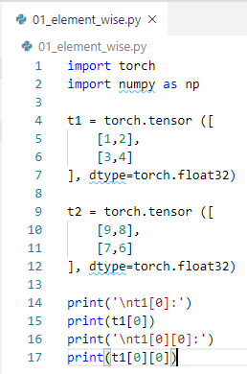

12.2 Element-wise Operation
https://www.youtube.com/watch?v=QscEWm0QTRY&list=PLZbbT5o_s2xrfNyHZsM6ufI0iZENK9xgG&index=12
Create Two Tensors
Create two tensors. Both are 2 x 2.
Elements of first axis are arrays.
Elements of the second axis are numbers.

Slide 7
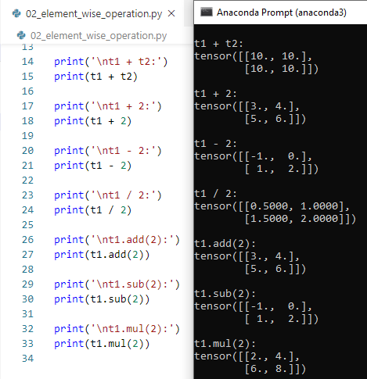
12.2 Element-wise Operation
https://www.youtube.com/watch?v=QscEWm0QTRY&list=PLZbbT5o_s2xrfNyHZsM6ufI0iZENK9xgG&index=12
Create Two Tensors
Element-wise operation examples. This one break the rule because scalar does not have same shape as tensors.

Slide 8
12.3 Broadcasting

Slide 9
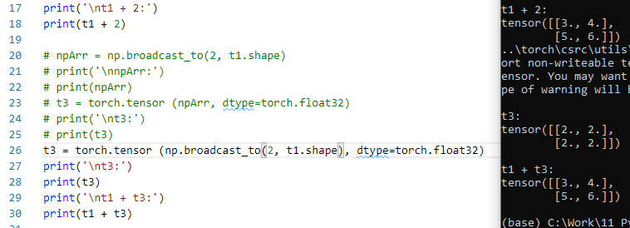
12.3 Broadcasting
https://www.youtube.com/watch?v=QscEWm0QTRY&list=PLZbbT5o_s2xrfNyHZsM6ufI0iZENK9xgG&index=12
Broadcasting
> t1 + 2
The scalar value is being broadcasted to the shape of the tensor t1.
The element-wise operation is carried out.
We can see what the broadcasted scalar value look like.
> np.broadcast_tp(2, t1.shape)

Slide 10
12.3 Broadcasting
https://www.youtube.com/watch?v=QscEWm0QTRY&list=PLZbbT5o_s2xrfNyHZsM6ufI0iZENK9xgG&index=12
Broadcasting
Broadcasting is use to transform different shapes, such as, 2x2 vs 2x4, of tensor into the same shape and then perform the operation.
We do the broadcasting in neural network for different shapes of tensors.
The element-wise, component-wise, or point-wise are referred the same thing.

Slide 11
12.4 Summary

Slide 12
12.4 Summary
https://www.youtube.com/watch?v=QscEWm0QTRY&list=PLZbbT5o_s2xrfNyHZsM6ufI0iZENK9xgG&index=12
Summary
An element-wise operation is an operation between two tensors that operate on corresponding elements within the respective tensors.
Definition of element-wise operation: An element-wise operation is an operation that operates on tensor elements that correspond on have the same index location within the tensor. We say that an element-wise operation operates on corresponding elements and two elements are said to be corresponding if the two elements occupy the same position within the tensor.
The position within the tensor is determined by the indices that are used to locate each element.
Broadcasting is use to transform different shapes, such as, 2x2 vs 2x4, of tensor into the same shape and then perform the operation.
We do the broadcasting in neural network for different shapes of tensors.
The element-wise, component-wise, or point-wise are referred the same thing.

Slide 13
12.5 Quiz

Slide 14
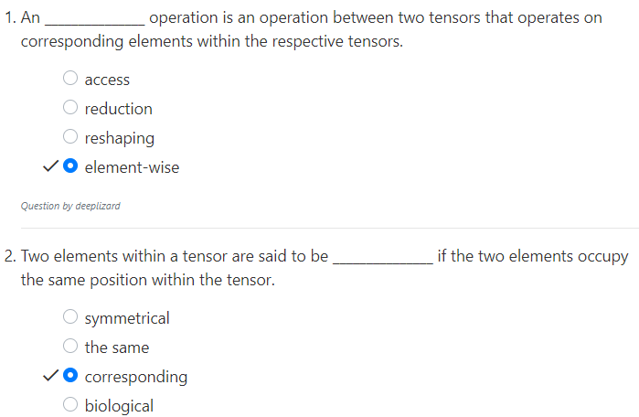
12.5 Quiz
https://www.youtube.com/watch?v=QscEWm0QTRY&list=PLZbbT5o_s2xrfNyHZsM6ufI0iZENK9xgG&index=12
Quiz

Slide 15
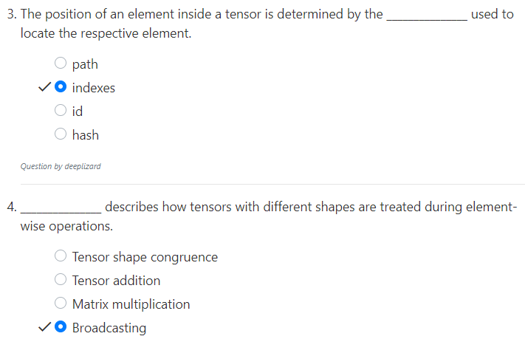
12.5 Quiz
https://www.youtube.com/watch?v=QscEWm0QTRY&list=PLZbbT5o_s2xrfNyHZsM6ufI0iZENK9xgG&index=12
Quiz

Slide 16
End of Chapter

