Slide 1

13 ArgMax and Reduction
Peter H. Chen

Slide 2
13 ArgMax and Reduction
https://www.youtube.com/watch?v=K3lX3Cltt4c&list=PLZbbT5o_s2xrfNyHZsM6ufI0iZENK9xgG&index=13
ArgMax and Reduction
We discusses the ArgMax function and Reduction Function.
We started by Tensor Reduction Operations.
A reduction operation on a tensor is an operation that reduced the nuber of elements contained within the tensor.
We know the tensors are the data structure of deep learning.
Out firs task is to load pour data elements into the tensor.
For this reason, tensors are super important.
In deep learning, we manage our data element contained within our tensors.
Tensors give us the ability to manage our data.
Data structures in general do this.
Data structures provide the necessary structure for performing data management tasks, such as, computation, storage, access, and etc.
Reshaping operations give us ability to position our elements along particular axes.

Slide 3
13 ArgMax and Reduction
https://www.youtube.com/watch?v=K3lX3Cltt4c&list=PLZbbT5o_s2xrfNyHZsM6ufI0iZENK9xgG&index=13
ArgMax and Reduction
Element-wise operations allow us to perform operations on elements between two tensors.
Reduction operations allow us to perform operations on elements within a single tensor.
Let’s look at the example.

Slide 4
13.1 Reduction: sum, numel

Slide 5
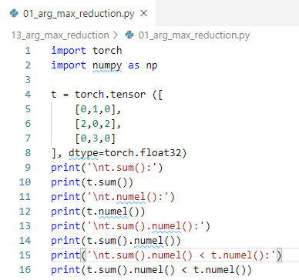
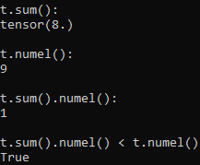
13.1 Reduction: sum, numel
https://www.youtube.com/watch?v=K3lX3Cltt4c&list=PLZbbT5o_s2xrfNyHZsM6ufI0iZENK9xgG&index=13
Reduction Operation
> import torch
> import numpy as np
> # 3 x3 tensor
> t = torch.tensor ([
> [0,1,0],
> [2,0,2],
> [0,3,0}
>],dtype=torch.float32)
> t.sum() # tensor(8.0)
> t.numel() # 9
> t.sum().numel() # 1
> t.sum().numel() < t.numel() # True

Slide 6
13.2 Reduction: sum, mean, prod, std

Slide 7
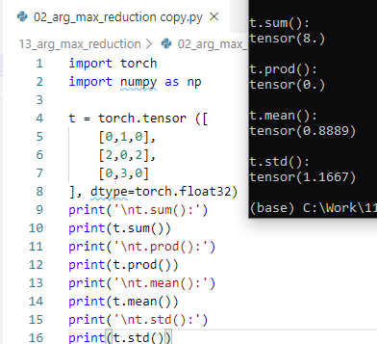
13.2 Reduction: sum, mean, prod, std
https://www.youtube.com/watch?v=K3lX3Cltt4c&list=PLZbbT5o_s2xrfNyHZsM6ufI0iZENK9xgG&index=13
Reduction Operation
All the following tensor method, reduce the tensor to scalar value.

Slide 8
13.2 Reduction: sum, mean, prod, std

Slide 9
13.3 Reduction with dim
https://www.youtube.com/watch?v=K3lX3Cltt4c&list=PLZbbT5o_s2xrfNyHZsM6ufI0iZENK9xgG&index=13
Reduction Operation
Question:
All the tensor reduction operation always reduce to a tensor with a single scalar element?
Answer: No
In fact, we often reduce specific axes at a time and this usually leads to a reduction output that has multiple elements.

Slide 10
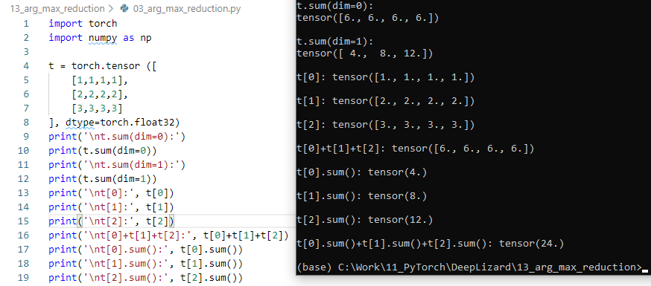
13.3 Reduction with dim
https://www.youtube.com/watch?v=K3lX3Cltt4c&list=PLZbbT5o_s2xrfNyHZsM6ufI0iZENK9xgG&index=13
Reduction Operation
To reduce the tensor with respect to a specific axis, we use the same methods and we jus pass a value for the dimension parameters.

Slide 11
13.4 ArgMax Operation

Slide 12
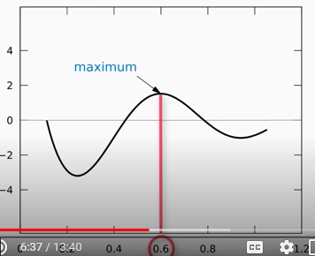
13.4 ArgMax Operation
https://www.youtube.com/watch?v=K3lX3Cltt4c&list=PLZbbT5o_s2xrfNyHZsM6ufI0iZENK9xgG&index=13
ArgMax Operation
ArgMax is the index of maximum function.

Slide 13
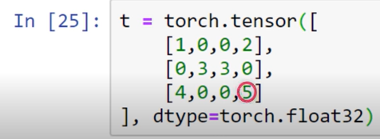
13.4 ArgMax Operation
https://www.youtube.com/watch?v=K3lX3Cltt4c&list=PLZbbT5o_s2xrfNyHZsM6ufI0iZENK9xgG&index=13
ArgMax Operation
Maximum value of torch.tensor() is 5.

Slide 14
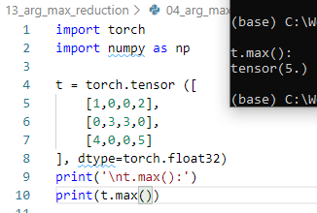
13.4 ArgMax Operation
https://www.youtube.com/watch?v=K3lX3Cltt4c&list=PLZbbT5o_s2xrfNyHZsM6ufI0iZENK9xgG&index=13
ArgMax Operation
Maximum value of torch.tensor() is 5.

Slide 15
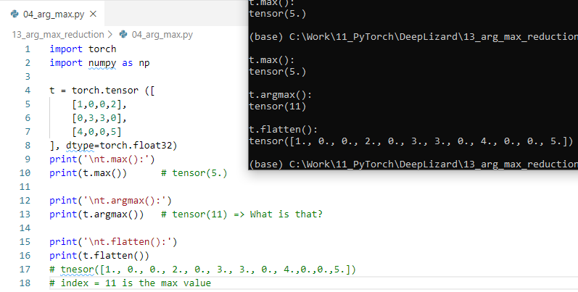
13.4 ArgMax Operation
https://www.youtube.com/watch?v=K3lX3Cltt4c&list=PLZbbT5o_s2xrfNyHZsM6ufI0iZENK9xgG&index=13
ArgMax Operation
Maximum value of torch.tensor() is 5
argmax() = 11, the index location of maximum value 5 is 11.

Slide 16
13.5 ArgMax with dim

Slide 17
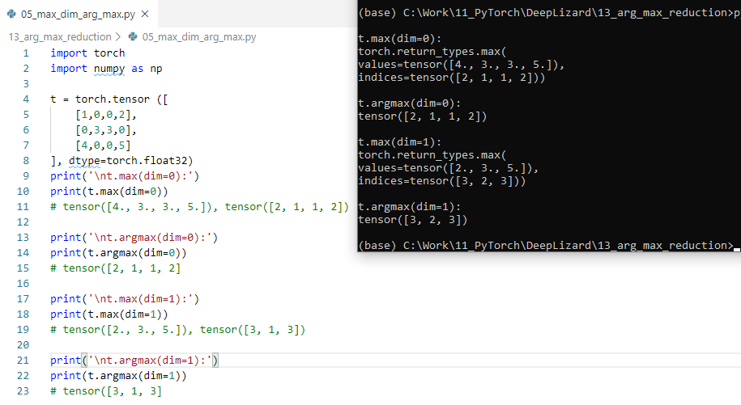
13.5 ArgMax with dim
https://www.youtube.com/watch?v=K3lX3Cltt4c&list=PLZbbT5o_s2xrfNyHZsM6ufI0iZENK9xgG&index=13
ArgMax Operation
Maximum value of torch.tensor() is 5
argmax() = 11, the index location of maximum value 5 is 11.

Slide 18
13.6 item, tolist

Slide 19
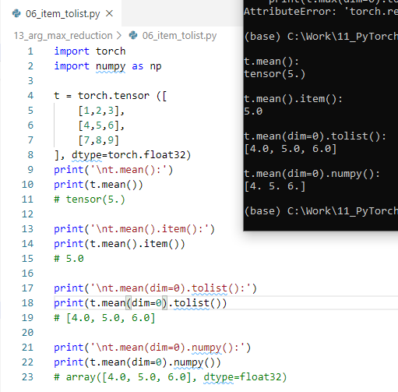
13.5 ArgMax with dim
https://www.youtube.com/watch?v=K3lX3Cltt4c&list=PLZbbT5o_s2xrfNyHZsM6ufI0iZENK9xgG&index=13
ArgMax Operation
In neural network, we have argmax for index for particular prediction category.

Slide 20
13.7 Quiz

Slide 21
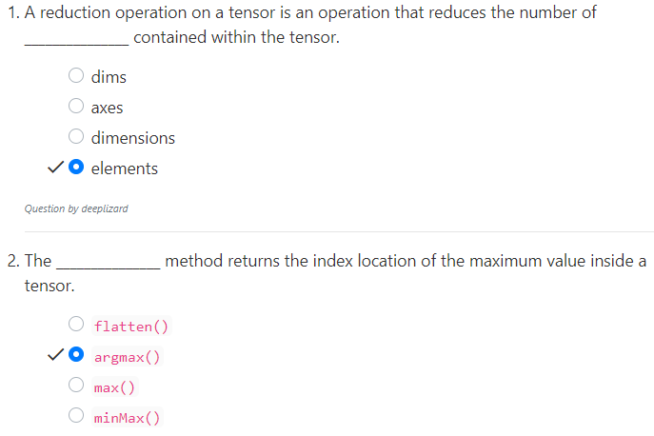
13.6 Quiz
https://www.youtube.com/watch?v=K3lX3Cltt4c&list=PLZbbT5o_s2xrfNyHZsM6ufI0iZENK9xgG&index=13
Quiz

Slide 22
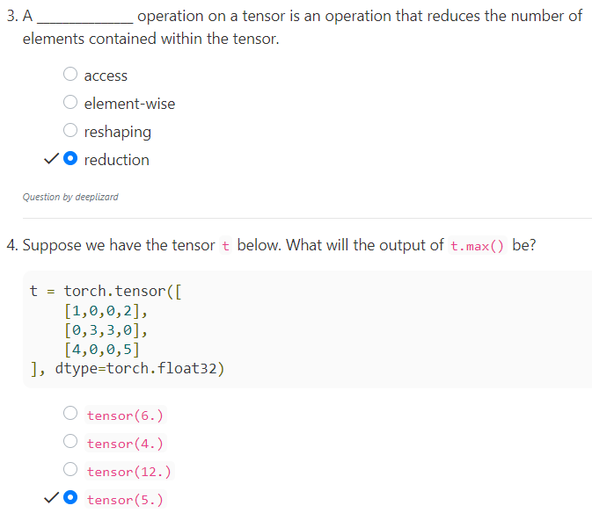
13.6 Quiz
https://www.youtube.com/watch?v=K3lX3Cltt4c&list=PLZbbT5o_s2xrfNyHZsM6ufI0iZENK9xgG&index=13
Quiz

Slide 23
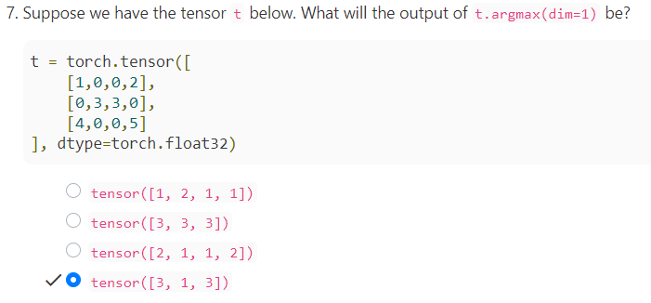
13.6 Quiz
https://www.youtube.com/watch?v=K3lX3Cltt4c&list=PLZbbT5o_s2xrfNyHZsM6ufI0iZENK9xgG&index=13
Quiz
7) dim = 1, in the row direction. Maximum is [2, 3,5]. The indices [3, 1, 3].

Slide 24
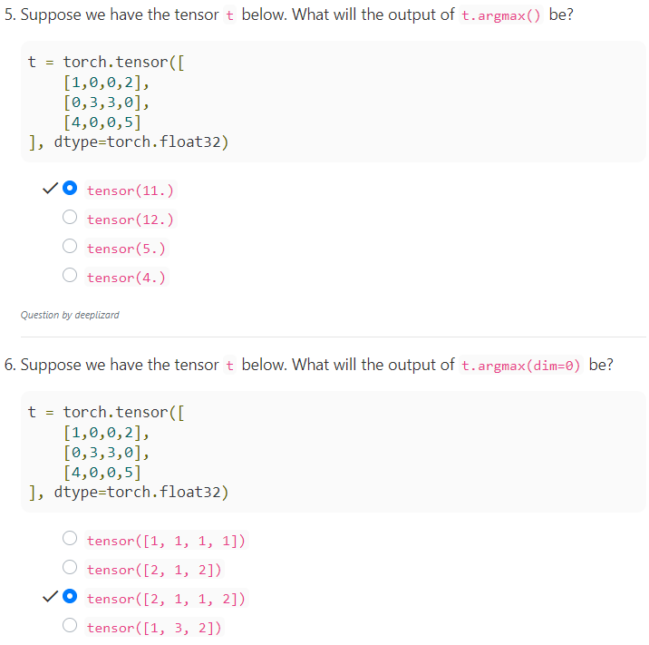
13.6 Quiz
https://www.youtube.com/watch?v=K3lX3Cltt4c&list=PLZbbT5o_s2xrfNyHZsM6ufI0iZENK9xgG&index=13
Quiz
5) t.argmax() flatten the tensors into 1D and count the index of max.
6) dim = 0, find index of each column of the maximum number [4, 3, 3, 5]. The indices are [2, 1, 2, 2]

Slide 25
End of Chapter

