Slide 1

14 MNIST Dataset
Peter H. Chen

Slide 2
14 MNIST Dataset
https://www.youtube.com/watch?v=EqpzfvxBx30&list=PLZbbT5o_s2xrfNyHZsM6ufI0iZENK9xgG&index=14
MNIST Data
We discusses the MNIST Dataset.
How the dataset is built?
How the dataset differs from the original dataset of handwritten digits?
Why should we take the time to study a dataset?
Data is the primary ingredient of deep learning.
It is the responsibility of neural network programmers to let neural networks to learn from data.
We have the responsibility to know the nature and history of the data we used to do the training.
Jack Ma said:
Machine drink the electricity and they drink data. Data is our water and soil.
If we want the machine smart, the machine must drink data.

Slide 3
14 MNIST Dataset
https://www.youtube.com/watch?v=EqpzfvxBx30&list=PLZbbT5o_s2xrfNyHZsM6ufI0iZENK9xgG&index=14
MNIST Data
In the past, the programmer job is to write the code or software.
In deep learning and neural network, the weight of neural network merge automatically during the training process.
The actual software produced itself though the training process.
It is the programmers job to oversee and guide the learning process through training. We can think of this as an indirect way of writing software or code.
By using data and deep learning, neural network programmers can produce software capable of performing computations without actually writing the code to explicitly carry out the computation.
For this reason, the role of data in developing software is shifting.
We will likely to see the role of software developers shift as well.
As a developer, if we want to tweak our software or make a change opposed tweaking the code directly, we will be tweaking the data.

Slide 4
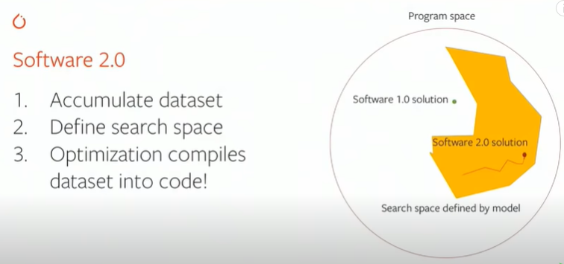
14 MNIST Dataset
https://www.youtube.com/watch?v=EqpzfvxBx30&list=PLZbbT5o_s2xrfNyHZsM6ufI0iZENK9xgG&index=14
MNIST Data
Software 1.0 shift to Software .20.
In stead of change to code, we change the dataset.
Dataset is a kind of constraint on desirable behavior of the program.

Slide 5
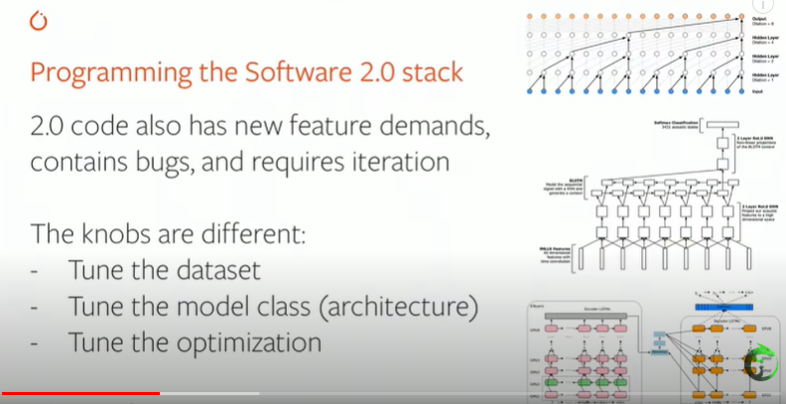
14 MNIST Dataset
https://www.youtube.com/watch?v=EqpzfvxBx30&list=PLZbbT5o_s2xrfNyHZsM6ufI0iZENK9xgG&index=14
MNIST Data
Then, we select the optimization to for the neural network. The stochastic gradient descent is used to modify weight of neural network.
We select the model in the neural network in neural network.
The knobs are different in the production mode. We are not writing the code, fixing the bugs, but are iterating the dataset, model, and optimization for training the model.

Slide 6
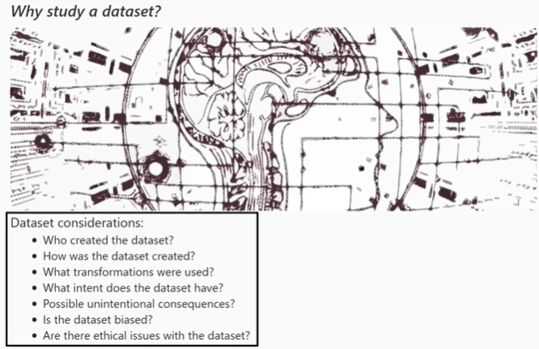
14 MNIST Dataset
https://www.youtube.com/watch?v=EqpzfvxBx30&list=PLZbbT5o_s2xrfNyHZsM6ufI0iZENK9xgG&index=14
Dataset consideration
Who create the dataset?
How was the dataset created?
What transformation were used?
What intent does the dataset have?
Possible unintentional consequences?
Is the dataset biased?
Are there ethical issues with the dataset?

Slide 7
14 MNIST Dataset
https://www.youtube.com/watch?v=EqpzfvxBx30&list=PLZbbT5o_s2xrfNyHZsM6ufI0iZENK9xgG&index=14
Dataset consideration
Categorize the dataset in company. Who is collecting the critical information to train our computer?
Who is the leader of collecting the dataset? Amazon.
Who is the leader of intent of collecting dataset? Google.
Who is the leader of content consumption of dataset? Facebook.
In health care, there is no winner yet.
In education and adaptive learning, there is no clear winner yet.
In financial regulation and insurance credit, there is no clear winner yet.
There is many markets, we do not know yet.

Slide 8
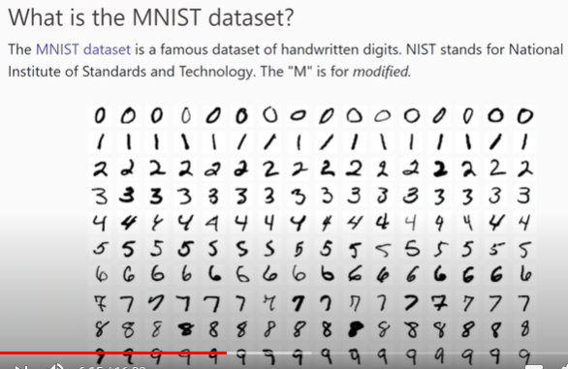
14 MNIST Dataset
https://www.youtube.com/watch?v=EqpzfvxBx30&list=PLZbbT5o_s2xrfNyHZsM6ufI0iZENK9xgG&index=14
What is the MNIST Dataset?
The MNIST dataset a famous dataset of handwritten digits commonly used in training image processing systems for machine learning.

Slide 9
14 MNIST Dataset
https://www.youtube.com/watch?v=EqpzfvxBx30&list=PLZbbT5o_s2xrfNyHZsM6ufI0iZENK9xgG&index=14
What is the MNIST Dataset?
NIST stands for National Institute of Standard and Technology. The “M” is modified.
There was an original NIST dataset of digits that was modified to give us the MNIST.

Slide 10
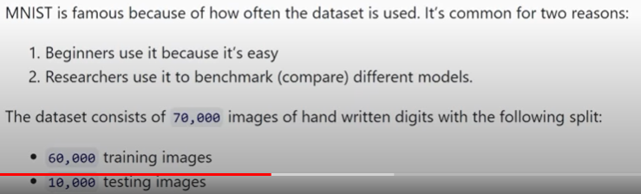
14 MNIST Dataset
https://www.youtube.com/watch?v=EqpzfvxBx30&list=PLZbbT5o_s2xrfNyHZsM6ufI0iZENK9xgG&index=14
What is the MNIST Dataset?
MNIST is famous because of how often the dataset is used. MNIST is commonly used for two reasons.
Number one: The beginner use it because it is relatively easy.
Number two: Researcher use it as the benchmark or compare different models.
The dataset consists of 70,000 images of handwritten with the following splits.
We have 60,000 images in the training set.
We have 10,000 images in the testing set.

Slide 11
14 MNIST Dataset
https://www.youtube.com/watch?v=EqpzfvxBx30&list=PLZbbT5o_s2xrfNyHZsM6ufI0iZENK9xgG&index=14
What is Fashion-MNIST Dataset?
The original MNIST Dataset is used by high school students.
The image recognition technology has improved so much that the dataset is considered too easy.
This is why Fashion-MNIST was created.

Slide 12
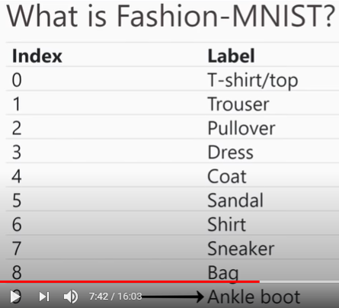
14 MNIST Dataset
https://www.youtube.com/watch?v=EqpzfvxBx30&list=PLZbbT5o_s2xrfNyHZsM6ufI0iZENK9xgG&index=14
What is Fashion-MNIST Dataset?
Fashion-MNIST dataset, as is name suggested, is the dataset of Fashion items, specifically, the dataset has the following 10 classes of fashion items.
We have T-shorts, Trouser, Pullover, Dress, Coat, Sandal, Shirt, Sneaker (Sport shoe), Bag, and Ankle boot (Sandal boot).

Slide 13
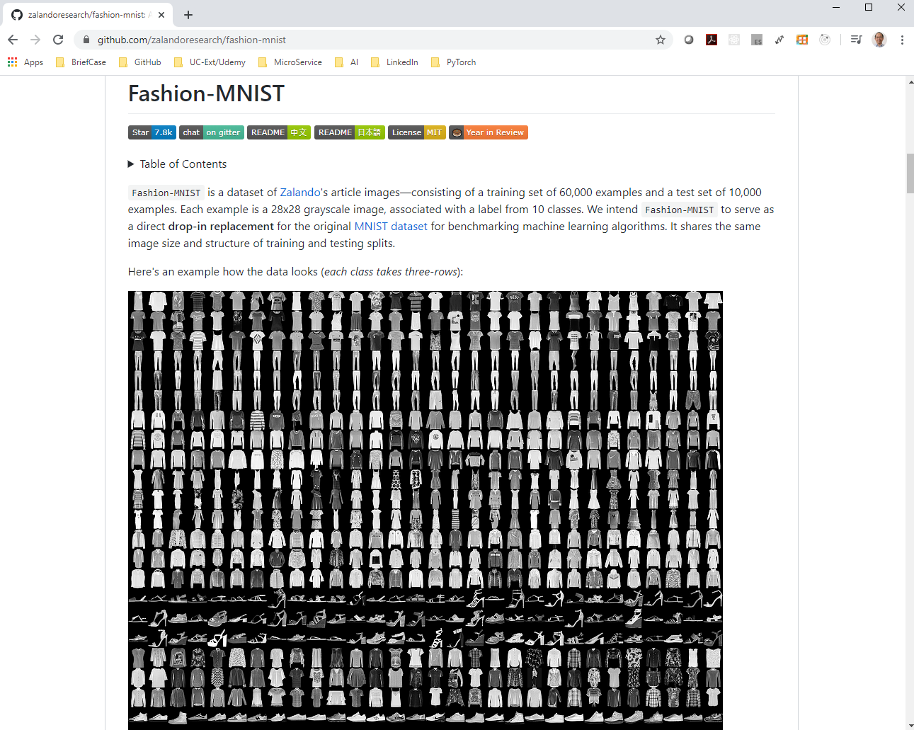
14 MNIST Dataset
https://www.youtube.com/watch?v=EqpzfvxBx30&list=PLZbbT5o_s2xrfNyHZsM6ufI0iZENK9xgG&index=14
What is Fashion-MNIST Dataset?
Fashion-MNIST dataset is from Zalando web site (Zalando.com).
Zalando is a German Base multinational fashion commerce company.
The Zalando dataset can be found on GitHub. (https://github.com/zalandoresearch/fashion-mnist).
The Zalando Fashion-MNIST Dataset is availed for download.

Slide 14
14 MNIST Dataset
https://www.youtube.com/watch?v=EqpzfvxBx30&list=PLZbbT5o_s2xrfNyHZsM6ufI0iZENK9xgG&index=14
What is Fashion-MNIST Dataset?
Fashion-MNIST dataset is a group of dataset the Zalando company created.
What is in Fashion-MNIST?
We will see the specific ways that Fashion-MNIST mirrors the original dataset in there.
After all, MNIST is a separate organization from Zalando.

Slide 15
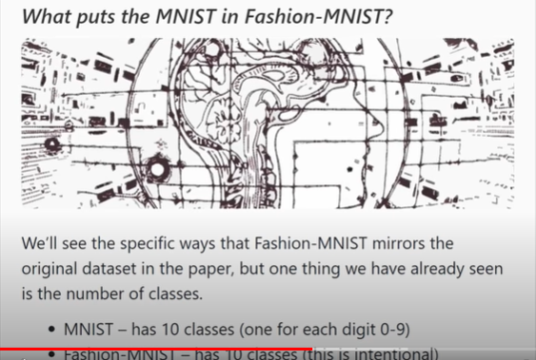
14 MNIST Dataset
https://www.youtube.com/watch?v=EqpzfvxBx30&list=PLZbbT5o_s2xrfNyHZsM6ufI0iZENK9xgG&index=14
What is Fashion-MNIST Dataset?
The MNIST has 19 classes (One for each digit 0-9)
The Fashion-MNIST has 10 classes. This is intentional creation to replace the original MNIST. The Fashion-MNIST was design in such as way that mirrors the original dataset. It does as closely as possible but still introducing a higher level of difficulty in terms of training.

Slide 16
14 MNIST Dataset
https://www.youtube.com/watch?v=EqpzfvxBx30&list=PLZbbT5o_s2xrfNyHZsM6ufI0iZENK9xgG&index=14
What is Fashion-MNIST Dataset?
The original dataset has 10 classes. One for each digit.
The fashion dataset also has 10 classes that corresponds to 10 pieces of clothing,
The implication of this is that neural network that have been trained on the original MNIST dataset can be swapped over to the fashion dataset without changing their output layers.

Slide 17
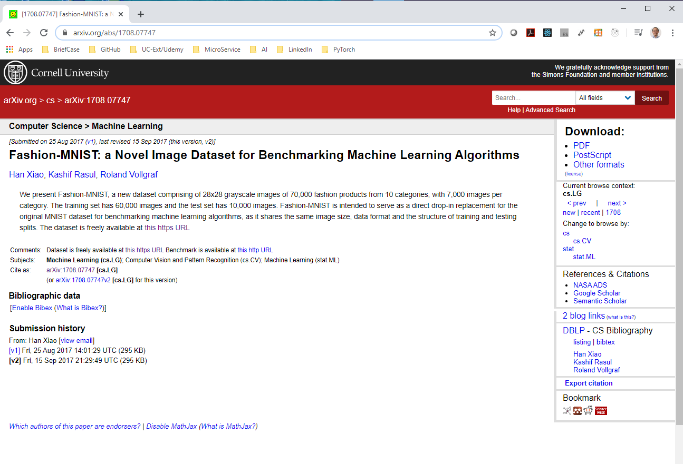
14 MNIST Dataset
https://www.youtube.com/watch?v=EqpzfvxBx30&list=PLZbbT5o_s2xrfNyHZsM6ufI0iZENK9xgG&index=14
What is Fashion-MNIST Dataset?
The original dataset has 10 classes. One for each digit.
The fashion dataset also has 10 classes that corresponds to 10 pieces of clothing,
The implication of this is that neural network that have been trained on the original MNIST dataset can be swapped over to the fashion dataset without changing their output layers. “Fashion-MNIST: a Novel Image Dataset for Benchmarking Machine Learning Algorithms”
https://arxiv.org/abs/1708.07747
One the right, click the PDF download.

Slide 18
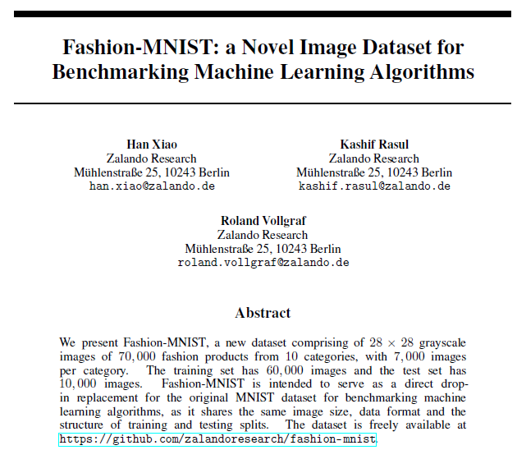
14 MNIST Dataset
https://www.youtube.com/watch?v=EqpzfvxBx30&list=PLZbbT5o_s2xrfNyHZsM6ufI0iZENK9xgG&index=14
What is Fashion-MNIST Dataset?
We can see clearly why Fashion-MNIST dataset is created.
Each image is 28 x 28.
Total 70,000 images.
60,000 image for training.
10,000 images for testing.
It uses the same image size, data format, same structure of training, and testing splits.
The dataset is freely available in this dataset.
The fashion dataset is designed to be a drop-in replacement for the original in this dataset.

Slide 19
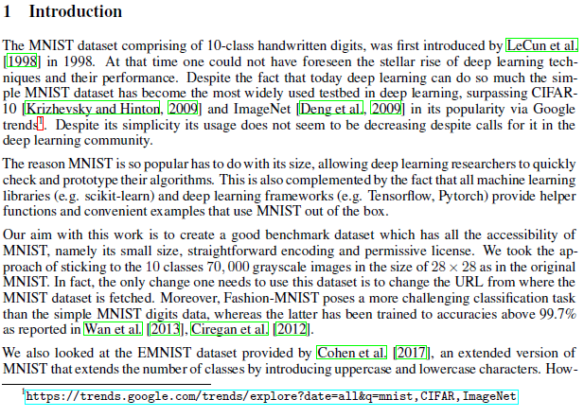
14 MNIST Dataset
https://www.youtube.com/watch?v=EqpzfvxBx30&list=PLZbbT5o_s2xrfNyHZsM6ufI0iZENK9xgG&index=14
What is Fashion-MNIST Dataset?
The Fashion dataset specs match the original MNIST-spec.
The switch over from the old MNIST to new Fashion-MNIST dataset can be smooth.
The only changed needed to switch the dataset is to change the point of URL to the point of fashion dataset.
Why the MNIST is so popular?
The deep learning researcher can quickly check and prototype their algorithms.

Slide 20
14 MNIST Dataset
https://www.youtube.com/watch?v=EqpzfvxBx30&list=PLZbbT5o_s2xrfNyHZsM6ufI0iZENK9xgG&index=14
What is Fashion-MNIST Dataset?
This is also complemented by the fact that all machine learning algorithm libraries, e.g., scikit-learn and deep learning frameworks, e.g., tensorflow and pyTorch, provides the help functions and convenient examples that are used out-of-the-box.
PyTorch indeed provide us with the package called torchvision that make us easy to start with MNIST as well as fashion MNIST Dataset.
We will be using torchvision in next.

Slide 21
14.1 Quiz

Slide 22
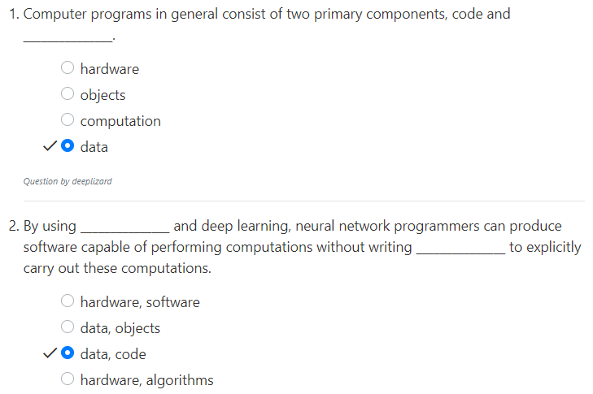
14.1 Quiz
https://www.youtube.com/watch?v=EqpzfvxBx30&list=PLZbbT5o_s2xrfNyHZsM6ufI0iZENK9xgG&index=14
Quiz

Slide 23
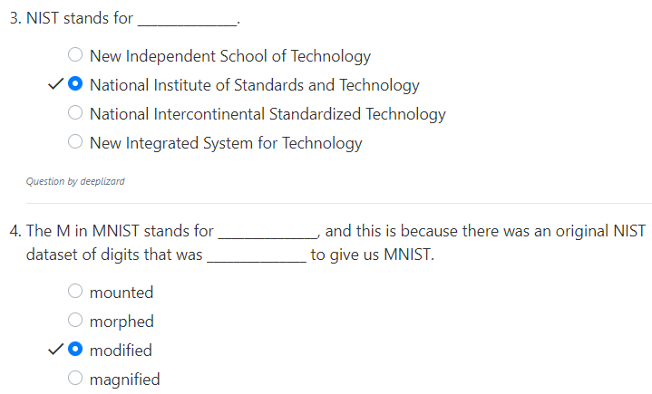
14.1 Quiz
https://www.youtube.com/watch?v=EqpzfvxBx30&list=PLZbbT5o_s2xrfNyHZsM6ufI0iZENK9xgG&index=14
Quiz

Slide 24
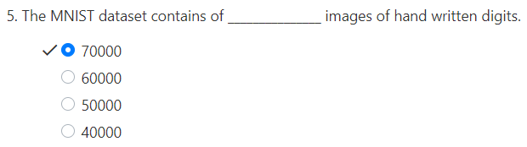
14.1 Quiz
https://www.youtube.com/watch?v=EqpzfvxBx30&list=PLZbbT5o_s2xrfNyHZsM6ufI0iZENK9xgG&index=14
Quiz

Slide 25
End of Chapter

