Slide 1

15 Extract Transform Load (Part 2)
Peter H. Chen

Slide 2
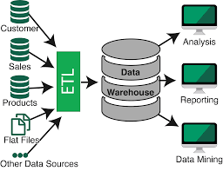
15 Extract Transform Load (Part 2)
https://www.youtube.com/watch?v=8n-TGaBZnk4&list=PLZbbT5o_s2xrfNyHZsM6ufI0iZENK9xgG&index=15
ETL (Extract Transform Load)
We start the part 2 of PyTorch: ETL (Extract Transform Load)
We perform ETL (Extract, Transform, and Load) pipeline by using torchvision, the PyTorch computer vision package, for machine learning.
There are four general steps for machine learning:
Prepare the data
Build the Model
Train the Model
Analyze the model result
We discuss the Prepare the Data.
We will use ETL (Extract, Transform, and Load) process.
Extract (E) data from data source.
Transform (T) data into the desirable format.
Then, we Load (L) the data into a suitable structure for querying and analysis.

Slide 3
15 Extract Transform Load (Part 2)
https://www.youtube.com/watch?v=8n-TGaBZnk4&list=PLZbbT5o_s2xrfNyHZsM6ufI0iZENK9xgG&index=15
ETL (Extract Transform Load)
This ETL process can be thought of as a fractal (broken) process and this is because it can be applied on various scales.
The ETL process can be used on small scale (single program) or on a large scale (all the way up the enterprise level) where there are huge systems handling each of the individual parts.
The data science discuss the general data science pipeline.
Once we completed the ETL process, we are ready to build and train the deep learning model.
The PyTorch has built-in packages and classes that make the ETL very easy.
> import torch
> import torchvision
> import torchvision.transforms as transforms

Slide 4
15 Extract Transform Load (Part 2)
https://www.youtube.com/watch?v=8n-TGaBZnk4&list=PLZbbT5o_s2xrfNyHZsM6ufI0iZENK9xgG&index=15
ETL (Extract Transform Load)
The torch is the top-level PyTorch package.
The torchvision is a package that provide access to popular dataset model architecture and image transformation. For compute vision, torchvision is PyTorch package for this but it does some as a separate install.
The torchvision.transforms is an interface that gives us access to common transformation for image processing. The torchivision.transforms is inside the torchvision package.

Slide 5
15 Extract Transform Load (Part 2)
https://www.youtube.com/watch?v=8n-TGaBZnk4&list=PLZbbT5o_s2xrfNyHZsM6ufI0iZENK9xgG&index=15
Prepare the data using PyTorch
Extract: Get the Fashion-MNIST image data from the source.
Transform: Put our data into PyTorch tensor form.
Load: Put the data into an object to make easily accessible.
For these purpose, PyTorch gives us two classes data.
class | Description
torch.utils.data.Dataset | An abstract class for representing a dataset
torch.utils.data.DataLoader | Wraps a dataset and provides access to the underlying data.
An abstract class is a Python class that has method we are required to be implemented.
We can create a custom dataset by creating a subclass that extends the functionality of the Dataset class.

Slide 6
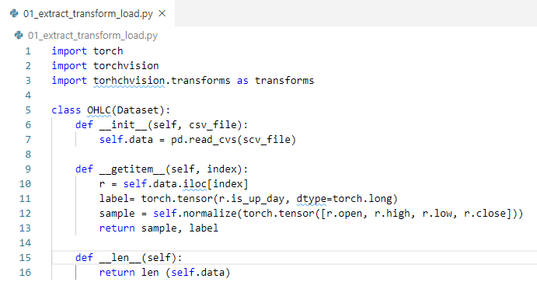
15 Extract Transform Load (Part 2)
https://www.youtube.com/watch?v=8n-TGaBZnk4&list=PLZbbT5o_s2xrfNyHZsM6ufI0iZENK9xgG&index=15
Define class OHLC(Dataset):

Slide 7
15.1 FashionMNIST

Slide 8
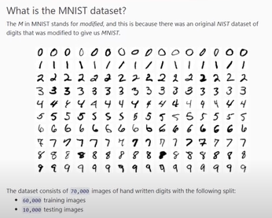
15.1 FashionMNIST
https://www.youtube.com/watch?v=8n-TGaBZnk4&list=PLZbbT5o_s2xrfNyHZsM6ufI0iZENK9xgG&index=15
Package gives us access to the following resources.
How to see with torchvision
Datasets (like MNIST and Fashion-MNIST)
Models
Transforms
Utils
The top two are more important.

Slide 9
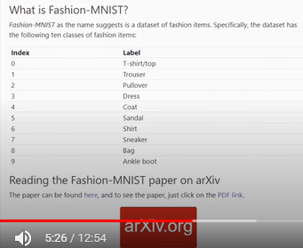
15.1 FashionMNIST
https://www.youtube.com/watch?v=8n-TGaBZnk4&list=PLZbbT5o_s2xrfNyHZsM6ufI0iZENK9xgG&index=15
Fashion-MNIST

Slide 10
15.2 Class FashionMNIST

Slide 11
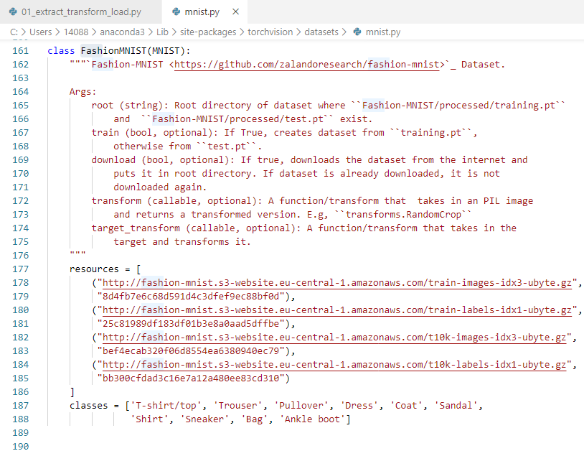
15.2 Class FashionMNIST
https://www.youtube.com/watch?v=8n-TGaBZnk4&list=PLZbbT5o_s2xrfNyHZsM6ufI0iZENK9xgG&index=15
In the local site-packages folder, we can find torchvision\datasets\mnist.py
C:\Users\14088\anaconda3\Lib\site-packages\torchvision\datasets\mnist.py
It has class FashionMNIST (MNIST):

Slide 12
15.2 Class FashionMNIST
https://www.youtube.com/watch?v=8n-TGaBZnk4&list=PLZbbT5o_s2xrfNyHZsM6ufI0iZENK9xgG&index=15
We can see at the top, the FashioMNIST class, in the class extends the class MNIST.

Slide 13
15.2 Class FashionMNIST
https://www.youtube.com/watch?v=8n-TGaBZnk4&list=PLZbbT5o_s2xrfNyHZsM6ufI0iZENK9xgG&index=15
The FashionMNIST paper said, it onlydrop in replacement of the Dataset MNIST.
FashionMNIST only requires swap the URLs and that is indeed what we see here.
Otherwise, FashionMNIST is same as the Dataset MNIST.

Slide 14
15.2 Class FashionMNIST
https://www.youtube.com/watch?v=8n-TGaBZnk4&list=PLZbbT5o_s2xrfNyHZsM6ufI0iZENK9xgG&index=15
We need to figure out
Which class in this dataset extends?
Where is this class fetches its data?
Specifically, find a domain name where the data is being fetched.
You can figure out the significance of name in the domain name as it pertains to CNNs.

Slide 15
15.3 Extract Dataset

Slide 16
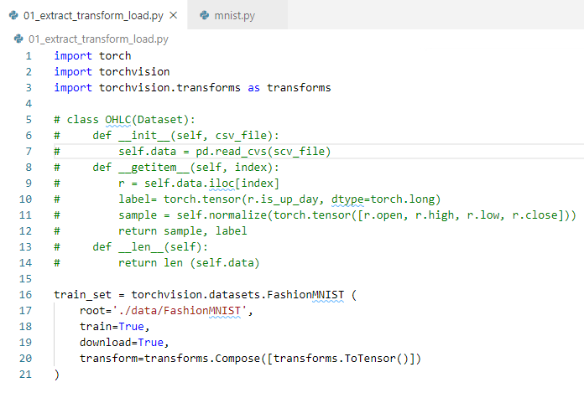
15.3 Extract Dataset
https://www.youtube.com/watch?v=8n-TGaBZnk4&list=PLZbbT5o_s2xrfNyHZsM6ufI0iZENK9xgG&index=15
Our task here is to get a dataset and then wrap it with a data loader to get an instance of the fashion.
In this dataset, using torchvision we create on like this.

Slide 17
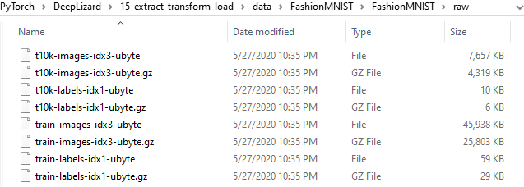
15.3 Extract Dataset
https://www.youtube.com/watch?v=8n-TGaBZnk4&list=PLZbbT5o_s2xrfNyHZsM6ufI0iZENK9xgG&index=15
./data/FashionMIST: Locaiton on local disk.

Slide 18
15.3 Extract Dataset
https://www.youtube.com/watch?v=8n-TGaBZnk4&list=PLZbbT5o_s2xrfNyHZsM6ufI0iZENK9xgG&index=15
The train parameter set to True. This tell us that we want the train data for the training set.
The fashion dataset is split with 60,000 images in the training data and 10,000 images in the testing data.

Slide 19
15.3 Extract Dataset
https://www.youtube.com/watch?v=8n-TGaBZnk4&list=PLZbbT5o_s2xrfNyHZsM6ufI0iZENK9xgG&index=15
We pass download parameter to True. This tell us to download the data if it is not present at the location we specified for route.

Slide 20
15.4 Transform Dataset into Tensor

Slide 21
15.4 Transform Dataset into Tensor
https://www.youtube.com/watch?v=8n-TGaBZnk4&list=PLZbbT5o_s2xrfNyHZsM6ufI0iZENK9xgG&index=15
We have the transform parameter. We pass the composition of transformation that should be performed on dataset elements.
We want our images to be transformed into tensors. We use two built-in ToTensor() transformation and since we want this dataset to be used for training. We name the instance training set accordingly.

Slide 22
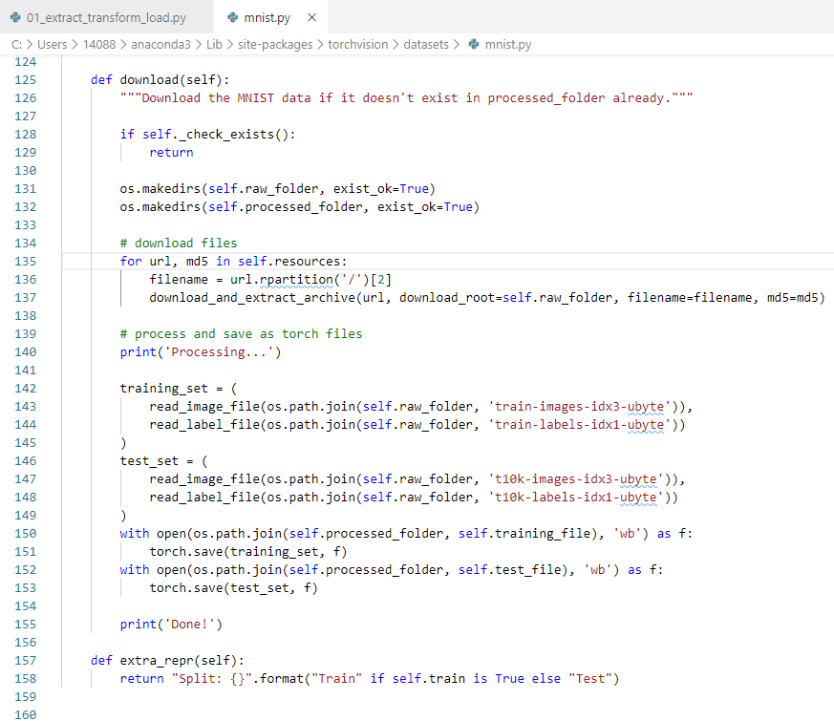
15.4 Transform Dataset into Tensor
https://www.youtube.com/watch?v=8n-TGaBZnk4&list=PLZbbT5o_s2xrfNyHZsM6ufI0iZENK9xgG&index=15
When we run the code for the firs time, the fashion in this dataset will be downloaded locally using the URLs we saw in the class definition subsequent.

Slide 23
15.5 Load Tensor into Object

Slide 24
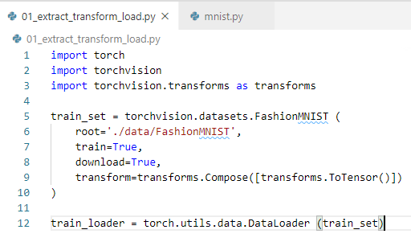
15.5 Load Tensor into Object
https://www.youtube.com/watch?v=8n-TGaBZnk4&list=PLZbbT5o_s2xrfNyHZsM6ufI0iZENK9xgG&index=15
DataLoader load the data_set in PyTorch to load tensor into object (streamline ETL tasks).

Slide 25
15.6 Quiz

Slide 26
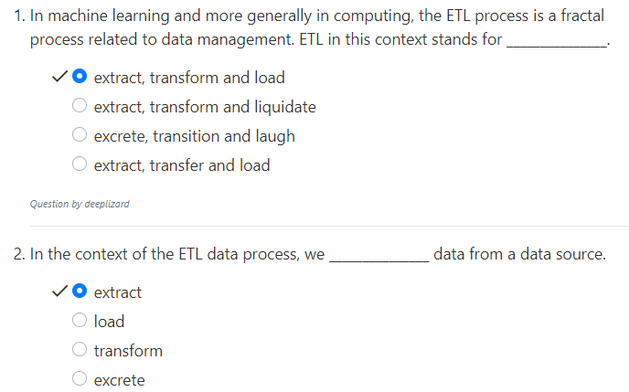
15.6 Quiz
https://www.youtube.com/watch?v=8n-TGaBZnk4&list=PLZbbT5o_s2xrfNyHZsM6ufI0iZENK9xgG&index=15
Quiz

Slide 27
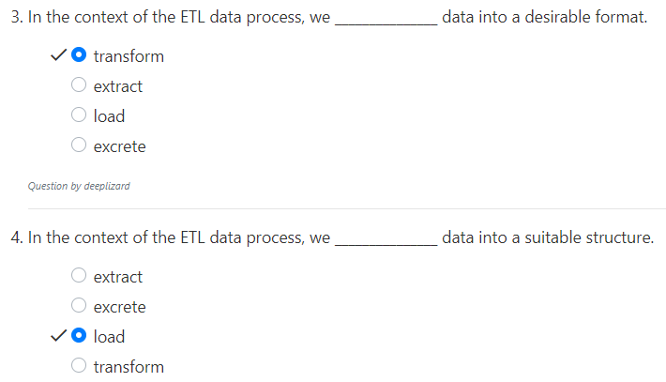
15.6 Quiz
https://www.youtube.com/watch?v=8n-TGaBZnk4&list=PLZbbT5o_s2xrfNyHZsM6ufI0iZENK9xgG&index=15
Quiz

Slide 28
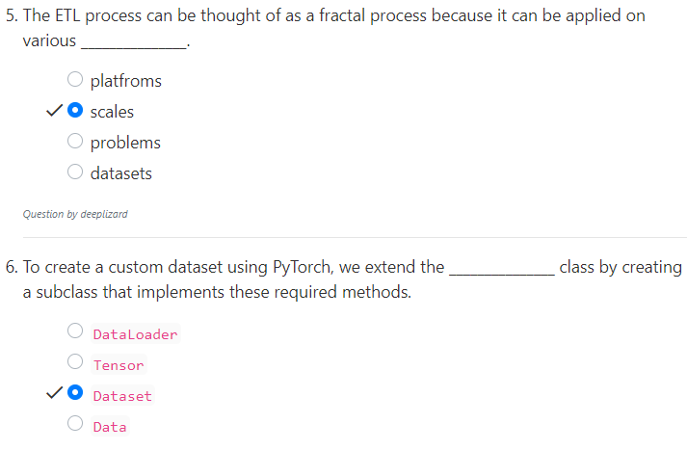
15.6 Quiz
https://www.youtube.com/watch?v=8n-TGaBZnk4&list=PLZbbT5o_s2xrfNyHZsM6ufI0iZENK9xgG&index=15
Quiz

Slide 29
End of Chapter

