Slide 1

16 Training Set (Part 2)
Peter H. Chen

Slide 2
16 Training Set (Part 2)
https://www.youtube.com/watch?v=mUueSPmcOBc&list=PLZbbT5o_s2xrfNyHZsM6ufI0iZENK9xgG&index=16
Training Set
We discuss how to work with dataset and dataloader of PyTorch classes.
The goal is to get familiar with these classes.
From the high level perspective, we still in the Preparation of data.
Prepare the Data
Build the Model
Train the Model
Analyze the Model result
We will work on Dataset and Data loader objects that we created.
Remember, we have two PyTorch Objects, a Dataset and a Dataloader.
We called the dataset variable train_set and we called the dataloader variable train_loader.

Slide 3
16 Training Set (Part 2)
https://www.youtube.com/watch?v=mUueSPmcOBc&list=PLZbbT5o_s2xrfNyHZsM6ufI0iZENK9xgG&index=16
We import torch, torchvision, and transforms class in the torchvision package.
> import torch
> import torchvision
> import torchvision.transforms as transforms
> train_set = torchvision.datasets.FashionMNIST (
> roo=‘./data/FashionMNIST’,
> train=True,
> download=True,
> transform=transforms.compose ([transofrms.ToTensor()])
> )
> train_loader = torch.utils.data.DataLoader(train_set, batch_size=10)

Slide 4
16 Training Set (Part 2)
https://www.youtube.com/watch?v=mUueSPmcOBc&list=PLZbbT5o_s2xrfNyHZsM6ufI0iZENK9xgG&index=16
Train_set:
The train_set is an instance of the Fashion in this class that also live inside the torchvision package.
In the constructor, we specify the directory where the data is located on disk.
We want the data to be the train data.
The data should be downloaded if it does not existed on disk.
And finally, we define a transform should be performed on our data element.
The composed class allows us to create a composition of transformation.
In this case, we turn our data into a tensor which is a single transformation.
Train_loader:
For the train_loader, we are using the DataLoader constructor and passing the train_set and batch_size of 10.
Note, we did not specify the batch_size in the last discussion.
The default batch_size = 1 if we do not specify an alternative here. We can see more images in this discussion.

Slide 5
16 Training Set (Part 2)
https://www.youtube.com/watch?v=mUueSPmcOBc&list=PLZbbT5o_s2xrfNyHZsM6ufI0iZENK9xgG&index=16
We do some operations to understand our data.
We import numpy and import pyplot class within matplotlib package.
> import numpy as np
> import matplotlib.pyplot as plt
# Print line width
> torch.set_printoptions(linewidth=120)
> print ('\nlen(train_set):', len(train_set))
# train_set length is 60,000
> print ('\ntrain_set.train_labels:', train_set.train_labels)
# [9, 0, 0, …, 3, 0, 5]: category 9 is Ankle Boot, category 0 is T-shirt

Slide 6
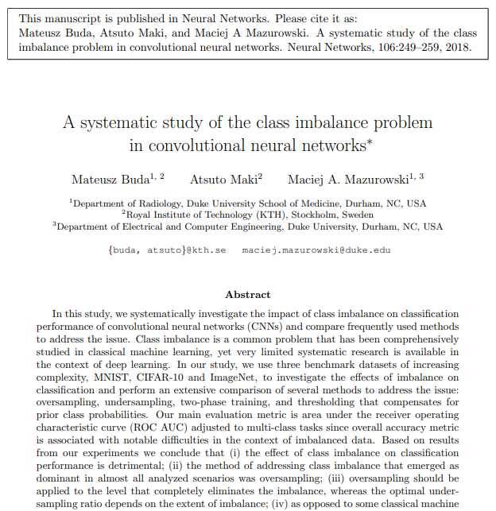
16 Training Set (Part 2)
https://www.youtube.com/watch?v=mUueSPmcOBc&list=PLZbbT5o_s2xrfNyHZsM6ufI0iZENK9xgG&index=16
> print ('\ntrain_set.train_labels.bincount():', train_set.train_labels.bincount())
# bincount is frequency appeared [6000, 6000, 6000, …, 6000, 6000, 6000]
# for each label 0-9. This is an uniform sample of all the labels.
The training set should have the equal number of each category (class or label).
If not equal number, just duplicate the less frequency one to be equal number for consistency.
https://arxiv.org/abs/1710.05381

Slide 7
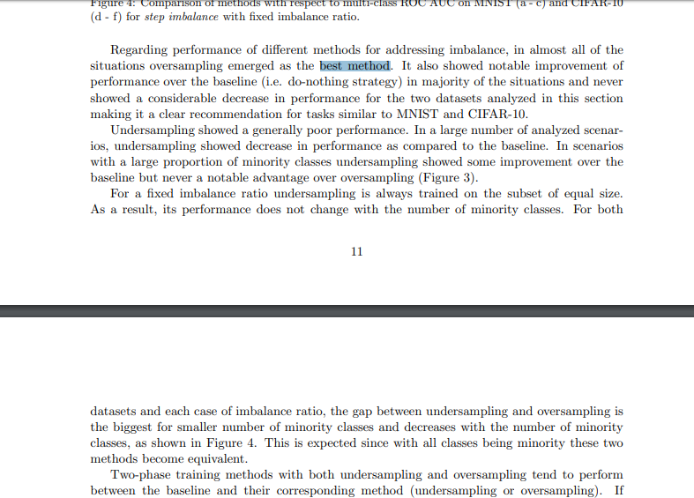
16 Training Set (Part 2)
https://www.youtube.com/watch?v=mUueSPmcOBc&list=PLZbbT5o_s2xrfNyHZsM6ufI0iZENK9xgG&index=16
“Over sample” is the best method to build up the model.

Slide 8
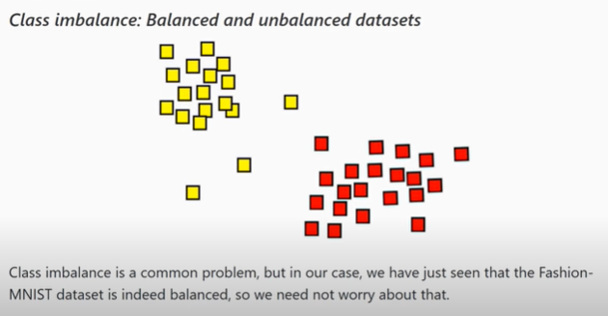
16 Training Set (Part 2)
https://www.youtube.com/watch?v=mUueSPmcOBc&list=PLZbbT5o_s2xrfNyHZsM6ufI0iZENK9xgG&index=16
Class imbalance is a common problem.

Slide 9
16.1 train_set

Slide 10
16.1 train_set
https://www.youtube.com/watch?v=mUueSPmcOBc&list=PLZbbT5o_s2xrfNyHZsM6ufI0iZENK9xgG&index=16
Now, we can access one of our data samples in code.
# iter function return an object with a stream of data that we can iterate over.
# with the stream of data, we can use Python built-in next function.
> sample = next(iter(train_set))
> print (‘len(sample):’, len(sample)
# 2
# only two items? Very strang.
> print (‘type(sample):’, type(sample))
# tuple

Slide 11
16.1 train_set
https://www.youtube.com/watch?v=mUueSPmcOBc&list=PLZbbT5o_s2xrfNyHZsM6ufI0iZENK9xgG&index=16
The sample contains two items only.
This sample contains only image and label pairs.
Each sample that we retrieved from the training set contains the image data as the tensor and corresponding label as a tensor.
Since sample is Python sequence type, we can use a concept known as sequence unpacking to assign the image and the label.
This is the short cut for accessing each item in the sequence using its index.
In stead of two lines of code:
> image = sample[0]
> label = sample[1]
We can just write this one line.
This shortcut is called sequence unpacking or list unpacking. It is also called this as deconstructing the object.
> image, label = sample

Slide 12
16.1 train_set
https://www.youtube.com/watch?v=mUueSPmcOBc&list=PLZbbT5o_s2xrfNyHZsM6ufI0iZENK9xgG&index=16
> image, label = sample
> print(image.shape)
# [1, 28, 28]
> print(image.label)
> plt.imshow(image.squeeze(), cmap=‘gray’)
# squeeze() take out the outmost dimension.
> plt.show()
> print(label)
# label: 9 (Ankle boot)

Slide 13
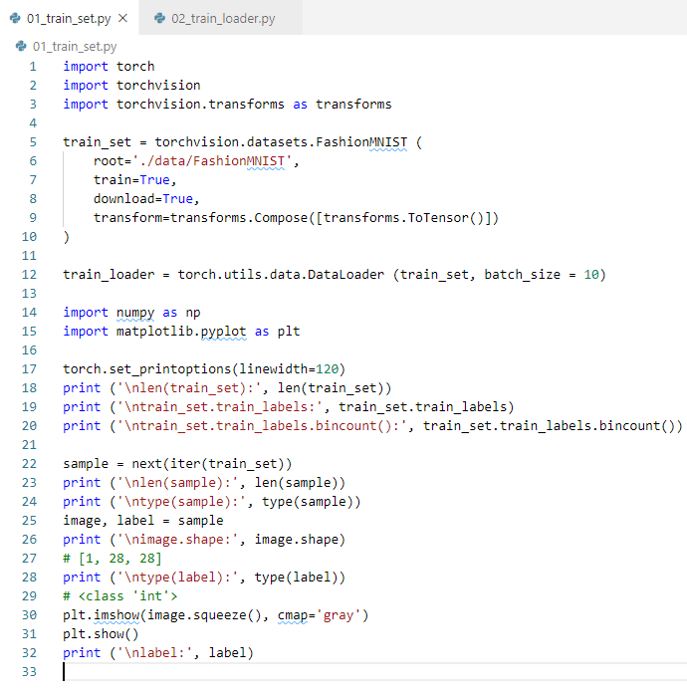
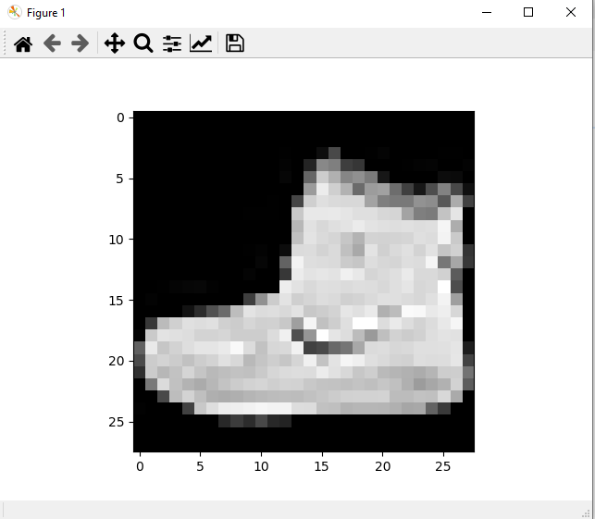
16.1 train_set
https://www.youtube.com/watch?v=mUueSPmcOBc&list=PLZbbT5o_s2xrfNyHZsM6ufI0iZENK9xgG&index=16
Result

Slide 14
16.2 train_loader

Slide 15
16.2 train_loader
https://www.youtube.com/watch?v=mUueSPmcOBc&list=PLZbbT5o_s2xrfNyHZsM6ufI0iZENK9xgG&index=16
Work with DataLoader
The train_set is tensor based vs. Data loader is object based.
> batch = next (iter(train_loader))
> print(len(batch))
# 2
> print (type (batch))
# list
> images, labels = batch

Slide 16
16.2 train_loader
https://www.youtube.com/watch?v=mUueSPmcOBc&list=PLZbbT5o_s2xrfNyHZsM6ufI0iZENK9xgG&index=16
Work with DataLoader
Create a grid using torchvision make_grid utitlity function. We pass the images tensor as the first argument. For the nrow parameter, we pass 10. All the images will be displayed along a single row. The nrow parameter specifies the number of images in each row. Batch size is 10. This gives us a single row of images.
> grid = torchvision.utils.make_grid (images, nrow=10)
After the grid, we specify some plot configuration.
We use numpy to transpose the grid. Exchange axis 1 and axis 2.
> plt.figure(figsize=(15,15))
> plt.imshow(np.transpose(grid, (1, 2, 0)))
> plt.show()

Slide 17
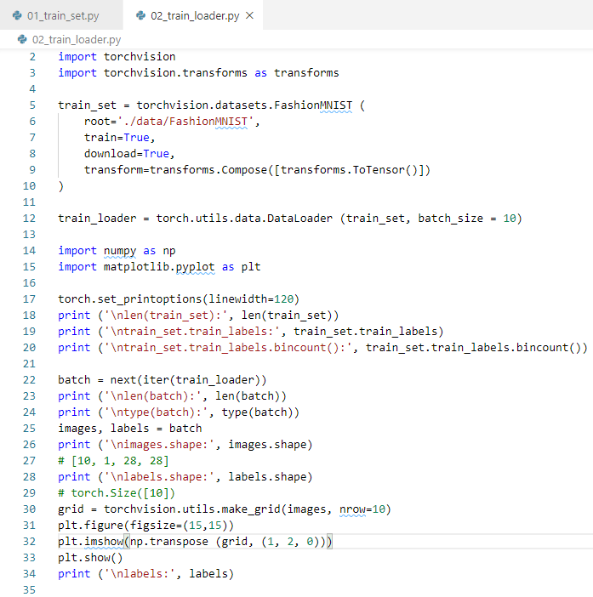
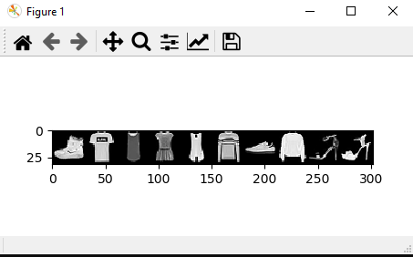
16.2 train_loader
https://www.youtube.com/watch?v=mUueSPmcOBc&list=PLZbbT5o_s2xrfNyHZsM6ufI0iZENK9xgG&index=16
Work with DataLoader
Result.

Slide 18
16.3 More Batch in train_loader

Slide 19
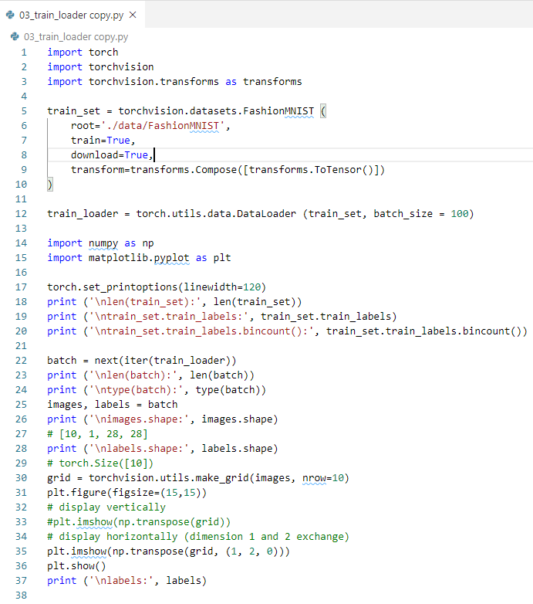
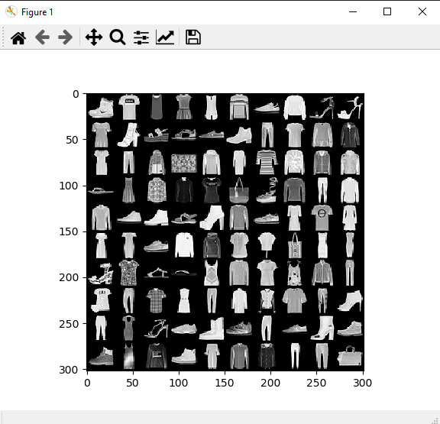
16.3 More Batch in train_loader
https://www.youtube.com/watch?v=mUueSPmcOBc&list=PLZbbT5o_s2xrfNyHZsM6ufI0iZENK9xgG&index=16
Data in the DataLoader is directly used in the neural network.

Slide 20
16.4 Summary

Slide 21
16.4 Summary
https://www.youtube.com/watch?v=mUueSPmcOBc&list=PLZbbT5o_s2xrfNyHZsM6ufI0iZENK9xgG&index=16
Summary
We discuss how to work with dataset and dataloader of PyTorch classes.
The goal is to get familiar with these classes.
From the high level perspective, we still in the Preparation of data.
Prepare the Data
Build the Model
Train the Model
Analyze the Model result
We will work on Dataset and Data loader objects that we created.
Remember, we have two PyTorch Objects, a Dataset and a Dataloader.
We called the dataset variable train_set and we called the dataloader variable train_loader.

Slide 22
16.5 Quiz

Slide 23
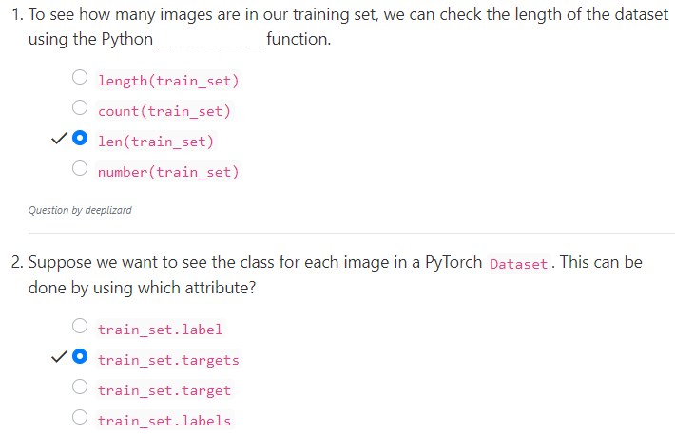
16.5 Quiz
https://www.youtube.com/watch?v=mUueSPmcOBc&list=PLZbbT5o_s2xrfNyHZsM6ufI0iZENK9xgG&index=16
Quiz

Slide 24
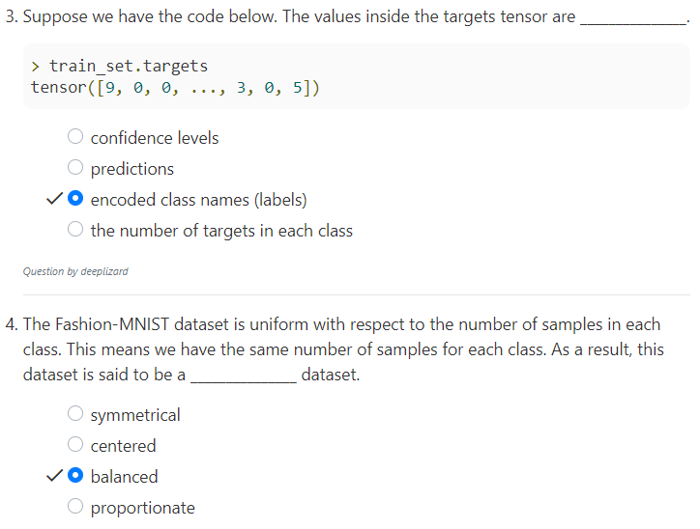
16.5 Quiz
https://www.youtube.com/watch?v=mUueSPmcOBc&list=PLZbbT5o_s2xrfNyHZsM6ufI0iZENK9xgG&index=16
Quiz

Slide 25
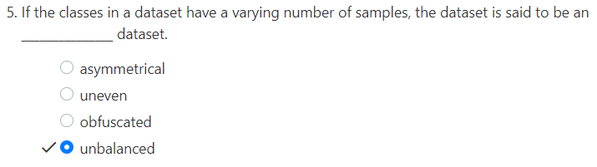
16.5 Quiz
https://www.youtube.com/watch?v=mUueSPmcOBc&list=PLZbbT5o_s2xrfNyHZsM6ufI0iZENK9xgG&index=16
Quiz

Slide 26
End of Chapter

