Slide 1

18 Deep CNN (Part 2)
Peter H. Chen

Slide 2
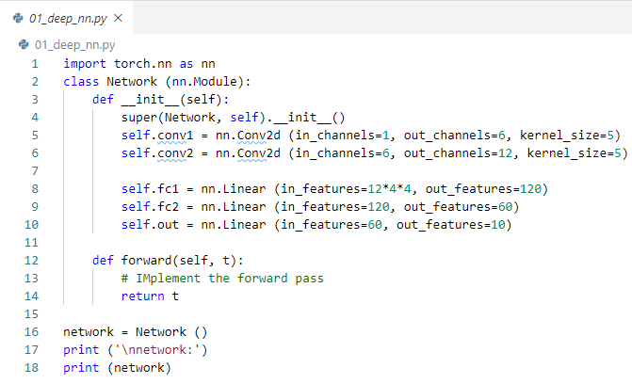
18 Deep CNN (Part 2)
https://www.youtube.com/watch?v=IKOHHItzukk&list=PLZbbT5o_s2xrfNyHZsM6ufI0iZENK9xgG&index=18
Build CNN
We discuss CNN building and constructing parameters.
We started building CNN
By extending PyTorch neural network model class ssnn.Module and
By defining some layers as class attributes.

Slide 3
18.1 Define Layers

Slide 4
18.1 Define Layers
https://www.youtube.com/watch?v=IKOHHItzukk&list=PLZbbT5o_s2xrfNyHZsM6ufI0iZENK9xgG&index=18
Define 2 Convolution Layer2 and 3 Linear Layers
We define two convolution layers and three linear layers by specifying them inside our constructor.
1
2
1
2
3

Slide 5
18.1 Define Layers

Slide 6
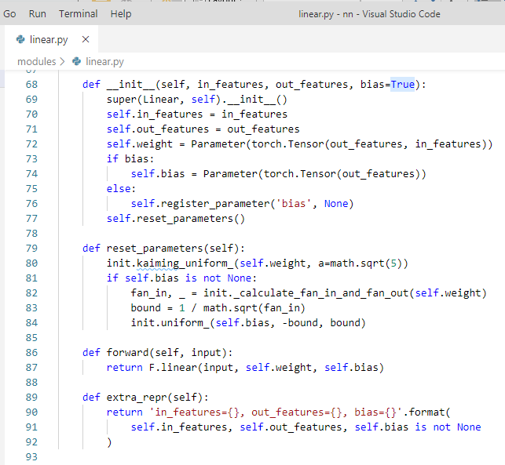
18 Deep CNN (Part 2)
https://www.youtube.com/watch?v=IKOHHItzukk&list=PLZbbT5o_s2xrfNyHZsM6ufI0iZENK9xgG&index=18
Build CNN
In torch/nn/modules/linear.py:
Each Layer, there are two primary items (in_features and out_features) encapsulated and a weight tensor inside.
The weights are updated when the neural network learns during the training process.

Slide 7
18.2 Define Weight

Slide 8
18.2 Define Weight
https://www.youtube.com/watch?v=IKOHHItzukk&list=PLZbbT5o_s2xrfNyHZsM6ufI0iZENK9xgG&index=18
Define Weight and Forward Method
In torch/nn/modules/linear.py:
This is the reason we are specifying our layers as class attributes inside the network class.
PyTorch is the neural network class keeps track the weight tensor inside each layers.

Slide 9
18.3 Linear Class

Slide 10
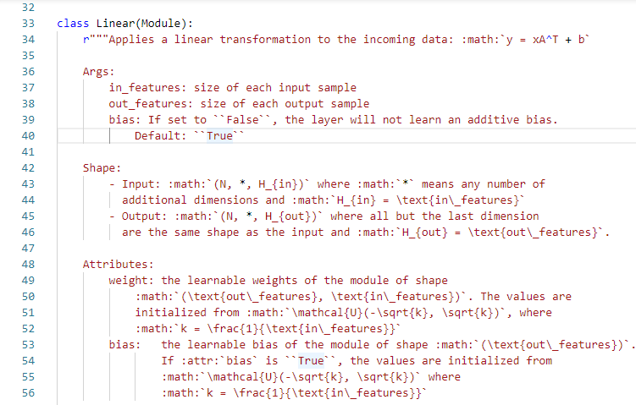
18.3 Linear Class
https://www.youtube.com/watch?v=IKOHHItzukk&list=PLZbbT5o_s2xrfNyHZsM6ufI0iZENK9xgG&index=18
Linear Class
In torch/nn/modules/linear.py:
Since we are extending the neural network module class, we inherit the this functionality automatically.

Slide 11
18.4 Module Class

Slide 12
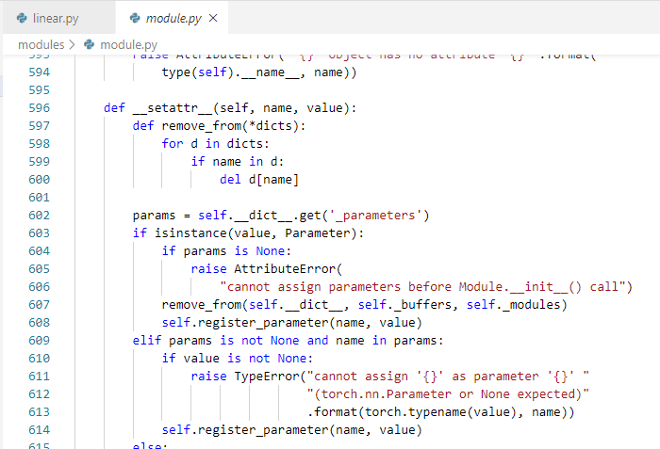
18.4 Module Class
https://www.youtube.com/watch?v=IKOHHItzukk&list=PLZbbT5o_s2xrfNyHZsM6ufI0iZENK9xgG&index=18
Module Class
In torch/nn/modules/module.py:
The inherited module includes the __setattr__() method.
We assign our layers as attributes inside our network module.
The module base class will see this and register our weight as learn about parameters of our network.
We focus on parameter and values.

Slide 13
18.5 Parameter and Value

Slide 14
18.5 Parameter and Value
https://www.youtube.com/watch?v=IKOHHItzukk&list=PLZbbT5o_s2xrfNyHZsM6ufI0iZENK9xgG&index=18
Parameter and Value
We focus the parameters and values that we pass for these parameters in the layers constructor.
1
2
1
2
3

Slide 15
18.6 Hyper Parameter and Depa
https://www.youtube.com/watch?v=IKOHHItzukk&list=PLZbbT5o_s2xrfNyHZsM6ufI0iZENK9xgG&index=18
Parameter and Value
First, we focus on parameter and arguments.
What is the difference between the parameter and argument?
Parameters are used inside the function definition. Parameter are placeholder.
Arguments, on the other hand, are the actual value passed to the function when the function is called.
Parameters of a function are the local variables that live inside of a function.
Arguments are the values that are assigned to these variables from the outside by the caller of the function.

Slide 16
18.5 Parameter and Value
https://www.youtube.com/watch?v=IKOHHItzukk&list=PLZbbT5o_s2xrfNyHZsM6ufI0iZENK9xgG&index=18
Parameter and Value
In our network example, the names are the parameters and the values we specified are the arguments.

Slide 17
18.5 Data Dependent/Hyperparameter

Slide 18
18.5 Data Dependent/Hyperparameter
https://www.youtube.com/watch?v=IKOHHItzukk&list=PLZbbT5o_s2xrfNyHZsM6ufI0iZENK9xgG&index=18
Hyperparameter and Data Dependent Hyperparameter
Two categories or types of parameters that we used when we constructed our layers.
Two categories are:
Hyperparameter and
Data Dependent hyperparameters
A lot of terms in Deep Learning are used loosely and the word parameter is definitely one of them.
A parameter is a placeholder
The argument is the value of the parameter
Argument / Value
48
Parameter

Slide 19
18.5 Data Dependent/Hyperparameter
https://www.youtube.com/watch?v=IKOHHItzukk&list=PLZbbT5o_s2xrfNyHZsM6ufI0iZENK9xgG&index=18
Hyperparameter and Data Dependent Hyperparameter
We can construct the layer. Passed value for each parameter to the layer constructor.
For the convolutional layers, we have three parameters.
For the linear layer, we have two parameter.

Slide 20
18.5 Data Dependent/Hyperparameter
https://www.youtube.com/watch?v=IKOHHItzukk&list=PLZbbT5o_s2xrfNyHZsM6ufI0iZENK9xgG&index=18
Hyperparameter and Data Dependent Hyperparameter
For the convolutional layers, we have in_channels, out_channels, and kernel_size.
For the linear layer, we have in_features and out_features.

Slide 21
18.5 Data Dependent/Hyperparameter
https://www.youtube.com/watch?v=IKOHHItzukk&list=PLZbbT5o_s2xrfNyHZsM6ufI0iZENK9xgG&index=18
Hyperparameter and Data Dependent Hyperparameter
Let’s see how these parameters are decided?
Start by looking at hyper parameters and see how the dependent hyperparameters.
Hyperparameters are parameters whose values are chosen manually and arbitrarily.
This means that as neural network programmer, we choose hyperparameter values mainly based on trial and error and increasingly by utilizing values that have proven to work well in the past.
For building our CNN layers, these are parameters we choose manually:
kernel size,
out_channels,
out_features.
When we say manually, we mean that these value are not derived value.
We normally test and tune these parameters to find the values that work best.

Slide 22
18.6 Setup Hyperparameter

Slide 23
18.6 Setup Hyperparameter
https://www.youtube.com/watch?v=IKOHHItzukk&list=PLZbbT5o_s2xrfNyHZsM6ufI0iZENK9xgG&index=18
Setup Hyperparameter
Let’s check the manually parameters and understand our decisions can impact the network architecture.
Parameter | Description
kernel_size | Sets the filter size, The words kernel and filter are interchangeable.
out_channels | Sets the number of filters. One filter produces one output channel.
out_features | Set the size of the output tensor.

Slide 24
18.6 Setup Hyperparameter
https://www.youtube.com/watch?v=IKOHHItzukk&list=PLZbbT5o_s2xrfNyHZsM6ufI0iZENK9xgG&index=18
Setup Hyperparameter
The kernel_size set the size of the filter that will be used inside the layer. In deep learning, the word kernel is another word for filter. We can say convolutional kernel or we can say convolutional filter.
Inside the convolutional layer, the input channels are paired with a convolutional filter to perform the convolution operation. The filter convolve the input channels and result of this operation is an output channel.
So one filter convolving the input channels gives us the corresponding output channels.
This is why we set our output channels. We are actually setting the number of filters.
If we pass the value of 6 for out_channel parameters indicating that we want 6 output channels. It also indicating that we want to have 6 filters inside the layer.

Slide 25
18.6 Setup Hyperparameter
https://www.youtube.com/watch?v=IKOHHItzukk&list=PLZbbT5o_s2xrfNyHZsM6ufI0iZENK9xgG&index=18
Setup Hyperparameter
In the case of out first convolutional layer, we have one input channel that will be convolved by 6 different filters (the code shows 5 different filters), which will create 6 output channels.

Slide 26
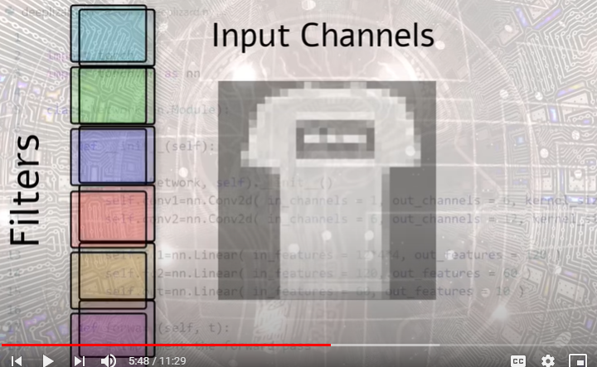
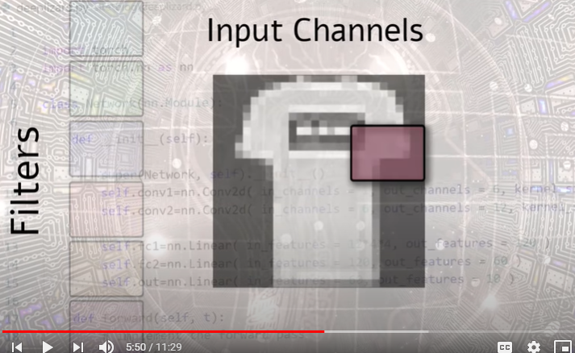
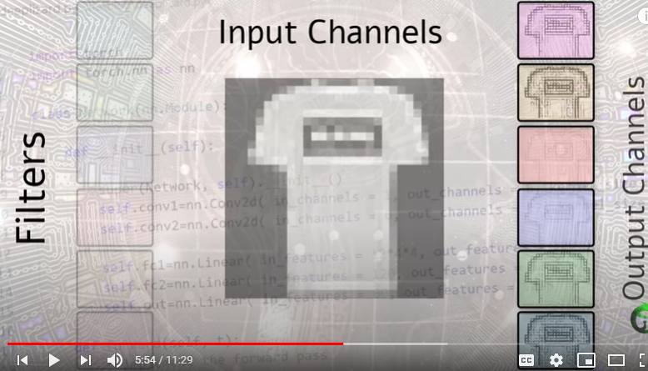
18.6 Setup Hyperparameter
https://www.youtube.com/watch?v=IKOHHItzukk&list=PLZbbT5o_s2xrfNyHZsM6ufI0iZENK9xgG&index=18
Setup Hyperparameter
One input channel that will be convolved by 6 different filters
We have 6 output channels.

Slide 27
18.6 Setup Hyperparameter
https://www.youtube.com/watch?v=IKOHHItzukk&list=PLZbbT5o_s2xrfNyHZsM6ufI0iZENK9xgG&index=18
Setup Hyperparameter
These output channel also go by another name. This name is feature maps.
If we are dealing with linear layers, we do not call the feature map because the output are just rank one tensors. We just refer them as features.
We have out_features instead of out_channels or feature maps.
We choose values for out_features based on arbitrarily on how many nodes we want in our layers, however, when we talk about the data dependent paramaters, we will see that there is a caveat (warning) with the output layer, the last linear layer.
Parameter | Description
kernel_size | Sets the filter size, The words kernel and filter are interchangeable.
out_channels | Sets the number of filters. One filter produces one output channel.
out_features | Set the size of the output tensor.

Slide 28
18.6 Setup Hyperparameter
https://www.youtube.com/watch?v=IKOHHItzukk&list=PLZbbT5o_s2xrfNyHZsM6ufI0iZENK9xgG&index=18
Setup Hyperparameter
One pattern that shows up quite often for setting these parameters is that we increase our output channels as we add additional convolutional layers.

Slide 29
18.6 Setup Hyperparameter
https://www.youtube.com/watch?v=IKOHHItzukk&list=PLZbbT5o_s2xrfNyHZsM6ufI0iZENK9xgG&index=18
Setup Hyperparameter
After we switch to linear layers, we shrink our out_features as we sort of filtered down to the number of output classes.
We have all these parameters impact our architecture.

Slide 30
18.6 Setup Hyperparameter
https://www.youtube.com/watch?v=IKOHHItzukk&list=PLZbbT5o_s2xrfNyHZsM6ufI0iZENK9xgG&index=18
Setup Hyperparameter
Specifically, these parameters directly impact the weight tensors inside the layers.
We will discuss more in future discussion.
We will learn about the parameters and inspect the weight tensor.

Slide 31
18.8 Data Dependent Hyperparameter

Slide 32
18.8 Data Dependent Hyperparameter
https://www.youtube.com/watch?v=IKOHHItzukk&list=PLZbbT5o_s2xrfNyHZsM6ufI0iZENK9xgG&index=18
Data Dependent Hyperparameter
Data Dependent Hyperparameter are parameters whose value depend on data.

Slide 33
18.8 Data Dependent Hyperparameter
https://www.youtube.com/watch?v=IKOHHItzukk&list=PLZbbT5o_s2xrfNyHZsM6ufI0iZENK9xgG&index=18
Data Dependent Hyperparameter
What are the parameters at the start of network and at the end of network?
The in_channels=1 of the first convolutional layer and last out_features=10 of the last linear filter.

Slide 34
18.8 Data Dependent Hyperparameter
https://www.youtube.com/watch?v=IKOHHItzukk&list=PLZbbT5o_s2xrfNyHZsM6ufI0iZENK9xgG&index=18
Data Dependent Hyperparameter
What are the parameters at the start of network and at the end of network?
The in_channels=1 of the first convolutional layer and last out_features=10 of the last linear filter.

Slide 35
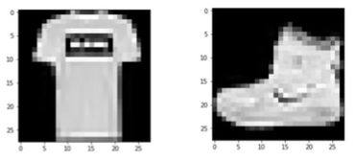
18.8 Data Dependent Hyperparameter
https://www.youtube.com/watch?v=IKOHHItzukk&list=PLZbbT5o_s2xrfNyHZsM6ufI0iZENK9xgG&index=18
Data Dependent Hyperparameter
The in_channels of first convolutional layer depend on number of color channels present inside the images that make up the training set.
Since we are dealing with grayscale images (= 1), the in_cahnnel = 1 (grayscale value).

Slide 36
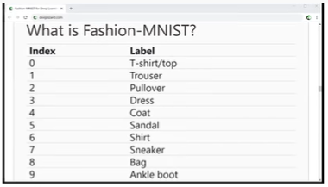
18.8 Data Dependent Hyperparameter
https://www.youtube.com/watch?v=IKOHHItzukk&list=PLZbbT5o_s2xrfNyHZsM6ufI0iZENK9xgG&index=18
Data Dependent Hyperparameter
The out_features of the output layer depend on number the number of classes that are present inside out training set.
We have 10 classes of clothing articles.
We know the out_features = 10 (10 classes or labels)

Slide 37
18.8 Data Dependent Hyperparameter
https://www.youtube.com/watch?v=IKOHHItzukk&list=PLZbbT5o_s2xrfNyHZsM6ufI0iZENK9xgG&index=18
Data Dependent Hyperparameter
The 10 outputs are the predictions from the network for each category.
In general, the input to one layer is the output from previous output layer.

Slide 38
18.8 Data Dependent Hyperparameter
https://www.youtube.com/watch?v=IKOHHItzukk&list=PLZbbT5o_s2xrfNyHZsM6ufI0iZENK9xgG&index=18
Data Dependent Hyperparameter
All the in_channel in the convolution layers and in_features in the linear layers depend on the data coming from the previous layers.
All these are data dependent hyperparameters.

Slide 39
18.8 Data Dependent Hyperparameter
https://www.youtube.com/watch?v=IKOHHItzukk&list=PLZbbT5o_s2xrfNyHZsM6ufI0iZENK9xgG&index=18
Data Dependent Hyperparameter
Now, when we switch from a convolutional layer to linear layer, we have to flatten out tensor.
We have 12*4*4 in_features for linear filter.

Slide 40
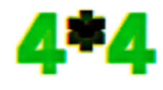
18.8 Data Dependent Hyperparameter
https://www.youtube.com/watch?v=IKOHHItzukk&list=PLZbbT5o_s2xrfNyHZsM6ufI0iZENK9xgG&index=18
Data Dependent Hyperparameter
The linear filter 12 * 4 * 4. The 12 come from the out_channels in the previous layer (conv2 layer).
Why do we have 4 * 4?

Slide 41
18.8 Data Dependent Hyperparameter
https://www.youtube.com/watch?v=IKOHHItzukk&list=PLZbbT5o_s2xrfNyHZsM6ufI0iZENK9xgG&index=18
Data Dependent Hyperparameter
Why do we have 4 * 4?
We will discuss in future. But for now, what is 4*4 represent?

Slide 42
18.9 Setup Data Table

Slide 43
18.9 Setup Data Table
https://www.youtube.com/watch?v=IKOHHItzukk&list=PLZbbT5o_s2xrfNyHZsM6ufI0iZENK9xgG&index=18
Parameter Table (1)
Check out this table for the parameter below and understand how the parameter is setting:
Layer | Parameter name | Param value | Description
Conv1 | In_channels | 1 | The number of color channel in the input image
Conv1 | Kernel_size | 5 | A hyperparameter
Conv1 | Out_channels | 6 | A hyperparameter
Conv2 | In_channels | 6 | The number of out_channels in the previous layer
Conv2 | Kernel_size | 5 | A hyperparameter
Conv2 | Out_channels | 12 | A hyperparameter (higher than previous conv layer)

Slide 44
18.9 Setup Data Table
https://www.youtube.com/watch?v=IKOHHItzukk&list=PLZbbT5o_s2xrfNyHZsM6ufI0iZENK9xgG&index=18
Parameter Table (2)
Layer | Parameter name | Param value | Description
fc1 | In_features | 12*4*4 | The length of the flatten output from previous layer
fc1 | Out_features | 120 | A hyperparameter
fc2 | In_features | 120 | The number of the out_features of previous layer
fc2 | Out_features | 60 | A hyperparameter
out | In_features | 60 | The number of the out_feature of previous layer
out | Out_features | 10 | Output feature (10)

Slide 45
18.10 Quiz

Slide 46
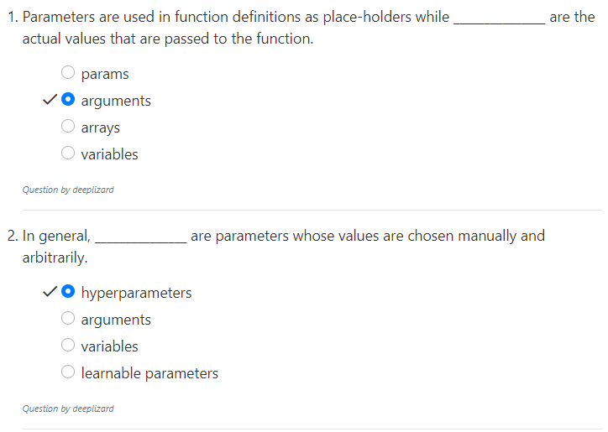
18.10 Quiz
https://www.youtube.com/watch?v=IKOHHItzukk&list=PLZbbT5o_s2xrfNyHZsM6ufI0iZENK9xgG&index=18
Quiz

Slide 47
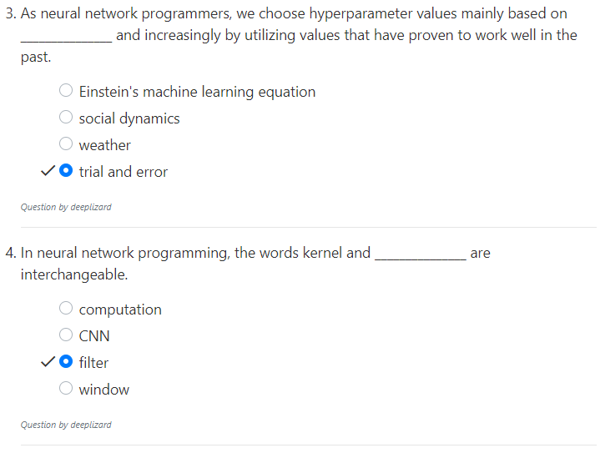
18.10 Quiz
https://www.youtube.com/watch?v=IKOHHItzukk&list=PLZbbT5o_s2xrfNyHZsM6ufI0iZENK9xgG&index=18
Quiz

Slide 48
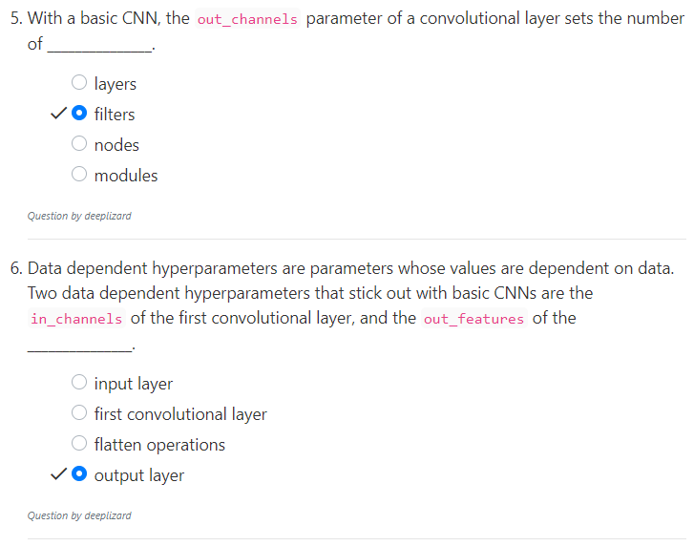
18.10 Quiz
https://www.youtube.com/watch?v=IKOHHItzukk&list=PLZbbT5o_s2xrfNyHZsM6ufI0iZENK9xgG&index=18
Quiz

Slide 49
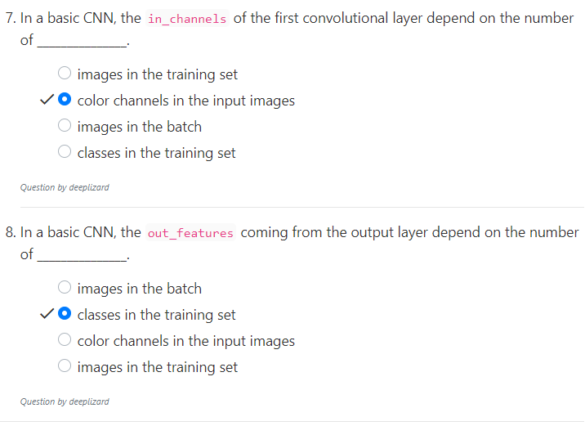
18.10 Quiz
https://www.youtube.com/watch?v=IKOHHItzukk&list=PLZbbT5o_s2xrfNyHZsM6ufI0iZENK9xgG&index=18
Quiz

Slide 50
End of Chapter

