Slide 1

19 Weight Tensor (Part 2)
Peter H. Chen

Slide 2
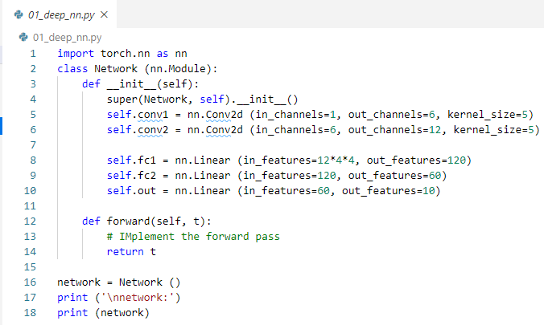
19 Weight Tensor (Part 2)
https://www.youtube.com/watch?v=stWU37L91Yc&list=PLZbbT5o_s2xrfNyHZsM6ufI0iZENK9xgG&index=19
Weight Tensor
We discuss wight tensor inside the CNN.
We find the weight tensor live inside our layers and all the learnable parameter of our networks.

Slide 3
19 Weight Tensor (Part 2)
https://www.youtube.com/watch?v=stWU37L91Yc&list=PLZbbT5o_s2xrfNyHZsM6ufI0iZENK9xgG&index=19
Weight Tensor
We define five layers inside our neural network constructor.
We will use these layers inside the forward method.
Now, we take a look of learnable parameter of networks.
We discussed hyperparameter in last discussion.
We saw the hyperparameters are parameters whose values are picked arbitrarily.
The hyperparameters are used to construct the network’s architecture.
Through the layers we constructed and assigned the class attributes, these hyperparameters are not the only parameter.
We will see more parameters when we start the training process.
What we are concerned now is different type of parameter called a learnable parameter.

Slide 4
19 Weight Tensor (Part 2)
https://www.youtube.com/watch?v=stWU37L91Yc&list=PLZbbT5o_s2xrfNyHZsM6ufI0iZENK9xgG&index=19
Learnable Parameters
The learnable parameters are parameters whose values are learned during the training process.
With learnable parameters, we typically start out with a set of arbitrary values, and these values then get updated in an iterative fashion as the network learns.
In fact, when we say that a network is learning, we specially mean that the network is learning the appropriate values for the learnable parameters.
Appropriate values are values that minimize the loss function.
When it comes to out network, we might be thinking: Where are these learnable parameters?
All we have so far is a network class with layers that have been assigned as class attributes.
The learnable parameters are the weights inside our network and they live inside each layer.
Using PyTorch, we can inspect the weights directly.
Let’s grab the instance of our network class and see this.

Slide 5
19.1 Deep Neural Network

Slide 6
19.1 Deep Neural Network
https://www.youtube.com/watch?v=stWU37L91Yc&list=PLZbbT5o_s2xrfNyHZsM6ufI0iZENK9xgG&index=19
Deep Neural Network
> network = Network()
When the code executed, the Network() class call constructor__init__().
The __init__() assigns 5 layers of attributes and return the object network.

Slide 7
19.1 Deep Neural Network
https://www.youtube.com/watch?v=stWU37L91Yc&list=PLZbbT5o_s2xrfNyHZsM6ufI0iZENK9xgG&index=19
Deep Neural Network
The five layers are attributes initialized with values of other objects.
The objects are nested inside other objects, the objects are created by PyTorch layers classes.

Slide 8
19.1 Deep Neural Network
https://www.youtube.com/watch?v=stWU37L91Yc&list=PLZbbT5o_s2xrfNyHZsM6ufI0iZENK9xgG&index=19
Deep Neural Network
After the objects are initialized, we can access the object by the network variable.

Slide 9
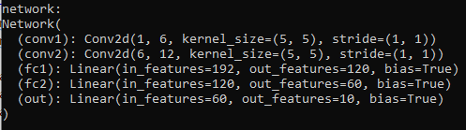
19.1 Deep Neural Network
https://www.youtube.com/watch?v=stWU37L91Yc&list=PLZbbT5o_s2xrfNyHZsM6ufI0iZENK9xgG&index=19
Deep Neural Network
Th print function print console a string representation.

Slide 10
19.1 Deep Neural Network
https://www.youtube.com/watch?v=stWU37L91Yc&list=PLZbbT5o_s2xrfNyHZsM6ufI0iZENK9xgG&index=19
Deep Neural Network
The print out is a details of network architecture.
Listing out the network layers and showing the values that we passed to the layer constructors.
The Network Class is inheriting the functionality form PyTorch base class Module.

Slide 11
19.2 Remove Inherit Module

Slide 12
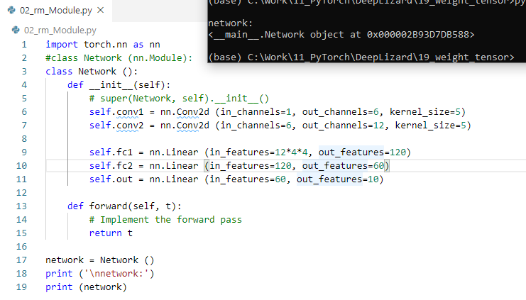
19.2 Remove Inherit Module
https://www.youtube.com/watch?v=stWU37L91Yc&list=PLZbbT5o_s2xrfNyHZsM6ufI0iZENK9xgG&index=19
Learnable Parameters
If we remove inheritance of Module class.
The “<__main__.Network object at …>” is Python string representation.
We do not have attributes (objects) inside the Network object.

Slide 13
19.2 Remove Inherit Module
https://www.youtube.com/watch?v=stWU37L91Yc&list=PLZbbT5o_s2xrfNyHZsM6ufI0iZENK9xgG&index=19
Learnable Parameters
When we extend the class with Module by “Network(Module)”, we get all the functionality of Module.
We can add additional functionality.
We can also override the exiting functionality by changing it to behave differently.

Slide 14
19.3 String Representation

Slide 15
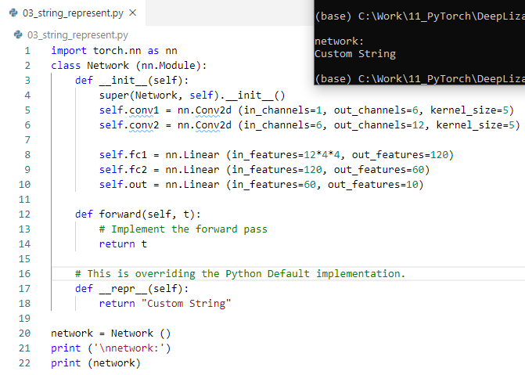
19.3 String Representation
https://www.youtube.com/watch?v=stWU37L91Yc&list=PLZbbT5o_s2xrfNyHZsM6ufI0iZENK9xgG&index=19
String Representation
We can also override the exiting functionality by changing it to behave differently.
We can change the string representation by
> def__repr__(self):
> return “Custom String”
“__repr__” is short for “representation”.

Slide 16
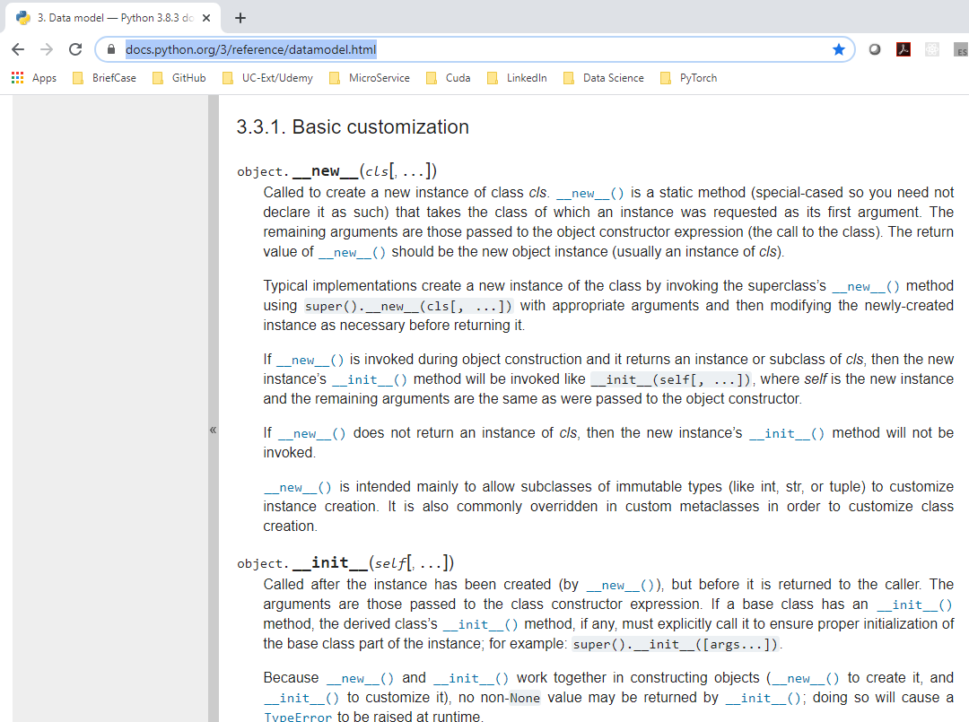
19.3 String Representation
https://www.youtube.com/watch?v=stWU37L91Yc&list=PLZbbT5o_s2xrfNyHZsM6ufI0iZENK9xgG&index=19
String Representation
https://docs.python.org/3/reference/datamodel.html
The definition of __init__, __repr__, and etc. can be found under Python release Lib/collection/__init__.py

Slide 17
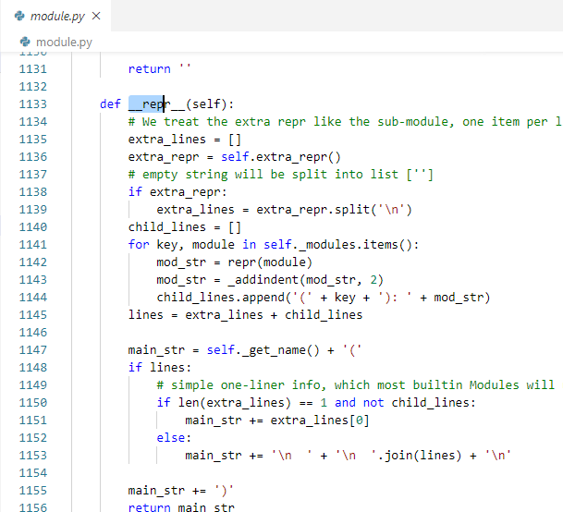
19.3 String Representation
https://www.youtube.com/watch?v=stWU37L91Yc&list=PLZbbT5o_s2xrfNyHZsM6ufI0iZENK9xgG&index=19
String Representation
The “__init__ (self)” is special for constructor.
There are other methods, such as, “__repr__” is for string representation for object.
All the Python special method are embed with “__name__”
The PyTorch method __repr__ in Module class overrides the __repr__ method in Python Lib/collection/__init__.py.

Slide 18
19.3 String Representation
https://www.youtube.com/watch?v=stWU37L91Yc&list=PLZbbT5o_s2xrfNyHZsM6ufI0iZENK9xgG&index=19
String Representation
Use jupyter debugger to walk through the PyTroch Lirbary source code.

Slide 19
19.3 String Representation
https://www.youtube.com/watch?v=stWU37L91Yc&list=PLZbbT5o_s2xrfNyHZsM6ufI0iZENK9xgG&index=19
String Representation
Look at the string representation that PyTorch give us is pretty match what we expected based on how configured our network layers.

Slide 20
19.4 Kernel Size and Stride

Slide 21
19.4 Kernel Size and Stride
https://www.youtube.com/watch?v=stWU37L91Yc&list=PLZbbT5o_s2xrfNyHZsM6ufI0iZENK9xgG&index=19
Kernel Size and Stride
The convolutional layer, the kernel size argument is a Python tuple (5, 5). Even we pass in kernel_size = 5 in the constructor.
This is because our filter actually have height and width.

Slide 22
19.4 Kernel Size and Stride
https://www.youtube.com/watch?v=stWU37L91Yc&list=PLZbbT5o_s2xrfNyHZsM6ufI0iZENK9xgG&index=19
Kernel Size and Stride
When we passed in the kernel_size = 5 to the constructor, the constructor assume the square filter.

Slide 23
19.4 Kernel Size and Stride
https://www.youtube.com/watch?v=stWU37L91Yc&list=PLZbbT5o_s2xrfNyHZsM6ufI0iZENK9xgG&index=19
Kernel Size and Stride
Next, we have a stride which is (1, 1).
When the stride is not specified in the layer constructor, the layer automatically set it.
The stride tells the convolution layer how far the filter should slide.

Slide 24
19.4 Kernel Size and Stride
https://www.youtube.com/watch?v=stWU37L91Yc&list=PLZbbT5o_s2xrfNyHZsM6ufI0iZENK9xgG&index=19
Kernel Size and Stride
The stride (1, 1), the first argument 1 means move 1 unit when move from left to right.
The second argument 1 means move 1 unit down when move from up to down.

Slide 25
19.5 Layer Information

Slide 26
19.5 Layer Information
https://www.youtube.com/watch?v=stWU37L91Yc&list=PLZbbT5o_s2xrfNyHZsM6ufI0iZENK9xgG&index=19
Layer Information
For the Linear Layer, we have the additional parameter called the bias.

Slide 27
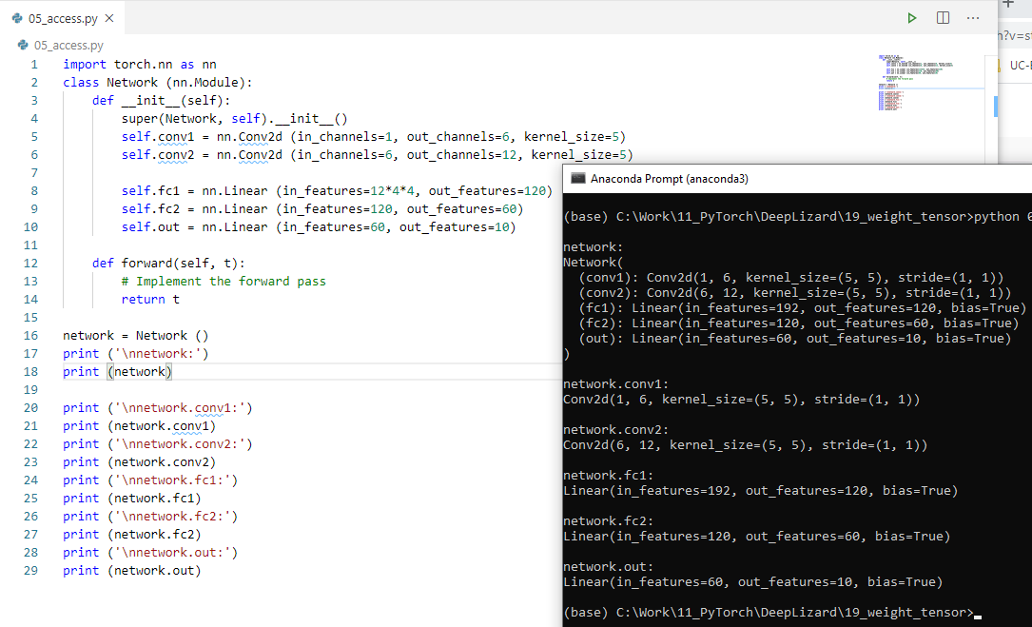
19.5 Layer Information
https://www.youtube.com/watch?v=stWU37L91Yc&list=PLZbbT5o_s2xrfNyHZsM6ufI0iZENK9xgG&index=19
Layer Information
We can access each object information by network.conv1, network.conv2, and etc.

Slide 28
19.6 Conv Weight

Slide 29
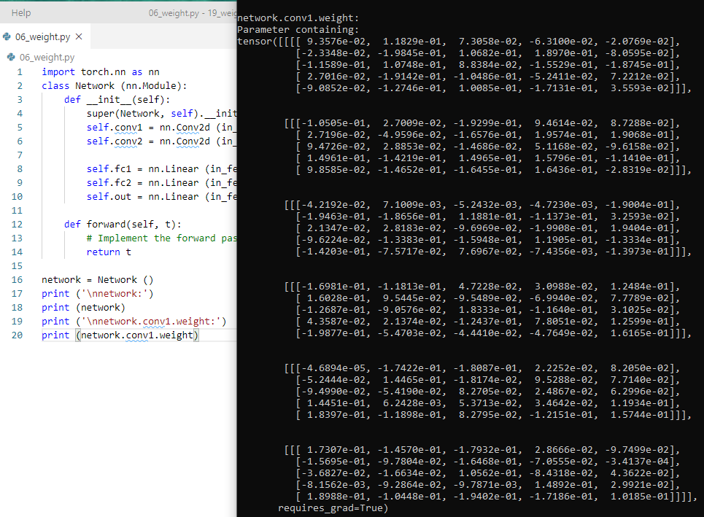
19.6 Conv Weight
https://www.youtube.com/watch?v=stWU37L91Yc&list=PLZbbT5o_s2xrfNyHZsM6ufI0iZENK9xgG&index=19
Conv Weight
> print (network.conv1.weight)
First, access the conv1 object nested inside the network object, and
then access the weight object that live inside the conv1 layer object.
All these objects are chained or linked together.

Slide 30
19.6 Conv Weight
https://www.youtube.com/watch?v=stWU37L91Yc&list=PLZbbT5o_s2xrfNyHZsM6ufI0iZENK9xgG&index=19
Conv Weight
There is “Parameter containing” for this special wight tensor.
This means the tensor is actually learn when we train.
As we train these weight values are updated in such a way that loss function is minimized.

Slide 31
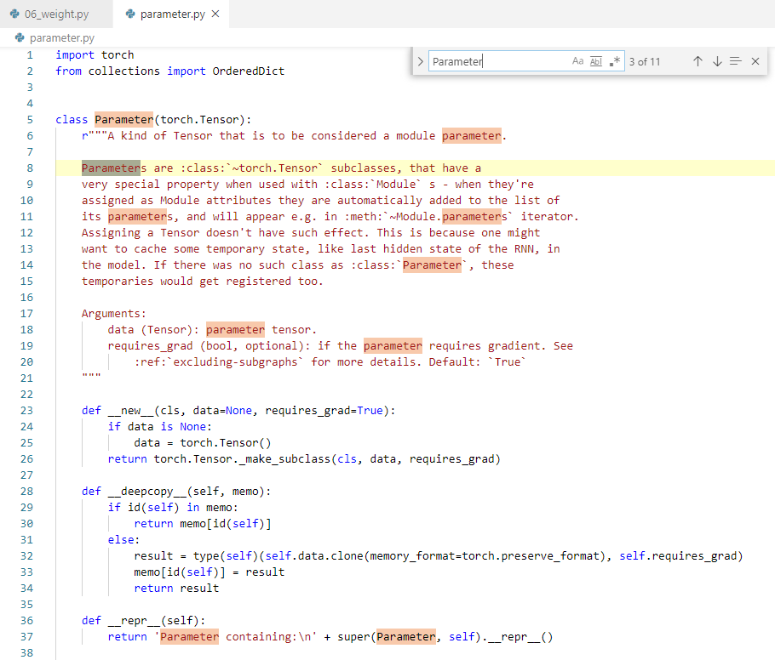
19.6 Conv Weight
https://www.youtube.com/watch?v=stWU37L91Yc&list=PLZbbT5o_s2xrfNyHZsM6ufI0iZENK9xgG&index=19
Conv Weight
The Lib/site-packages/torhc/nn/parameter.py has a Parameter Class.
The Parameter class extends the torch.Tensor class.
The weight tensor inside every layer is an instance of this Parameter class.
This is why we saw the “Parameter Containing:” text overriding with __repr__ + with super().__repr_ message.

Slide 32
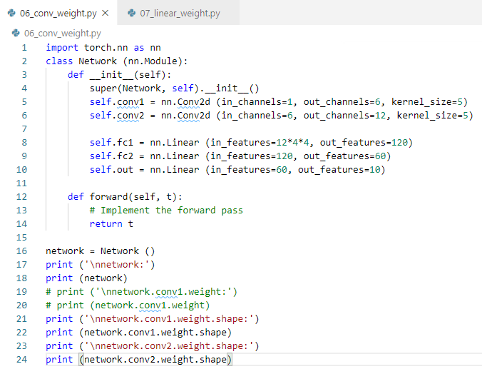
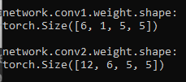
19.6 Conv Weight
https://www.youtube.com/watch?v=stWU37L91Yc&list=PLZbbT5o_s2xrfNyHZsM6ufI0iZENK9xgG&index=19
Conv Weight

Slide 33
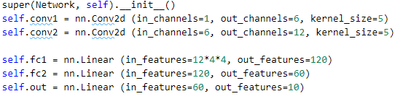
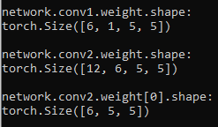
19.6 Conv Weight
https://www.youtube.com/watch?v=stWU37L91Yc&list=PLZbbT5o_s2xrfNyHZsM6ufI0iZENK9xgG&index=19
Conv Weight
First conv1 layer is one color channel.
Convolutional Layers
Layer Weight

Slide 34
19.6 Conv Weight
https://www.youtube.com/watch?v=stWU37L91Yc&list=PLZbbT5o_s2xrfNyHZsM6ufI0iZENK9xgG&index=19
Conv Weight
First conv2 layer is one color channel.
Convolutional Layers
Layer Weight

Slide 35
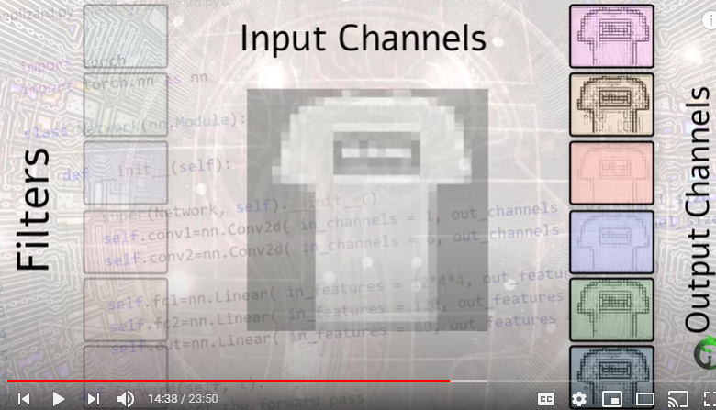
19.6 Conv Weight
https://www.youtube.com/watch?v=stWU37L91Yc&list=PLZbbT5o_s2xrfNyHZsM6ufI0iZENK9xgG&index=19
Conv Weight
Convolution result.

Slide 36
19.7 Linear Weight

Slide 37
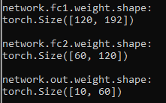
19.7 Linear Weight
https://www.youtube.com/watch?v=stWU37L91Yc&list=PLZbbT5o_s2xrfNyHZsM6ufI0iZENK9xgG&index=19
Linear Weight
For Linear layers.
Convolutional Layers
Layer Weight

Slide 38
19.8 Matrix Operation

Slide 39
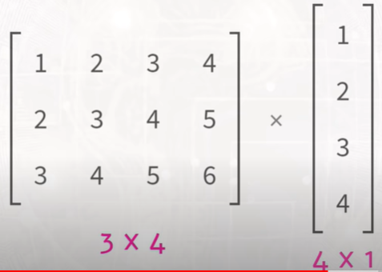
19.8 Matrix Operation
https://www.youtube.com/watch?v=stWU37L91Yc&list=PLZbbT5o_s2xrfNyHZsM6ufI0iZENK9xgG&index=19
Matrix Operation
We have two tensors = [3 x 4] x [4 x 1]
Matrix multiplication

Slide 40
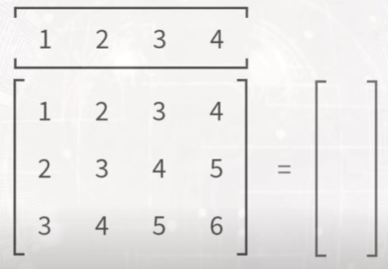
19.8 Matrix Operation
https://www.youtube.com/watch?v=stWU37L91Yc&list=PLZbbT5o_s2xrfNyHZsM6ufI0iZENK9xgG&index=19
Matrix Operation
We have two tensors = [3 x 4] x [4 x 1]
Matrix multiplication

Slide 41
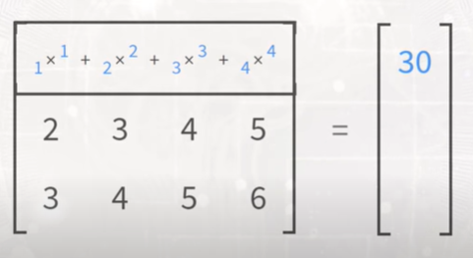
19.8 Matrix Operation
https://www.youtube.com/watch?v=stWU37L91Yc&list=PLZbbT5o_s2xrfNyHZsM6ufI0iZENK9xgG&index=19
Matrix Operation
We have two tensors = [3 x 4] x [4 x 1]
Matrix multiplication

Slide 42
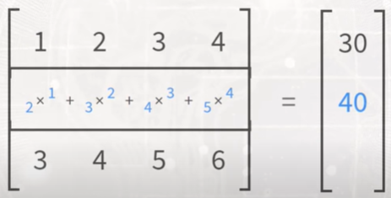
19.8 Matrix Operation
https://www.youtube.com/watch?v=stWU37L91Yc&list=PLZbbT5o_s2xrfNyHZsM6ufI0iZENK9xgG&index=19
Matrix Operation
We have two tensors = [3 x 4] x [4 x 1]
Matrix multiplication

Slide 43
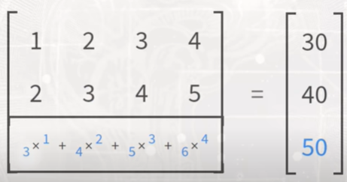
19.8 Matrix Operation
https://www.youtube.com/watch?v=stWU37L91Yc&list=PLZbbT5o_s2xrfNyHZsM6ufI0iZENK9xgG&index=19
Matrix Operation
We have two tensors = [3 x 4] x [4 x 1]
Matrix multiplication

Slide 44
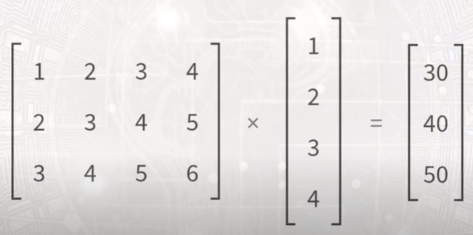
19.8 Matrix Operation
https://www.youtube.com/watch?v=stWU37L91Yc&list=PLZbbT5o_s2xrfNyHZsM6ufI0iZENK9xgG&index=19
Matrix Operation
We have two tensors = [3 x 4] x [4 x 1] = [3x1]
Matrix multiplication

Slide 45
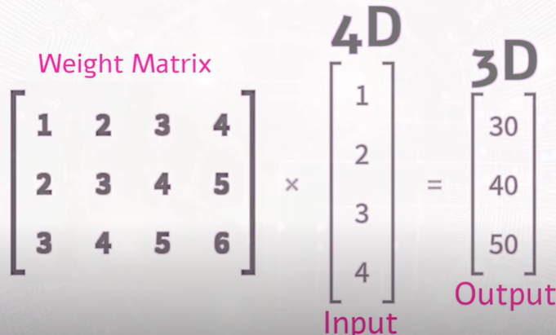
19.8 Matrix Operation)
https://www.youtube.com/watch?v=stWU37L91Yc&list=PLZbbT5o_s2xrfNyHZsM6ufI0iZENK9xgG&index=19
Matrix Operation
We have two tensors = [3 x 4] x [4 x 1] = [3x1]
Matrix multiplication

Slide 46
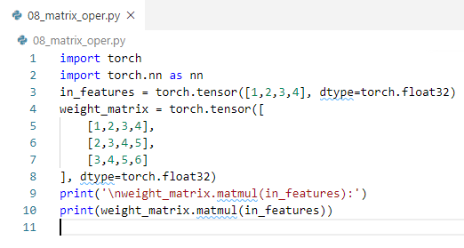
19.8 Matrix Operation
https://www.youtube.com/watch?v=stWU37L91Yc&list=PLZbbT5o_s2xrfNyHZsM6ufI0iZENK9xgG&index=19
Matrix Operation
How to perform the matrix operation in PyTorch?

Slide 47
19.9 Access Parameter

Slide 48
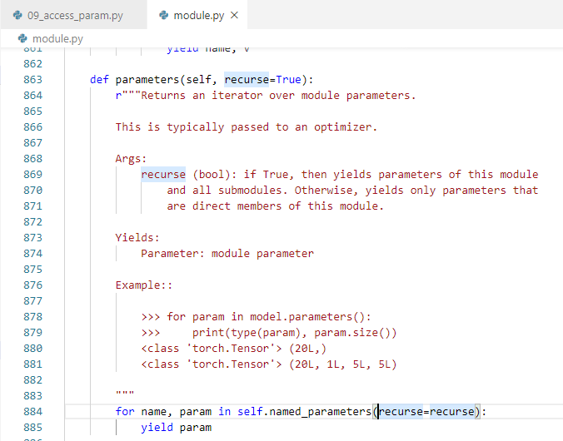
19.9 Access Parameter)
https://www.youtube.com/watch?v=stWU37L91Yc&list=PLZbbT5o_s2xrfNyHZsM6ufI0iZENK9xgG&index=19
How to access the parameter?

Slide 49
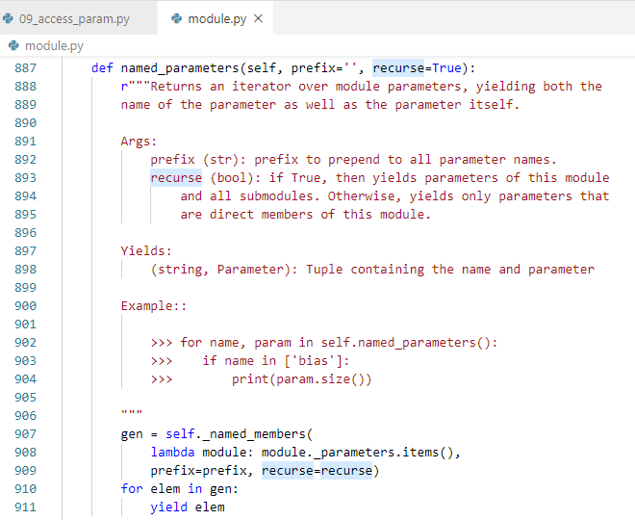
19.9 Access Parameter
https://www.youtube.com/watch?v=stWU37L91Yc&list=PLZbbT5o_s2xrfNyHZsM6ufI0iZENK9xgG&index=19
How to access the parameter?

Slide 50
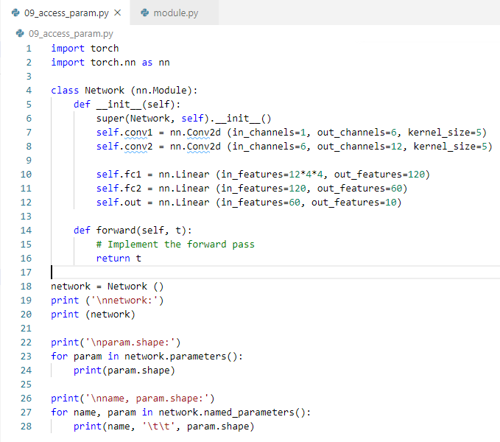
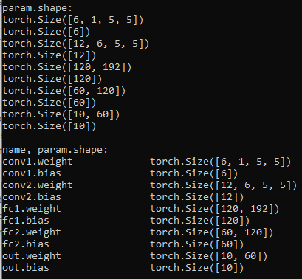
19.9 Access Parameter
https://www.youtube.com/watch?v=stWU37L91Yc&list=PLZbbT5o_s2xrfNyHZsM6ufI0iZENK9xgG&index=19
How to access the parameter?

Slide 51
19.10 Quiz

Slide 52
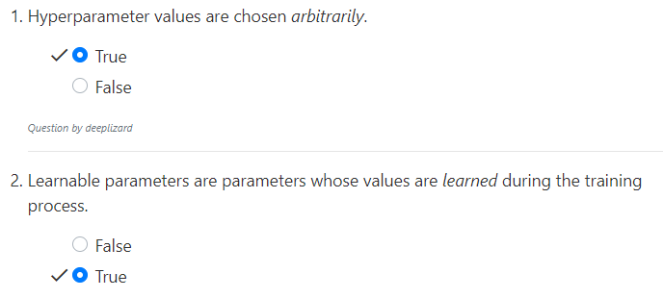
19.10 Quiz
https://www.youtube.com/watch?v=stWU37L91Yc&list=PLZbbT5o_s2xrfNyHZsM6ufI0iZENK9xgG&index=19
Quiz

Slide 53
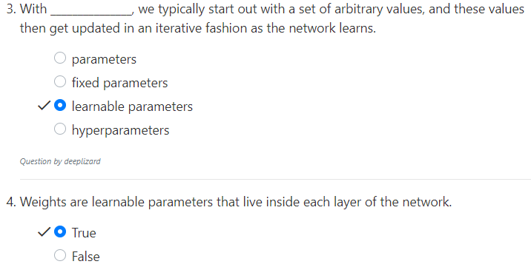
19.10 Quiz
https://www.youtube.com/watch?v=stWU37L91Yc&list=PLZbbT5o_s2xrfNyHZsM6ufI0iZENK9xgG&index=19
Quiz

Slide 54
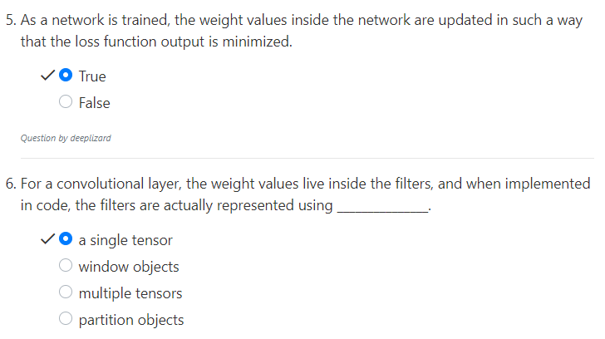
19.10 Quiz
https://www.youtube.com/watch?v=stWU37L91Yc&list=PLZbbT5o_s2xrfNyHZsM6ufI0iZENK9xgG&index=19
Quiz

Slide 55
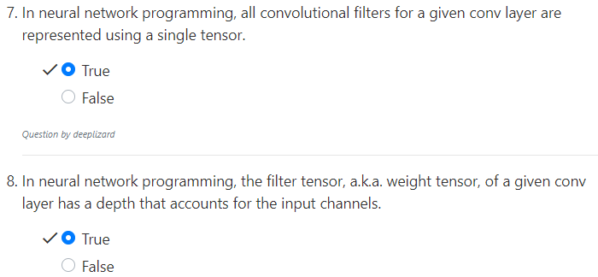
19.10 Quiz
https://www.youtube.com/watch?v=stWU37L91Yc&list=PLZbbT5o_s2xrfNyHZsM6ufI0iZENK9xgG&index=19
Quiz

Slide 56
19.10 Quiz
https://www.youtube.com/watch?v=stWU37L91Yc&list=PLZbbT5o_s2xrfNyHZsM6ufI0iZENK9xgG&index=19
Quiz

Slide 57
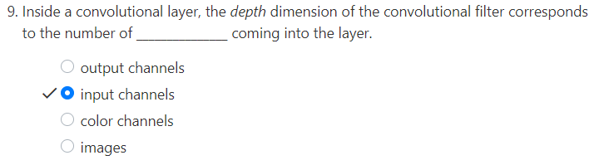
19.10 Quiz
https://www.youtube.com/watch?v=stWU37L91Yc&list=PLZbbT5o_s2xrfNyHZsM6ufI0iZENK9xgG&index=19
Quiz

Slide 58
End of Chapter

