Slide 1

20 Linear Layer (Part 2)
Peter H. Chen

Slide 2
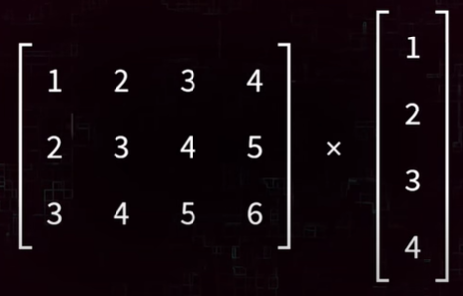
20 Linear Layer (Part 2)
https://www.youtube.com/watch?v=rcc86nXKwkw&list=PLZbbT5o_s2xrfNyHZsM6ufI0iZENK9xgG&index=20
Linear Layer
Linear Layer transform the in_features to out_features.
In_features are received by a linear layer.

Slide 3
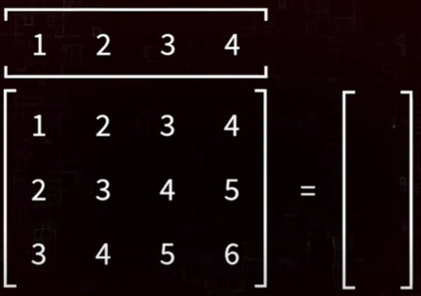
20 Linear Layer (Part 2)
https://www.youtube.com/watch?v=rcc86nXKwkw&list=PLZbbT5o_s2xrfNyHZsM6ufI0iZENK9xgG&index=20
Linear Layer
Input features are passed in the form of a flattened one-dimensional tensor.

Slide 4
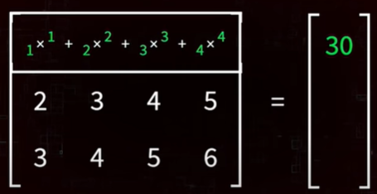
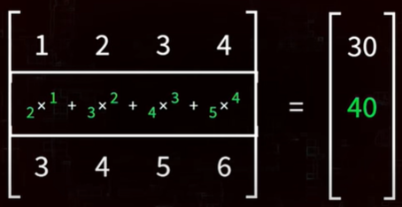
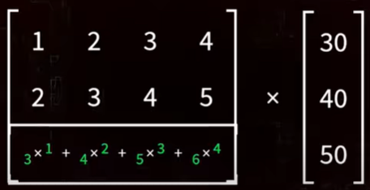
20 Linear Layer (Part 2)
https://www.youtube.com/watch?v=rcc86nXKwkw&list=PLZbbT5o_s2xrfNyHZsM6ufI0iZENK9xgG&index=20
Linear Layer
Multiple by the weight matrix.

Slide 5
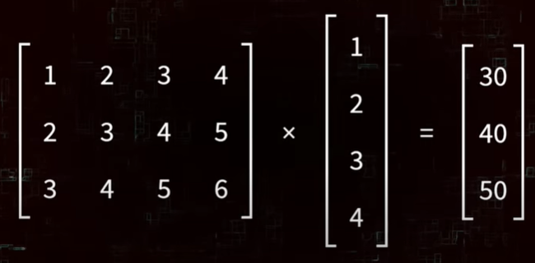
20 Linear Layer (Part 2)
https://www.youtube.com/watch?v=rcc86nXKwkw&list=PLZbbT5o_s2xrfNyHZsM6ufI0iZENK9xgG&index=20
Linear Layer
This matrix multiplication produces output features.

Slide 6
20.1 Output from Matrix Transform

Slide 7
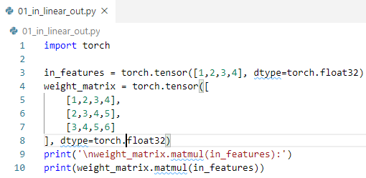

20.1 Output from Matrix Transform
https://www.youtube.com/watch?v=rcc86nXKwkw&list=PLZbbT5o_s2xrfNyHZsM6ufI0iZENK9xgG&index=20
Output from Matrix transform from Input
Implement the Linear Filter multiplication
Create one-dimensional tensor called in_features.
Create weight matrix
Use matmul function to perform multiplication that produces a one-dimensional tensor.
This is a 3x4 matrix Euclidean space input maps into 3x1 Euclidean space output.

Slide 8
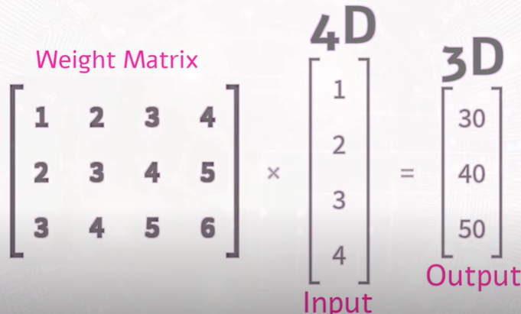
20.1 Output from Matrix Transform
https://www.youtube.com/watch?v=rcc86nXKwkw&list=PLZbbT5o_s2xrfNyHZsM6ufI0iZENK9xgG&index=20
Output from Matrix transform from Input
This is how linear layers work.
Linear Layers maps an in_features space to an out_features using a weight matrix.

Slide 9
20.1 Output from Matrix Transform
https://www.youtube.com/watch?v=rcc86nXKwkw&list=PLZbbT5o_s2xrfNyHZsM6ufI0iZENK9xgG&index=20
Output from Matrix transform from Input
We define a linear layer that accept 4 input features and transform into 3 output features. We map from 4 dimensional space into 3 dimensional space.
> fc = nn.Linear (in_features=4, out_features=3)

Slide 10
20.2 Linear Layer w/o Parameter

Slide 11
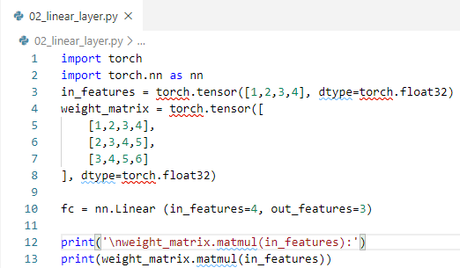

20.2 Linear Layer w/o Parameter
https://www.youtube.com/watch?v=rcc86nXKwkw&list=PLZbbT5o_s2xrfNyHZsM6ufI0iZENK9xgG&index=20
PyTorch Linear Layer w/o Parameter
Now, we need a weight_matrix is used to perform this operation. Where is the weight matrix?
Weight matrix live inside the PyTorch linear layer class and created by PyTorch. The PyTorch linear layer class uses the number 4 and 3 that are passed into the constructor to create a 3 by 4 weight matrix.

Slide 12
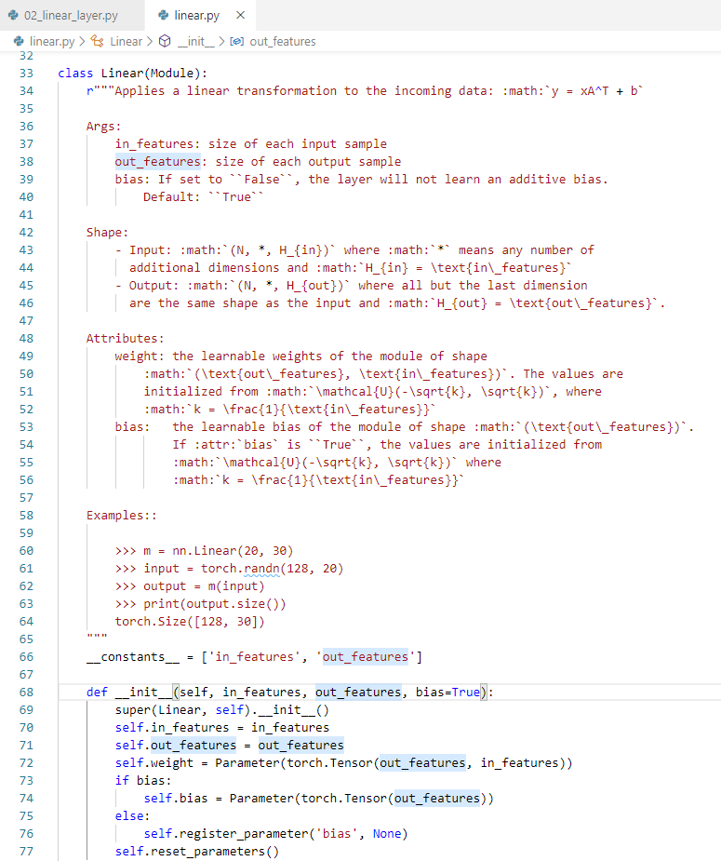
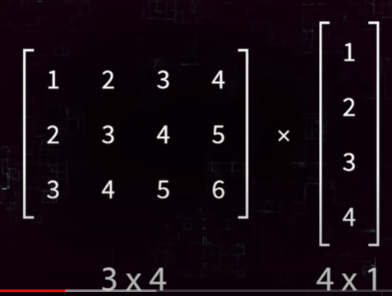
20.2 Linear Layer w/o Parameter
https://www.youtube.com/watch?v=rcc86nXKwkw&list=PLZbbT5o_s2xrfNyHZsM6ufI0iZENK9xgG&index=20
PyTorch Linear Layer w/o Parameter
Let’s Verify at the PyTorch source code nn.Linear().
Check the in_features, out_features, and weight.

Slide 13


20.2 Linear Layer w/o Parameter
https://www.youtube.com/watch?v=rcc86nXKwkw&list=PLZbbT5o_s2xrfNyHZsM6ufI0iZENK9xgG&index=20
PyTorch Linear Layer w/o Parameter
PyTorch instances are callable Python Object.
We can passed in the input features.
> fc (in_features)
The out put is one dimensional tensor with three elements, however, different values are produced here.
Because PyTroch create a weight matrix and initializes it with random values.

Slide 14
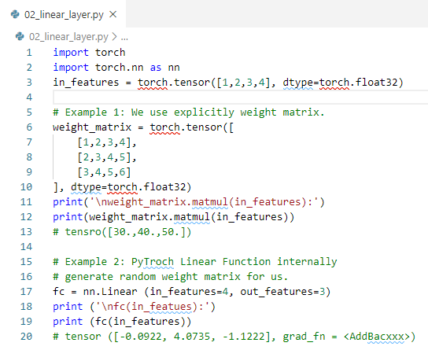

20.2 Linear Layer w/o Parameter
https://www.youtube.com/watch?v=rcc86nXKwkw&list=PLZbbT5o_s2xrfNyHZsM6ufI0iZENK9xgG&index=20
PyTorch Linear Layer w/o Parameter
This means that the linear function from the two examples are indeed different.
(4:40/13:20)

Slide 15
20.3 Linear Layer with Bias On

Slide 16
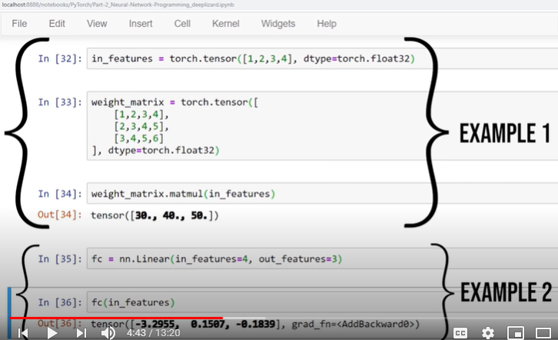
20.3 Linear Layer with Bias On
https://www.youtube.com/watch?v=rcc86nXKwkw&list=PLZbbT5o_s2xrfNyHZsM6ufI0iZENK9xgG&index=20
PyTorch Linear Layer
Use two different examples for different functionalities.
The weight is updating during the training process.

Slide 17
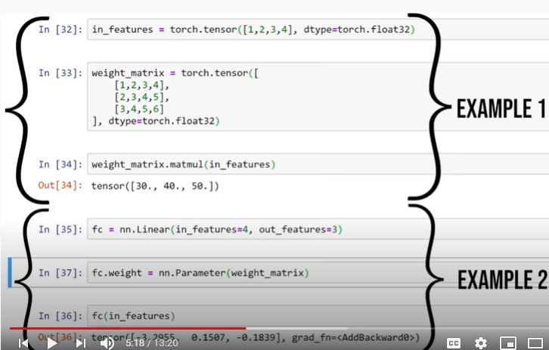
20.3 Linear Layer with Bias On
https://www.youtube.com/watch?v=rcc86nXKwkw&list=PLZbbT5o_s2xrfNyHZsM6ufI0iZENK9xgG&index=20
PyTorch Linear Layer
PyTorch module weights need to be Parameter
Parameters need to be instances of the parameter class
> fc.weight = nn.Parameter (weight_matrix)

Slide 18
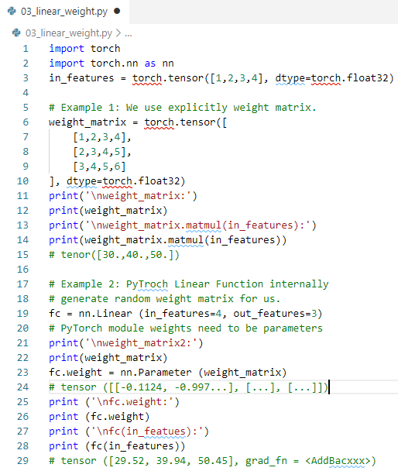
20.3 Linear Layer with Bias On
https://www.youtube.com/watch?v=rcc86nXKwkw&list=PLZbbT5o_s2xrfNyHZsM6ufI0iZENK9xgG&index=20
PyTorch Linear Layer
Add Parameter(weight_matrix).

Slide 19
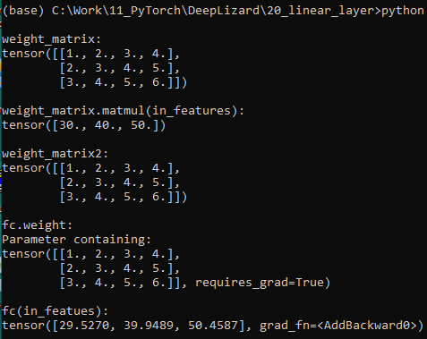
20.3 Linear Layer with Bias On
https://www.youtube.com/watch?v=rcc86nXKwkw&list=PLZbbT5o_s2xrfNyHZsM6ufI0iZENK9xgG&index=20
PyTorch Linear Layer
Add Parameter(weight_matrix).
This time, the weight result is very close to output of matmulr(in_features).
This is because the Linear Layer is adding a biased tensor to the output.

Slide 20
20.4 Linear Layer with Bias Off

Slide 21
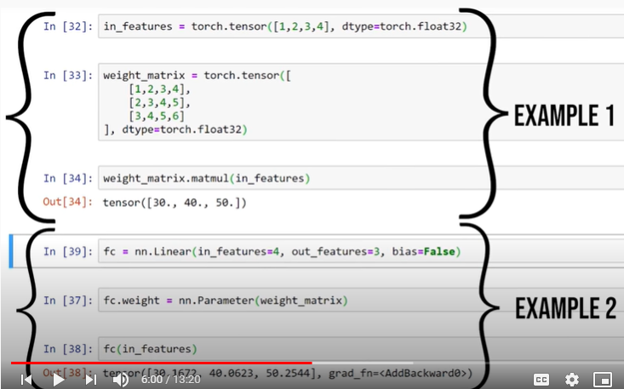
20.4 Linear Layer with Bias Off
https://www.youtube.com/watch?v=rcc86nXKwkw&list=PLZbbT5o_s2xrfNyHZsM6ufI0iZENK9xgG&index=20
Linear Layer with Bias Off
We can turn the bias off to the constructor.

Slide 22
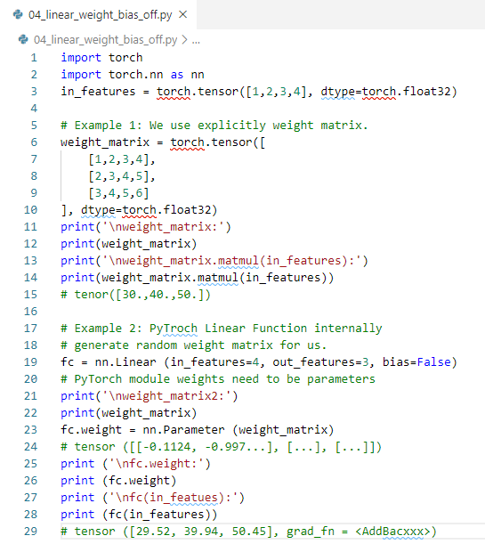
20.4 Linear Layer with Bias Off
https://www.youtube.com/watch?v=rcc86nXKwkw&list=PLZbbT5o_s2xrfNyHZsM6ufI0iZENK9xgG&index=20
Linear Layer with Bias Off
When we turn off the bias.

Slide 23
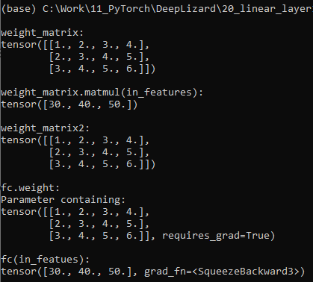
20.4 Linear Layer with Bias Off
https://www.youtube.com/watch?v=rcc86nXKwkw&list=PLZbbT5o_s2xrfNyHZsM6ufI0iZENK9xgG&index=20
Linear Layer with Bias Off
When we turn off the bias, we have the exactly match.
This is how Linear Layers works.

Slide 24
20.5 Linear Transform Math

Slide 25
20.5 Linear Transform Math
https://www.youtube.com/watch?v=rcc86nXKwkw&list=PLZbbT5o_s2xrfNyHZsM6ufI0iZENK9xgG&index=20
Mathematical Notation of the Linear Transformation
y = Ax + b
Variable | Definition
A | Weight matrix tensor
x | Input tensor
b | Bias tensor
y | Output tensor

Slide 26
20.5 Linear Transform Math
https://www.youtube.com/watch?v=rcc86nXKwkw&list=PLZbbT5o_s2xrfNyHZsM6ufI0iZENK9xgG&index=20
Write the y = Ax + b into Layer (input).
In PyTorh, it implements another special Python method __CALL__ (input).
If a class implements this special call method, the special call method will be invoked any time the object instance is called.
This is an important PyTorch concept because of the way the special call method interacts with the forward (input) method for our layers networks instead of calling a forward method directly, we call the object instance instead.
After the object instance is called, the special __call__(input) method is invoked under the PyTorch and call method in turns invokes the forward (input) for us and this applies to all PyTorch neural network modules, namely, networks and layers.
Let’s debugging the PyTorch Linear Layer.

Slide 27
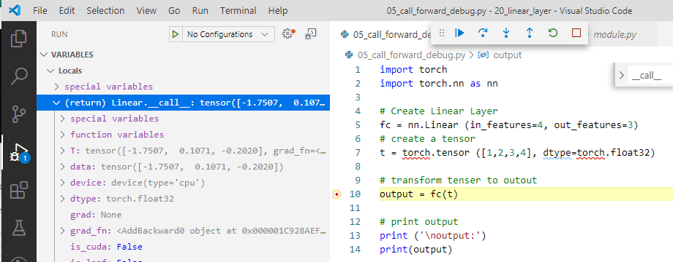
20.5 Linear Transform Math
https://www.youtube.com/watch?v=rcc86nXKwkw&list=PLZbbT5o_s2xrfNyHZsM6ufI0iZENK9xgG&index=20
Back to the Linear Layer program
When we input the tensor to Linear Layer, it first invokes __call__() in the module.py.

Slide 28
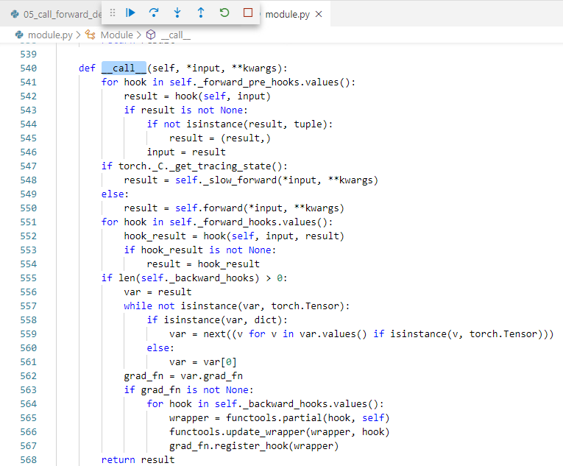
20.5 Linear Transform Math
https://www.youtube.com/watch?v=rcc86nXKwkw&list=PLZbbT5o_s2xrfNyHZsM6ufI0iZENK9xgG&index=20
In the moduel.py, the __call__() invokes the forward() method.
> result = self.forward ()

Slide 29
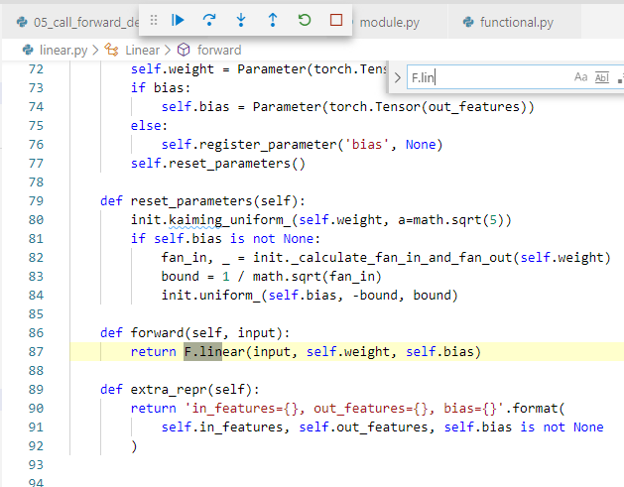
20.5 Linear Transform Math
https://www.youtube.com/watch?v=rcc86nXKwkw&list=PLZbbT5o_s2xrfNyHZsM6ufI0iZENK9xgG&index=20
In the linear.py, call forward (), and then F.linear()

Slide 30
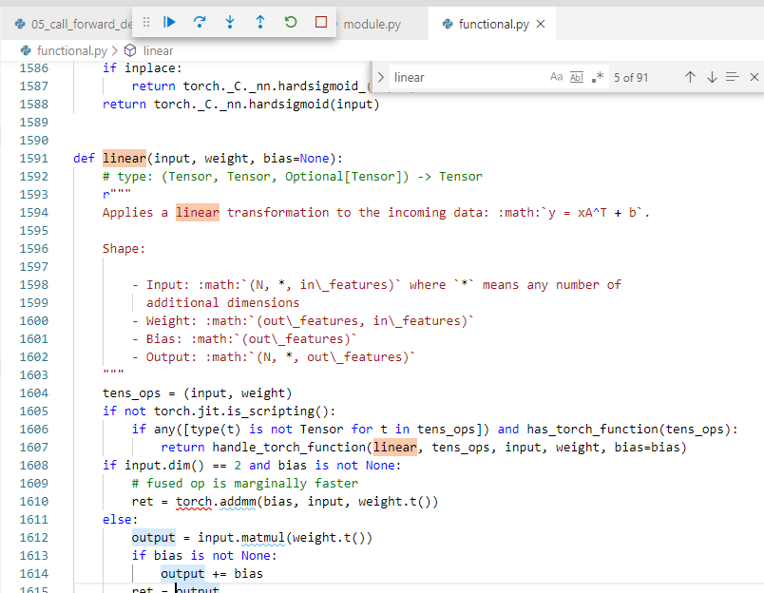
20.5 Linear Transform Math
https://www.youtube.com/watch?v=rcc86nXKwkw&list=PLZbbT5o_s2xrfNyHZsM6ufI0iZENK9xgG&index=20
In the functional.py, the linear() is called.

Slide 31
20.5 Linear Transform Math
https://www.youtube.com/watch?v=rcc86nXKwkw&list=PLZbbT5o_s2xrfNyHZsM6ufI0iZENK9xgG&index=20
This is the forward() method implementation.
It uses the linear function that lives in the functional package.
That is Capital F is. Torch.funcitnal.
Note that we passed in the input tensor, weight tensor, and bias tensor.
These are three elements needed in order to produce the output.

Slide 32
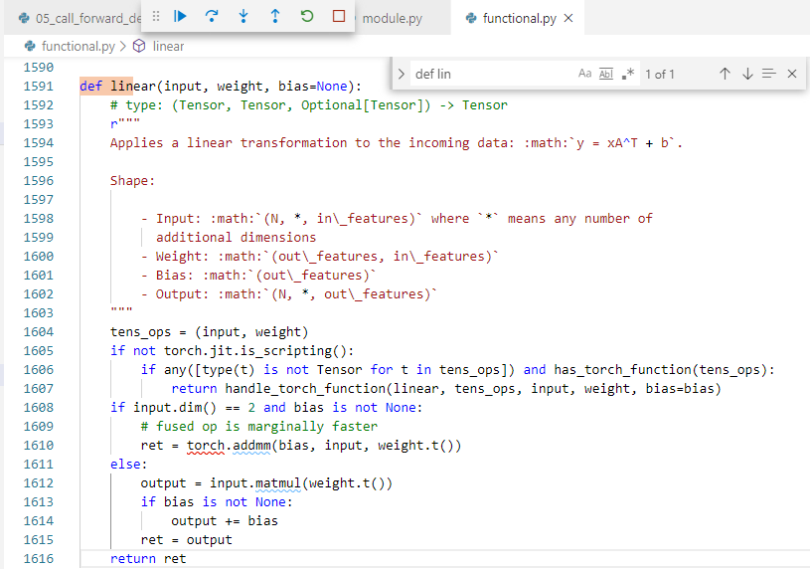
20.5 Linear Transform Math
https://www.youtube.com/watch?v=rcc86nXKwkw&list=PLZbbT5o_s2xrfNyHZsM6ufI0iZENK9xgG&index=20
In the functional.py, we have output is calculate from input, weight, and bias using the matmul function.

Slide 33
20.6 Quiz

Slide 34
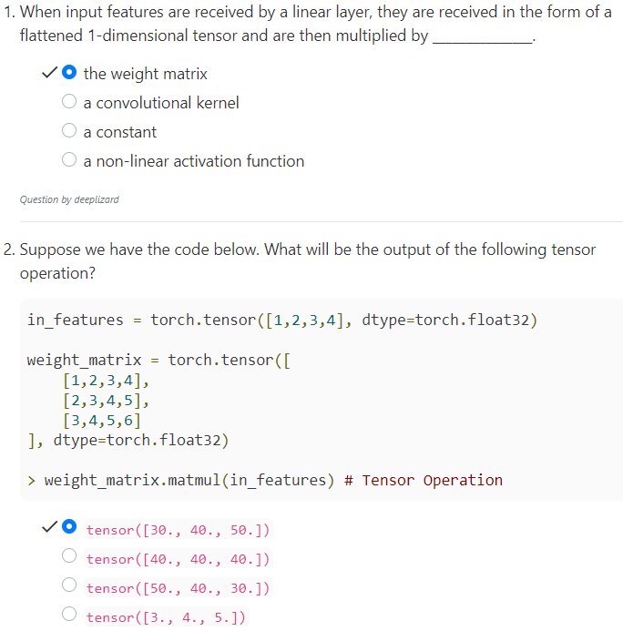
20.6 Quiz
https://www.youtube.com/watch?v=rcc86nXKwkw&list=PLZbbT5o_s2xrfNyHZsM6ufI0iZENK9xgG&index=20
Quiz

Slide 35
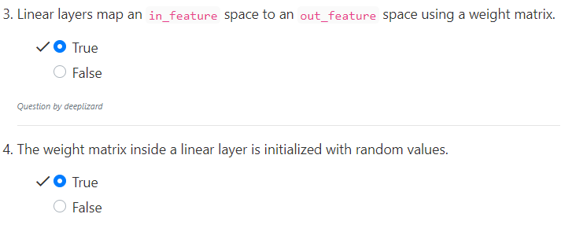
20.6 Quiz
https://www.youtube.com/watch?v=rcc86nXKwkw&list=PLZbbT5o_s2xrfNyHZsM6ufI0iZENK9xgG&index=20
Quiz

Slide 36
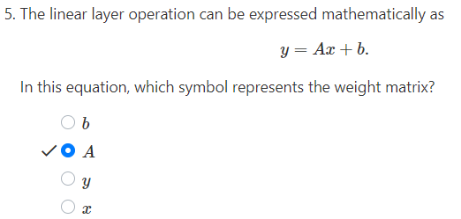
20.6 Quiz
https://www.youtube.com/watch?v=rcc86nXKwkw&list=PLZbbT5o_s2xrfNyHZsM6ufI0iZENK9xgG&index=20
Quiz

Slide 37
End of Chapter

