Slide 1

35 Dataset Normalization (Part 3)
Peter H. Chen

Slide 2
35 Dataset Normalization (Part 3)
https://www.youtube.com/watch?v=lu7TCu7HeYc&list=PLZbbT5o_s2xrfNyHZsM6ufI0iZENK9xgG&index=35
Dataset Normalization
We discuss dataset normalization.

Slide 3
35.1 Use GPU for Deep Learning

Slide 4
35.1 Data Normalization
https://www.youtube.com/watch?v=lu7TCu7HeYc&list=PLZbbT5o_s2xrfNyHZsM6ufI0iZENK9xgG&index=35
Data Normalization
The idea of data normalization is an general concept that refers to the act of transforming the original values of a dataset to new values. The new values are typically encoded relative to the dataset itself and are scaled in some way.
Feature Scaling
For this reason, another name for data normalization that is sometimes used is feature scaling. This term refers to the fact that when normalizing data, we often transform different features of a given dataset to a similar scale.
In this case, we are not just thinking of a dataset of values but rather, a dataset of elements that have multiple features, each with their on value.

Slide 5
35.2 Quiz

Slide 6
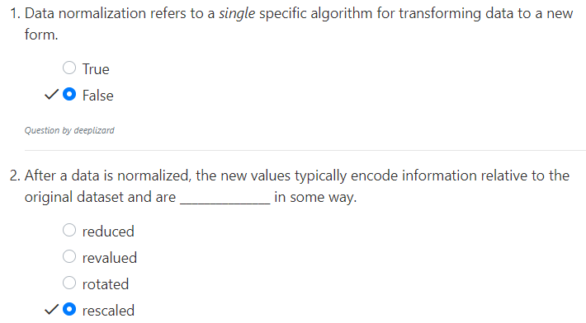
35.2 Quiz
https://www.youtube.com/watch?v=lu7TCu7HeYc&list=PLZbbT5o_s2xrfNyHZsM6ufI0iZENK9xgG&index=35
Quiz

Slide 7
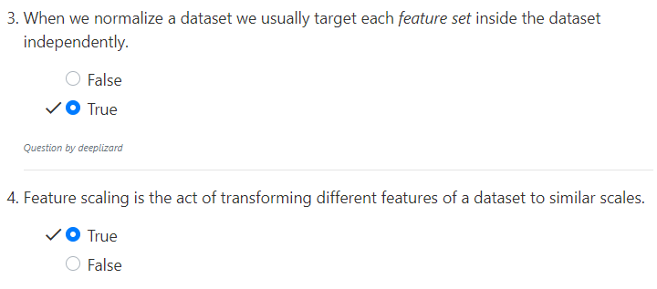
35.2 Quiz
https://www.youtube.com/watch?v=lu7TCu7HeYc&list=PLZbbT5o_s2xrfNyHZsM6ufI0iZENK9xgG&index=35
Quiz

Slide 8
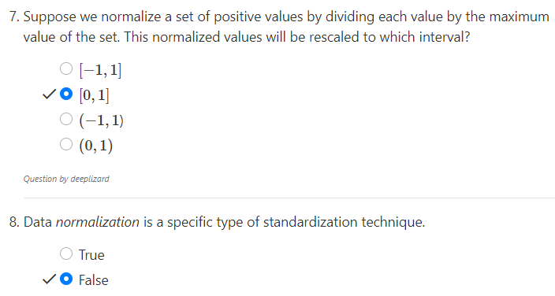
35.2 Quiz
https://www.youtube.com/watch?v=lu7TCu7HeYc&list=PLZbbT5o_s2xrfNyHZsM6ufI0iZENK9xgG&index=35
Quiz

Slide 9
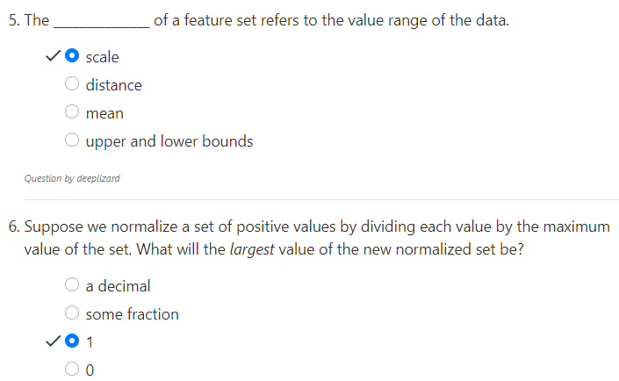
35.2 Quiz
https://www.youtube.com/watch?v=lu7TCu7HeYc&list=PLZbbT5o_s2xrfNyHZsM6ufI0iZENK9xgG&index=35
Quiz

Slide 10
End of Chapter

