Slide 1

23 Batch Image Prediction (Part 2)
Peter H. Chen

Slide 2
23 Batch Image Prediction (Part 2)
https://www.youtube.com/watch?v=p1xZ2yWU1eo&list=PLZbbT5o_s2xrfNyHZsM6ufI0iZENK9xgG&index=23
Batch Image Prediction
We discuss the pass a batch of images to our network and interpret the results.
Prepare the data
Build the model
Understand how batches are passed to the network
Train the model
Analyze the model’s results
In the last discussion, we passed a single image to CNN network.
How to do pass a batch of images to CNN network?
In the discussion, we learned about forward propagation and how to pass a single image from our training set to our network.

Slide 3

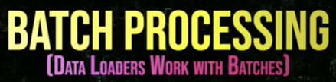
23 Batch Image Prediction (Part 2)
https://www.youtube.com/watch?v=p1xZ2yWU1eo&list=PLZbbT5o_s2xrfNyHZsM6ufI0iZENK9xgG&index=23
Batch Image Prediction
Now, let's see how to do this using a batch of images.
We'll use the data loader to get the batch.
Then, after passing the batch to the network, we'll interpret the output.

Slide 4
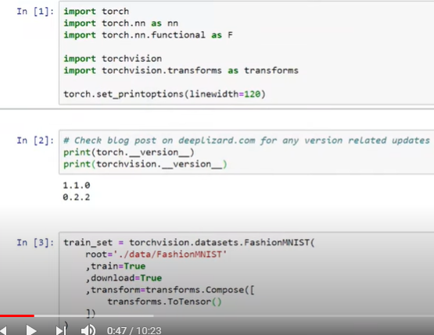
23 Batch Image Prediction (Part 2)
https://www.youtube.com/watch?v=p1xZ2yWU1eo&list=PLZbbT5o_s2xrfNyHZsM6ufI0iZENK9xgG&index=23
Batch Image Prediction
Let’s begin by reviewing the code setup from the last discussion.
First, we have our imports. Next we look the PyTorch Version 1.1.0 and torchvision 0.2.2.

Slide 5
23 Batch Image Prediction (Part 2)
https://www.youtube.com/watch?v=p1xZ2yWU1eo&list=PLZbbT5o_s2xrfNyHZsM6ufI0iZENK9xgG&index=23
Pass Batch Image to Network
Next, we create training set, access the FashionNIST. It is in the class inside of trochvision and dataset, the root directory where the data will live there. We specify that we want the data to be the training set.
We specify the data to be downloaded if it does not already exist on disk. Then, we transform the data into composition, where the composition consists of a single transform to tensor.
We are taking our images data and transforming into a tensor.

Slide 6
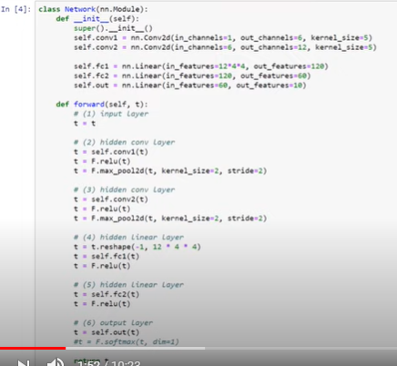
23 Batch Image Prediction (Part 2)
https://www.youtube.com/watch?v=p1xZ2yWU1eo&list=PLZbbT5o_s2xrfNyHZsM6ufI0iZENK9xgG&index=23
Pass Batch Image to Network
Next, we have a network class definition.

Slide 7
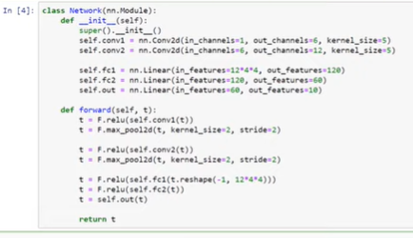
23 Batch Image Prediction (Part 2)
https://www.youtube.com/watch?v=p1xZ2yWU1eo&list=PLZbbT5o_s2xrfNyHZsM6ufI0iZENK9xgG&index=23
Pass Batch Image to Network
Now, one thing you might have noticed, in the last discussion, when we wrote our class definition, we did it in more of a condensed form like this where we composed the convolutional operations with the relu operations.

Slide 8
23 Batch Image Prediction (Part 2)
https://www.youtube.com/watch?v=p1xZ2yWU1eo&list=PLZbbT5o_s2xrfNyHZsM6ufI0iZENK9xgG&index=23
Pass Batch Image to Network
Now, go back this way because the logic is more sequential and sometimes easier to understand what is going on in the sequential way.

Slide 9
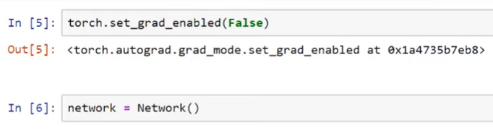
23 Batch Image Prediction (Part 2)
https://www.youtube.com/watch?v=p1xZ2yWU1eo&list=PLZbbT5o_s2xrfNyHZsM6ufI0iZENK9xgG&index=23
Batch Image Prediction
Next, we are turning off the PyTorch gradient tracking feature.
Then, we get an instance of our network by calling Network() constructor.
With this, we are ready.

Slide 10
23 Batch Image Prediction (Part 2)
https://www.youtube.com/watch?v=p1xZ2yWU1eo&list=PLZbbT5o_s2xrfNyHZsM6ufI0iZENK9xgG&index=23
Batch Image Prediction
Summarize the previous steps. We need the following:
Our imports.
Our training set.
Our Network class definition.
To disable gradient tracking. (optional)
A Network class instance.

Slide 11
23.1 Pass Batch Image

Slide 12

23.1 Pass Batch Image
https://www.youtube.com/watch?v=p1xZ2yWU1eo&list=PLZbbT5o_s2xrfNyHZsM6ufI0iZENK9xgG&index=23
Pass Batch Image to Network
Now, we’ll use our training set to create a new DataLoader instance, and we’ll set our batch_size=10, so the outputs will be more manageable.
We got 10 images in the data loader.

Slide 13

23.1 Pass Batch Image
https://www.youtube.com/watch?v=p1xZ2yWU1eo&list=PLZbbT5o_s2xrfNyHZsM6ufI0iZENK9xgG&index=23
Pass Batch Image to Network
The “next(iter(data_loader))” gives us 10 images in the batch.
The “images, labels = batch” gives us two tensors: a tensor of images and a tensor of corresponding labels.

Slide 14


23.1 Pass Batch Image
https://www.youtube.com/watch?v=p1xZ2yWU1eo&list=PLZbbT5o_s2xrfNyHZsM6ufI0iZENK9xgG&index=23
Pass Batch Image to Network
In the last discussion, when we pulled a single image from our training set, we had to unsqueeze() the tensor to add another dimension that would effectively transform the singleton image into a batch with a size of one.
Now that we are working with the data loader instead of training set.
We are dealing with batches by default. There is no further processing needed.
The data loader returns a batch of images that are packaged into a single tensor with a shape that reflects the following axes.

Slide 15
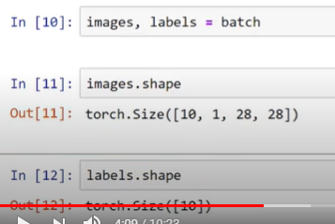
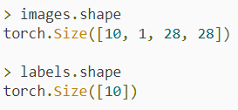
23.1 Pass Batch Image
https://www.youtube.com/watch?v=p1xZ2yWU1eo&list=PLZbbT5o_s2xrfNyHZsM6ufI0iZENK9xgG&index=23
Pass Batch Image to Network
This means tensor's shape is in good shape, and there's no need to unsqueeze it.

Slide 16
23.1 Pass Batch Image
https://www.youtube.com/watch?v=p1xZ2yWU1eo&list=PLZbbT5o_s2xrfNyHZsM6ufI0iZENK9xgG&index=23
Pass Batch Image to Network
Let’s make sure we understand the interpretation of both of these shapes.
The first axis of the image tensor tells us that we have a batch of 10 images.
These 10 images have a single color channel with a height 28 and width of 28.
The labels tensor has a single axis with a shape of 10, which corresponds to the 10 images inside our batch.
One label for each image.

Slide 17
23.1 Pass Batch Image
https://www.youtube.com/watch?v=p1xZ2yWU1eo&list=PLZbbT5o_s2xrfNyHZsM6ufI0iZENK9xgG&index=23
Pass Batch Image to Network
Alright. Let’s get a prediction by passing the images tensor to the network.
> preds = network(images)
> preds.shape
torch.Size([10, 10])
> preds
tensor( [
[ 0.1072, -0.1255, -0.0782, -0.1073, 0.1048, 0.1142, -0.0804, -0.0087, 0.0082, 0.0180],
[ 0.1070, -0.1233, -0.0798, -0.1060, 0.1065, 0.1163, -0.0689, -0.0142, 0.0085, 0.0134],
[ 0.0985, -0.1287, -0.0979, -0.1001, 0.1092, 0.1129, -0.0605, -0.0248, 0.0290, 0.0066],
[ 0.0989, -0.1295, -0.0944, -0.1054, 0.1071, 0.1146, -0.0596, -0.0249, 0.0273, 0.0059],
[ 0.1004, -0.1273, -0.0843, -0.1127, 0.1072, 0.1183, -0.0670, -0.0162, 0.0129, 0.0101],
[ 0.1036, -0.1245, -0.0842, -0.1047, 0.1097, 0.1176, -0.0682, -0.0126, 0.0128, 0.0147],
[ 0.1093, -0.1292, -0.0961, -0.1006, 0.1106, 0.1096, -0.0633, -0.0163, 0.0215, 0.0046],
[ 0.1026, -0.1204, -0.0799, -0.1060, 0.1077, 0.1207, -0.0741, -0.0124, 0.0098, 0.0202],
[ 0.0991, -0.1275, -0.0911, -0.0980, 0.1109, 0.1134, -0.0625, -0.0391, 0.0318, 0.0104],
[ 0.1007, -0.1212, -0.0918, -0.0962, 0.1168, 0.1105, -0.0719, -0.0265, 0.0207, 0.0157]
] )

Slide 18
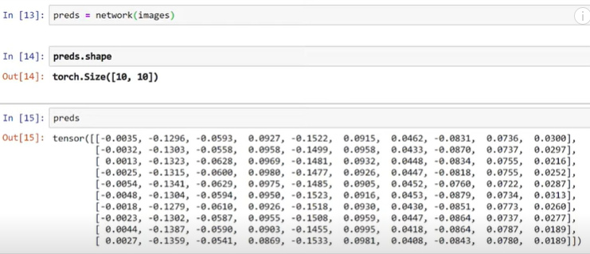

23.1 Pass Batch Image
https://www.youtube.com/watch?v=p1xZ2yWU1eo&list=PLZbbT5o_s2xrfNyHZsM6ufI0iZENK9xgG&index=23
Pass Batch Image to Network
The prediction tensor has a shape of 10 by 10, which gives us two axes that each have a length of 10.
This reflects the fact that we have 10 images and for each of these 10 images we have 10 prediction classes.
10
10

Slide 19
23.1 Pass Batch Image
https://www.youtube.com/watch?v=p1xZ2yWU1eo&list=PLZbbT5o_s2xrfNyHZsM6ufI0iZENK9xgG&index=23
Pass Batch Image to Network
The elements of the first dimension are arrays of length 10.
Each of these array elements contain the ten predictions for each category for the corresponding image.
The elements of the second dimension are numbers. Each number is the assigned value of the specific output class.
The output classes are encoded by the indexes, so each index represents a specific output class.
10 predictions
10 categorizes

Slide 20
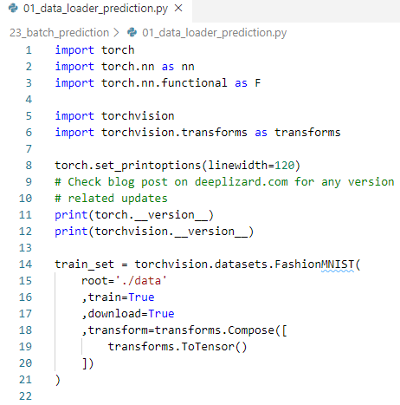
23.1 Pass Batch Image
https://www.youtube.com/watch?v=p1xZ2yWU1eo&list=PLZbbT5o_s2xrfNyHZsM6ufI0iZENK9xgG&index=23
Pass Batch Image to Network
The train_set:

Slide 21
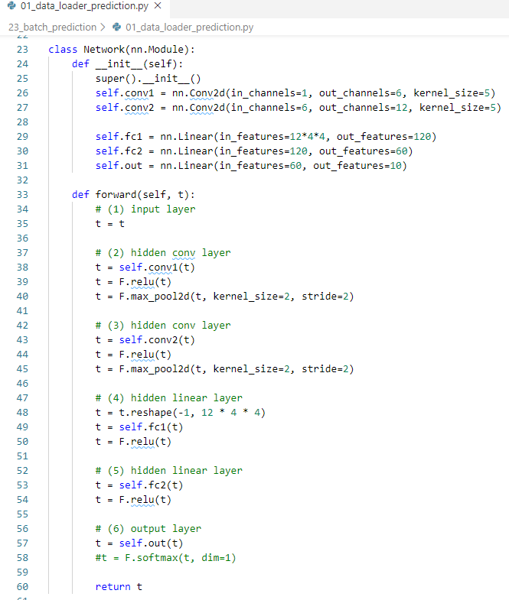
23.1 Pass Batch Image
https://www.youtube.com/watch?v=p1xZ2yWU1eo&list=PLZbbT5o_s2xrfNyHZsM6ufI0iZENK9xgG&index=23
Pass Batch Image to Network
Network:

Slide 22
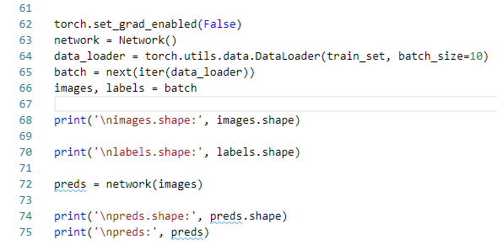
23.1 Pass Batch Image
https://www.youtube.com/watch?v=p1xZ2yWU1eo&list=PLZbbT5o_s2xrfNyHZsM6ufI0iZENK9xgG&index=23
Pass Batch Image to Network
The data load, images, prediction:

Slide 23
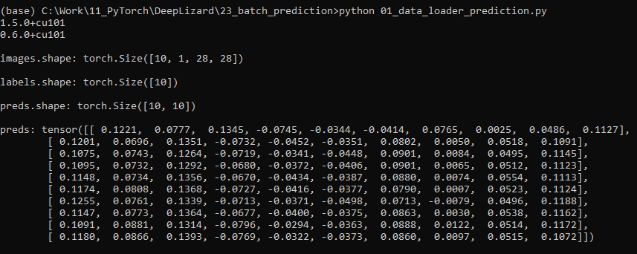
23.1 Pass Batch Image
https://www.youtube.com/watch?v=p1xZ2yWU1eo&list=PLZbbT5o_s2xrfNyHZsM6ufI0iZENK9xgG&index=23
Pass Batch Image to Network
The data load, images, prediction:

Slide 24
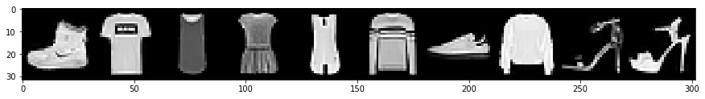
23.1 Pass Batch Image
https://www.youtube.com/watch?v=p1xZ2yWU1eo&list=PLZbbT5o_s2xrfNyHZsM6ufI0iZENK9xgG&index=23
Pass Batch Image to Network
This mapping is given by this table.
Fashion MNISY Classes
Index | Label
0 | T-shirt/top
1 | Trouser
2 | Pullover
3 | Dress
4 | Coat
5 | Sandal
6 | Shirt
7 | Sneaker
8 | Bag
9 | Ankle boot

Slide 25
23.2 Using Argmax

Slide 26
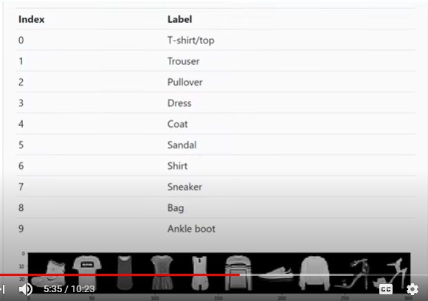
23.1 Pass Batch Image
https://www.youtube.com/watch?v=p1xZ2yWU1eo&list=PLZbbT5o_s2xrfNyHZsM6ufI0iZENK9xgG&index=23
Pass Batch Image to Network
The mapping we talked about here is given by this table.
We have indices 0 to 9, starting with a T-short or top.

Slide 27
23.1 Pass Batch Image
https://www.youtube.com/watch?v=p1xZ2yWU1eo&list=PLZbbT5o_s2xrfNyHZsM6ufI0iZENK9xgG&index=23
Pass Batch Image to Network
We use the Argmax function to figure out which index contains the highest the prediction value.
Once we have the index has the highest prediction value, we can compare the index with the label too see if there is a match.

Slide 28
23.1 Pass Batch Image
https://www.youtube.com/watch?v=p1xZ2yWU1eo&list=PLZbbT5o_s2xrfNyHZsM6ufI0iZENK9xgG&index=23
Pass Batch Image to Network
To do this, we pass the prediction tensor to the argmax function and we specify the second dimension.
Second dimension is the last dimension of our prediction tensor.
Remember, from all of our work on tensors, the last dimension of a tensor always contains the number while every other dimension contains other tensors that are smaller.
In our prediction tensors case, we have 10 groups of numbers.

Slide 29
23.1 Pass Batch Image
https://www.youtube.com/watch?v=p1xZ2yWU1eo&list=PLZbbT5o_s2xrfNyHZsM6ufI0iZENK9xgG&index=23
Pass Batch Image to Network
What argmax function is doing is looking inside each of these ten groups, finding the max value, and then outputting its index.
In short, if we have argmax function, we did the following.
For each group of 10 numbers:
Find max value.
Output index

Slide 30
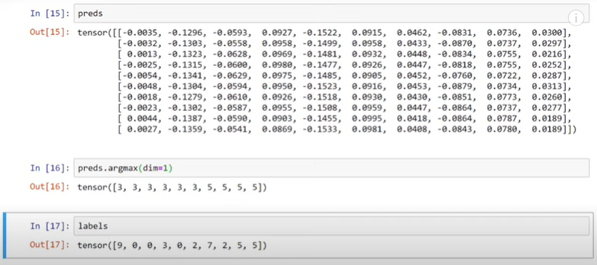
23.2 Using Argmax
https://www.youtube.com/watch?v=p1xZ2yWU1eo&list=PLZbbT5o_s2xrfNyHZsM6ufI0iZENK9xgG&index=23
Using Argmax: Prediction vs Label
The interpretation of this is that, for each of the images in the batch, we are finding the prediction class that has the highest value.
This is the category the network is predicting most strongly.

Slide 31
23.2 Using Argmax
https://www.youtube.com/watch?v=p1xZ2yWU1eo&list=PLZbbT5o_s2xrfNyHZsM6ufI0iZENK9xgG&index=23
Using Argmax: Prediction vs Label
> preds.argmax(dim=1)
The result of argmax is a tensor with 10 categories. Each number is the index of the highest value occurs.

Slide 32
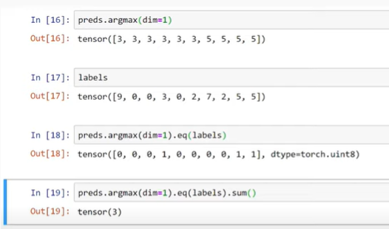
23.2 Using Argmax
https://www.youtube.com/watch?v=p1xZ2yWU1eo&list=PLZbbT5o_s2xrfNyHZsM6ufI0iZENK9xgG&index=23
Using Argmax: Prediction vs Label
We have 10 numbers because there are 10 images.
> labels
To see 10 labels,

Slide 33
23.2 Using Argmax
https://www.youtube.com/watch?v=p1xZ2yWU1eo&list=PLZbbT5o_s2xrfNyHZsM6ufI0iZENK9xgG&index=23
Using Argmax: Prediction vs Label
Once we have the indices of highest values, we can compare it against the labels tensor.
To achieve the comparison, we are using the equals function or eq (labels). The eq function will do the element-wise equals operations in between the argmax output and the labels tensor.
This give us a 1 if the prediction category and the argmax output matches the label and 0 if not matches.

Slide 34
23.2 Using Argmax
https://www.youtube.com/watch?v=p1xZ2yWU1eo&list=PLZbbT5o_s2xrfNyHZsM6ufI0iZENK9xgG&index=23
Using Argmax: Prediction vs Label
This give us a 1 if the prediction category and the argmax output matches the label and 0 if not matches.
Check results one-by-one.

Slide 35
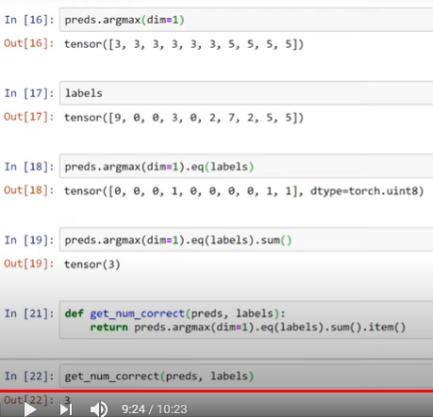
23.2 Using Argmax
https://www.youtube.com/watch?v=p1xZ2yWU1eo&list=PLZbbT5o_s2xrfNyHZsM6ufI0iZENK9xgG&index=23
Using Argmax: Prediction vs Label
Finally, if we call the sum function on this result, we get the output from the argmax function into a single of correct prediction.
We can wrap this call into a function called get_num_correct with accepts of prediction tensor and labels tensor. Then use the item method to return a Python number of correct prediction.

Slide 36
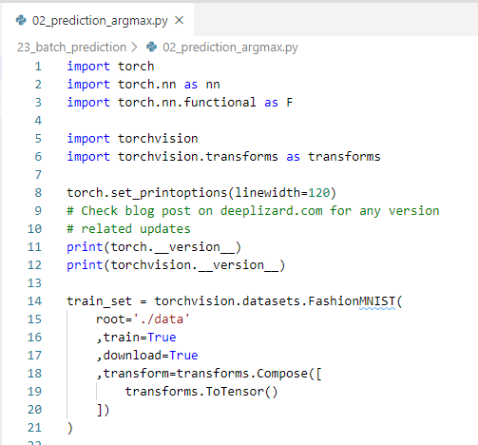
23.2 Using Argmax
https://www.youtube.com/watch?v=p1xZ2yWU1eo&list=PLZbbT5o_s2xrfNyHZsM6ufI0iZENK9xgG&index=23
Using Argmax: Prediction vs Label
Code: train_set

Slide 37
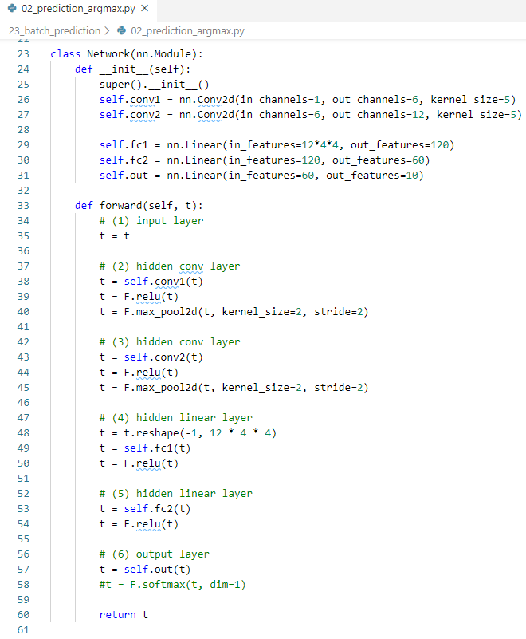
23.2 Using Argmax
https://www.youtube.com/watch?v=p1xZ2yWU1eo&list=PLZbbT5o_s2xrfNyHZsM6ufI0iZENK9xgG&index=23
Using Argmax: Prediction vs Label
Code: network()

Slide 38
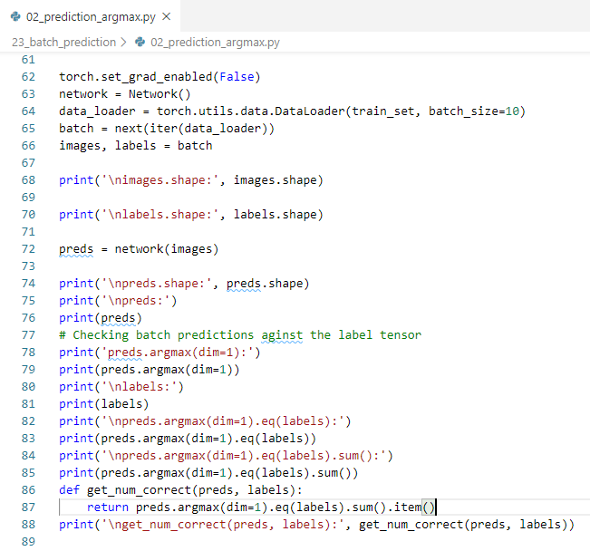
23.2 Using Argmax
https://www.youtube.com/watch?v=p1xZ2yWU1eo&list=PLZbbT5o_s2xrfNyHZsM6ufI0iZENK9xgG&index=23
Using Argmax: Prediction vs Label
Code: Column match by argmax (dim=1).

Slide 39
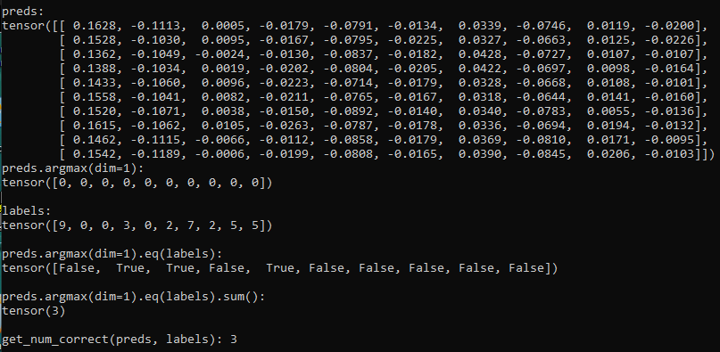
23.2 Using Argmax
https://www.youtube.com/watch?v=p1xZ2yWU1eo&list=PLZbbT5o_s2xrfNyHZsM6ufI0iZENK9xgG&index=23
Using Argmax: Prediction vs Label
Test Code:
Highest values
Matched columns
Matched Logic

Slide 40
23.3 Conclusion

Slide 41
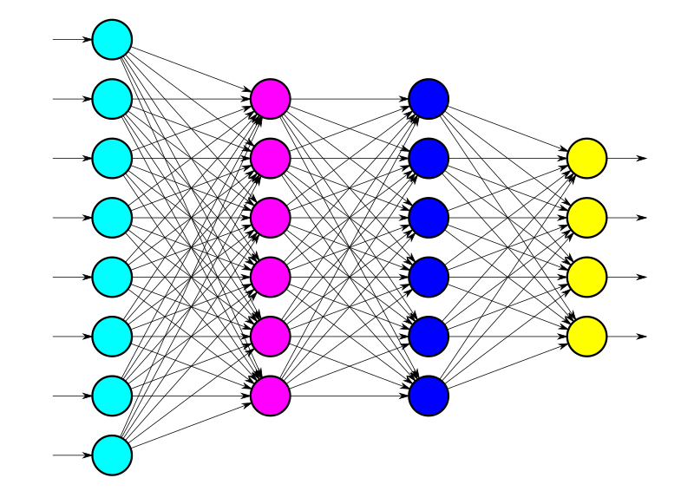
23.3 Conclusion
https://www.youtube.com/watch?v=p1xZ2yWU1eo&list=PLZbbT5o_s2xrfNyHZsM6ufI0iZENK9xgG&index=23
Conclusion
We should now have a good understanding of how to pass a batch of inputs to a network and what the expected shape is when dealing with a convolutional neural network.

Slide 42
23.4 Summary

Slide 43
23.4 Summary
https://www.youtube.com/watch?v=p1xZ2yWU1eo&list=PLZbbT5o_s2xrfNyHZsM6ufI0iZENK9xgG&index=23
Summary
In the discussion, we learned about forward propagation and how to pass a single image from our training set to our network.
Now, let's see how to do this using a batch of images.
We'll use the data loader to get the batch, and then, after passing the batch to the network, we'll interpret the output.

Slide 44
23.5 Quiz

Slide 45
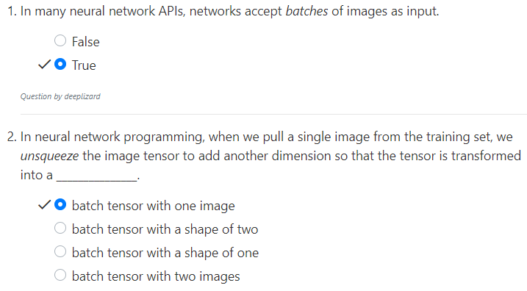
23.5 Quiz
https://www.youtube.com/watch?v=p1xZ2yWU1eo&list=PLZbbT5o_s2xrfNyHZsM6ufI0iZENK9xgG&index=23
Quiz

Slide 46
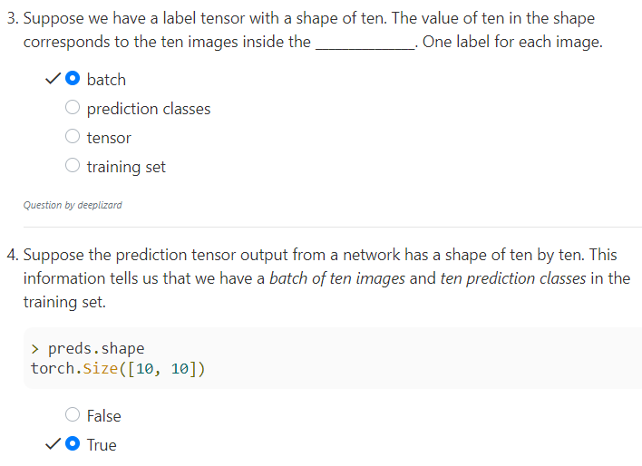
23.5 Quiz
https://www.youtube.com/watch?v=p1xZ2yWU1eo&list=PLZbbT5o_s2xrfNyHZsM6ufI0iZENK9xgG&index=23
Quiz

Slide 47
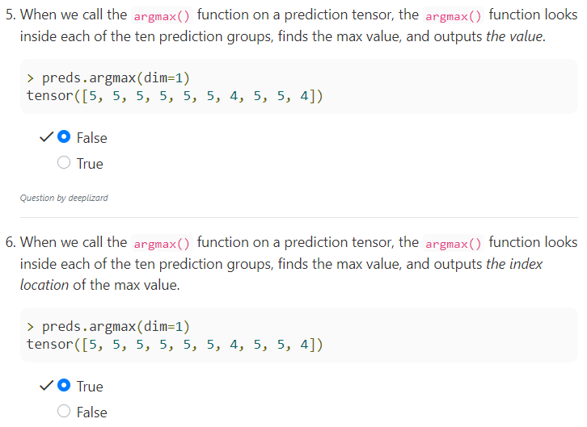
23.5 Quiz
https://www.youtube.com/watch?v=p1xZ2yWU1eo&list=PLZbbT5o_s2xrfNyHZsM6ufI0iZENK9xgG&index=23
Quiz

Slide 48
End of Chapter

