Slide 1

34 Neural Network Cuda (Part 3)
Peter H. Chen

Slide 2
34 Neural Network Cuda (Part 3)
https://www.youtube.com/watch?v=Bs1mdHZiAS8&list=PLZbbT5o_s2xrfNyHZsM6ufI0iZENK9xgG&index=34
Neural Network Cuda
We discuss how to use GPU with PyTorch.

Slide 3
34.1 Use GPU for Deep Learning

Slide 4
34.1 Use GPU for Deep Learning
https://www.youtube.com/watch?v=Bs1mdHZiAS8&list=PLZbbT5o_s2xrfNyHZsM6ufI0iZENK9xgG&index=34
Use GPU for Deep Learning
To make use of our GPU during the training process, there are two essential requirements. These requirements are as follows, the data must be moved to the GPU, and the network must be moved to the GPU.
Data on the GPU
Network on the GPU
By default, when a PyTorch tensor or a PyTorch neural network module is created, the corresponding data is initialized on the CPU. Specifically, the data exists inside the CPU's memory.
Now, let's create a tensor and a network, and see how we make the move from CPU to GPU.

Slide 5


34.1 Use GPU for Deep Learning
https://www.youtube.com/watch?v=Bs1mdHZiAS8&list=PLZbbT5o_s2xrfNyHZsM6ufI0iZENK9xgG&index=34
Use GPU for Deep Learning
Here, we create a tensor and a network:
Now, we call the cuda() method and reassign the tensor and network to returned values that have been copied onto the GPU:

Slide 6
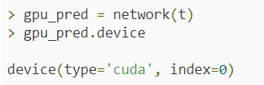
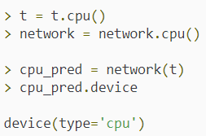
34.1 Use GPU for Deep Learning
https://www.youtube.com/watch?v=Bs1mdHZiAS8&list=PLZbbT5o_s2xrfNyHZsM6ufI0iZENK9xgG&index=34
Use GPU for Deep Learning
Next, we can get a prediction from the network and see that the prediction tensor's device attribute confirms that the data is on cuda, which is the GPU:
Likewise, we can go in the opposite way:

Slide 7
34.1 Use GPU for Deep Learning
https://www.youtube.com/watch?v=Bs1mdHZiAS8&list=PLZbbT5o_s2xrfNyHZsM6ufI0iZENK9xgG&index=34
Writing Device Agnostic PyTorch Code
Before we wrap up, we need to talk about writing device agnostic code. This term device agnostic (agnostic means not-known) means that our code doesn't depend on the underlying device. You may come across this terminology when reading PyTorch documentation.
For example, suppose we write code that uses the cuda() method everywhere, and then, we give the code to a user who doesn't have a GPU. This won't work. Don't worry. We've got options!
We'll, one of the reasons that the to() method is preferred, is because the to() method is parameterized, and this makes it easier to alter the device we are choosing, i.e. it's flexible!
For example, a user could pass in cpu or cuda as an argument to a deep learning program, and this would allow the program to be device agnostic.
Allowing the user of a program to pass an argument that determines the program's behavior is perhaps the best way to make a program be device agnostic. However, we can also use PyTorch to check for a supported GPU, and set our devices that way.

Slide 8
34.1 Use GPU for Deep Learning
https://www.youtube.com/watch?v=Bs1mdHZiAS8&list=PLZbbT5o_s2xrfNyHZsM6ufI0iZENK9xgG&index=34
General Idea Of Using A GPU
The main takeaway at this point is that our network and our data must both exist on the GPU in order to perform computations using the GPU, and this applies to any programming language or framework.
GPUs and CPUs are compute devices that compute on data, and so any two values that are directly being used with one another in a computation, must exist on the same device.

Slide 9
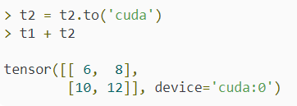
34.1 Use GPU for Deep Learning
https://www.youtube.com/watch?v=Bs1mdHZiAS8&list=PLZbbT5o_s2xrfNyHZsM6ufI0iZENK9xgG&index=34
PyTorch Tensor Computations On A GPU
Let's dive deeper by demonstrating some tensor computations.

Slide 10

34.1 Use GPU for Deep Learning
https://www.youtube.com/watch?v=Bs1mdHZiAS8&list=PLZbbT5o_s2xrfNyHZsM6ufI0iZENK9xgG&index=34
PyTorch nn.Module Computations On A GPU
We've just seen how tensors can be moved to and from devices.
Now, let's see how this is done with PyTorch nn.Module instances.
More generally, we are interested in understanding how and what it means for a network to be on a device like a GPU or CPU.
PyTorch aside, this is the essential issue.
We put a network on a device by moving the network's parameters to that said device.
Let's create a network and take a look at what we mean.

Slide 11
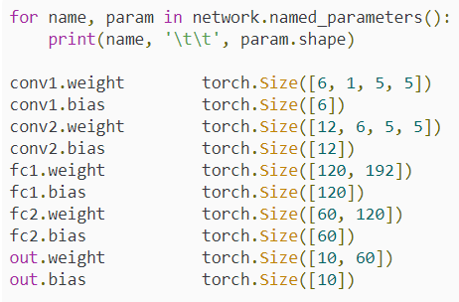
34.1 Use GPU for Deep Learning
https://www.youtube.com/watch?v=Bs1mdHZiAS8&list=PLZbbT5o_s2xrfNyHZsM6ufI0iZENK9xgG&index=34
PyTorch nn.Module Computations On A GPU
Now, let's look at the network's parameters:

Slide 12
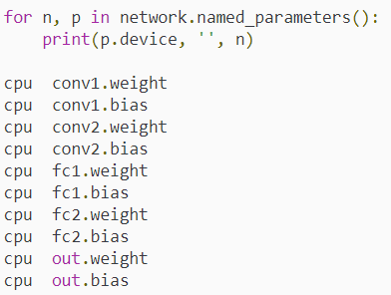
34.1 Use GPU for Deep Learning
https://www.youtube.com/watch?v=Bs1mdHZiAS8&list=PLZbbT5o_s2xrfNyHZsM6ufI0iZENK9xgG&index=34
PyTorch nn.Module Computations On A GPU
Here, we've created a PyTorch network, and we've iterated through the network's parameters. As we can see, the network's parameters are the weights and biases inside the network.
In other words, these are simply tensors that live on a device like we have already seen. Let's verify this by checking the device of each of the parameters.

Slide 13
34.1 Use GPU for Deep Learning
https://www.youtube.com/watch?v=Bs1mdHZiAS8&list=PLZbbT5o_s2xrfNyHZsM6ufI0iZENK9xgG&index=34
PyTorch nn.Module Computations On A GPU
This shows us that all the parameters inside the network are, by default, initialized on the CPU.
An important consideration of this is that it explains why nn.Module instances like networks don't actually have a device.
It's not the network that lives on a device, but the tensors inside the network that live on a device.

Slide 14
34.2 Quiz

Slide 15
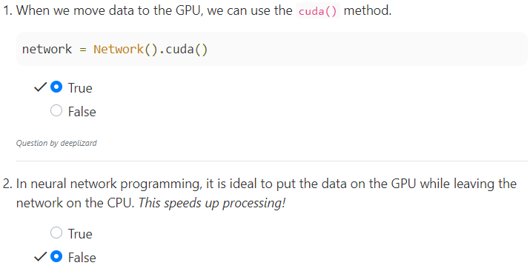
33.2 Quiz
https://www.youtube.com/watch?v=Bs1mdHZiAS8&list=PLZbbT5o_s2xrfNyHZsM6ufI0iZENK9xgG&index=34
Quiz
Both Data and network on GPU.

Slide 16
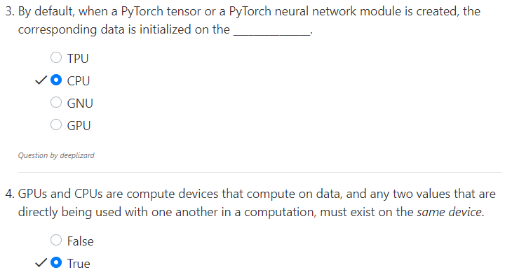
33.2 Quiz
https://www.youtube.com/watch?v=Bs1mdHZiAS8&list=PLZbbT5o_s2xrfNyHZsM6ufI0iZENK9xgG&index=34
Quiz
Default create on CPU and then move to GPU by command.

Slide 17
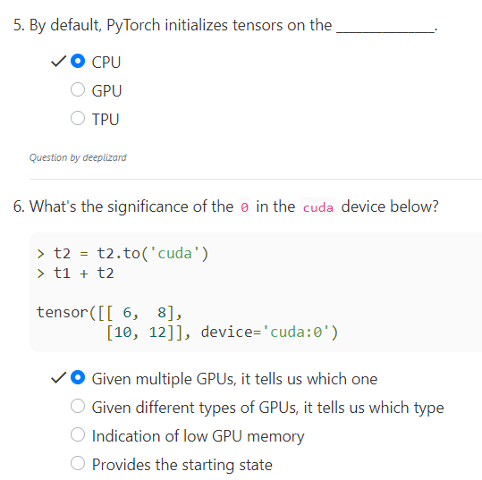
33.2 Quiz
https://www.youtube.com/watch?v=Bs1mdHZiAS8&list=PLZbbT5o_s2xrfNyHZsM6ufI0iZENK9xgG&index=34
Quiz

Slide 18
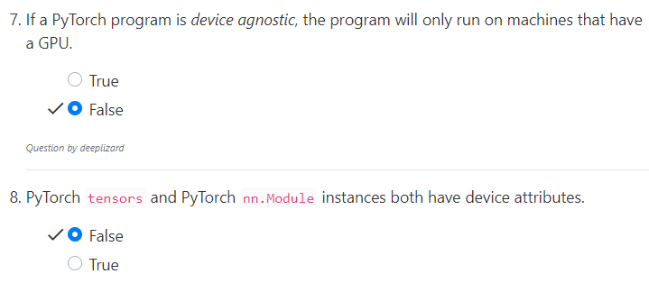
33.2 Quiz
https://www.youtube.com/watch?v=Bs1mdHZiAS8&list=PLZbbT5o_s2xrfNyHZsM6ufI0iZENK9xgG&index=34
Quiz
Program can assign the CPU.
Only tensor have device attributes
Module and network do not have device attribute

Slide 19
End of Chapter

