Slide 1

24 Output Size Formula (Part 2)
Peter H. Chen

Slide 2
24 Output Size Formula (Part 2)
https://www.youtube.com/watch?v=cin4YcGBh3Q&list=PLZbbT5o_s2xrfNyHZsM6ufI0iZENK9xgG&index=24
Output Size Formula
In this discussion, we are going to see how an input tensor is transformed as it flows through a CNN.
High-Level Overview Of Our Process
Prepare the data
Build the model
Understanding forward pass transformations
Train the model
Analyze the model’s results

Slide 3
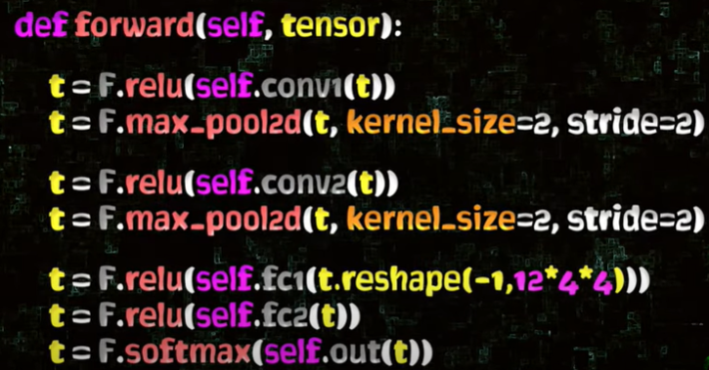
24 Output Size Formula (Part 2)
https://www.youtube.com/watch?v=cin4YcGBh3Q&list=PLZbbT5o_s2xrfNyHZsM6ufI0iZENK9xgG&index=24
Output Size Formula
We creates 6 layers example in CNN.
It has an input layer, through the convolutional layers, and through the linear layers, and an output layer.

Slide 4
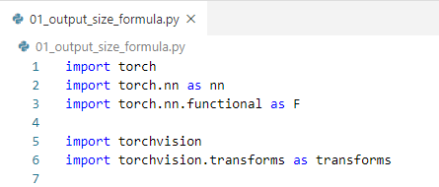
24 Output Size Formula (Part 2)
https://www.youtube.com/watch?v=cin4YcGBh3Q&list=PLZbbT5o_s2xrfNyHZsM6ufI0iZENK9xgG&index=24
Output Size Formula
We will see the tensors transform from end to end as it moves through the network.
We will check the formulas for calculating the height and width output sizes that with the conv and pooling layers operations.
We need to import the torch, torch.nn, torch.nn.functional, torchvision, and torchvision.transform libraries for this debugging process.

Slide 5
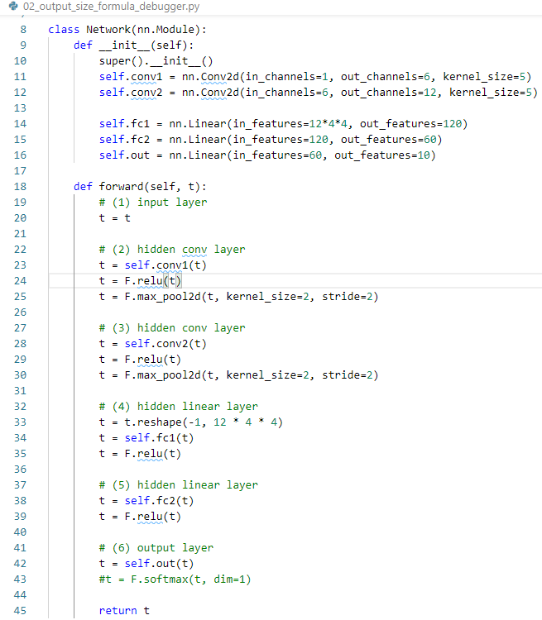
24 Output Size Formula (Part 2)
https://www.youtube.com/watch?v=cin4YcGBh3Q&list=PLZbbT5o_s2xrfNyHZsM6ufI0iZENK9xgG&index=24
Output Size Formula
Next, we define the Network class.
We have the class attributes defined for class constructor.
We must have the forward method implementation.
When we pass the tensor to network, the forward method is what actually transform the tensor from an input to an output.

Slide 6
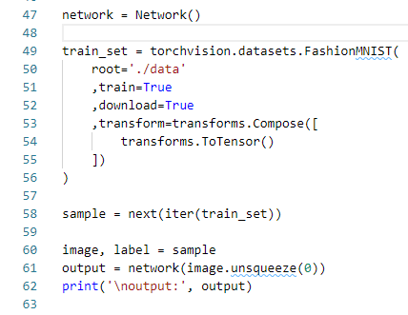
24 Output Size Formula (Part 2)
https://www.youtube.com/watch?v=cin4YcGBh3Q&list=PLZbbT5o_s2xrfNyHZsM6ufI0iZENK9xgG&index=24
Output Size Formula
Next, we have a class definition for the network.
We get the instance of our network by calling the class constructor.
Here we name the network name network.
Then, we dataset train_set by accessing Fashion image class from dataset and torch vision and transform into the tensor.
Then, we unpackage the sample into the image and a label.
Finally, we are ready to pass our image into our network so we can debug it.
We need to unsqueeze the image into a batch with a size of 1. The reason to do this is because we our network for batch.

Slide 7
24.1 Overview of Network

Slide 8
24.1 Overview of Network
https://www.youtube.com/watch?v=cin4YcGBh3Q&list=PLZbbT5o_s2xrfNyHZsM6ufI0iZENK9xgG&index=24
The CNN we will use is the one that we have been working with over the last few posts that has six layers.
Input layer
Hidden conv layer
Hidden conv layer
Hidden linear layer
Hidden linear layer
Output layer

Slide 9
24.1 Overview of Network
https://www.youtube.com/watch?v=cin4YcGBh3Q&list=PLZbbT5o_s2xrfNyHZsM6ufI0iZENK9xgG&index=24
We built this network using PyTorch’s nn.Module class, and the Network class definition is as follows:
def forward(self, t):
# (1) input layer
t = t
# (2) hidden conv layer
t = self.conv1(t)
t = F.relu(t)
t = F.max_pool2d(t, kernel_size=2, stride=2)
# (3) hidden conv layer
t = self.conv2(t)
t = F.relu(t)
t = F.max_pool2d(t, kernel_size=2, stride=2)
# (4) hidden linear layer
t = t.reshape(-1, 12 * 4 * 4)
t = self.fc1(t) t = F.relu(t)
# (5) hidden linear layer
t = self.fc2(t) t = F.relu(t)
# (6) output layer
t = self.out(t)
#t = F.softmax(t, dim=1)
return t
class Network(nn.Module):
def __init__(self):
super().__init__()
self.conv1 = nn.Conv2d(in_channels=1, out_channels=6, kernel_size=5)
self.conv2 = nn.Conv2d(in_channels=6, out_channels=12, kernel_size=5)
self.fc1 = nn.Linear(in_features=12*4*4, out_features=120)
self.fc2 = nn.Linear(in_features=120, out_features=60)
self.out = nn.Linear(in_features=60, out_features=10)

Slide 10
24.1 Overview of Network

Slide 11
24.1 Overview of Network
https://www.youtube.com/watch?v=cin4YcGBh3Q&list=PLZbbT5o_s2xrfNyHZsM6ufI0iZENK9xgG&index=24
Overview of Network
The CNN we will use is the one that we have been working with over the last few posts that has six layers.
Input layer
Hidden conv layer
Hidden conv layer
Hidden linear layer
Hidden linear layer
Output layer

Slide 12
24.1 Overview of Network
https://www.youtube.com/watch?v=cin4YcGBh3Q&list=PLZbbT5o_s2xrfNyHZsM6ufI0iZENK9xgG&index=24
Overview of Network
We built this network using PyTorch’s nn.Module class, and the Network class definition is as follows:
def forward(self, t):
# (1) input layer
t = t
# (2) hidden conv layer
t = self.conv1(t)
t = F.relu(t)
t = F.max_pool2d(t, kernel_size=2, stride=2)
# (3) hidden conv layer
t = self.conv2(t)
t = F.relu(t)
t = F.max_pool2d(t, kernel_size=2, stride=2)
# (4) hidden linear layer
t = t.reshape(-1, 12 * 4 * 4)
t = self.fc1(t) t = F.relu(t)
# (5) hidden linear layer
t = self.fc2(t) t = F.relu(t)
# (6) output layer
t = self.out(t)
#t = F.softmax(t, dim=1)
return t
class Network(nn.Module):
def __init__(self):
super().__init__()
self.conv1 = nn.Conv2d(in_channels=1, out_channels=6, kernel_size=5)
self.conv2 = nn.Conv2d(in_channels=6, out_channels=12, kernel_size=5)
self.fc1 = nn.Linear(in_features=12*4*4, out_features=120)
self.fc2 = nn.Linear(in_features=120, out_features=60)
self.out = nn.Linear(in_features=60, out_features=10)

Slide 13
24.2 Pass Single Image

Slide 14

24.2 Pass Single Image
https://www.youtube.com/watch?v=cin4YcGBh3Q&list=PLZbbT5o_s2xrfNyHZsM6ufI0iZENK9xgG&index=24
Pass a Batch of Size One (Pass a Single Image)
In a previous discussion, we saw how we can pass a single image by adding a batch dimension using PyTorch’s unsqueeze() method.
We’ll pass this tensor to the network again, but this time we will step through the forward() method using the debugger.
This will allow us to inspect our tensor as transformations are performed.

Slide 15


24.2 Pass Single Image
https://www.youtube.com/watch?v=cin4YcGBh3Q&list=PLZbbT5o_s2xrfNyHZsM6ufI0iZENK9xgG&index=24
Pass a Batch of Size One (Pass a Single Image)
# 1 Input Layer
When the tensor comes into the input layer, we have:
This value in each of these dimensions represent the following values:
Since the input layer is just the identity function, the output shape doesn’t change.

Slide 16


24.2 Pass Single Image
https://www.youtube.com/watch?v=cin4YcGBh3Q&list=PLZbbT5o_s2xrfNyHZsM6ufI0iZENK9xgG&index=24
Pass a Batch of Size One (Pass a Single Image)
#2 Convolutional Layer (1)
When the tensor comes into this layer, we have:
After the first convolution operation self.conv1, we have:
Note: we have 6 filters. Each filter size is 5 x 5.

Slide 17
24.2 Pass Single Image
https://www.youtube.com/watch?v=cin4YcGBh3Q&list=PLZbbT5o_s2xrfNyHZsM6ufI0iZENK9xgG&index=24
Pass a Batch of Size One (Pass a Single Image)
The number of color channels has increased from 1 to 6.
Note: we have 6 filters (produce 6 output channels). Each filter size is 5 x 5.
After we move forward beyond the first convolutional layer, we don’t think of the channels as color channels any longer.
We just think of them as output channels.
The reason we have 6 output channels is due to the number of out_channels that we specified when self.conv1 was created.
class Network(nn.Module):
def __init__(self):
super().__init__()
self.conv1 = nn.Conv2d(in_channels=1, out_channels=6, kernel_size=5)
self.conv2 = nn.Conv2d(in_channels=6, out_channels=12, kernel_size=5)
self.fc1 = nn.Linear(in_features=12*4*4, out_features=120)
self.fc2 = nn.Linear(in_features=120, out_features=60)
self.out = nn.Linear(in_features=60, out_features=10)

Slide 18
24.2 Pass Single Image
https://www.youtube.com/watch?v=cin4YcGBh3Q&list=PLZbbT5o_s2xrfNyHZsM6ufI0iZENK9xgG&index=24
Convolution Operations Use Filters
Like we have seen, this number 6 is arbitrary.
Note: we have 6 filters (produce 6 output channels). Each filter size is 5 x 5.
The out_channels parameter instructs the nn.Conv2d layer class generate six filters, also known as kernels, with shape 5 by 5 with randomly initialized values.
These filters are used to generate the six output channels.
class Network(nn.Module):
def __init__(self):
super().__init__()
self.conv1 = nn.Conv2d(in_channels=1, out_channels=6, kernel_size=5)
self.conv2 = nn.Conv2d(in_channels=6, out_channels=12, kernel_size=5)
self.fc1 = nn.Linear(in_features=12*4*4, out_features=120)
self.fc2 = nn.Linear(in_features=120, out_features=60)
self.out = nn.Linear(in_features=60, out_features=10)

Slide 19

24.2 Pass Single Image
https://www.youtube.com/watch?v=cin4YcGBh3Q&list=PLZbbT5o_s2xrfNyHZsM6ufI0iZENK9xgG&index=24
Convolution Operations Use Filters
The filters are tensors, and they are used to convolve the input tensor when the tensor is passed to the layer instance, self.conv1.
The random values inside the filter tensors are the weights of the convolutional layer.
Remember though, we don't actually have six distinct tensor.
All six of the filters are packaged into a single weight tensor that has a height and width of five.
Note: we have 6 filters (produce 6 output channels). Each filter size is 5 x 5.
class Network(nn.Module):
def __init__(self):
super().__init__()
self.conv1 = nn.Conv2d(in_channels=1, out_channels=6, kernel_size=5)
self.conv2 = nn.Conv2d(in_channels=6, out_channels=12, kernel_size=5)
self.fc1 = nn.Linear(in_features=12*4*4, out_features=120)
self.fc2 = nn.Linear(in_features=120, out_features=60)
self.out = nn.Linear(in_features=60, out_features=10)

Slide 20
24.2 Pass Single Image
https://www.youtube.com/watch?v=cin4YcGBh3Q&list=PLZbbT5o_s2xrfNyHZsM6ufI0iZENK9xgG&index=24
Convolution Operations Use Filters
The filters are tensors, and they are used to convolve the input tensor when the tensor is passed to the layer instance, self.conv1.
The random values inside the filter tensors are the weights of the convolutional layer.
Note: we have 6 filters (produce 6 output channels). Each filter size is 5 x 5 (for weight).
Remember though, we don't actually have six distinct tensor.
All six of the filters are packaged into a single weight tensor that has a height and width of five.
class Network(nn.Module):
def __init__(self):
super().__init__()
self.conv1 = nn.Conv2d(in_channels=1, out_channels=6, kernel_size=5)
self.conv2 = nn.Conv2d(in_channels=6, out_channels=12, kernel_size=5)
self.fc1 = nn.Linear(in_features=12*4*4, out_features=120)
self.fc2 = nn.Linear(in_features=120, out_features=60)
self.out = nn.Linear(in_features=60, out_features=10)

Slide 21
24.2 Pass Single Image
https://www.youtube.com/watch?v=cin4YcGBh3Q&list=PLZbbT5o_s2xrfNyHZsM6ufI0iZENK9xgG&index=24
Convolution Operations Use Filters
After the weight tensors (filters) are used to convolve the input tensor, the result is the output channels.
Note: we have 6 filters (produce 6 output channels). Each filter size is 5 x 5.
Another name for output channels is feature maps.
The terms here are interchangeable.
This is due to the fact that the pattern detection that emerges as the weights are updated represent features like edges and other more sophisticated patterns.
class Network(nn.Module):
def __init__(self):
super().__init__()
self.conv1 = nn.Conv2d(in_channels=1, out_channels=6, kernel_size=5)
self.conv2 = nn.Conv2d(in_channels=6, out_channels=12, kernel_size=5)
self.fc1 = nn.Linear(in_features=12*4*4, out_features=120)
self.fc2 = nn.Linear(in_features=120, out_features=60)
self.out = nn.Linear(in_features=60, out_features=10)

Slide 22

24.2 Pass Single Image
https://www.youtube.com/watch?v=cin4YcGBh3Q&list=PLZbbT5o_s2xrfNyHZsM6ufI0iZENK9xgG&index=24
Convolution Operations Use Filters
The algorithm:
Color channels are passed in.
Convolutions are performed using the weight tensor (filters).
Feature maps are produced and passed forward.
Conceptually, we can think of the weight tensors as being distinct.
However, what we really have in code is a single weight tensor that has an out_channels (filters) dimension.
We can see this by checking the shape of the weight tensor:
class Network(nn.Module):
def __init__(self):
super().__init__()
self.conv1 = nn.Conv2d(in_channels=1, out_channels=6, kernel_size=5)
self.conv2 = nn.Conv2d(in_channels=6, out_channels=12, kernel_size=5)
self.fc1 = nn.Linear(in_features=12*4*4, out_features=120)
self.fc2 = nn.Linear(in_features=120, out_features=60)
self.out = nn.Linear(in_features=60, out_features=10)

Slide 23
24.2 Pass Single Image
https://www.youtube.com/watch?v=cin4YcGBh3Q&list=PLZbbT5o_s2xrfNyHZsM6ufI0iZENK9xgG&index=24
Pass a Batch of Size One (Pass a Single Image)
Convolution Operations Use Filters
This tensor’s shape is given by:
class Network(nn.Module):
def __init__(self):
super().__init__()
self.conv1 = nn.Conv2d(in_channels=1, out_channels=6, kernel_size=5)
self.conv2 = nn.Conv2d(in_channels=6, out_channels=12, kernel_size=5)
self.fc1 = nn.Linear(in_features=12*4*4, out_features=120)
self.fc2 = nn.Linear(in_features=120, out_features=60)
self.out = nn.Linear(in_features=60, out_features=10)

Slide 24
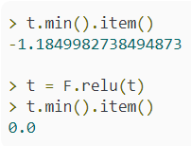

24.2 Pass Single Image
https://www.youtube.com/watch?v=cin4YcGBh3Q&list=PLZbbT5o_s2xrfNyHZsM6ufI0iZENK9xgG&index=24
The relu() Activation Function
The call to the relu() function removes any negative values and replaces them with zeros.
We can verify this by checking the min() of the tensor before and after the call.
def forward(self, t):
# (1) input layer
t = t
# (2) hidden conv layer
t = self.conv1(t)
t = F.relu(t)
t = F.max_pool2d(t, kernel_size=2, stride=2)
# (3) hidden conv layer
t = self.conv2(t)
t = F.relu(t)
t = F.max_pool2d(t, kernel_size=2, stride=2)
# (4) hidden linear layer
t = t.reshape(-1, 12 * 4 * 4)
t = self.fc1(t) t = F.relu(t)
# (5) hidden linear layer
t = self.fc2(t) t = F.relu(t)
# (6) output layer
t = self.out(t)
#t = F.softmax(t, dim=1)
return t
The relu() function can be expressed mathematically as

Slide 25
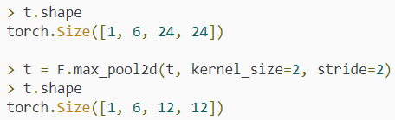
24.2 Pass Single Image
https://www.youtube.com/watch?v=cin4YcGBh3Q&list=PLZbbT5o_s2xrfNyHZsM6ufI0iZENK9xgG&index=24
The Max Pooling Operation
The pooling operation reduces the shape of our tensor further by extracting the maximum value from each 2x2 location within our tensor.
def forward(self, t):
# (1) input layer
t = t
# (2) hidden conv layer
t = self.conv1(t)
t = F.relu(t)
t = F.max_pool2d(t, kernel_size=2, stride=2)
# (3) hidden conv layer
t = self.conv2(t)
t = F.relu(t)
t = F.max_pool2d(t, kernel_size=2, stride=2)
# (4) hidden linear layer
t = t.reshape(-1, 12 * 4 * 4)
t = self.fc1(t) t = F.relu(t)
# (5) hidden linear layer
t = self.fc2(t) t = F.relu(t)
# (6) output layer
t = self.out(t)
#t = F.softmax(t, dim=1)
return t

Slide 26
24.2 Pass Single Image
https://www.youtube.com/watch?v=cin4YcGBh3Q&list=PLZbbT5o_s2xrfNyHZsM6ufI0iZENK9xgG&index=24
Convolution Layer Summary
The shapes of the tensor input to and output from the convolutional layer is given by:
Input shape: [1, 1, 28, 28]
Output shape: [1, 6, 12, 12]
[1,1,28,28]
class Network(nn.Module):
def __init__(self):
super().__init__()
self.conv1 = nn.Conv2d(in_channels=1, out_channels=6, kernel_size=5)
self.conv2 = nn.Conv2d(in_channels=6, out_channels=12, kernel_size=5)
self.fc1 = nn.Linear(in_features=12*4*4, out_features=120)
self.fc2 = nn.Linear(in_features=120, out_features=60)
self.out = nn.Linear(in_features=60, out_features=10)
[1,6,12,12]

Slide 27
24.2 Pass Single Image
https://www.youtube.com/watch?v=cin4YcGBh3Q&list=PLZbbT5o_s2xrfNyHZsM6ufI0iZENK9xgG&index=24
Convolution Layer Summary
Summary of each operation that occurs:
The convolution layer convolves the input tensor using six randomly initialized 5x5 filters.
This reduces the height and width dimensions by four.
Note: we have 6 filters (produce 6 output channels). Each filter size is 5 x 5 (for weight). The filter size is reduced to 4 x 4.
The relu activation function operation maps all negative values to 0.
This means that all the values in the tensor are now positive.
The max pooling operation extracts the max value from each 2x2 section of the six feature maps that were created by the convolutions.
This reduced the height and width dimensions by twelve.
Note: formula in next page = (28-5+2x0)/2 +1 = int(11.5)+1=12)
def forward(self, t):
# (1) input layer
t = t
# (2) hidden conv layer
t = self.conv1(t)
t = F.relu(t)
t = F.max_pool2d(t, kernel_size=2, stride=2)
# (3) hidden conv layer
t = self.conv2(t)
t = F.relu(t)
t = F.max_pool2d(t, kernel_size=2, stride=2)
# (4) hidden linear layer
t = t.reshape(-1, 12 * 4 * 4)
t = self.fc1(t) t = F.relu(t)
# (5) hidden linear layer
t = self.fc2(t) t = F.relu(t)
# (6) output layer
t = self.out(t)
#t = F.softmax(t, dim=1)
return t

Slide 28
24.3 CNN Output Size Formula

Slide 29

24.3 CNN Output Size Formula
https://www.youtube.com/watch?v=cin4YcGBh3Q&list=PLZbbT5o_s2xrfNyHZsM6ufI0iZENK9xgG&index=24
CNN Output Size Formulas
Let's have a look at the formula for computing the output size of the tensor after performing convolutional and pooling operations.
CNN Output Size Formula (Square)
Suppose we have an n×n input.
Suppose we have an f×f filter.
Suppose we have a padding of p and a stride of s.
The output size O is given by this formula:
This value will be the height and width of the output.
However, if the input or the filter isn't a square, this formula needs to be applied twice, once for the width and once for the height.

Slide 30


24.3 CNN Output Size Formula
https://www.youtube.com/watch?v=cin4YcGBh3Q&list=PLZbbT5o_s2xrfNyHZsM6ufI0iZENK9xgG&index=24
CNN Output Size Formula (Non-Square)
Suppose we have an n_{h}×n_{w} input.
Suppose we have an f_{h}×f_{w} filter.
Suppose we have a padding of p and a stride of s.
The height of the output size O_{h} is given by this formula:
The width of the output size O_{w} is given by this formula:

Slide 31

24.3 CNN Output Size Formula
https://www.youtube.com/watch?v=cin4YcGBh3Q&list=PLZbbT5o_s2xrfNyHZsM6ufI0iZENK9xgG&index=24
#3 Convolutional Layer (2)
The second hidden convolutional layer self.conv2, transforms the tensor in the same was as self.conv1 and reduces the height and width dimensions further.
Before we run through these transformations, let’s check the shape of the weight tensor for self.conv2:

Slide 32
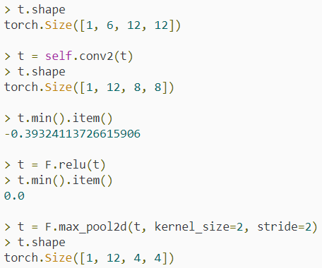
24.3 CNN Output Size Formula
https://www.youtube.com/watch?v=cin4YcGBh3Q&list=PLZbbT5o_s2xrfNyHZsM6ufI0iZENK9xgG&index=24
#3 Convolutional Layer (2)
This time our weight tensor has twelve filters of height of five and width of five, but instead of having a single input channel, the number of channels is coming in at six, which gives the filters a depth.
This accounts for the six output channels from the first convolutional layer.
The resulting output will have twelve channels.
Let’s run these operations now.

Slide 33

24.3 CNN Output Size Formula
https://www.youtube.com/watch?v=cin4YcGBh3Q&list=PLZbbT5o_s2xrfNyHZsM6ufI0iZENK9xgG&index=24
#3 Convolutional Layer (2)
The shape of the resulting output of self.conv2 allows us to see why we reshape the tensor using 12*4*4 before passing the tensor to the first linear layer, self.fc1.
As we have seen in the past, this particular reshaping is called flattening the tensor.
The flatten operation puts all of the tensor’s elements into a single dimension output
The resulting shape is 1x192.
The 1 in this case represents the batch size, and the 192 is the number of elements in the tensor that are now in the same dimension.

Slide 34
24.3 CNN Output Size Formula
https://www.youtube.com/watch?v=cin4YcGBh3Q&list=PLZbbT5o_s2xrfNyHZsM6ufI0iZENK9xgG&index=24
#4 #5 #6 Linear Layers
Now, we just have a series of linear layers followed by non-linear activation function until we reach the output layer.
> t = self.fc1(t)
> t.shape
torch.Size([1, 120])
> t = self.fc2(t)
> t.shape
torch.Size([1, 60])
> t = self.out(t)
> t.shape
torch.Size([1, 10])
> t tensor([[ 0.1009, -0.0842, 0.0349, -0.0640, 0.0754, -0.0057, 0.0878, 0.0296, 0.0345, 0.0236]])

Slide 35
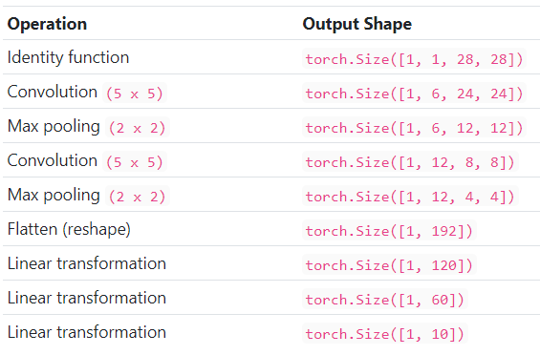
24.3 CNN Output Size Formula
https://www.youtube.com/watch?v=cin4YcGBh3Q&list=PLZbbT5o_s2xrfNyHZsM6ufI0iZENK9xgG&index=24
This table summarizes the shape changing operations and the resulting shape of each:

Slide 36
24.4 Summary

Slide 37
24.4 Summary
https://www.youtube.com/watch?v=cin4YcGBh3Q&list=PLZbbT5o_s2xrfNyHZsM6ufI0iZENK9xgG&index=24
Training The CNN Is Next
We should now have a good understanding of how input tensors are transformed by convolutional neural networks, how to debug neural networks in PyTorch, and how to inspect the weight tensors of all of the layers.
In the next discussion, we will begin training our network, which will lead to the values in our weight tensor to be updated to make the forward method of our network map the inputs to the correct output classes.

Slide 38
24.5 Quiz

Slide 39
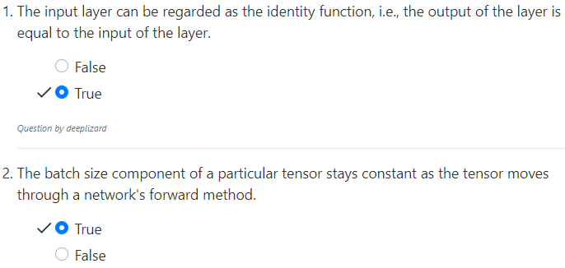
24.5 Quiz
https://www.youtube.com/watch?v=cin4YcGBh3Q&list=PLZbbT5o_s2xrfNyHZsM6ufI0iZENK9xgG&index=24
Quiz

Slide 40
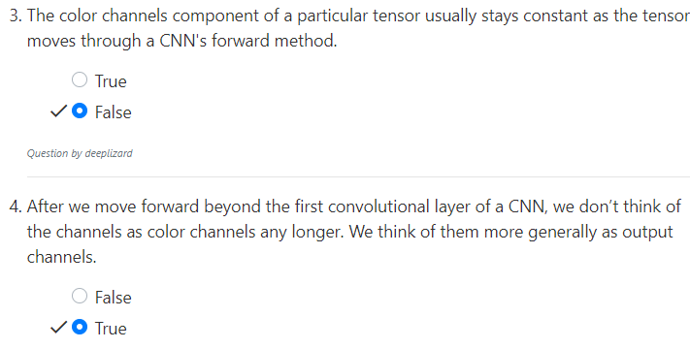
24.5 Quiz
https://www.youtube.com/watch?v=cin4YcGBh3Q&list=PLZbbT5o_s2xrfNyHZsM6ufI0iZENK9xgG&index=24
Quiz

Slide 41
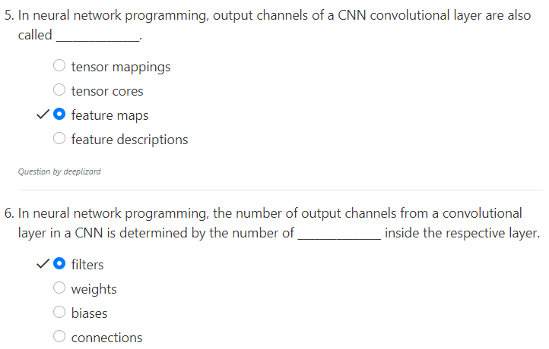
24.5 Quiz
https://www.youtube.com/watch?v=cin4YcGBh3Q&list=PLZbbT5o_s2xrfNyHZsM6ufI0iZENK9xgG&index=24
Quiz

Slide 42
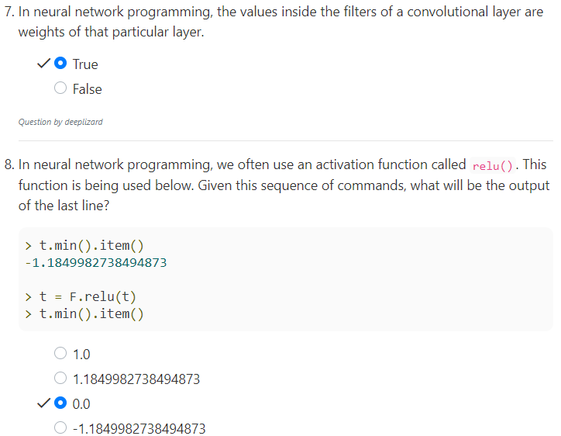
24.5 Quiz
https://www.youtube.com/watch?v=cin4YcGBh3Q&list=PLZbbT5o_s2xrfNyHZsM6ufI0iZENK9xgG&index=24
Quiz

Slide 43
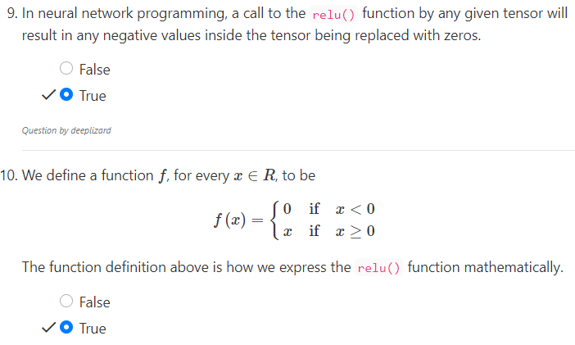
24.5 Quiz
https://www.youtube.com/watch?v=cin4YcGBh3Q&list=PLZbbT5o_s2xrfNyHZsM6ufI0iZENK9xgG&index=24
Quiz

Slide 44
End of Chapter

