Slide 1

21 Forward (Part 2)
Peter H. Chen

Slide 2
21 Forward (Part 2)
https://www.youtube.com/watch?v=MasG7tZj-hw&list=PLZbbT5o_s2xrfNyHZsM6ufI0iZENK9xgG&index=21
Forward
We discuss forward() Method in PyTorch.
We already prepared the data and build our model.
We created our network by extending nn.Modlue. PyTorch base class.
In the class constructor, we defined the network layers as class attributes.
Now, we need to implement our network’s forward () method.
Finally, we will be ready to train our model.
Prepare The Data
Build the Model
Create a neural network class that extends the nn.Module base class.
In the class constructor, define the network’s layers as class attributes.
Use the network’s layer attributes and nn.functional API operations define the network’s forward pass.
Trian the Model
Analyze the Model Result

Slide 3
21 Forward (Part 2)
https://www.youtube.com/watch?v=MasG7tZj-hw&list=PLZbbT5o_s2xrfNyHZsM6ufI0iZENK9xgG&index=21
Reviewing The Network
At the moment, we know that our forward() method accepts a tensor as input, and then, returns a tensor as output.
Right now, the tensor that is returned is the same tensor that is passed. However, after we build out the implementation, the returned tensor will be the output of the network.
This means that the forward method implementation will use all of the layers we defined inside the constructor. In this way, the forward method explicitly defines the network's transformation.
The forward() method is the actual network transformation. The forward method is the mapping that maps an input tensor to a prediction output tensor. Let's see how this is done.
Recall that in our network's constructor, we can see that we have five layers defined.

Slide 4
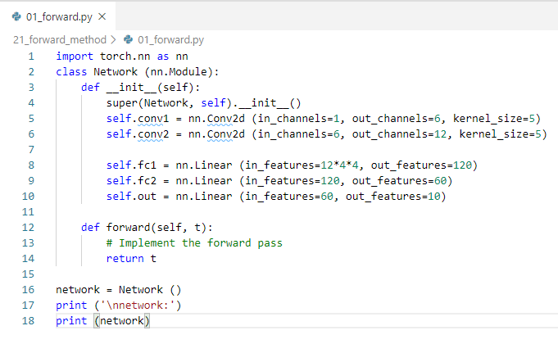
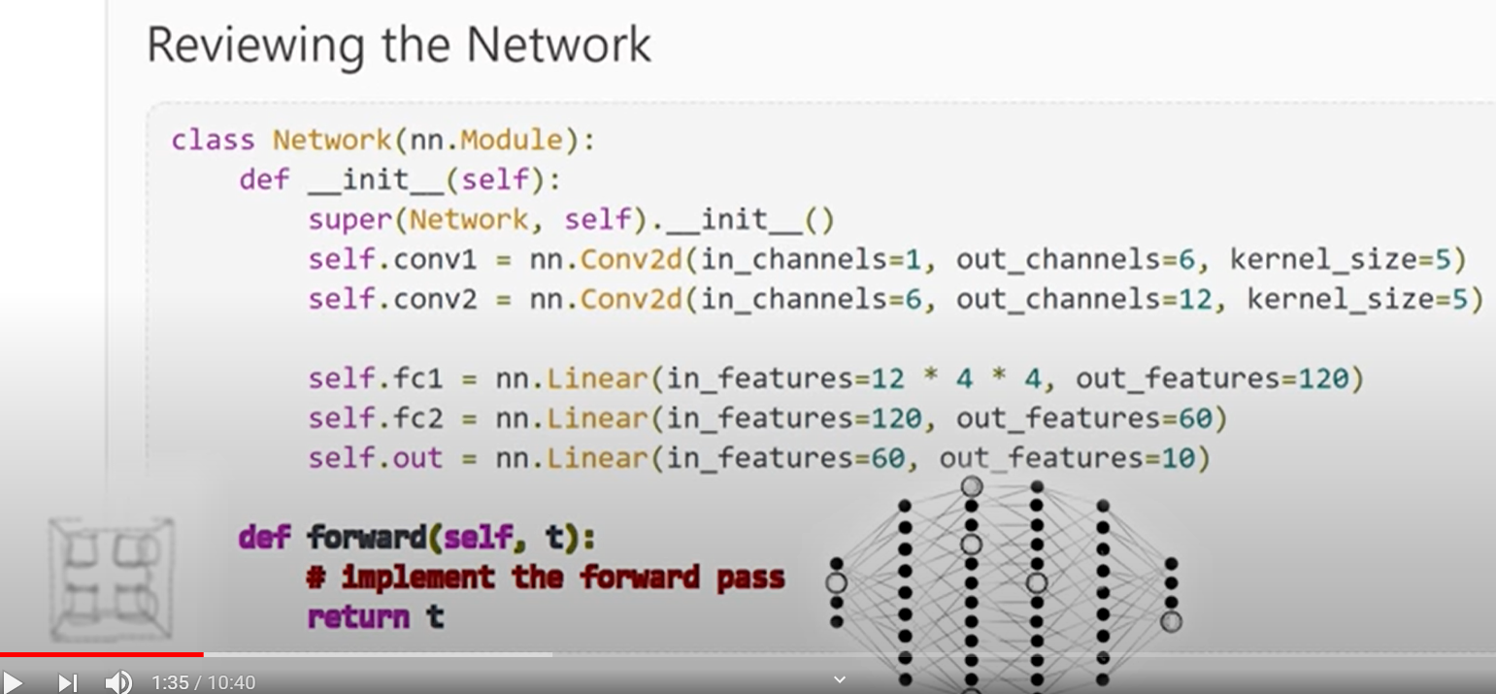
21 Forward (Part 2)
https://www.youtube.com/watch?v=MasG7tZj-hw&list=PLZbbT5o_s2xrfNyHZsM6ufI0iZENK9xgG&index=21
Recall that in our network's constructor, we can see that we have five layers defined.
We have two convolutional layers and three Linear layers.
If we count the input layer, this gives us a network with a total of six layers.

Slide 5
21.1 Implement forward() Method

Slide 6
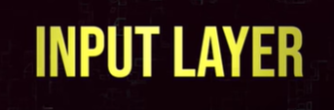
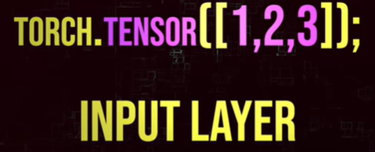
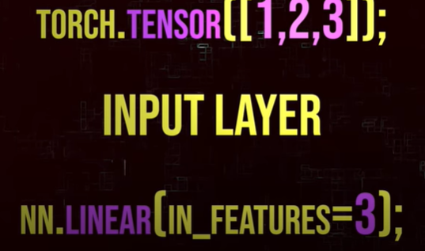
21.1 Implement forward() Method
https://www.youtube.com/watch?v=MasG7tZj-hw&list=PLZbbT5o_s2xrfNyHZsM6ufI0iZENK9xgG&index=21
We start with the input layer.
Input Layer #1
The input layer of any neural network is determined by the input data.
For example, if our input tensor contains three elements, our network would have three nodes contained in its input layer.
For this reason, we can think of the input layer as the identity transformation.

Slide 7
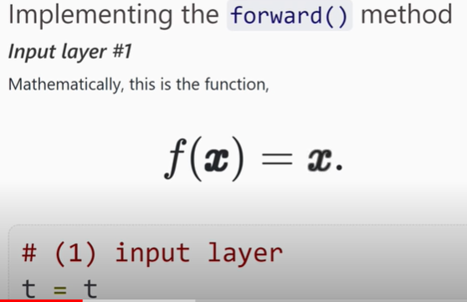
21.1 Implement forward() Method
https://www.youtube.com/watch?v=MasG7tZj-hw&list=PLZbbT5o_s2xrfNyHZsM6ufI0iZENK9xgG&index=21
Input Layer #1
Mathematically, this is the function,
We give any x as the input, and we get back the same x as the output.
Th reason we usually do not see the input when we are working with neural network API.
The input layer exist implicitly. It is definitely not required but for the sake of completion.

Slide 8
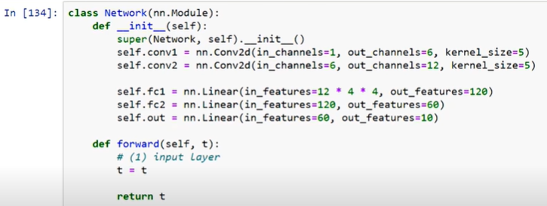
21.1 Implement forward() Method
https://www.youtube.com/watch?v=MasG7tZj-hw&list=PLZbbT5o_s2xrfNyHZsM6ufI0iZENK9xgG&index=21
Layer #1
We will show the identity operation in our forward method.
There. We have
> t = t
Our input layer is t coming in and coming out.

Slide 9
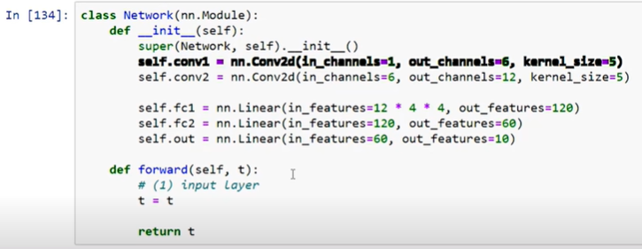
21.1 Implement forward() Method
https://www.youtube.com/watch?v=MasG7tZj-hw&list=PLZbbT5o_s2xrfNyHZsM6ufI0iZENK9xgG&index=21
Hidden Convolution Layers: Layers #2 and #3
There is no change here for out tensor t to perform the convolution operation.
We pass the tensor to the forward method of the first convolutional layer self.conv1.
We learned how all PyTorch eternal network modules have a forward method and when we call the forward method of an nn.modules class instance, there is a special way we make the call.
We call that actual instance instead of calling the forward method directly.

Slide 10
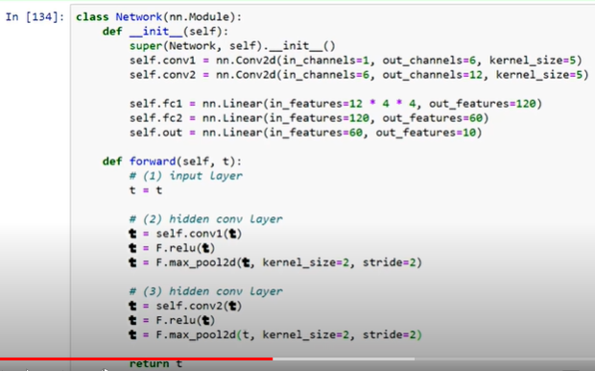
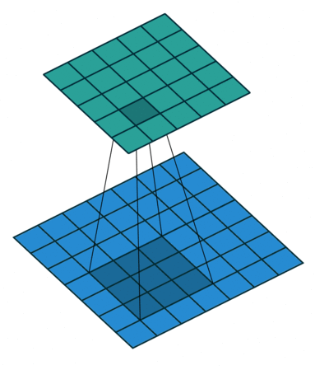
21.1 Implement forward() Method
https://www.youtube.com/watch?v=MasG7tZj-hw&list=PLZbbT5o_s2xrfNyHZsM6ufI0iZENK9xgG&index=21
Hidden Convolution Layers: Layers #2 and #3
As in the last discussion, instead of doing self.conv1.foward (tensor), we do self.conv1(tensor).
We add the implement for both convolutional layers.
As we see here, our input tensor is transformed in two convolutional layers.
The input tensor move through the conv1 and then relu activation, and then max_pool2d (kernel_size =2, stride=2).

Slide 11
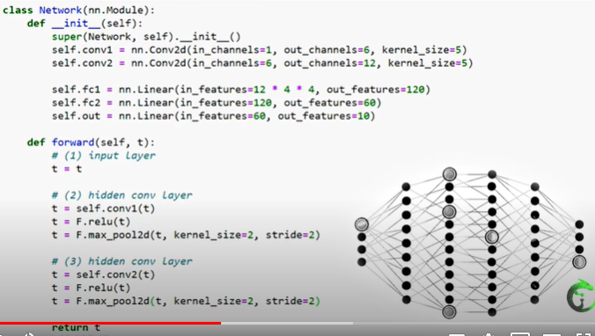
21.1 Implement forward() Method
https://www.youtube.com/watch?v=MasG7tZj-hw&list=PLZbbT5o_s2xrfNyHZsM6ufI0iZENK9xgG&index=21
Hidden Convolution Layers: Layers #2 and #3
The output tensor t of the conv1 layer is then passed to self.conv2 as do the same thing as conv1 except we call conv2 instead of conv1.
Each layers is comprised of a collection of weight and a collection of operations.
The weights are encapsulated inside the neural networks module and layer class instances.

Slide 12
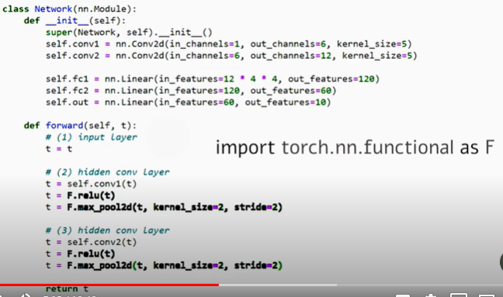
21.1 Implement forward() Method
https://www.youtube.com/watch?v=MasG7tZj-hw&list=PLZbbT5o_s2xrfNyHZsM6ufI0iZENK9xgG&index=21
Hidden Convolution Layers: Layers #2 and #3
Both the relu operations and max_pooling operations are just pure operations.
Neither of relu and max_pooling have the weights.
This is why we calling them directly from nn.functional API.
Sometimes, we may see polling operations referred to as polling layers.
Sometimes, we may even hear activation operations called activation layers.

Slide 13
21.1 Implement forward() Method
https://www.youtube.com/watch?v=MasG7tZj-hw&list=PLZbbT5o_s2xrfNyHZsM6ufI0iZENK9xgG&index=21
Hidden Convolution Layers: Layers #2 and #3
However, what makes a layer distinct from an operations is that layers have weights and operation does not have weight.
Since pooling operations and activation functions do not have weights, we will refer them as simply operations and view them as being added to the collection of layer operations.
For example, we'll say that the second layer in our network is a convolutional layer that contains a collection of weights, and preforms three operations, a convolution operation, the relu activation operation, and the max pooling operation.
The main thing that we need to aware of is which operations are defined using weights and which ones not use weights.
Historically, the operations defined using weights are called layers.
And later, other operations were added to the mix like activation functions and polling operations.
This addition cause some confusion in terminology.

Slide 14
21.1 Implement forward() Method
https://www.youtube.com/watch?v=MasG7tZj-hw&list=PLZbbT5o_s2xrfNyHZsM6ufI0iZENK9xgG&index=21
Hidden Convolution Layers: Layers #2 and #3
Mathematically, the entire network is just a composition of functions, and a composition of functions is a function itself.
All the terms like layers, activation functions, and weights, are just used to help describe the different parts.
Don't let these terms confuse the fact that the whole network is simply a composition of functions, and what we are doing now is defining this composition inside our forward() method.

Slide 15
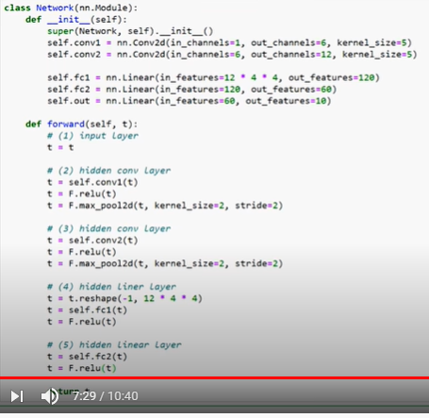
21.1 Implement forward() Method
https://www.youtube.com/watch?v=MasG7tZj-hw&list=PLZbbT5o_s2xrfNyHZsM6ufI0iZENK9xgG&index=21
Hidden Linear Layers: Layer #4 and #5
Before we pass our input to the first hidden linear layer, we must reshape() or flatten our tensor.
This will be the case any time we are passing output from a convolutional layer as input to a linear layer.
Since the fourth layer is the first linear layer, we will include our reshaping operation as a part of the forth layer.

Slide 16
21.1 Implement forward() Method
https://www.youtube.com/watch?v=MasG7tZj-hw&list=PLZbbT5o_s2xrfNyHZsM6ufI0iZENK9xgG&index=21
Hidden Linear Layers: Layer #4 and #5
We discussed that the number 12 in the reshaping operation is determined by the number of output channels coming from the previous convolutional layer.
However, the 4 * 4 was left as an open question.
Let's reveal the answer now.
The 4 * 4 is actually the height and width of each of the 12 output channels.

Slide 17
21.1 Implement forward() Method
https://www.youtube.com/watch?v=MasG7tZj-hw&list=PLZbbT5o_s2xrfNyHZsM6ufI0iZENK9xgG&index=21
Hidden Linear Layers: Layer #4 and #5
We started with a 1 x 28 x 28 input tensor. This gives a single color channel (1), 28 x 28 image, and by the time our tensor arrives at the first linear layer, the dimensions have changed.
The height and width dimensions have been reduced from 28 x 28 to 4 x 4 by the convolution and pooling operations.
Convolution and pooling operations are reduction operations on the height and width dimensions.
We will see how this works and see a formula for calculating these reductions in the next discussion.
For now, let's finish implementing our this forward() method.
After the tensor is reshaped, we pass the flattened tensor to the linear layer and pass this result to the relu() activation function.

Slide 18
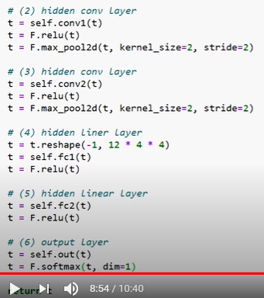
21.1 Implement forward() Method
https://www.youtube.com/watch?v=MasG7tZj-hw&list=PLZbbT5o_s2xrfNyHZsM6ufI0iZENK9xgG&index=21
Output Layer #6
The sixth and last layer of our network is a linear layer we call the output layer.
When we pass our tensor to the output layer, the result will be the prediction tensor.
Since our data has ten prediction classes, we know our output tensor will have ten elements.

Slide 19
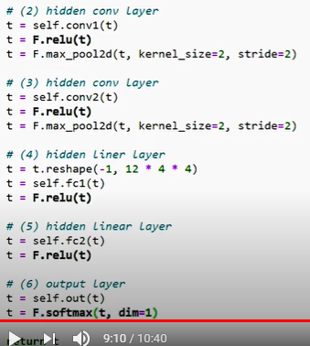
21.1 Implement forward() Method
https://www.youtube.com/watch?v=MasG7tZj-hw&list=PLZbbT5o_s2xrfNyHZsM6ufI0iZENK9xgG&index=21
Output Layer #6
The values inside each of the ten components will correspond to the prediction value for each of our prediction classes.
Inside the network we usually use relu() as our non-linear activation function, but for the output layer, whenever we have a single category that we are trying to predict, we use softmax().
The softmax function returns a positive probability for each of the prediction classes, and the probabilities sum to 1.

Slide 20
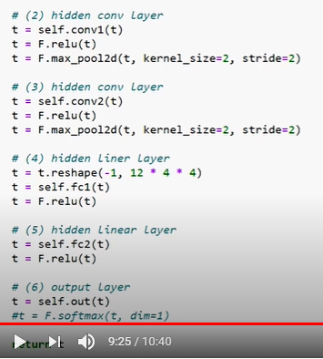
21.1 Implement forward() Method
https://www.youtube.com/watch?v=MasG7tZj-hw&list=PLZbbT5o_s2xrfNyHZsM6ufI0iZENK9xgG&index=21
Output Layer #6
However, in our case, we will not use softmax() because the loss function that we'll use, F.cross_entropy(), implicitly performs the softmax() operation on its input, so we will just return the result of the last linear transformation.
The implication of this is that our network will be trained using the softmax operation.
We will not need to compute the additional operation when the network is used for inference after the training process is complete.

Slide 21
21.2 Conclusion

Slide 22
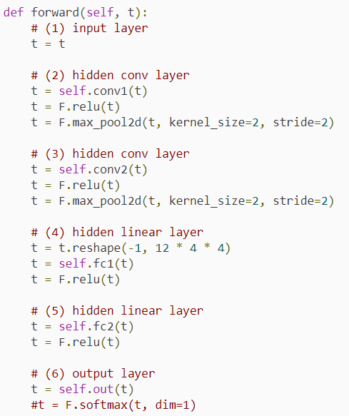
21.2 Conclusion
https://www.youtube.com/watch?v=MasG7tZj-hw&list=PLZbbT5o_s2xrfNyHZsM6ufI0iZENK9xgG&index=21
Conclusion
We did it.
This is how we implement a neural network forward method in PyTorch.

Slide 23
21.3 Quiz

Slide 24
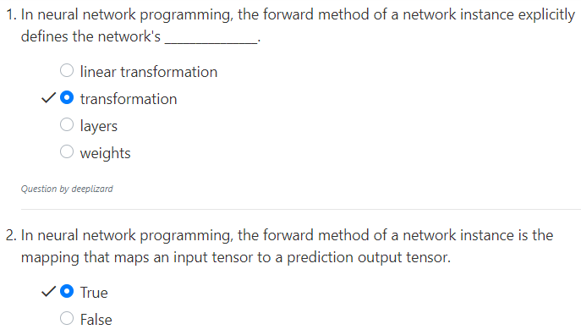
21.3 Quiz
https://www.youtube.com/watch?v=MasG7tZj-hw&list=PLZbbT5o_s2xrfNyHZsM6ufI0iZENK9xgG&index=21
Quiz

Slide 25
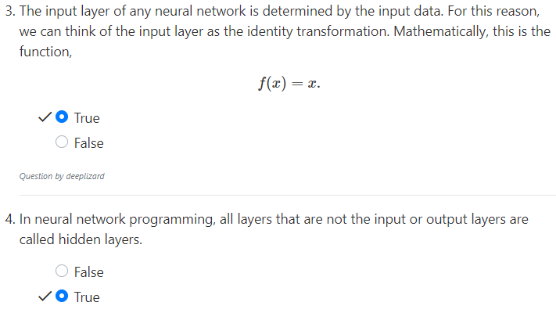
21.3 Quiz
https://www.youtube.com/watch?v=MasG7tZj-hw&list=PLZbbT5o_s2xrfNyHZsM6ufI0iZENK9xgG&index=21
Quiz

Slide 26
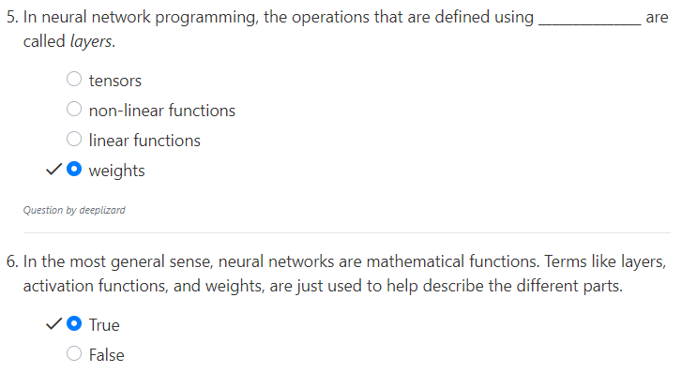
21.3 Quiz
https://www.youtube.com/watch?v=MasG7tZj-hw&list=PLZbbT5o_s2xrfNyHZsM6ufI0iZENK9xgG&index=21
Quiz

Slide 27
End of Chapter

