Slide 1

1 PyProch
Peter H. Chen

Slide 2
1 PyTorch
https://www.youtube.com/watch?v=v5cngxo4mIg&list=PLZbbT5o_s2xrfNyHZsM6ufI0iZENK9xgG&index=1
PyTorch
PyTorch requires Programming experience and Neural Network experience.
For Programming experience, we use Python for the programing.
For the Neural Network, we use the PyTorch.
PyTorch is a very thin Deep Learning Neural Network API for Python. From Python prospect, PyTorch is very close to programming neural network from the scratch. For this reason, we will be benefit to be aware of neural network and deep learning concept.
The deep learning fundamental theory is required for PyTorch.

Slide 3
1 PyTorch
https://www.youtube.com/watch?v=v5cngxo4mIg&list=PLZbbT5o_s2xrfNyHZsM6ufI0iZENK9xgG&index=1
Part 1: PyTorch and Tensors
Section 1: Introduction to PyTorch
PyTorch Explanation: Python Deep Learning Neural Network API.
PyTorch Installatopn: Quick and Easy
CUDA Explanation: Why Deep Learning uses GPUs
Section 2: Tensors
Tensor Explanation: Data Structure of Deep Learning
PyTorch Tensor Explanation: Neural Network Programming
Create PyTorch Tensors: Best Options
PyTorch Tensors: Reshape Operation
PyTorch Tensors: Element Operation
PyTorch tensors: Reduction and Access Operation

Slide 4
1 PyTorch
https://www.youtube.com/watch?v=v5cngxo4mIg&list=PLZbbT5o_s2xrfNyHZsM6ufI0iZENK9xgG&index=1
Part 2: Neural Network and Deep Learning with PyTorch
Section 1: Data and Data Processing
Fashion MNIST Explanation: Machine Learning Dataset
PyTorch torchvision explanation: ETL with Dataset and DataLoaders
PyTorch Dataset and DataLoaders for Machine Learning
Section 2: Neural Network and Deep Learning
Neural Network build with PyTorch
CNN Layer attribute parameters in PyTorch
CNN forward pass implementation by PyTorch
Forward propagation explanation. Pass single image to neural network.
Neural Network back processing. Pass Batch of images.
Convolutional Neural Network tensor transformation
Section 3: Training Neural Network
Train a Convolutional Neural Network with PyTorch
Analyze Result of CNN with confusion matrix.

Slide 5
1.1 Quiz

Slide 6
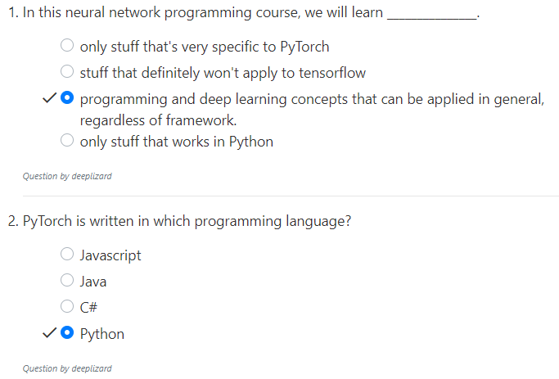
1.1 Quiz
https://www.youtube.com/watch?v=v5cngxo4mIg&list=PLZbbT5o_s2xrfNyHZsM6ufI0iZENK9xgG&index=1
Quiz

Slide 7
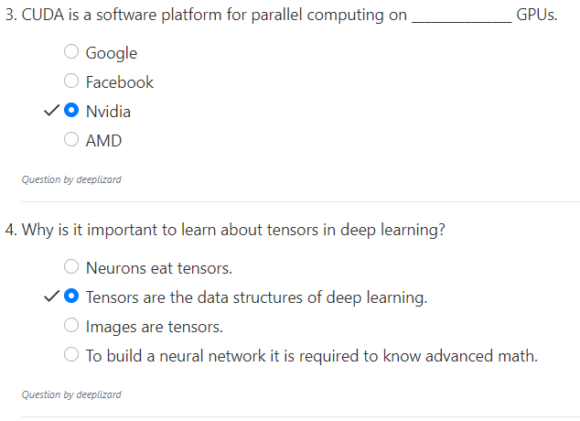
1.1 Quiz
https://www.youtube.com/watch?v=v5cngxo4mIg&list=PLZbbT5o_s2xrfNyHZsM6ufI0iZENK9xgG&index=1
Quiz

Slide 8
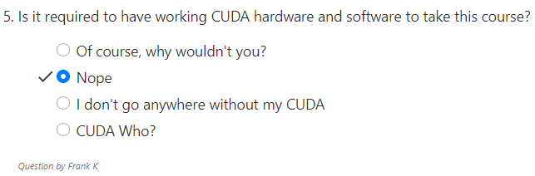
1.1 Quiz
https://www.youtube.com/watch?v=v5cngxo4mIg&list=PLZbbT5o_s2xrfNyHZsM6ufI0iZENK9xgG&index=1
Quiz

Slide 9
End of Chapter

