Slide 1

2 Deep Learning API
Peter H. Chen

Slide 2
2 Deep Learning API
https://www.youtube.com/watch?v=iTKbyFh-7GM&list=PLZbbT5o_s2xrfNyHZsM6ufI0iZENK9xgG&index=2
Deep Learning API
PyTorch is a Deep Learning Neural Network API doe Tensor Library and associated Tensor Operations.
An Tensor is N-Dimensional array or n-D array.
One of the popular scientific computing package for python is numpy.

Slide 3
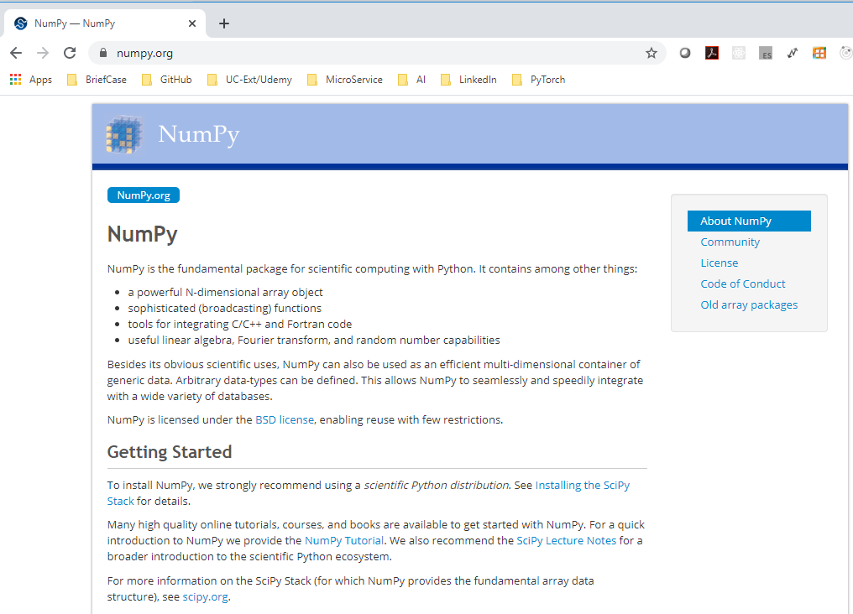
2 Deep Learning API
https://www.youtube.com/watch?v=iTKbyFh-7GM&list=PLZbbT5o_s2xrfNyHZsM6ufI0iZENK9xgG&index=2
numpy is the go to package for n-D array.
PyTorch tensor library mirrors numpy n-dimensional array capabilities very closely.
PyTorch is highly interoperable with numpy itself.

Slide 4
2 Deep Learning API
https://www.youtube.com/watch?v=iTKbyFh-7GM&list=PLZbbT5o_s2xrfNyHZsM6ufI0iZENK9xgG&index=2
With pyTorchy tensor GPU support, it is very easy to use PyTorch to move tensors to and from a GPU from our system.
PyTorch is a young framework. Initial release in October 2016.
Before PyTroch, there is another framework called Torch.
Torch is a machine learning framework released in 2002 based on Lua Programming Language.

Slide 5
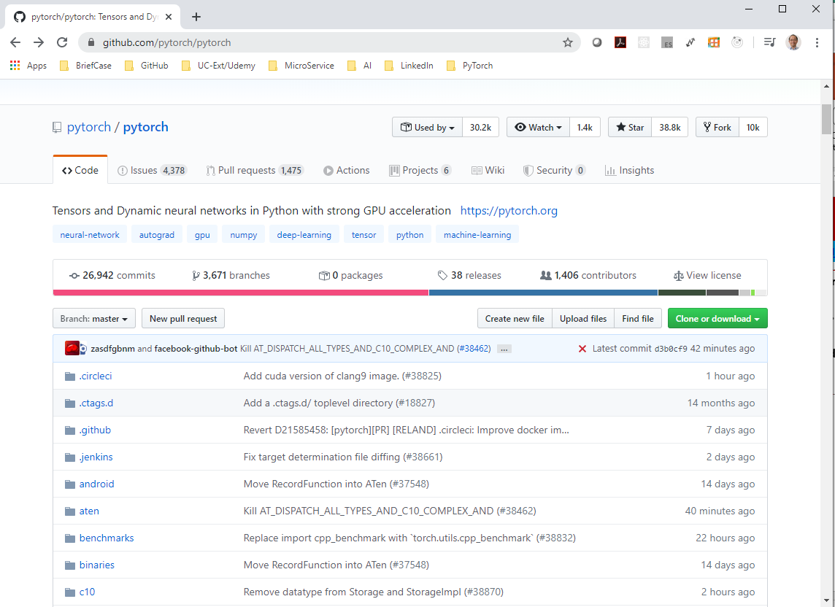
2 Deep Learning API
https://www.youtube.com/watch?v=iTKbyFh-7GM&list=PLZbbT5o_s2xrfNyHZsM6ufI0iZENK9xgG&index=2
Torch is faced out and Tensorflow is hard to use.
Facebook AI team move away from Torch and develop PyTorch.

Slide 6
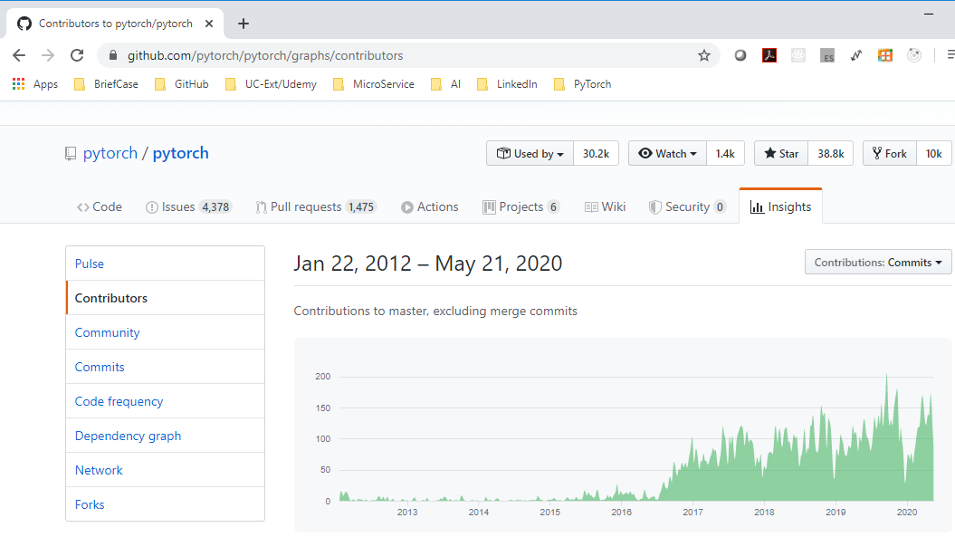
2 Deep Learning API
https://www.youtube.com/watch?v=iTKbyFh-7GM&list=PLZbbT5o_s2xrfNyHZsM6ufI0iZENK9xgG&index=2
The activity started from 2012 to 2020.

Slide 7
2 Deep Learning API
https://www.youtube.com/watch?v=iTKbyFh-7GM&list=PLZbbT5o_s2xrfNyHZsM6ufI0iZENK9xgG&index=2
Neural Network and Deep learning requires the use of tensors.
PyTorch gives us rich of frameworks:
Package | Description
torch | The top-level PyTorch package and tensor library
torch.nn | A subpackage that contains modules and extensible classes for building neural network
torch.autograd | A subpackage that supports all the differentiable Tensor operators in PyTorch
torch.nn.functional | A functional interface that contains operations for loss functions, activation function, and convolutional function.
torch.optim | A subpackage that contains standard optimization operations, SGD and Adam
torch.utils | A subpackage that contains utility classes, dataset and dataloaders for data preprocessing.
torchvision | A package that provides access to popular dataset, model architectures, and image transformation for computer vision.

Slide 8
2 Deep Learning API
https://www.youtube.com/watch?v=iTKbyFh-7GM&list=PLZbbT5o_s2xrfNyHZsM6ufI0iZENK9xgG&index=2
PyTorch let you understand how the neural network the deep learning process.
The Philosophy of PyTorch
Stay out of the way: PyTorch will not overburden them with abstraction or complicated API.
Cater to the impatient: PyTorch want to be interactive, quick, no compilation time.
Promote linear code-flow:
Full interop with the Python ecosystem:
Be as fast as anything else: As fast as any other packaged that provide the same features.
These philosophies keep PyTorch programmers just writing and extending standard Python classes. When we debug the PyTorch program, we are using the standard Python debugger.

Slide 9
2 Deep Learning API
https://www.youtube.com/watch?v=iTKbyFh-7GM&list=PLZbbT5o_s2xrfNyHZsM6ufI0iZENK9xgG&index=2
Debugging
PyTorch is a Python extension: Other framework may be run in C++ runtime, you cannot actually set Python breakpoint to see what is going on.
Use your favorite Python debugger: You can use PyCharm, PDB, and etc.
Use the most popular debugger, for example, print(foo)
PyTorch is a good framework about neural network mainly is for its simplicity.

Slide 10
2 Deep Learning API
https://www.youtube.com/watch?v=iTKbyFh-7GM&list=PLZbbT5o_s2xrfNyHZsM6ufI0iZENK9xgG&index=2
Another reason for PyTorch is preferred for the research.
Deep learning framework uses computational graphs.
Computational graphs are used to graph the function operations that occurs on tensors inside neural networks.
These graphs are use to compute the derivatives needed to optimize the neural networks.
PyTorch uses a computational graph that is called Dynamic Computational Graph. This means that the graph is generated on the fly as the operations are created.
This is contrast to static graphs that are fully determined before the actual operations occur. Many cutting edge research topics in deep learning are requiring or dynamic graphs.

Slide 11
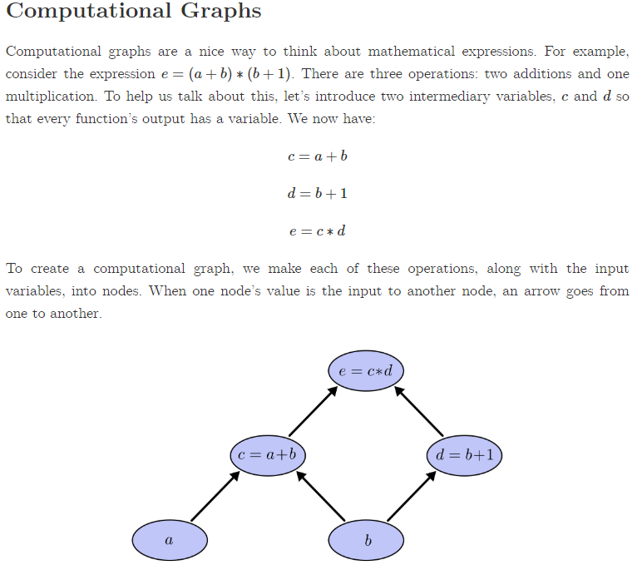
2 Deep Learning API
https://www.youtube.com/watch?v=iTKbyFh-7GM&list=PLZbbT5o_s2xrfNyHZsM6ufI0iZENK9xgG&index=2
Calculus on Computational Graphs: Backpropagation
https://colah.github.io/posts/2015-08-Backprop/
We compute the derivatives in deep learning.
Framework use computational graphs for function operations.
The functional operations occur on tensor inside neural networks.

Slide 12
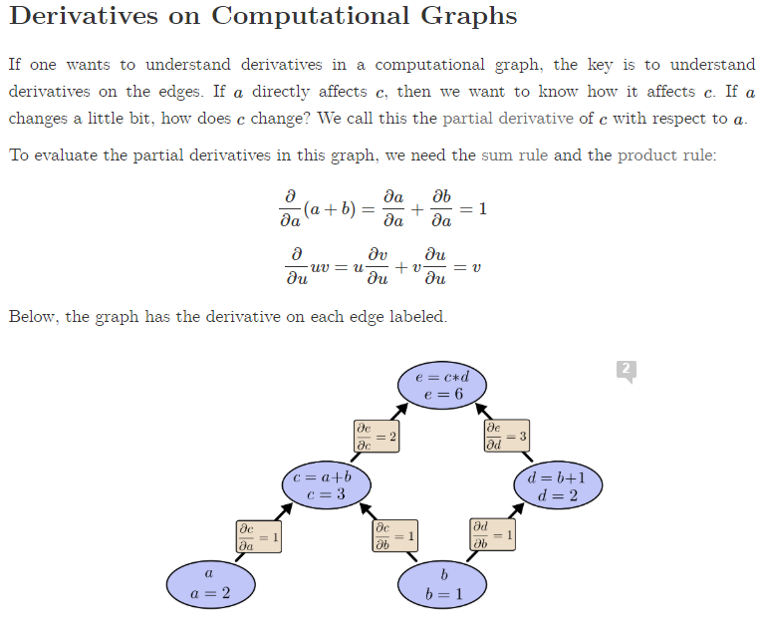
2 Deep Learning API
https://www.youtube.com/watch?v=iTKbyFh-7GM&list=PLZbbT5o_s2xrfNyHZsM6ufI0iZENK9xgG&index=2
Calculus on Computational Graphs: Backpropagation
https://colah.github.io/posts/2015-08-Backprop/
This derivatives needed to be optimized the neural networks weights.
PyTorch uses a computational graph that is called a Dynamic Computational Graphs.

Slide 13
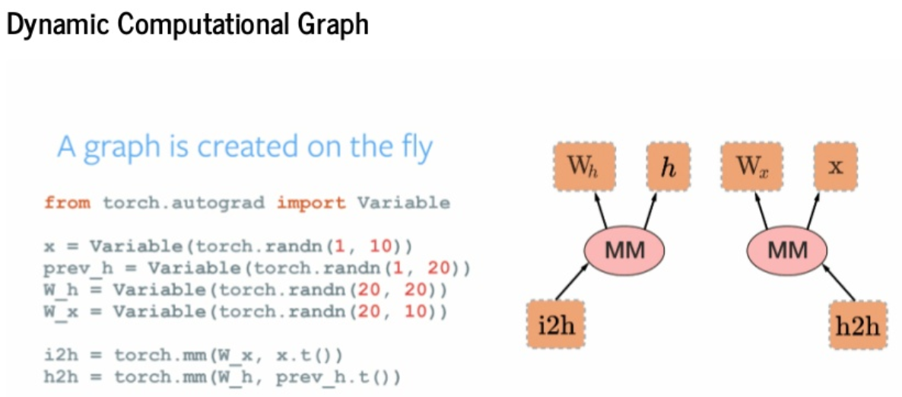
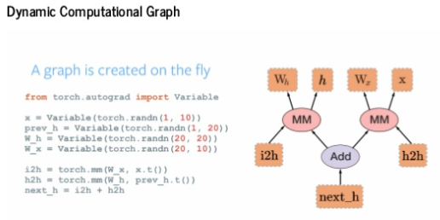
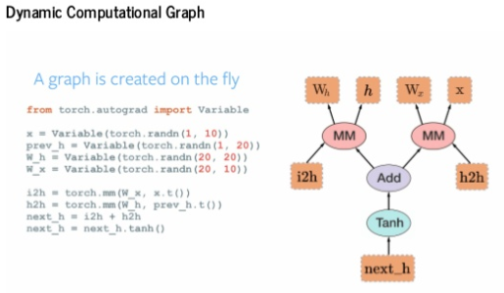
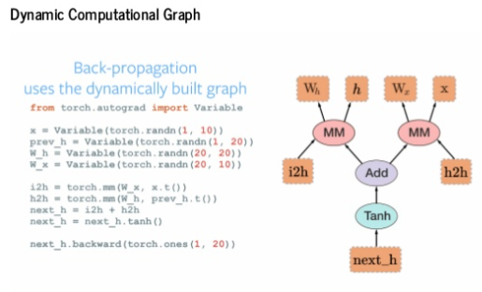
2 Deep Learning API
https://www.youtube.com/watch?v=iTKbyFh-7GM&list=PLZbbT5o_s2xrfNyHZsM6ufI0iZENK9xgG&index=2
Calculus on Computational Graphs: Backpropagation
https://www.slideshare.net/abdulmuneer/pytorch-for-tfdevelopers
PyTorch graph is generated on the fly.

Slide 14
2 Deep Learning API
https://www.youtube.com/watch?v=iTKbyFh-7GM&list=PLZbbT5o_s2xrfNyHZsM6ufI0iZENK9xgG&index=2
The cutting edge research topics in deep learning are requiring or benefiting greatly from dynamic graphs.

Slide 15
2.1 Quiz

Slide 16
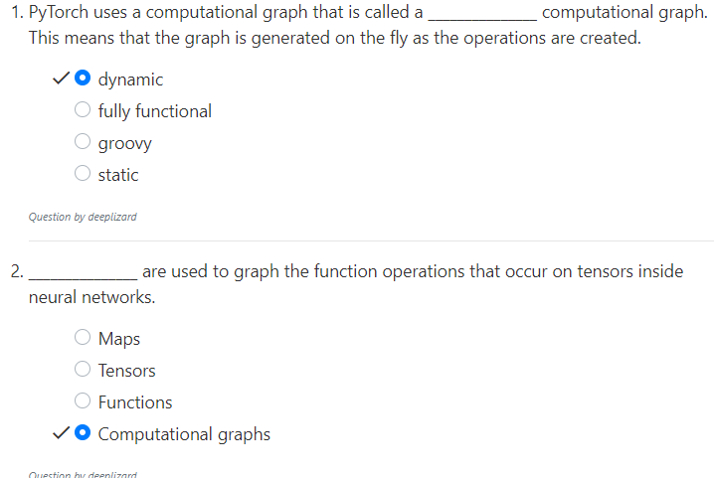
2.1 Quiz
https://www.youtube.com/watch?v=iTKbyFh-7GM&list=PLZbbT5o_s2xrfNyHZsM6ufI0iZENK9xgG&index=2
Quiz.

Slide 17
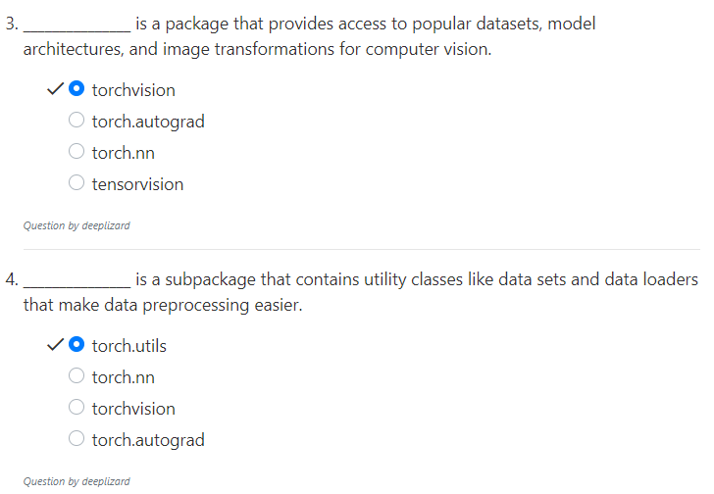
2.1 Quiz
https://www.youtube.com/watch?v=iTKbyFh-7GM&list=PLZbbT5o_s2xrfNyHZsM6ufI0iZENK9xgG&index=2
Quiz.

Slide 18
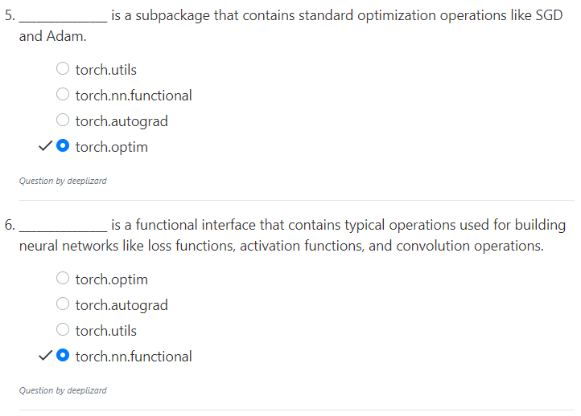
2.1 Quiz
https://www.youtube.com/watch?v=iTKbyFh-7GM&list=PLZbbT5o_s2xrfNyHZsM6ufI0iZENK9xgG&index=2
Quiz.

Slide 19
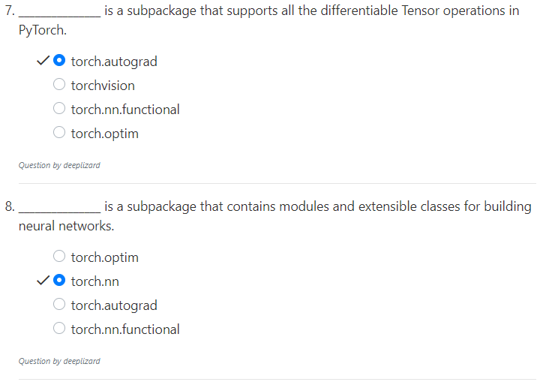
2.1 Quiz
https://www.youtube.com/watch?v=iTKbyFh-7GM&list=PLZbbT5o_s2xrfNyHZsM6ufI0iZENK9xgG&index=2
Quiz.

Slide 20
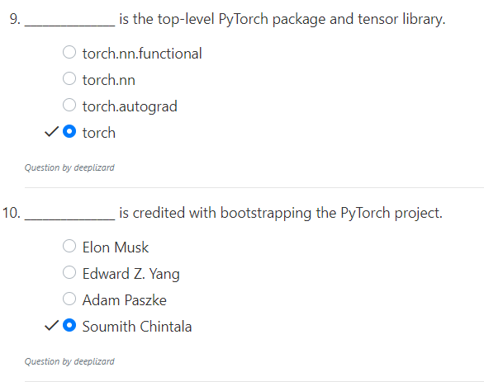
2.1 Quiz
https://www.youtube.com/watch?v=iTKbyFh-7GM&list=PLZbbT5o_s2xrfNyHZsM6ufI0iZENK9xgG&index=2
Quiz.

Slide 21
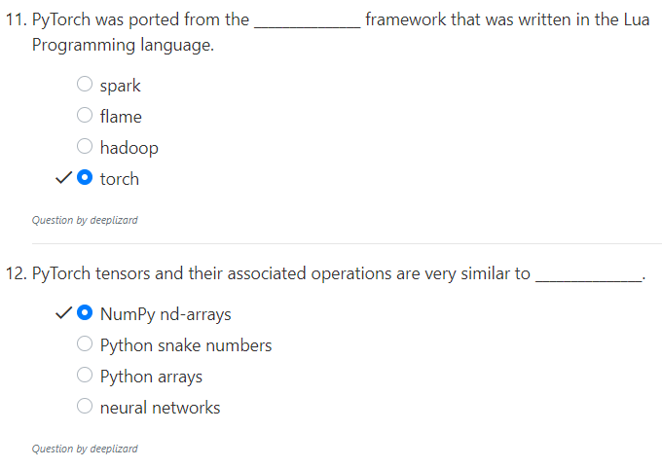
2.1 Quiz
https://www.youtube.com/watch?v=iTKbyFh-7GM&list=PLZbbT5o_s2xrfNyHZsM6ufI0iZENK9xgG&index=2
Quiz.

Slide 22
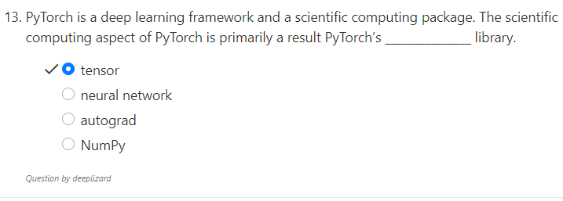
2.1 Quiz
https://www.youtube.com/watch?v=iTKbyFh-7GM&list=PLZbbT5o_s2xrfNyHZsM6ufI0iZENK9xgG&index=2
Quiz.

Slide 23
End of Chapter

