Slide 1

3 Install PyTorch
Peter H. Chen

Slide 2
3 Install PyTorch
https://www.youtube.com/watch?v=UWlFM0R_x6I&list=PLZbbT5o_s2xrfNyHZsM6ufI0iZENK9xgG&index=3
Install PyTorch
To install the PyTorch, it is best to use Anaconda Python Package manager.
With Anaconda, it is easy to get the Jupyter notebook, and other commonly use for scientific computing and data science including PyTorch.

Slide 3
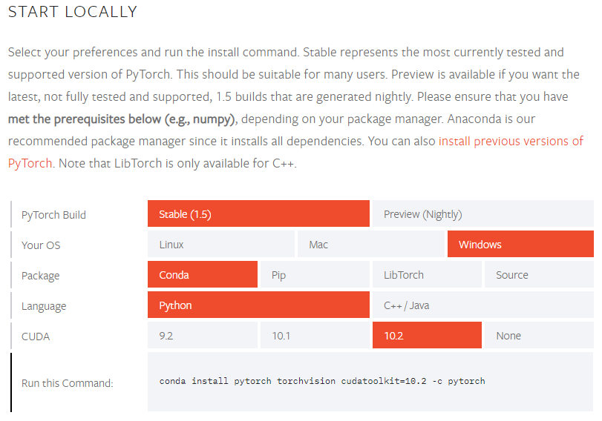
3 Install PyTorch
https://www.youtube.com/watch?v=UWlFM0R_x6I&list=PLZbbT5o_s2xrfNyHZsM6ufI0iZENK9xgG&index=3
Install PyTorch
https://pytorch.org/get-started/locally/
PyTorch: 1.5
OS: Windows
Package Manager: conda
Python: 3.7
CUDA: 10.2
> conda install pytorch torchvision cudatoolkit=10.2 -c pytorch

Slide 4
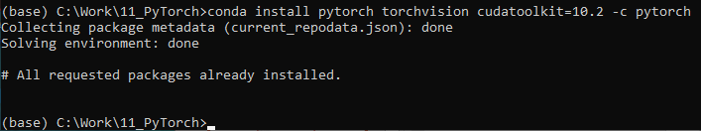
3 Install PyTorch
https://www.youtube.com/watch?v=UWlFM0R_x6I&list=PLZbbT5o_s2xrfNyHZsM6ufI0iZENK9xgG&index=3
Install PyTorch
https://medium.com/@bryant.kou/how-to-install-pytorch-on-windows-step-by-step-cc4d004adb2a
Search “Anaconda” Open Anaconda command prompt
> conda install pytorch torchvision cudatoolkit=10.2 -c pytorch

Slide 5
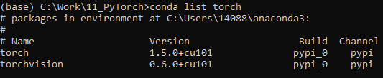
3 Install PyTorch
https://www.youtube.com/watch?v=UWlFM0R_x6I&list=PLZbbT5o_s2xrfNyHZsM6ufI0iZENK9xgG&index=3
How to check Pytorch version?
https://discuss.pytorch.org/t/how-do-i-know-the-current-version-of-pytorch/6754
> conda list torch
> conda list pytorch (This does not work on my computer)

Slide 6
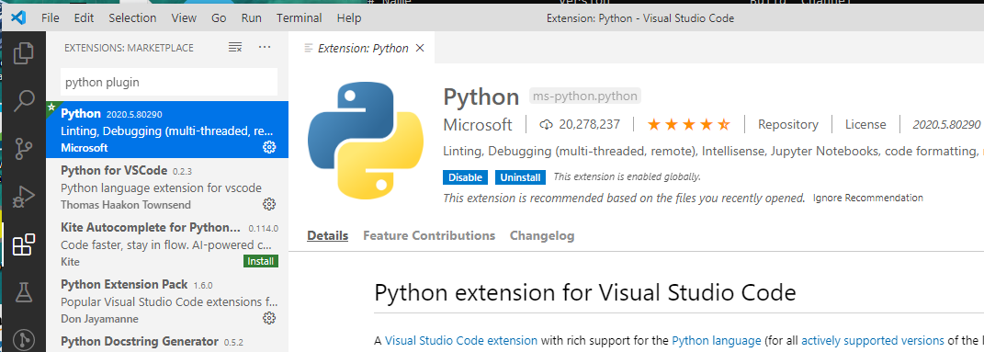
3 Install PyTorch
https://www.youtube.com/watch?v=UWlFM0R_x6I&list=PLZbbT5o_s2xrfNyHZsM6ufI0iZENK9xgG&index=3
Software We used
We use Jupyter (interactive environment) and VS Code (IDE) to write the code.
We also install the Python Plugin inside the VS Code.
This plugin is for the Python debugging in Part 2.
In Part 1, we use Jupyter notebook from Anaconda.

Slide 7
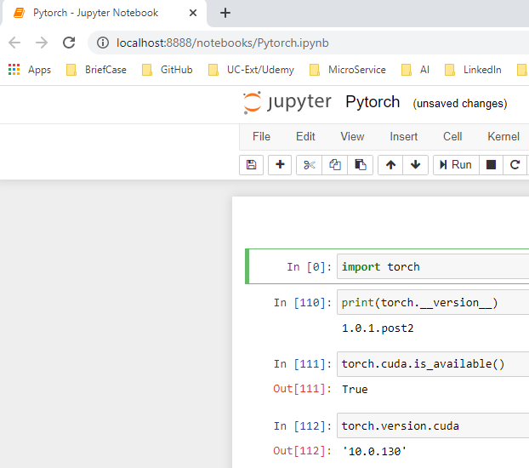
3 Install PyTorch
https://www.youtube.com/watch?v=UWlFM0R_x6I&list=PLZbbT5o_s2xrfNyHZsM6ufI0iZENK9xgG&index=3
Jupyter notebook:

Slide 8
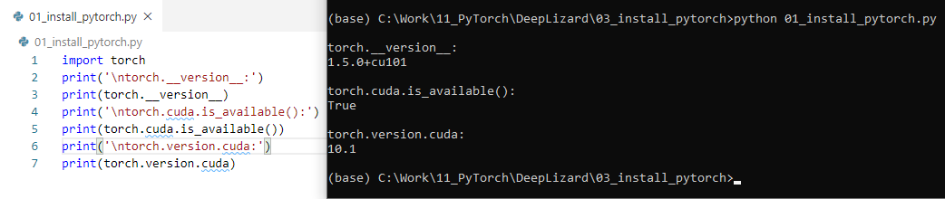
3 Install PyTorch
https://www.youtube.com/watch?v=UWlFM0R_x6I&list=PLZbbT5o_s2xrfNyHZsM6ufI0iZENK9xgG&index=3
Python print torch and cuda version:
Even you do not have cuda, you still can run pytorch without GPU.

Slide 9
3.1 Quiz

Slide 10
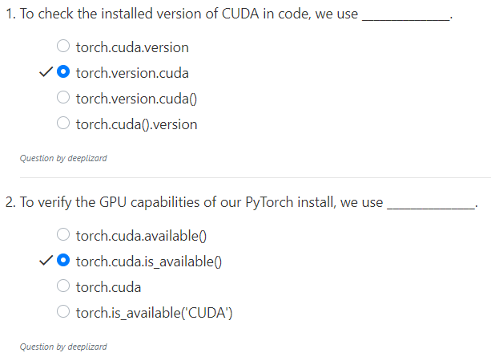
3.1 Quiz
https://www.youtube.com/watch?v=UWlFM0R_x6I&list=PLZbbT5o_s2xrfNyHZsM6ufI0iZENK9xgG&index=3
Quiz

Slide 11
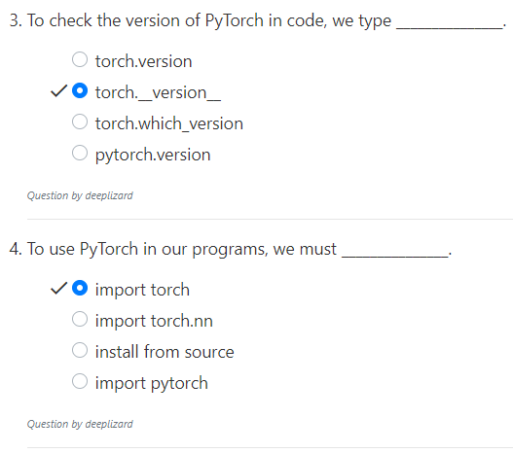
3.1 Quiz
https://www.youtube.com/watch?v=UWlFM0R_x6I&list=PLZbbT5o_s2xrfNyHZsM6ufI0iZENK9xgG&index=3
Quiz

Slide 12
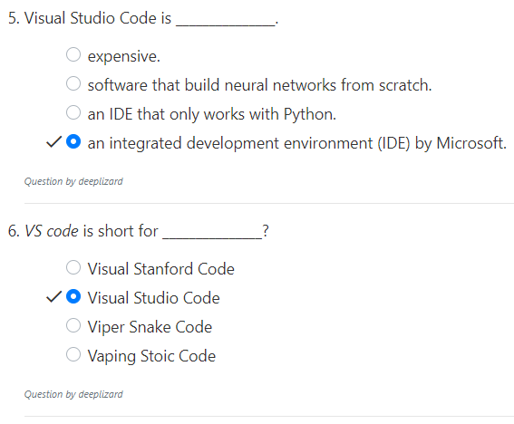
3.1 Quiz
https://www.youtube.com/watch?v=UWlFM0R_x6I&list=PLZbbT5o_s2xrfNyHZsM6ufI0iZENK9xgG&index=3
Quiz

Slide 13
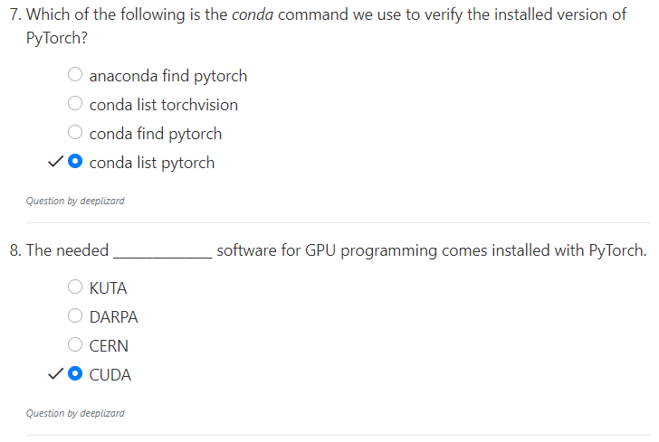
3.1 Quiz
https://www.youtube.com/watch?v=UWlFM0R_x6I&list=PLZbbT5o_s2xrfNyHZsM6ufI0iZENK9xgG&index=3
Quiz

Slide 14
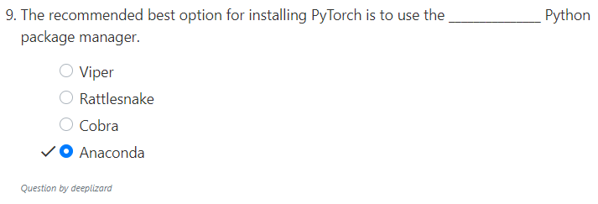
3.1 Quiz
https://www.youtube.com/watch?v=UWlFM0R_x6I&list=PLZbbT5o_s2xrfNyHZsM6ufI0iZENK9xgG&index=3
Quiz

Slide 15
End of Chapter

