Slide 1

4 Cuda
Peter H. Chen

Slide 2
4 Cuda
https://www.youtube.com/watch?v=6stDhEA0wFQ&list=PLZbbT5o_s2xrfNyHZsM6ufI0iZENK9xgG&index=4
Cuda
Why do we need Cuda? Why do we need the graphic processor?
Cuda is the software for NVIDIA GPU (Graphic Processor Unit).
A GPU is processor for specialized computation. This is contract to CPU (Central Processing Unit) for general computation.
CPU is a processor for regular computation.
A GPU can be much faster than CPU in parallel computation.
Parallel computation is a special computation can be broken into independent smaller computations that can be carried out simultaneously. The resulting computations are then recombined or synchronized to form the result of original larger computation.
The number of task that a larger computation can be broken into depends on the number of cores contained on a particular piece of hardware.
Cores are the units that actually do the computation within a given processor and CPUs typically have 4 or 16 cores while GPUs have potentially thousands of cores.

Slide 3
4 Cuda
https://www.youtube.com/watch?v=6stDhEA0wFQ&list=PLZbbT5o_s2xrfNyHZsM6ufI0iZENK9xgG&index=4
We can conclude that parallel computing is done by using GPUs.
We can also conclude that the tasks which are best suited to be of using a GPU are tasks that can be done in parallel.
If a computation can be done in parallel, we can accelerate our computation using parallel programming approaches.
GPUs let’s turn our attention to neural network and see why GPUs are heavily used in deep learning.

Slide 4
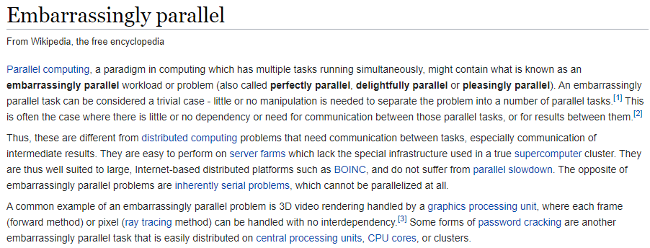
4 Cuda
https://www.youtube.com/watch?v=6stDhEA0wFQ&list=PLZbbT5o_s2xrfNyHZsM6ufI0iZENK9xgG&index=4
Embarrassing Parallel
We know the GPUs are suited for parallel computing and this fact about GPUs is why deep learning uses them.
Neural network are embarrassing parallel.
Seriously, in parallel computing, an embarrassing parallel task is a problem where little to no effort is needed to break the task down into an independent set of smaller tasks.

Slide 5
4 Cuda
https://www.youtube.com/watch?v=6stDhEA0wFQ&list=PLZbbT5o_s2xrfNyHZsM6ufI0iZENK9xgG&index=4
Neural Networks are Embarrassing Parallel
Neural Network are embarrassing Parallel. Typically, high-end GPUs have 3000 cores can run computations in parallel.
Neural network can be broken into smaller computations that are independent with respect to one another.
The nature of computations used in neural network that makes GPUs so useful in deep learning.

Slide 6
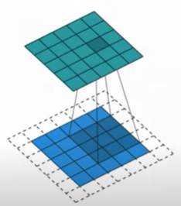
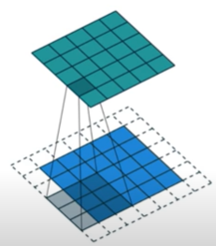
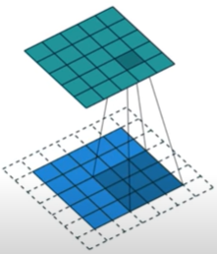
4 Cuda
https://www.youtube.com/watch?v=6stDhEA0wFQ&list=PLZbbT5o_s2xrfNyHZsM6ufI0iZENK9xgG&index=4
https://commons.wikimedia.org/wiki/File:Convolution_arithmetic_-_No_padding_no_strides.gif
When we perform the convolutional operation, we have input channel in blue on the bottom.
A convolutional filter shaded on top of the input channel that is sliding across the input channel.
A green output channel for each position of the convolutional filter.
On top of the input channel, there is a corresponding green region.
On the output channel, this is the output of the convolution operation at each point.

Slide 7
4 Cuda
https://www.youtube.com/watch?v=6stDhEA0wFQ&list=PLZbbT5o_s2xrfNyHZsM6ufI0iZENK9xgG&index=4
https://commons.wikimedia.org/wiki/File:Convolution_arithmetic_-_No_padding_no_strides.gif
In the animation, these computations are happening sequentially one after the other, however, each computation is independent form the other.
This means none of the computations depends on the results of any of the other computations.
In the result, all these independent computations can happen in parallel on a GPU and the overall output channel can be produced after all of the computations have been completed.

Slide 8
4 Cuda
https://www.youtube.com/watch?v=6stDhEA0wFQ&list=PLZbbT5o_s2xrfNyHZsM6ufI0iZENK9xgG&index=4
https://commons.wikimedia.org/wiki/File:Convolution_arithmetic_-_No_padding_no_strides.gif
This allows us to see that the convolutional operation can be accelerated using the parallel programming approach and a GPU.
This is where Cuda comes into neural networks.

Slide 9
4 Cuda
https://www.youtube.com/watch?v=6stDhEA0wFQ&list=PLZbbT5o_s2xrfNyHZsM6ufI0iZENK9xgG&index=4
NVIDIA is a technology company that design GPUs.
They created Cuda as a software platform that pairs with the GPU hardware making it easier for developers to build software that accelerate computations using the parallel processing power of NVIDIA GPUs.
The NVIDIA CPU is the hardware that enables parallel computation. Cuda is the software layer that provides an API for developers.
Cuda can be downloaded and installed from NVIDA website for free.

Slide 10
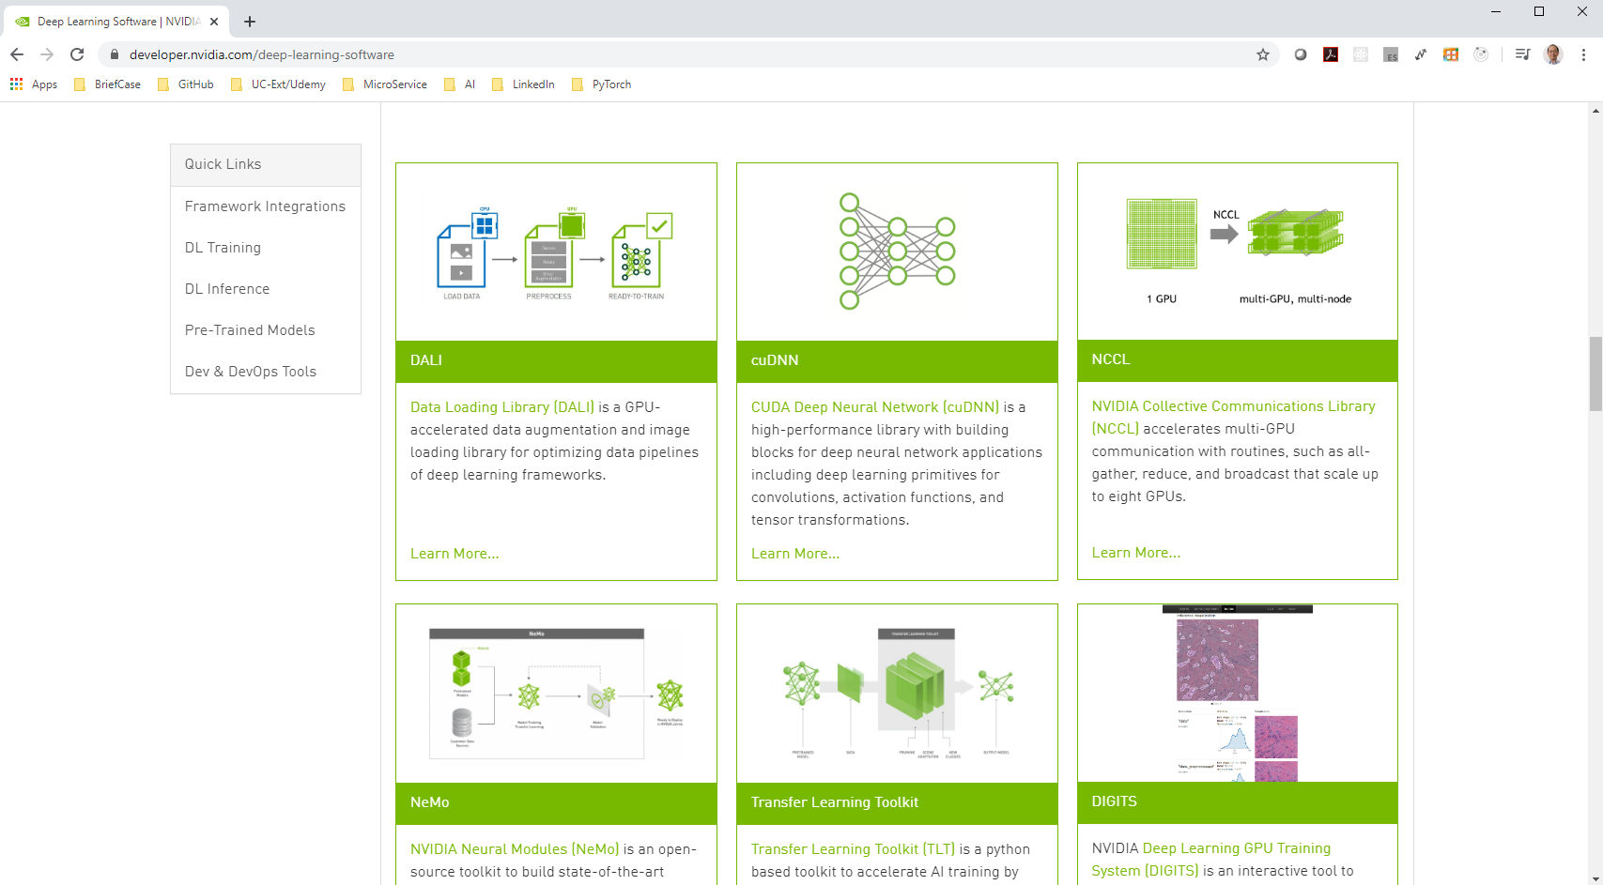
4 Cuda
https://www.youtube.com/watch?v=6stDhEA0wFQ&list=PLZbbT5o_s2xrfNyHZsM6ufI0iZENK9xgG&index=4
https://developer.nvidia.com/deep-learning-software
The Cuda has specialized libraries like CuDNN, TensorRT, DeepStream SDK, CuBLAS, cuSPARE

Slide 11
4 Cuda
https://www.youtube.com/watch?v=6stDhEA0wFQ&list=PLZbbT5o_s2xrfNyHZsM6ufI0iZENK9xgG&index=4
PyTotch is written by Python, however, they code will be translated into C/C++ and Cuda to speed up the processing and get that performance boost.

Slide 12
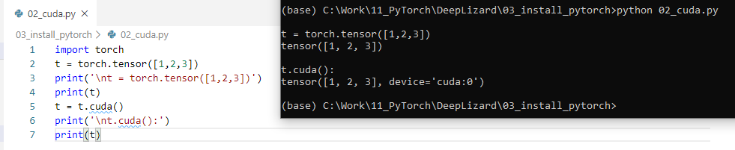
4 Cuda
https://www.youtube.com/watch?v=6stDhEA0wFQ&list=PLZbbT5o_s2xrfNyHZsM6ufI0iZENK9xgG&index=4
Using Cuda
> torch.tensor([1,2,3])
The PyTorch can be used CPU.
> t.cuda()
Cuda assign the tensor to each GPU unit 0 (cuda:0).
The computation can be versatile either on CPU or GPU.
The GPU is only faster for particular task.
The task move from CPU to GPU is costly and slower if the computation task is a simple one.

Slide 13
4 Cuda
https://www.youtube.com/watch?v=6stDhEA0wFQ&list=PLZbbT5o_s2xrfNyHZsM6ufI0iZENK9xgG&index=4
Using Cuda
GPU is only used when the task can be broken down.
If task is simple, move from CPU to GPU is slower.
NVIDIA is a pioneer for GPGPU (General Purpose Graphical Process Unit).
NVIDIA CEO Jensen Wong has envisioned GPU computing very early on.
Cuda is created 10 years ago.
Cuda is really now take flight.
NVIDIA GPU is leading for deep learning.

Slide 14
4.1 Quiz
Peter H. Chen

Slide 15
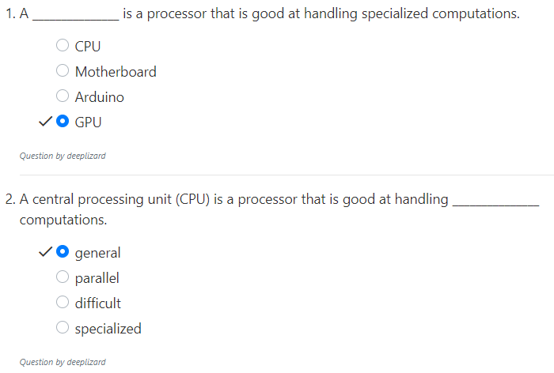
4.1 Quiz
https://www.youtube.com/watch?v=6stDhEA0wFQ&list=PLZbbT5o_s2xrfNyHZsM6ufI0iZENK9xgG&index=4
Quiz

Slide 16
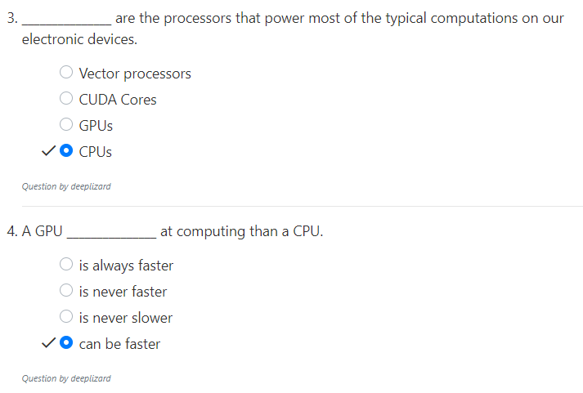
4.1 Quiz
https://www.youtube.com/watch?v=6stDhEA0wFQ&list=PLZbbT5o_s2xrfNyHZsM6ufI0iZENK9xgG&index=4
Quiz

Slide 17
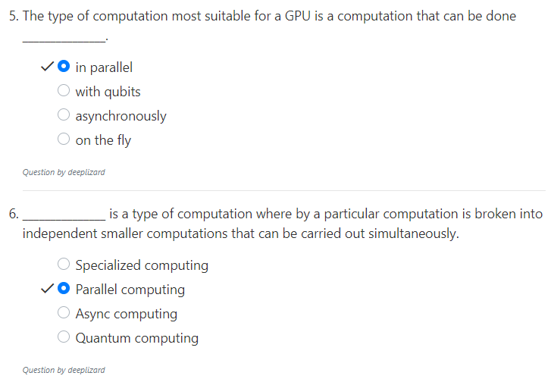
4.1 Quiz
https://www.youtube.com/watch?v=6stDhEA0wFQ&list=PLZbbT5o_s2xrfNyHZsM6ufI0iZENK9xgG&index=4
Quiz

Slide 18
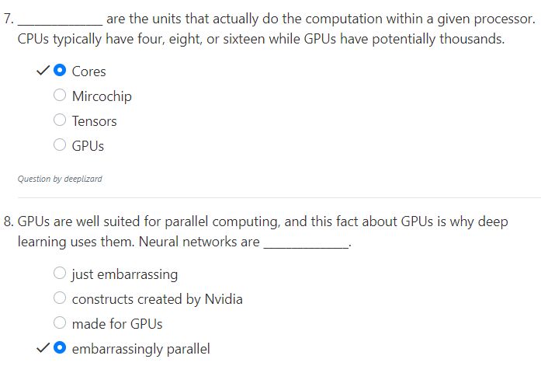
4.1 Quiz
https://www.youtube.com/watch?v=6stDhEA0wFQ&list=PLZbbT5o_s2xrfNyHZsM6ufI0iZENK9xgG&index=4
Quiz

Slide 19
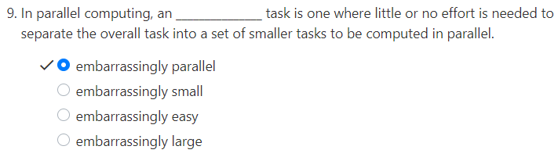
4.1 Quiz
https://www.youtube.com/watch?v=6stDhEA0wFQ&list=PLZbbT5o_s2xrfNyHZsM6ufI0iZENK9xgG&index=4
Quiz

Slide 20
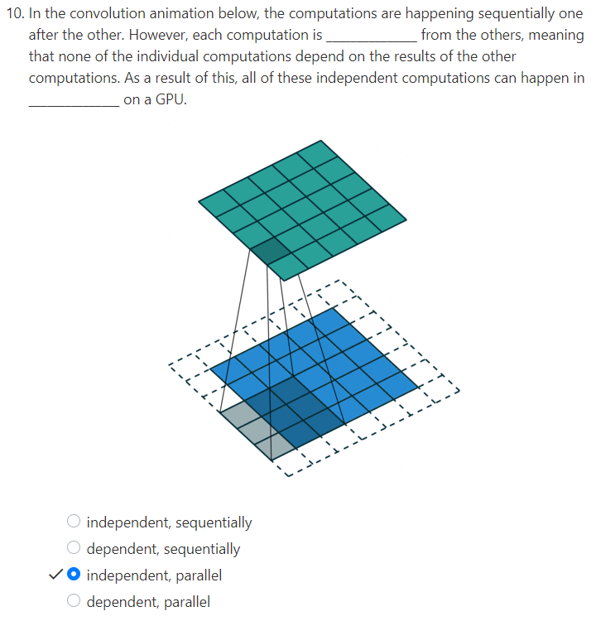
4.1 Quiz
https://www.youtube.com/watch?v=6stDhEA0wFQ&list=PLZbbT5o_s2xrfNyHZsM6ufI0iZENK9xgG&index=4
Quiz

Slide 21
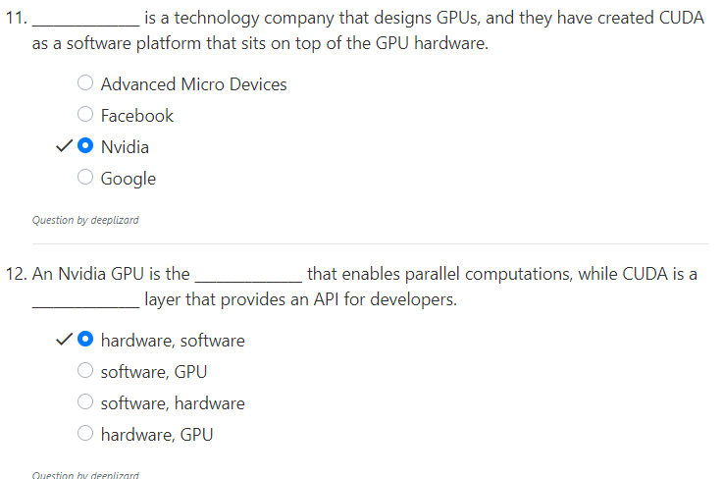
4.1 Quiz
https://www.youtube.com/watch?v=6stDhEA0wFQ&list=PLZbbT5o_s2xrfNyHZsM6ufI0iZENK9xgG&index=4
Quiz

Slide 22
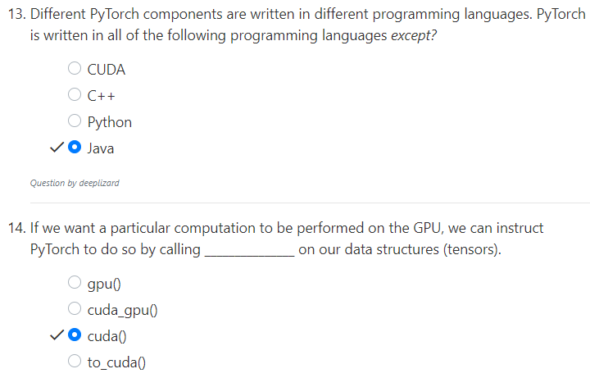
4.1 Quiz
https://www.youtube.com/watch?v=6stDhEA0wFQ&list=PLZbbT5o_s2xrfNyHZsM6ufI0iZENK9xgG&index=4
Quiz

Slide 23
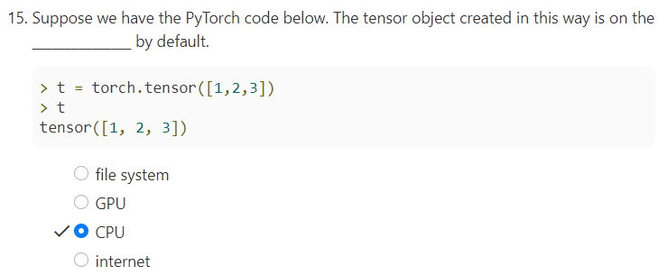
4.1 Quiz
https://www.youtube.com/watch?v=6stDhEA0wFQ&list=PLZbbT5o_s2xrfNyHZsM6ufI0iZENK9xgG&index=4
Quiz

Slide 24
End of Chapter

