Slide 1

5 Data Structure
Peter H. Chen

Slide 2
5 Data Structure
https://www.youtube.com/watch?v=Csa5R12jYRg&list=PLZbbT5o_s2xrfNyHZsM6ufI0iZENK9xgG&index=5
Data Structure
Tensors are the primary data structures used by neural networks.
The inputs, outputs, and transformations within neural networks are all represented using tensors.
As a result, neural networks programming utilizes tensors heavily.
The concept of a tensor is a mathematical generalization of other more specific concepts.

Slide 3
5 Data Structure
https://www.youtube.com/watch?v=Csa5R12jYRg&list=PLZbbT5o_s2xrfNyHZsM6ufI0iZENK9xgG&index=5
Each of the specific instances are the more general concept of a tensor.
number
scalar
array
vector
2d-array
matrix
We group the above tensors into two groups
number, array, 2d-array: These are used in computer science.
scalar, vector, matrix: These are used in mathematics.
We group the above tensors into three groups with indices to access the elements:
number, scalar
Array, vector
2d-array, matrix

Slide 4
5 Data Structure
https://www.youtube.com/watch?v=Csa5R12jYRg&list=PLZbbT5o_s2xrfNyHZsM6ufI0iZENK9xgG&index=5
Indexes required to access an element:
The relationship between each of these pairs is that they both require the same number of indexes to refer to a specific element within the data structure.
In neural network, tensors are multi-dimensional arrays or nd-arrays for short.
A tensor is a generalization term.
Because we use the word tensor for all values of n, for example, a scalar is zero dimensional tensor.
Scalar is 0d-tensor, Vector is 1d-tensor, Matrix is 2d-tensor, and nd-array is nd-tensor.
Indexes required | Computer Science | Mathematics
0 | Number | Scalar
1 | Array | Vector
2 | 2d-array | Matrix
n | Nd-array | Nd-tensor

Slide 5
6.1 Rank

Slide 6
6.1 Rank
https://www.youtube.com/watch?v=Csa5R12jYRg&list=PLZbbT5o_s2xrfNyHZsM6ufI0iZENK9xgG&index=5
Rank
Consider the following example:
Rank tell use how many indices are required to access or refer to a specific data element contained within the tensor.
Rank 1 requires one index to access the element. Rank 2 requires two indices to access the element.

Slide 7
6.2 Quiz

Slide 8
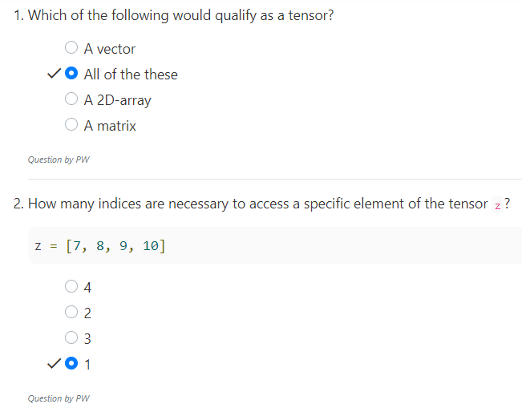
6.1 Quiz
https://www.youtube.com/watch?v=Csa5R12jYRg&list=PLZbbT5o_s2xrfNyHZsM6ufI0iZENK9xgG&index=5
Quiz

Slide 9
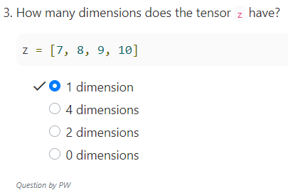
6.1 Quiz
https://www.youtube.com/watch?v=Csa5R12jYRg&list=PLZbbT5o_s2xrfNyHZsM6ufI0iZENK9xgG&index=5
Quiz

Slide 10
End of Chapter

