Slide 1

6 Rank, Axes, and Shape
Peter H. Chen

Slide 2
6 Rank, Axes, and Shape
https://www.youtube.com/watch?v=AiyK0idr4uM&list=PLZbbT5o_s2xrfNyHZsM6ufI0iZENK9xgG&index=6
Rank, Axes, and Shape
Three fundamental tensor attributes: rank, axes, and Shape.
What is the rank of Tensor?
The rank of a tensor refers to the number of dimensions present within the tensor.
Suppose we are told we have rank-2 tensor. This means all of the following:
We have a matrix
We have 2d-array
We have 2d-tensor
What is the rank tell us about the information?

Slide 3
6.1 Rank

Slide 4
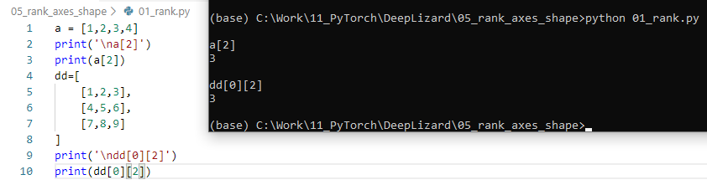
6.1 Rank
https://www.youtube.com/watch?v=AiyK0idr4uM&list=PLZbbT5o_s2xrfNyHZsM6ufI0iZENK9xgG&index=6
Rank
Consider the following example:
Rank tell use how many indices are required to access or refer to a specific data element contained within the tensor.
Rank 1 requires one index to access the element. Rank 2 requires two indices to access the element.
Rank 1 Tensor
Rank 2 Tensor

Slide 5
6.2 Axes

Slide 6
6.2 Axes
https://www.youtube.com/watch?v=AiyK0idr4uM&list=PLZbbT5o_s2xrfNyHZsM6ufI0iZENK9xgG&index=6
Axes
The axes of tensor is a specific dimension of tensor.
If we have a rank 2 tensor, we mean that tensor has two dimensions or equivalently the tensor has two axes.
Elements are said to exists or run along an axis. The running is constrained by the length of each axis. The length of each axis tell us how many indices are available along the axis.

Slide 7
6.2 Axes
https://www.youtube.com/watch?v=AiyK0idr4uM&list=PLZbbT5o_s2xrfNyHZsM6ufI0iZENK9xgG&index=6
Length of an axis
Suppose we have a tensor called t and we know tat the fist axis has a length of three while the second axis has a length of four.
> t[0], t[1], t[2]
> t[0][0]
> t[1][0]
> t[2][0]
> t[0][1]
> t[1][1]
> t[2][1]
> t[0][2]
> t[1][2]
> t[2][2]
> t[0][3]
> t[1][3]
> t[2][3]
Axis 1 has length of 3
Axis 2 has length of 4

Slide 8
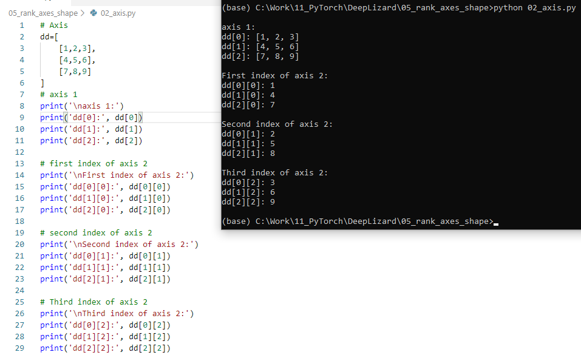
6.2 Axes
https://www.youtube.com/watch?v=AiyK0idr4uM&list=PLZbbT5o_s2xrfNyHZsM6ufI0iZENK9xgG&index=6
First axis and second axis.
> First axis: dd[0], dd[1], dd[2]
> Second axis: dd[:][0], dd[:][1], dd[:][2]

Slide 9
6.3 Shape

Slide 10
6.3 Shape
https://www.youtube.com/watch?v=AiyK0idr4uM&list=PLZbbT5o_s2xrfNyHZsM6ufI0iZENK9xgG&index=6
Shape
The rank tell us how many axes tensor has.
The length of axes leads us to know the shape of the tensor.
The shape of tensor is determined by the length of each axis.
If we know the shape of the tensor, then we know the length of each axis.
This tell us how many indices are available along each axis.

Slide 11
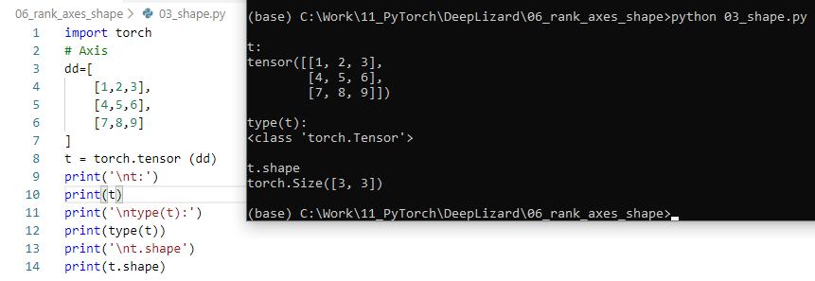
6.3 Shape
https://www.youtube.com/watch?v=AiyK0idr4uM&list=PLZbbT5o_s2xrfNyHZsM6ufI0iZENK9xgG&index=6
We can pass the python tensor to the torch tensor.
The shape 3 x 3 means we have a tensor with two axes.
Each axis have a length of 3. Each axis have three indices along each axis.
The shape also reveals the tensor rank.

Slide 12
6.3 Shape
https://www.youtube.com/watch?v=AiyK0idr4uM&list=PLZbbT5o_s2xrfNyHZsM6ufI0iZENK9xgG&index=6
The shape of tensor is import for two reasons:
First, the shape allows us to conceptually to think about or even visualize a tensor.
Higher rank tensors become more abstract.
The shape give us concrete to think about.
The shape also encodes all the relevant information about the axis, rank, and indices.
One of the types of operations that we must perform frequently when we write program of neural network is called reshaping.
As tensor flows through our network, certain shapes are expected at different points inside the network.
As neural network programmers, it is our job to understand the incoming hsape and have the ability to reshape as needed.

Slide 13
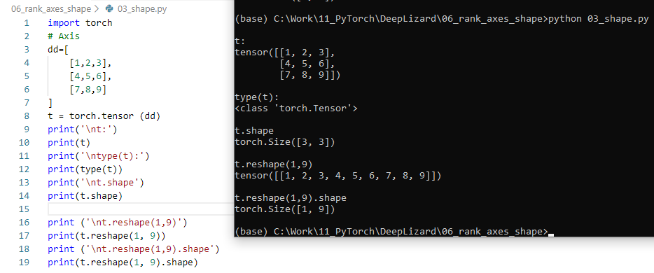
6.3 Shape
https://www.youtube.com/watch?v=AiyK0idr4uM&list=PLZbbT5o_s2xrfNyHZsM6ufI0iZENK9xgG&index=6
Reshaping a tensor
After reshape, the number of element remains the same.
Reshape change the shape but not the underlying data element.

Slide 14
6.4 Summary

Slide 15
6.4 Sumamry
https://www.youtube.com/watch?v=AiyK0idr4uM&list=PLZbbT5o_s2xrfNyHZsM6ufI0iZENK9xgG&index=6
Summary
Three fundamental tensor attributes: rank, axes, and Shape.
The rank of a tensor refers to the number of dimensions present within the tensor.
Suppose we are told we have rank-2 tensor. This means all of the following:
We have a matrix
We have 2d-array
We have 2d-tensor

Slide 16
6.5 Quiz

Slide 17
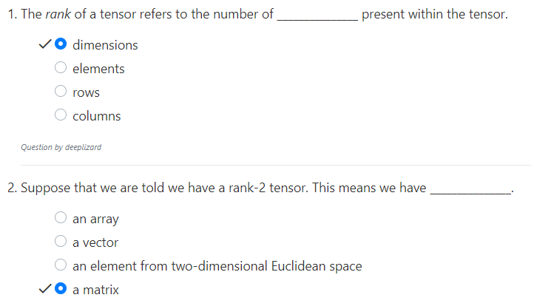
6.5 Quiz
https://www.youtube.com/watch?v=AiyK0idr4uM&list=PLZbbT5o_s2xrfNyHZsM6ufI0iZENK9xgG&index=6
Quiz

Slide 18
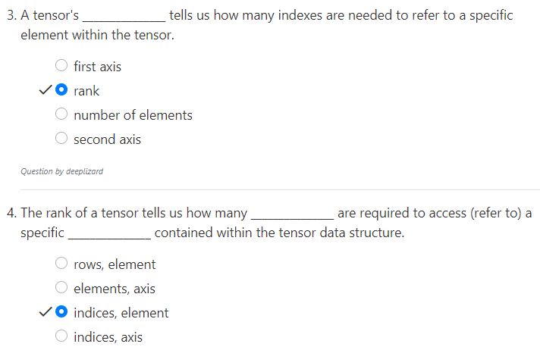
6.5 Quiz
https://www.youtube.com/watch?v=AiyK0idr4uM&list=PLZbbT5o_s2xrfNyHZsM6ufI0iZENK9xgG&index=6
Quiz

Slide 19
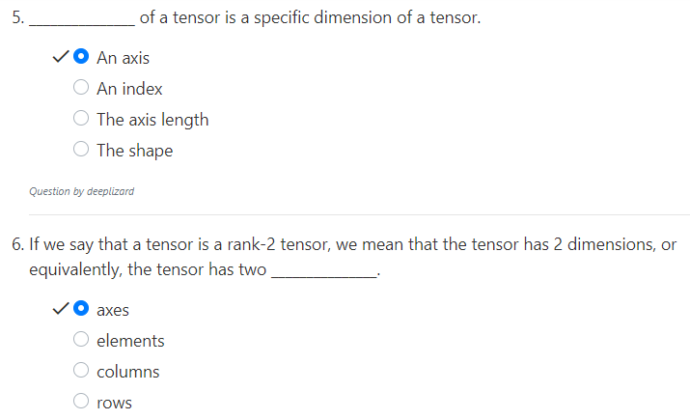
6.5 Quiz
https://www.youtube.com/watch?v=AiyK0idr4uM&list=PLZbbT5o_s2xrfNyHZsM6ufI0iZENK9xgG&index=6
Quiz

Slide 20
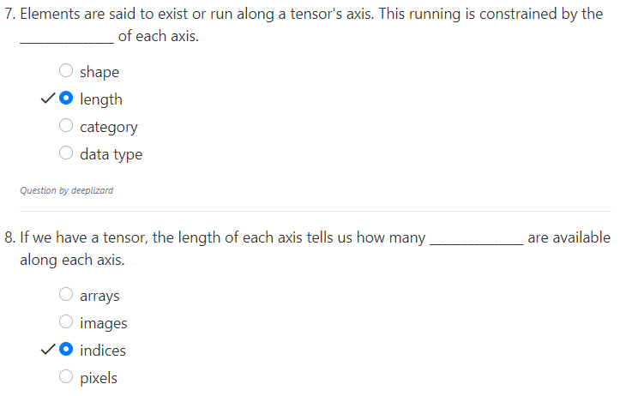
6.5 Quiz
https://www.youtube.com/watch?v=AiyK0idr4uM&list=PLZbbT5o_s2xrfNyHZsM6ufI0iZENK9xgG&index=6
Quiz

Slide 21
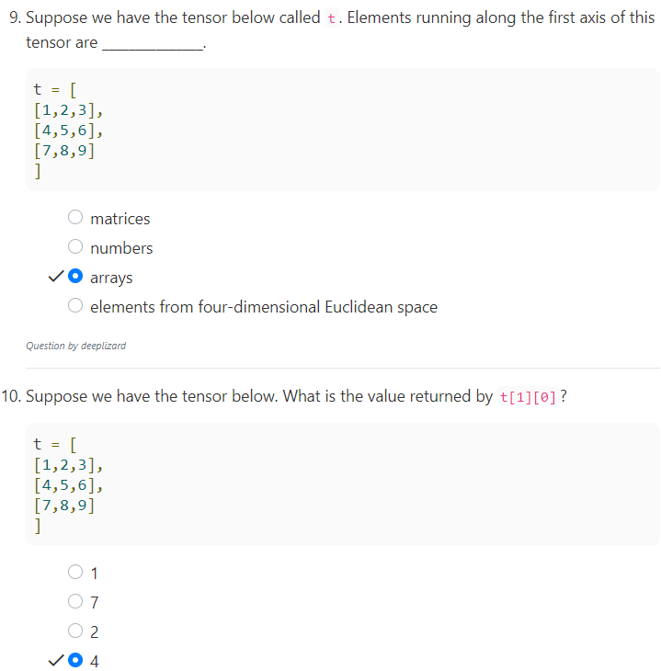
6.5 Quiz
https://www.youtube.com/watch?v=AiyK0idr4uM&list=PLZbbT5o_s2xrfNyHZsM6ufI0iZENK9xgG&index=6
Quiz

Slide 22
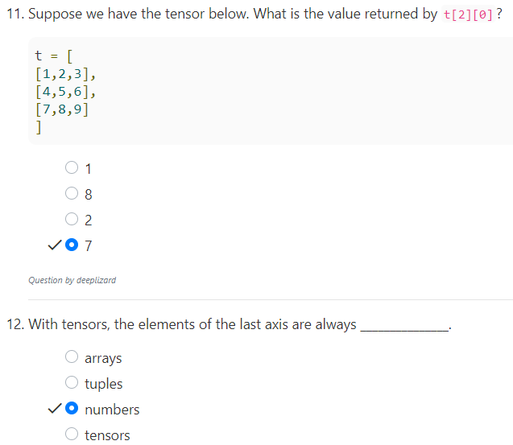
6.5 Quiz
https://www.youtube.com/watch?v=AiyK0idr4uM&list=PLZbbT5o_s2xrfNyHZsM6ufI0iZENK9xgG&index=6
Quiz

Slide 23
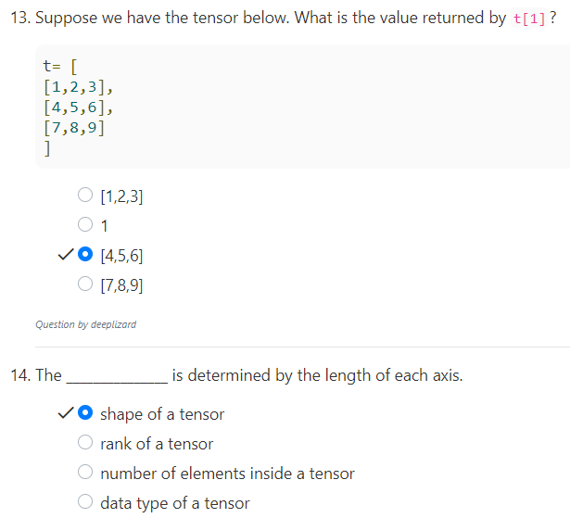
6.5 Quiz
https://www.youtube.com/watch?v=AiyK0idr4uM&list=PLZbbT5o_s2xrfNyHZsM6ufI0iZENK9xgG&index=6
Quiz

Slide 24
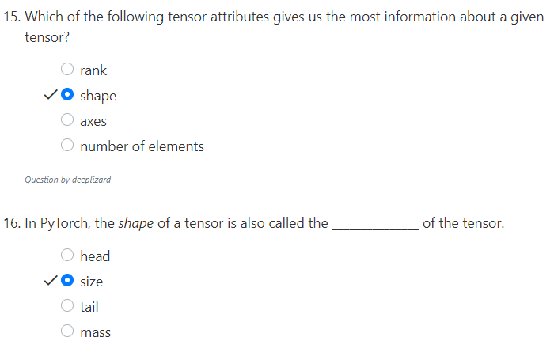
6.5 Quiz
https://www.youtube.com/watch?v=AiyK0idr4uM&list=PLZbbT5o_s2xrfNyHZsM6ufI0iZENK9xgG&index=6
Quiz

Slide 25
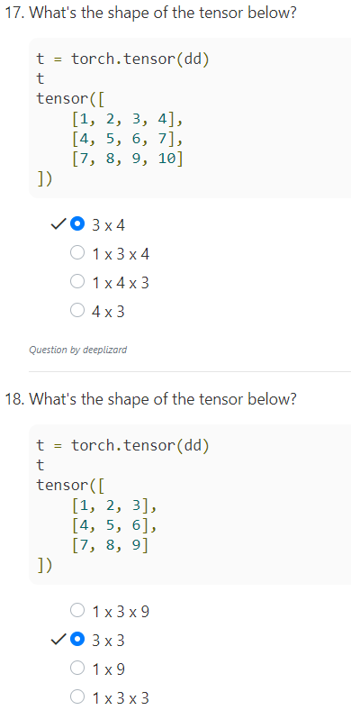
6.5 Quiz
https://www.youtube.com/watch?v=AiyK0idr4uM&list=PLZbbT5o_s2xrfNyHZsM6ufI0iZENK9xgG&index=6
Quiz

Slide 26
End of Chapter

