Slide 1

9 Create Tensor Option
Peter H. Chen

Slide 2
9 Create Tensor Option
https://www.youtube.com/watch?v=AglLTlms7HU&list=PLZbbT5o_s2xrfNyHZsM6ufI0iZENK9xgG&index=9
Create Tensor Option
We create tensors with instances of torch.Tensor class.
In the last discussion, we use four primary ways to create tensor instance.
One constructor and three factory functions.
Tensor class constructor: torch.Tensor(data)
Tensor factory function: torch.tensor(data)
Tensor factory function as_tensor: torch.as_tensor (data)
Tensor factory function from_numpy: torch.from_numpy(data)

Slide 3
9.1 Create Tensor

Slide 4
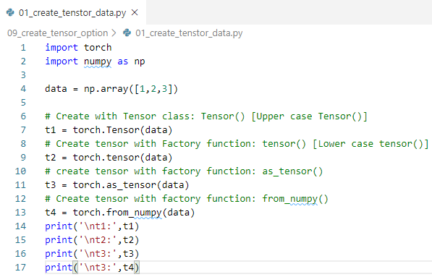
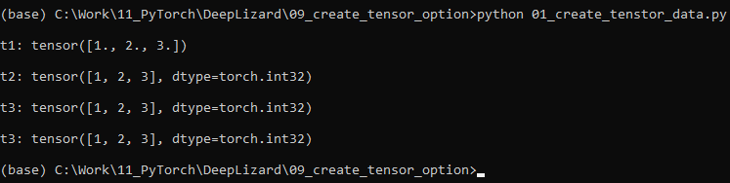
9.1 Create Tensor
https://www.youtube.com/watch?v=AglLTlms7HU&list=PLZbbT5o_s2xrfNyHZsM6ufI0iZENK9xgG&index=9
Create Tensor Option
Create tensor best option with class: Tensor()

Slide 5
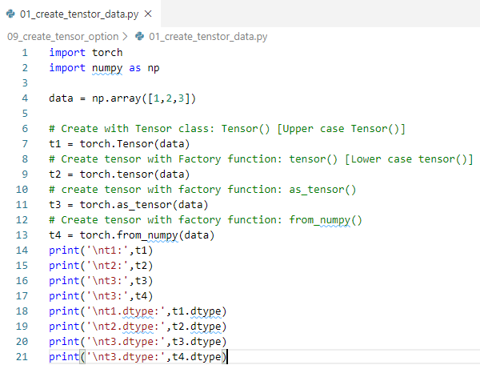
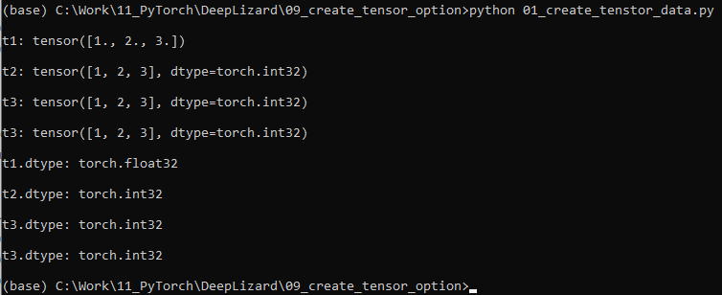
9.1 Create Tensor
https://www.youtube.com/watch?v=AglLTlms7HU&list=PLZbbT5o_s2xrfNyHZsM6ufI0iZENK9xgG&index=9
Create Tensor Option
Print dtype:

Slide 6
9.2 Setup datatype

Slide 7
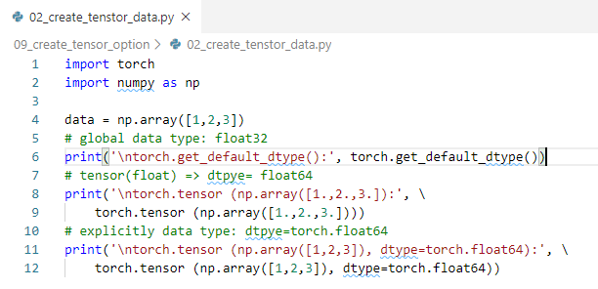
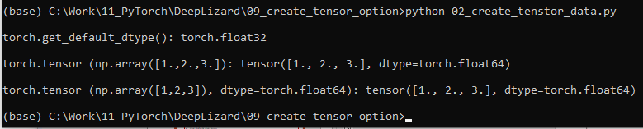
9.2 Setup datatype
https://www.youtube.com/watch?v=AglLTlms7HU&list=PLZbbT5o_s2xrfNyHZsM6ufI0iZENK9xgG&index=9
Setup datatype
Get default data type.
Float in and float out.
Explicitly setup data type.

Slide 8
9.3 Modify Data

Slide 9
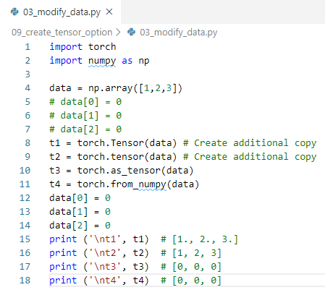
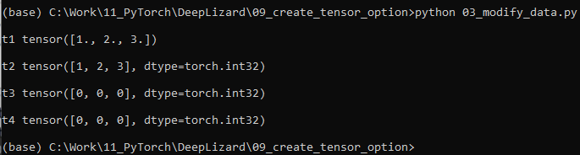
9.3 Modify Data
https://www.youtube.com/watch?v=AglLTlms7HU&list=PLZbbT5o_s2xrfNyHZsM6ufI0iZENK9xgG&index=9
Modify Data
Create Additional Copy
Share data

Slide 10
9.3 Modify Data
https://www.youtube.com/watch?v=AglLTlms7HU&list=PLZbbT5o_s2xrfNyHZsM6ufI0iZENK9xgG&index=9
Share memory for performane: copy vs. share
Copy Data | Share Data
torch.tensor() | torch.as_tensor()
torch.Tensor() | torch.from_numpy()

Slide 11
9.4 Summary

Slide 12
9.4 Summary
https://www.youtube.com/watch?v=AglLTlms7HU&list=PLZbbT5o_s2xrfNyHZsM6ufI0iZENK9xgG&index=9
Summary
We create tensors with instances of torch.Tensor class.
In the last discussion, we use four primary ways to create tensor instance.
One constructor and three factory functions.
Tensor class constructor: torch.Tensor(data)
Tensor factory function: torch.tensor(data)
Tensor factory function as_tensor: torch.as_tensor (data)
Tensor factory function from_numpy: torch.from_numpy(data)

Slide 13
9.5 Quiz

Slide 14
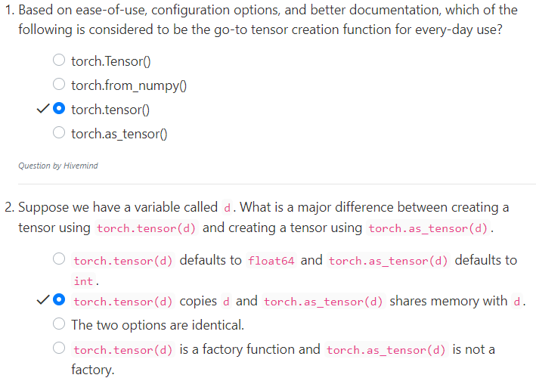
9.5 Quiz
https://www.youtube.com/watch?v=AglLTlms7HU&list=PLZbbT5o_s2xrfNyHZsM6ufI0iZENK9xgG&index=9
Quiz

Slide 15
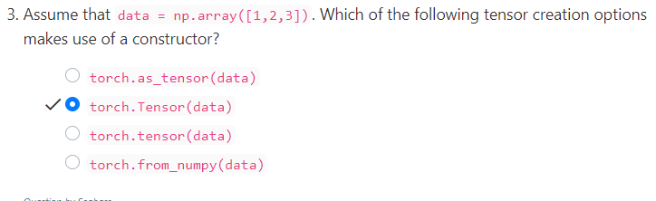
9.5 Quiz
https://www.youtube.com/watch?v=AglLTlms7HU&list=PLZbbT5o_s2xrfNyHZsM6ufI0iZENK9xgG&index=9
Quiz

Slide 16
End of Chapter

