Slide 1

10 Flatten, Reshape, and Squeeze
Peter H. Chen

Slide 2
10 Flatten, Reshape, and Squeeze
https://www.youtube.com/watch?v=fCVuiW9AFzY&list=PLZbbT5o_s2xrfNyHZsM6ufI0iZENK9xgG&index=10
Flatten, Reshape, and Squeeze
We discuss the reshape operation.
First, we get a high-level overview of the types of operations.
We do with tensors for neural networks in deep learning.
The primary operations fall into four categories:
Reshaping operations
Element-wise operations
Reduction operations
Access operations
There are a lot of individual operations but we group similar operations into categories based on their functionalities.
Grouping operations into four categories help tensor operations easier to understand.

Slide 3
10 Flatten, Reshape, and Squeeze
https://www.youtube.com/watch?v=fCVuiW9AFzY&list=PLZbbT5o_s2xrfNyHZsM6ufI0iZENK9xgG&index=10
Flatten, Reshape, and Squeeze
Reshape operations are the most important type of tensor operation.
This is because the shape of the tensor gives us something understand our tensors.

Slide 4
10.1 Create Tensor

Slide 5
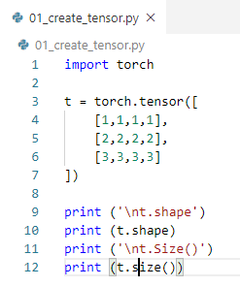

10.1 Create Tensor
https://www.youtube.com/watch?v=fCVuiW9AFzY&list=PLZbbT5o_s2xrfNyHZsM6ufI0iZENK9xgG&index=10
Create Tensor
> import torch
> t = torch.tensor([
> [1,1,1,1],
> [2,2,2,2],
> [3,3,3,3]
>], dtype=torch.float32)
This tensor is 3 x 4.
This tensor rank is 2, tensor with 2 axes.
The first axis has a length of 3.
The second axis is a length of 4.
The elements of the first axis are arrays.

Slide 6
10.1 Create Tensor
https://www.youtube.com/watch?v=fCVuiW9AFzY&list=PLZbbT5o_s2xrfNyHZsM6ufI0iZENK9xgG&index=10
Create Tensor
> import torch
> t = torch.tensor([
> [1,1,1,1],
> [2,2,2,2],
> [3,3,3,3]
>], dtype=torch.float32)
The elements of the second axis are numbers.
In PyTorch, we have two ways to access the shape.
Programmatically, we can use a size() method or we can use this shape attribute.

Slide 7
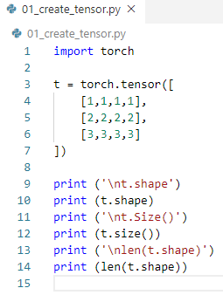
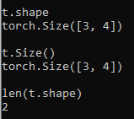
10.1 Create Tensor
https://www.youtube.com/watch?v=fCVuiW9AFzY&list=PLZbbT5o_s2xrfNyHZsM6ufI0iZENK9xgG&index=10
Create Tensor
> import torch
> t = torch.tensor([
> [1,1,1,1],
> [2,2,2,2],
> [3,3,3,3]
>], dtype=torch.float32)
We can obtain the tensors rank by checking length of its shape.
> len(t.shape)
>> 2

Slide 8
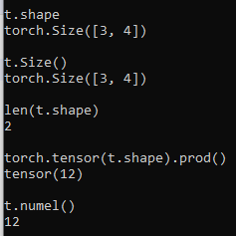
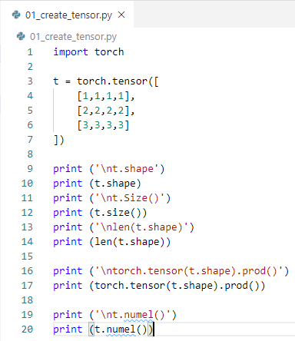
10.1 Create Tensor
https://www.youtube.com/watch?v=fCVuiW9AFzY&list=PLZbbT5o_s2xrfNyHZsM6ufI0iZENK9xgG&index=10
Create Tensor
The shape gives us the elements contained within the within the tensor.
This can be deduced by taking the product of the component values.
The t.shape = [3, 4] => take product = 12. The tensor contain 12 components, sometimes, it referred to as the scalar components of the tensor.
> torch.tensor(t.shape).prod()
>> tensor(12)

Slide 9
10.1 Create Tensor
https://www.youtube.com/watch?v=fCVuiW9AFzY&list=PLZbbT5o_s2xrfNyHZsM6ufI0iZENK9xgG&index=10
Create Tensor
Sometimes, we use numel() instead of prod().
numel() is for number of elements and get the same result 12.
>t.numel()
>> 12
In terms of reshaping, three is a reason we care about the number of elements.
Since the tensor has 12 elements, any reshape must account for all 12 of these elements.
When we reshape, we do not change the data. Only the shape of this data.

Slide 10
10.2 Reshape

Slide 11
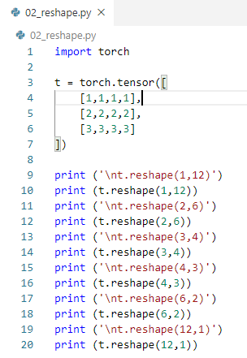
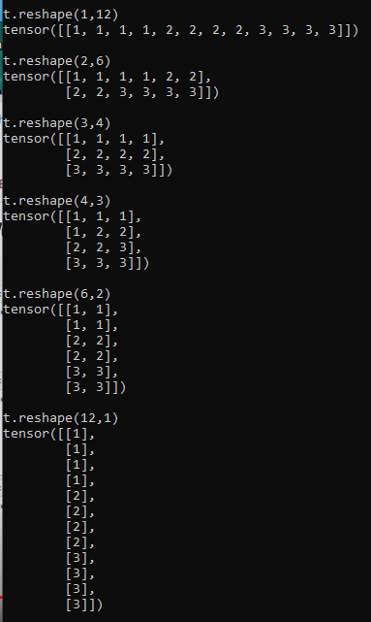
10.2 Reshape
https://www.youtube.com/watch?v=fCVuiW9AFzY&list=PLZbbT5o_s2xrfNyHZsM6ufI0iZENK9xgG&index=10
Create Tensor
> t.reshape(1,12)
> t.reshape(2,6)
> t.reshape(3,4)
> t.reshape(4,3 )
> t.reshape(6,2)
> t.reshape(12,1)

Slide 12
10.3 Squeeze and Unsqueeze

Slide 13
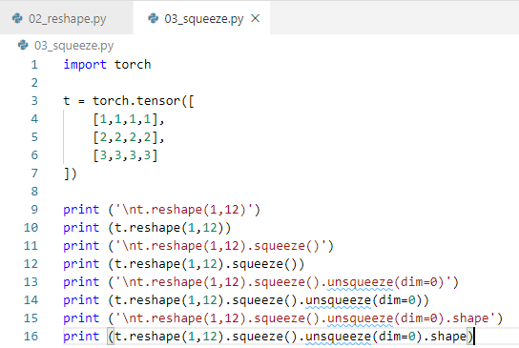
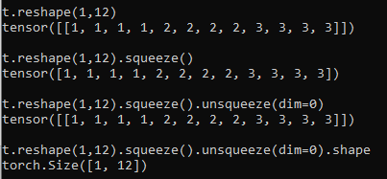
10.3 Squeeze and Unsqueeze
https://www.youtube.com/watch?v=fCVuiW9AFzY&list=PLZbbT5o_s2xrfNyHZsM6ufI0iZENK9xgG&index=10
Create Tensor
> squeeze()
> unsqueeze()

Slide 14
10.4 Flatten

Slide 15
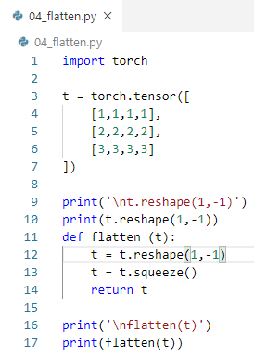

10.4 Flatten
https://www.youtube.com/watch?v=fCVuiW9AFzY&list=PLZbbT5o_s2xrfNyHZsM6ufI0iZENK9xgG&index=10
Create Tensor
> def flatten(t):
> t.reshape(1, -1)
> t.squeeze()
> return(t)
Reshape add another dimension.
Squeeze() remove one dimension.

Slide 16
10.5 Concatenate Tensor

Slide 17
10.5 Concatenate Tensor
https://www.youtube.com/watch?v=fCVuiW9AFzY&list=PLZbbT5o_s2xrfNyHZsM6ufI0iZENK9xgG&index=10
Concatenate Tensor
We combine tensors using cat() function, and the resulting tensor will have a shape that depends on the shape of the input tensors.
Suppose we have two tensors:
> t1 = torch.tensor ([
> [1,2],
> [3,4]
>])
> t2 = torch.tensor ([
> [5,6],
> [7,8]
>])

Slide 18
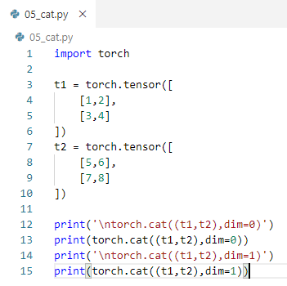
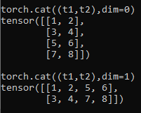
10.5 Concatenate Tensor
https://www.youtube.com/watch?v=fCVuiW9AFzY&list=PLZbbT5o_s2xrfNyHZsM6ufI0iZENK9xgG&index=10
Concatenate Tensor
We can combine t1 and t2 row-wise (axis=0) in the following way:
> torch.cat(t1,t2), dim=0)
>> tensor([
>> [1,2],
>> [3,4],
>> [5,6],
>> [7,8]])

Slide 19
10.5 Concatenate Tensor
https://www.youtube.com/watch?v=fCVuiW9AFzY&list=PLZbbT5o_s2xrfNyHZsM6ufI0iZENK9xgG&index=10
Concatenate Tensor
We can combine them column-wise (axis=1) like this:

Slide 20
10.6 Quiz

Slide 21
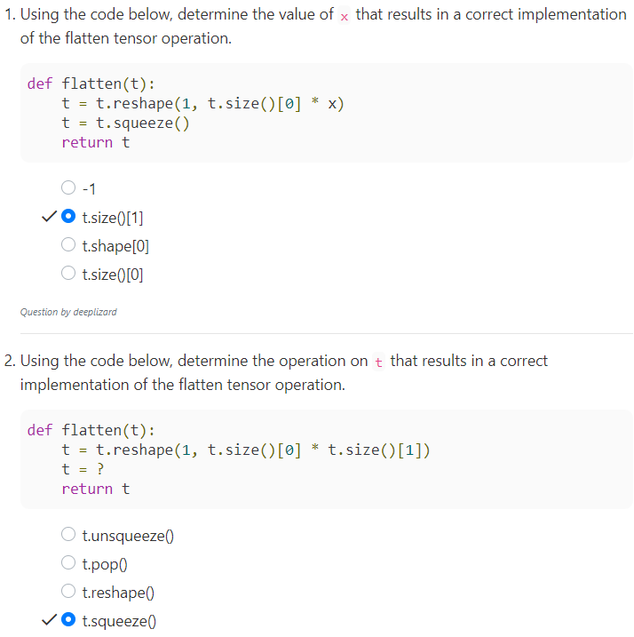
10.6 Quiz
https://www.youtube.com/watch?v=fCVuiW9AFzY&list=PLZbbT5o_s2xrfNyHZsM6ufI0iZENK9xgG&index=10
Quiz

Slide 22
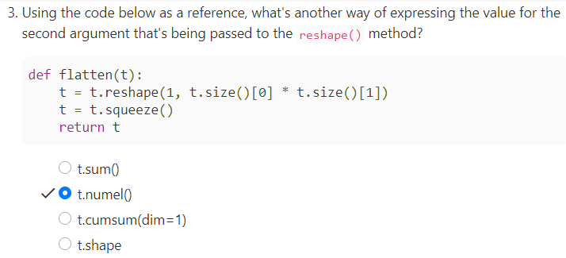
10.6 Quiz
https://www.youtube.com/watch?v=fCVuiW9AFzY&list=PLZbbT5o_s2xrfNyHZsM6ufI0iZENK9xgG&index=10
Quiz

Slide 23
End of Chapter

