Slide 1

26 Train Loop (Part 2)
Peter H. Chen

Slide 2
26 Train Loop (Part 2)
https://www.youtube.com/watch?v=XfYmia3q2Ow&list=PLZbbT5o_s2xrfNyHZsM6ufI0iZENK9xgG&index=26
CNN Training Loop
In this discussion, we will learn the steps needed to build a train loop for a convolutional neural network.
High-Level Overview Of Our Process
The training process is an iterative process, and to train a neural network, we build what is called the training loop.
Prepare the data
Build the model
Train the model
Build the training loop
Analyze the model's results

Slide 3
26.1 Single Batch Training

Slide 4
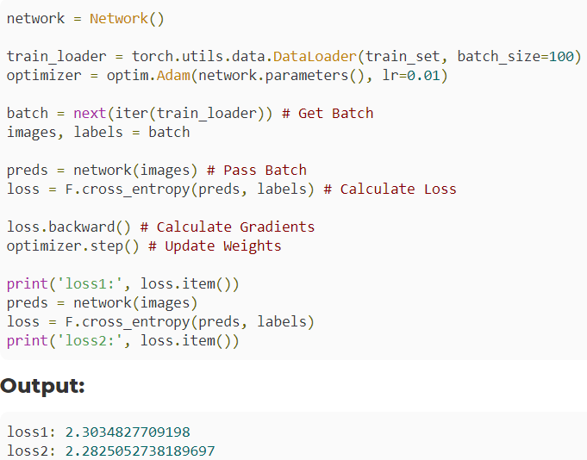
26.1 Single Batch Training
https://www.youtube.com/watch?v=XfYmia3q2Ow&list=PLZbbT5o_s2xrfNyHZsM6ufI0iZENK9xgG&index=26
Single Batch Training
We can summarize the code for the training with a single batch:

Slide 5
26.1 Single Batch Training
https://www.youtube.com/watch?v=XfYmia3q2Ow&list=PLZbbT5o_s2xrfNyHZsM6ufI0iZENK9xgG&index=26
Single Batch Training
One thing that you'll notice is that we get different results each time we run this code.
This is because the model is created each time at the top, and we know from previous posts that the model weights are randomly initialized.
Let's see now how we can modify this code to train using all of the batches and thus, the entire training set.

Slide 6
26.2 All Batches Training

Slide 7
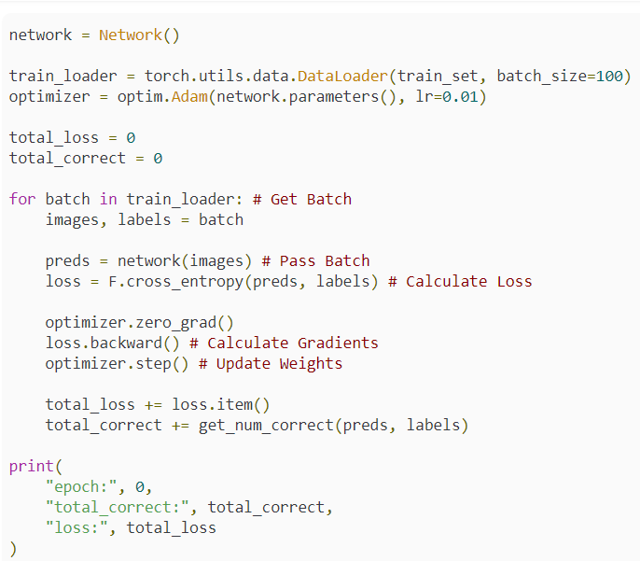
26.2 All Batches Training
https://www.youtube.com/watch?v=XfYmia3q2Ow&list=PLZbbT5o_s2xrfNyHZsM6ufI0iZENK9xgG&index=26
All Batches Training with Single Epoch
Now, to train with all of the batches available inside our data loader, we need to make a few changes and add one additional line of code:

Slide 8
26.2 All Batches Training
https://www.youtube.com/watch?v=XfYmia3q2Ow&list=PLZbbT5o_s2xrfNyHZsM6ufI0iZENK9xgG&index=26
All Batches Training with Single Epoch
Instead of getting a single batch from our data loader, we'll create a for loop that will iterate over all of the batches.
Since we have 60,000 samples in our training set, we will have 60,000 /100 = 600 iterations.
For this reason, we'll remove the print statement from within the loop, and keep track of the total loss and the total number of correct predictions printing them at the end.
Something to notice about these 600 iterations is that our weights will be updated 600 times by the end of the loop.
If we raise the batch_size this number will go down and if we lower the batch_size this number will go up.

Slide 9
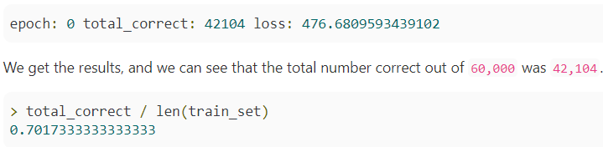
26.2 All Batches Training
https://www.youtube.com/watch?v=XfYmia3q2Ow&list=PLZbbT5o_s2xrfNyHZsM6ufI0iZENK9xgG&index=26
All Batches Training with Single Epoch
Finally, after we call the backward() method on our loss tensor, we know the gradients will be calculated and added to the grad attributes of our network's parameters.
For this reason, we need to zero out these gradients.
We can do this with a method called zero_grad() that comes with the optimizer.
We are ready to run this code.
This time the code will take longer because the loop is working on 600 batches with bacth_size = 100.

Slide 10
26.3 Batch Size = 10000

Slide 11


26.3 Batch Size = 10000
https://www.youtube.com/watch?v=XfYmia3q2Ow&list=PLZbbT5o_s2xrfNyHZsM6ufI0iZENK9xgG&index=26
All Batches Training with Single Epoch with Batch Size = 10000
That's pretty good after only one epoch (a single full pass over the data).
Even though we did one epoch, we still have to keep in mind that the weights were updated 600 times, and this fact depends on our batch size.
If made our batch_size larger, say 10,000, the weights would only be updated 6 times, and the results wouldn't be quite as good.
Total images = 60000
Bacth size = 100
Correct rate = 0.8
Total images = 60000
Bacth size = 10000
Correct rate = 0.17

Slide 12
26.4 Training with Multiple Epochs

Slide 13
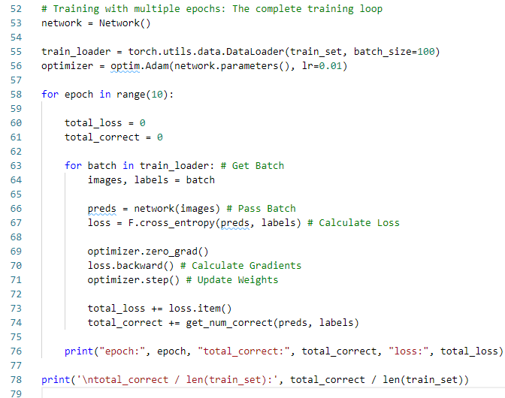
26.4 Training with Multiple Epochs
https://www.youtube.com/watch?v=XfYmia3q2Ow&list=PLZbbT5o_s2xrfNyHZsM6ufI0iZENK9xgG&index=26
Training with Multiple Epochs
To do multiple epochs, all we have to do is put this code into a for loop. We'll also add the epoch number to the print statement.

Slide 14
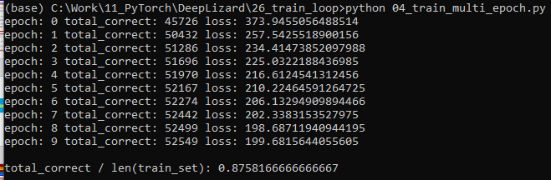
26.4 Training with Multiple Epochs
https://www.youtube.com/watch?v=XfYmia3q2Ow&list=PLZbbT5o_s2xrfNyHZsM6ufI0iZENK9xgG&index=26
Training with Multiple Epochs
After running this code, we get the results for each epoch.
We can see that the number of correct values goes up and the loss goes down.
Correct rate improve from 0.80 to 0.87

Slide 15
26.5 Summary

Slide 16
26.5 Summary
https://www.youtube.com/watch?v=XfYmia3q2Ow&list=PLZbbT5o_s2xrfNyHZsM6ufI0iZENK9xgG&index=26
Summary
We should now have a good understanding of training loops and how we build them using PyTorch.
The cool thing about PyTorch is that we can debug the training loop code just how we did with the forward() function.
In the next discussion, we'll see how we can get the predictions for every sample in the training set and use those predictions to create a confusion matrix.

Slide 17
26.6 Quiz

Slide 18
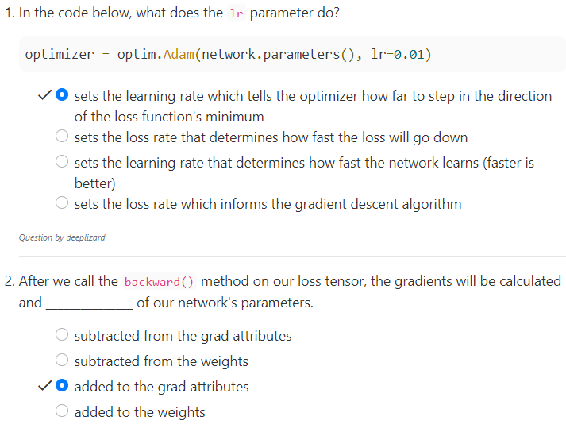
26.6 Quiz
https://www.youtube.com/watch?v=XfYmia3q2Ow&list=PLZbbT5o_s2xrfNyHZsM6ufI0iZENK9xgG&index=26
Quiz

Slide 19
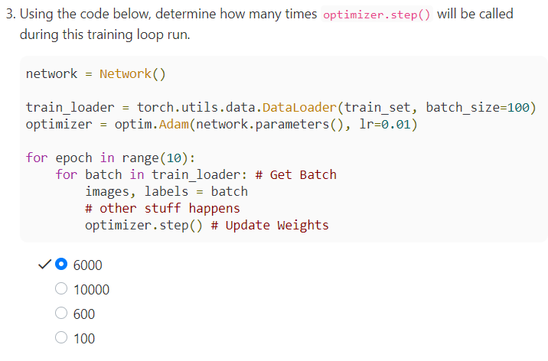
26.6 Quiz
https://www.youtube.com/watch?v=XfYmia3q2Ow&list=PLZbbT5o_s2xrfNyHZsM6ufI0iZENK9xgG&index=26
Quiz
Train_set contains 60,000 samples.
Step of each train_loader = 60,000/100= 600
There are 10 epoch for each_loader
Total step called = 600 x 10 = 6,000

Slide 20
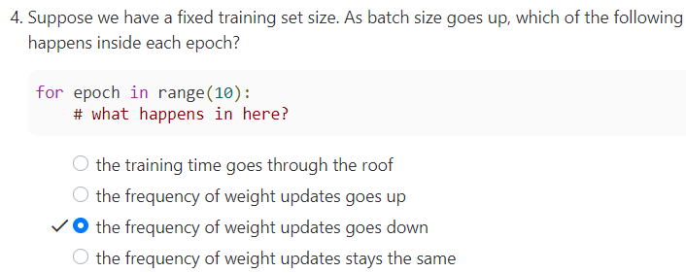
26.6 Quiz
https://www.youtube.com/watch?v=XfYmia3q2Ow&list=PLZbbT5o_s2xrfNyHZsM6ufI0iZENK9xgG&index=26
Quiz

Slide 21
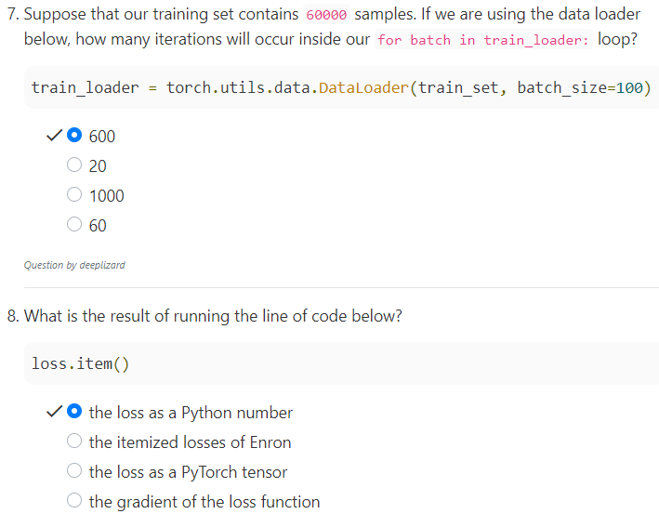
26.6 Quiz
https://www.youtube.com/watch?v=XfYmia3q2Ow&list=PLZbbT5o_s2xrfNyHZsM6ufI0iZENK9xgG&index=26
Quiz
Loss is a tensor.
Loss.item() is a pure number (scaler).

Slide 22
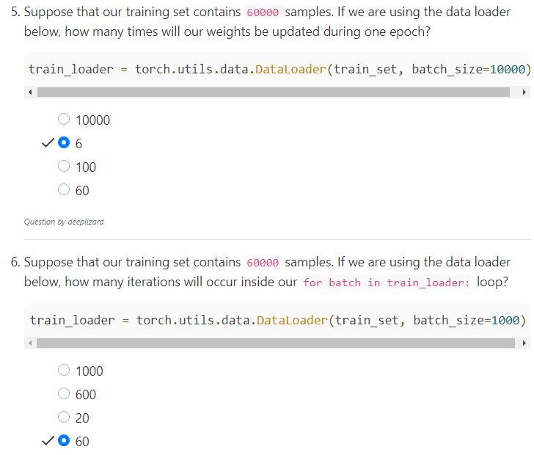
26.6 Quiz
https://www.youtube.com/watch?v=XfYmia3q2Ow&list=PLZbbT5o_s2xrfNyHZsM6ufI0iZENK9xgG&index=26
Quiz

Slide 23
End of Chapter

