Slide 1

28 Tensorflow and Numpy (Part 2)
Peter H. Chen

Slide 2
28 Tensorflow and Numpy (Part 2)
https://www.youtube.com/watch?v=kF2AlpykJGY&list=PLZbbT5o_s2xrfNyHZsM6ufI0iZENK9xgG&index=28
Tensorflow and Numpy
In this discussion, difference between concatenating and stacking tensors together.
We’ll look at three examples, one with PyTorch, one with TensorFlow, and one with NumPy.

Slide 3
28 Tensorflow and Numpy (Part 2)
https://www.youtube.com/watch?v=kF2AlpykJGY&list=PLZbbT5o_s2xrfNyHZsM6ufI0iZENK9xgG&index=28
Existing vs New Axes
The difference between stacking and concatenating tensors can be described in a single sentence.

Slide 4
28 Tensorflow and Numpy (Part 2)
https://www.youtube.com/watch?v=kF2AlpykJGY&list=PLZbbT5o_s2xrfNyHZsM6ufI0iZENK9xgG&index=28
Existing vs New Axes
This is the difference between stacking and concatenating. However, the description here is kind of tricky, so let’s look at some examples to get a handle on what exactly how this can be better understood.
We’ll look at stacking and concatenating in PyTorch, TensorFlow, and NumPy.
For the most part, concatenating along an existing axis of a tensor is pretty straight forward.
The confusion usually arises when we want to concat along a new axis.
For this we stack. Another way of saying that we stack is to say that we create a new axis and then concat on that axis.
Join Method | Where
Concatenate | Along an existing axis
Stack | Along a new axis

Slide 5
28.1 Insert an Axis into a Tensor

Slide 6


28.1 Insert an Axis into a Tensor
https://www.youtube.com/watch?v=kF2AlpykJGY&list=PLZbbT5o_s2xrfNyHZsM6ufI0iZENK9xgG&index=28
How to Add or Insert an Axis into a Tensor
To demonstrate this idea of adding an axis, we’ll use PyTorch.
Here, we’re importing PyTorch and creating a simple tensor that has a single axis of length three.
Now, to add an axis to a tensor in PyTorch, we use the unsqueeze() function.
Note that this is the opposite of squeezing.
Here, we are we are adding an axis, a.k.a., dimension at index zero of this tensor. This gives us a tensor with a shape of 1 x 3.
When we say index zero of the tensor, we mean the first index of the tensor's shape.

Slide 7

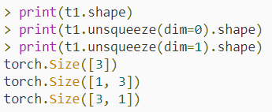
28.1 Insert an Axis into a Tensor
https://www.youtube.com/watch?v=kF2AlpykJGY&list=PLZbbT5o_s2xrfNyHZsM6ufI0iZENK9xgG&index=28
How to Add or Insert an Axis into a Tensor
Now, we can also add an axis at the second index of this tensor.
This gives us a tensor with a shape of 3 x 1.
Adding axes like this changes the way the data is organized inside the tensor, but it does not change the data itself.
Basically, we are just reshaping the tensor.
We can see that by checking the shape of each one of these.

Slide 8
28.1 Insert an Axis into a Tensor
https://www.youtube.com/watch?v=kF2AlpykJGY&list=PLZbbT5o_s2xrfNyHZsM6ufI0iZENK9xgG&index=28
How to Add or Insert an Axis into a Tensor
Now, thinking back about concatenating verses stacking, when we concat, we are joining a sequence of tensors along an existing axis.
This means that we are extending the length of an existing axis.
When we stack, we are creating a new axis that didn’t exist before and this happens across all the tensors in our sequence, and then we concat along this new sequence.
Let’s see how this is done in PyTorch.

Slide 9
28.2 Stack vs. Cat in PyTorch

Slide 10
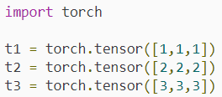
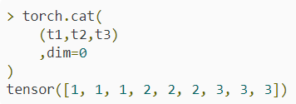
28.2 Stack vs. Cat in PyTorch
https://www.youtube.com/watch?v=kF2AlpykJGY&list=PLZbbT5o_s2xrfNyHZsM6ufI0iZENK9xgG&index=28
Stack vs. Cat in PyTorch
With PyTorch the two functions we use for these operations are stack and cat.
Let’s create a sequence of tensors.
Now, let’s concatenate these with one another.
Notice that each of these tensors have a single axis. This means that the result of the cat function will also have a single axis.
This is because when we concatenate, we do it along an existing axis.
Notice that in this example, the only existing axis is the first axis

Slide 11
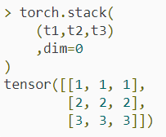
28.2 Stack vs. Cat in PyTorch
https://www.youtube.com/watch?v=kF2AlpykJGY&list=PLZbbT5o_s2xrfNyHZsM6ufI0iZENK9xgG&index=28
Stack vs. Cat in PyTorch
Alright, so we took three single axis tensors each having an axis length of three, and now we have a single tensor with an axis length of nine.
Now, let’s stack these tensors along a new axis that we’ll insert.
We’ll insert an axis at the first index.
Note that this insertion will be happening implicitly under the hood by the stack function.

Slide 12
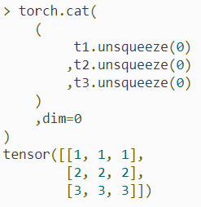
28.2 Stack vs. Cat in PyTorch
https://www.youtube.com/watch?v=kF2AlpykJGY&list=PLZbbT5o_s2xrfNyHZsM6ufI0iZENK9xgG&index=28
Stack vs. Cat in PyTorch
This gives us a new tensor that has a shape of 3 x 3.
Notice how the three tensors are concatenated along the first axis of this tensor.
Note that we can also insert the new axis explicitly, and preform the concatenation directly.
To see that this statement is true. Let’s add a new axis of length one to all of our tensors by unsqueezing them and then, cat along the first axis.

Slide 13

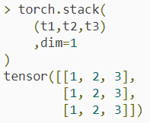
28.2 Stack vs. Cat in PyTorch
https://www.youtube.com/watch?v=kF2AlpykJGY&list=PLZbbT5o_s2xrfNyHZsM6ufI0iZENK9xgG&index=28
Stack vs. Cat in PyTorch
In this case, we can see that we get the same result that we got by stacking.
However, the call to stack was much cleaner because the new axis insertion was handed by the stack function.
Note that we cannot concat this sequence of tensors along the second axis because there currently is no second axis in existence, so in this case, stacking is our only option.
Let’s try stacking along the second axis.

Slide 14
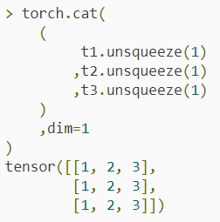
28.2 Stack vs. Cat in PyTorch
https://www.youtube.com/watch?v=kF2AlpykJGY&list=PLZbbT5o_s2xrfNyHZsM6ufI0iZENK9xgG&index=28
Stack vs. Cat in PyTorch
Alright, we stack with respect to the second axis and this is the result.

Slide 15
28.3 Quiz

Slide 16
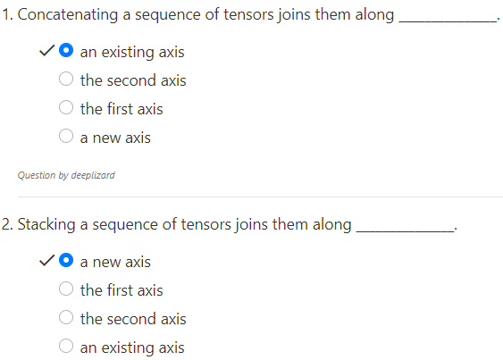
28.3 Quiz
https://www.youtube.com/watch?v=kF2AlpykJGY&list=PLZbbT5o_s2xrfNyHZsM6ufI0iZENK9xgG&index=28
Quiz

Slide 17
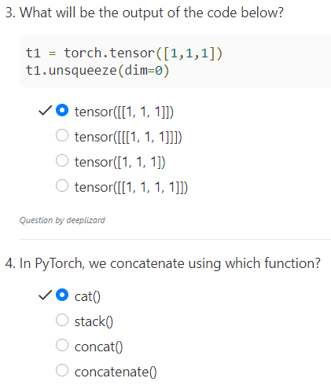
28.3 Quiz
https://www.youtube.com/watch?v=kF2AlpykJGY&list=PLZbbT5o_s2xrfNyHZsM6ufI0iZENK9xgG&index=28
Quiz

Slide 18
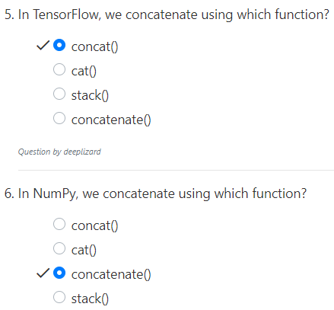
28.3 Quiz
https://www.youtube.com/watch?v=kF2AlpykJGY&list=PLZbbT5o_s2xrfNyHZsM6ufI0iZENK9xgG&index=28
Quiz

Slide 19
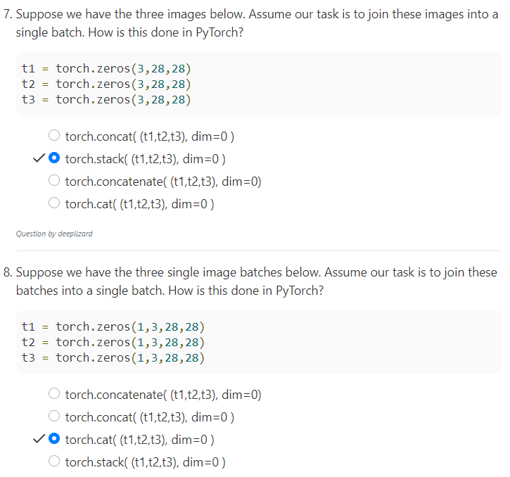
28.3 Quiz
https://www.youtube.com/watch?v=kF2AlpykJGY&list=PLZbbT5o_s2xrfNyHZsM6ufI0iZENK9xgG&index=28
Quiz

Slide 20
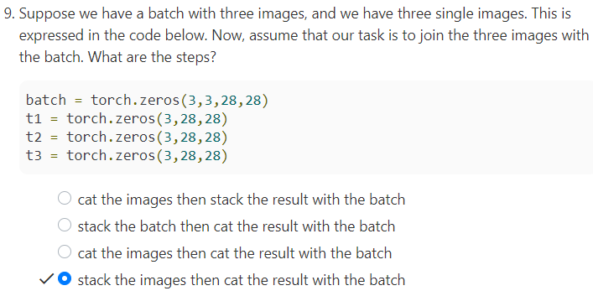
28.3 Quiz
https://www.youtube.com/watch?v=kF2AlpykJGY&list=PLZbbT5o_s2xrfNyHZsM6ufI0iZENK9xgG&index=28
Quiz

Slide 21
End of Chapter

