Slide 1

22 Prediction (Part 2)
Peter H. Chen

Slide 2
22 Prediction (Part 2)
https://www.youtube.com/watch?v=6vweQjouLEE&list=PLZbbT5o_s2xrfNyHZsM6ufI0iZENK9xgG&index=22
Prediction
We discuss the prediction output tensor from a sample image in dataset.
We build our model, can start training process.
We understand our network is working right out of the box.
We will understand the training process.

Slide 3
22.1 Forward Propagation

Slide 4

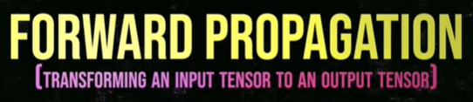
22.1 Forward Propagation
https://www.youtube.com/watch?v=6vweQjouLEE&list=PLZbbT5o_s2xrfNyHZsM6ufI0iZENK9xgG&index=22
What is Forward Propagation?
The first step is to understand forward propagation.
Forward propagation is the process of transforming an input tensor to an output tensor.

Slide 5
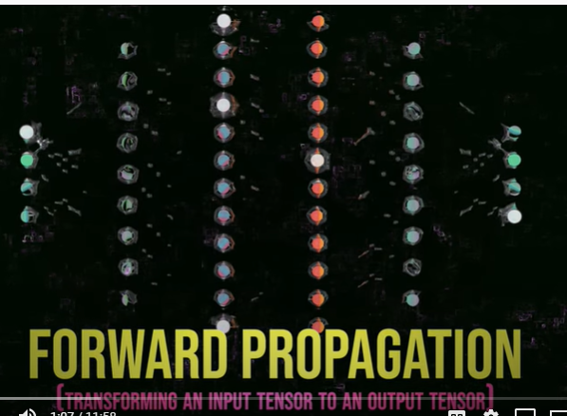
22.1 Forward Propagation
https://www.youtube.com/watch?v=6vweQjouLEE&list=PLZbbT5o_s2xrfNyHZsM6ufI0iZENK9xgG&index=22
What is Forward Propagation?
At its core, a neural network is a function that maps an input tensor to the output tensor.
Forward propagation is a special name for the process passing an input tensor to the network and receiving the output from the network

Slide 6
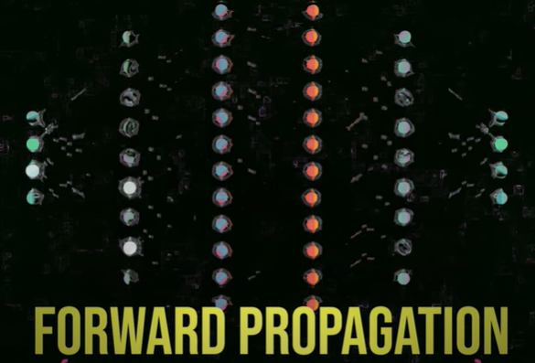
22.1 Forward Propagation
https://www.youtube.com/watch?v=6vweQjouLEE&list=PLZbbT5o_s2xrfNyHZsM6ufI0iZENK9xgG&index=22
What is Forward Propagation?
As we have seen, neural networks operate on data in the form of tensors.
The word Forward Propagation is used to indicate that the input tensor data
The concept forward propagate is used to indicate that the input tensor data is transmitted through the network in the forward direction.
For our network, what this means is simply passing our input tensor to the network and receiving the output tensor.
To do this, we pass our sample data to the network's forward() method.

Slide 7
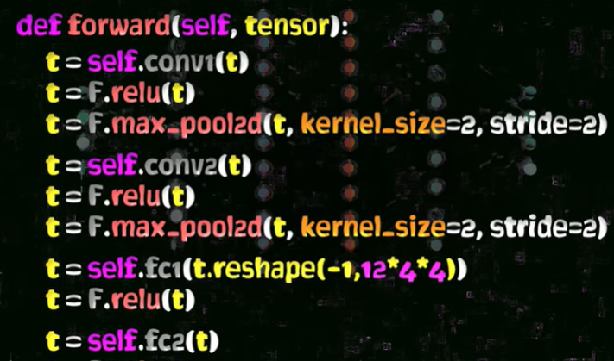
22.1 Forward Propagation
https://www.youtube.com/watch?v=6vweQjouLEE&list=PLZbbT5o_s2xrfNyHZsM6ufI0iZENK9xgG&index=22
What is Forward Propagation?
In our case and from a practical standpoint, forward propagation is the process of passing an input image tensor to the forward() method that we implemented in the last discussion.

Slide 8
22.1 Forward Propagation
https://www.youtube.com/watch?v=6vweQjouLEE&list=PLZbbT5o_s2xrfNyHZsM6ufI0iZENK9xgG&index=22
What is Forward Propagation?
The output is the network's prediction.
Now that we have our network defined and our forward() method implemented, pass an image to our network to get a prediction.
This is why, the forward() method has the name forward, the execution of the forward() is the process of forward propagation.
The word forward, is pretty straight forward.
However, the word propagate means to move or transmit through some medium. In the case of neural networks, data propagates through the layers of the network.

Slide 9
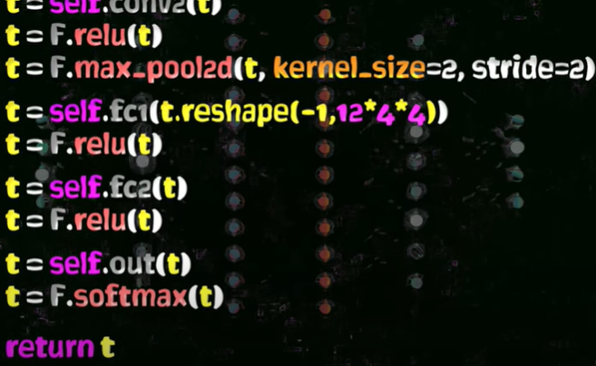
22.1 Forward Propagation
https://www.youtube.com/watch?v=6vweQjouLEE&list=PLZbbT5o_s2xrfNyHZsM6ufI0iZENK9xgG&index=22
What is Forward Propagation?
There is a notion of backward propagation (backpropagation) as well which makes the term forward propagation suitable as a first step. During the training process, backpropagation occurs after forward propagation.
The forward propagation occurs before the backward propagation.
It is the process passing an input image tensor to the forward method that we implemented.

Slide 10
22.1 Forward Propagation
https://www.youtube.com/watch?v=6vweQjouLEE&list=PLZbbT5o_s2xrfNyHZsM6ufI0iZENK9xgG&index=22
What is Forward Propagation?
The output we received from the forward method is the network prediction.
In the previous discussions, the dataset and data loaders.
We know
how to access a single sample image tensor from our training set and more importantly,
how to access a batch of image tensions from our data loader.
Now, we have our network defined and forward method implemented.

Slide 11
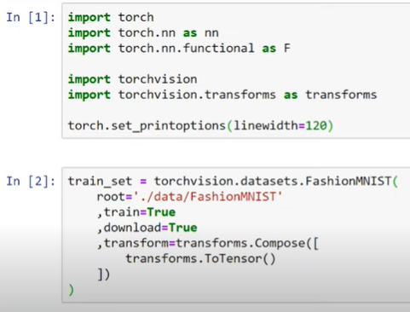
22.1 Forward Propagation
https://www.youtube.com/watch?v=6vweQjouLEE&list=PLZbbT5o_s2xrfNyHZsM6ufI0iZENK9xgG&index=22
What is Forward Propagation?
We are ready to pass a single sample image to network to get a prediction.

Slide 12
22.2 Prediction: Forward Pass

Slide 13
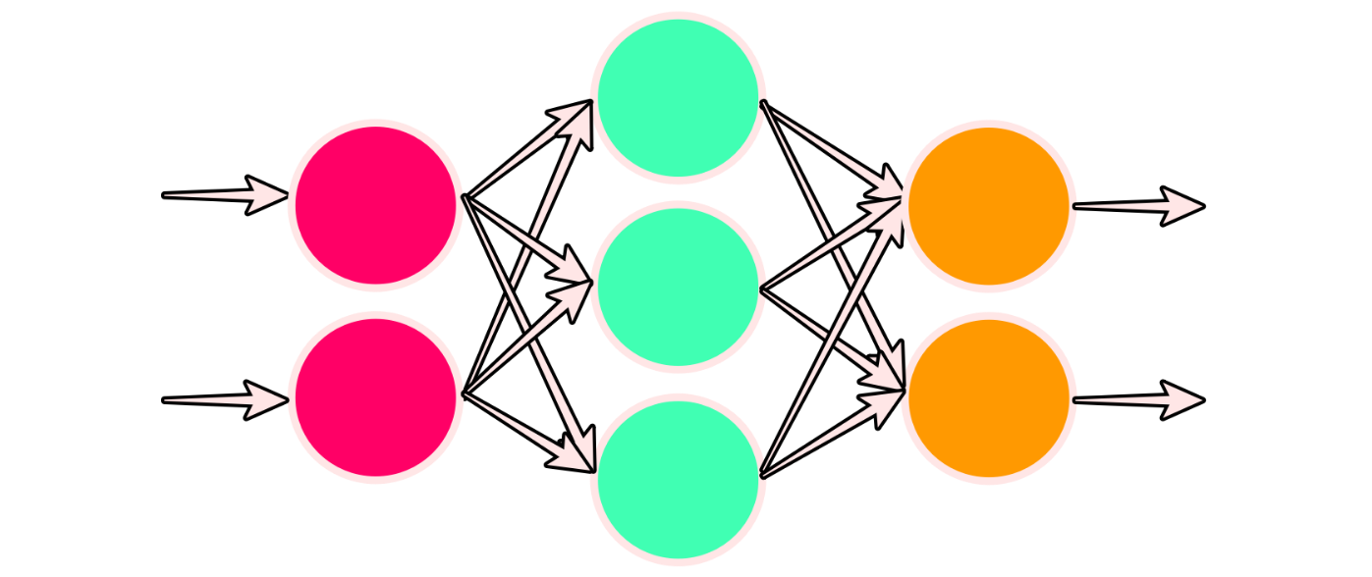
22.2 Prediction: Forward Pass
https://www.youtube.com/watch?v=6vweQjouLEE&list=PLZbbT5o_s2xrfNyHZsM6ufI0iZENK9xgG&index=22
Prediction by Neural Networks: Forward Pass
Before we being, we are going to turn off PyTorch’s gradient calculation feature.
This will stop PyTorch from automatically building a computation graph as our tensor flows through the network.

Slide 14
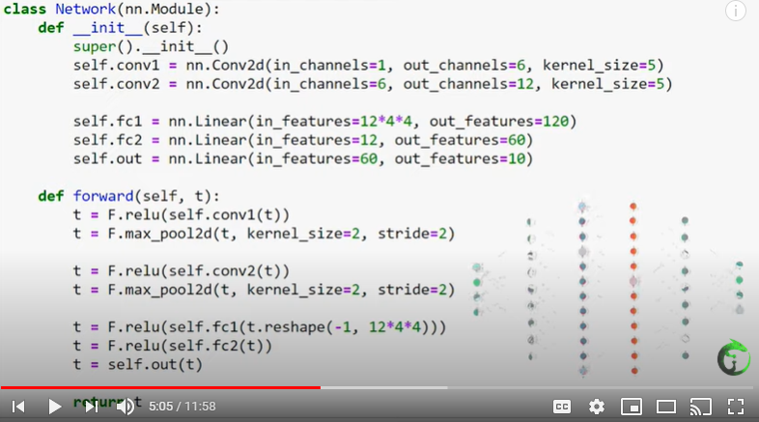
22.2 Prediction: Forward Pass
https://www.youtube.com/watch?v=6vweQjouLEE&list=PLZbbT5o_s2xrfNyHZsM6ufI0iZENK9xgG&index=22
Prediction by Neural Networks: Forward Pass
The computation graph keeps track the network’s mapping by tracking each computation that happens as the tensor propagate forward through the network.
The graph is then used during the training process to calculate the derivative also known as the gradient of the loss function.

Slide 15

22.2 Prediction: Forward Pass
https://www.youtube.com/watch?v=6vweQjouLEE&list=PLZbbT5o_s2xrfNyHZsM6ufI0iZENK9xgG&index=22
Prediction by Neural Networks: Forward Pass
Since we are not training the network yet, we aren’t planning on updating the weights, and so we don’t require gradient calculations.
We will turn this back on when training begins.
This process of tracking calculations happens in real-time, as the calculations occur. Remember back at the beginning of the series, we said that PyTorch uses a dynamic computational graph. We'll now we're turning it off.
Turning it off isn’t strictly necessary but having the feature turned off does reduce memory consumption since the graph isn't stored in memory. This code will turn the feature off.

Slide 16
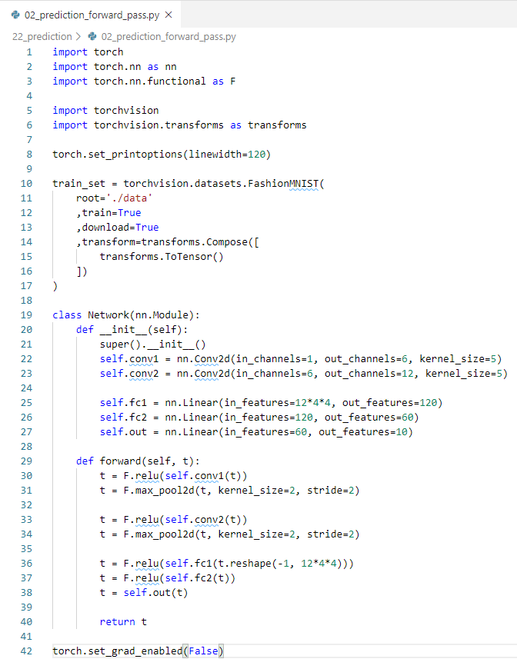
22.2 Prediction: Forward Pass
https://www.youtube.com/watch?v=6vweQjouLEE&list=PLZbbT5o_s2xrfNyHZsM6ufI0iZENK9xgG&index=22
Prediction by Neural Networks: Forward Pass
Code for prediction of forward pass:

Slide 17
22.3 Pass Image to Network

Slide 18

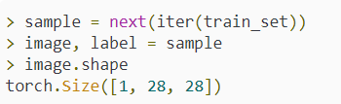
22.3 Pass Image to Network
https://www.youtube.com/watch?v=6vweQjouLEE&list=PLZbbT5o_s2xrfNyHZsM6ufI0iZENK9xgG&index=22
Passing A Single Image to The Network
Let’s continue by creating an instance of our Network class:
Next, we’ll procure a single sample from our training set, unpack the image and the label, and verify the image’s shape:

Slide 19
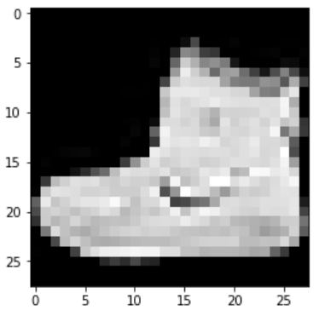
22.3 Pass Image to Network
https://www.youtube.com/watch?v=6vweQjouLEE&list=PLZbbT5o_s2xrfNyHZsM6ufI0iZENK9xgG&index=22
Passing A Single Image to The Network
The image tensor’s shape indicates that we have a single channel image that is 28 in height and 28 in width.
This is what we expect.

Slide 20

22.3 Pass Image to Network
https://www.youtube.com/watch?v=6vweQjouLEE&list=PLZbbT5o_s2xrfNyHZsM6ufI0iZENK9xgG&index=22
Passing A Single Image to The Network
Now, there's a second step we must preform before simply passing this tensor to our network.
When we pass a tensor to our network, the network is expecting a batch, so even if we want to pass a single image, we still need a batch.
This is no problem.
We can create a batch that contains a single image. All of this will be packaged into a single four dimensional tensor that reflects the following dimensions.

Slide 21

22.3 Pass Image to Network
https://www.youtube.com/watch?v=6vweQjouLEE&list=PLZbbT5o_s2xrfNyHZsM6ufI0iZENK9xgG&index=22
Passing A Single Image to The Network
This requirement of the network arises from the fact that the forward() method's in the nn.Conv2d convolutional layer classes expect their tenors to have 4 dimensions.
This is pretty standard as most neural network implementations deal with batches of input samples rather than single samples.
To put our single sample image tensor into a batch with a size of 1, we just need to unsqueeze() the tensor to add an additional dimension.
We saw how to do this in previous discussion.

Slide 22
22.3 Pass Image to Network
https://www.youtube.com/watch?v=6vweQjouLEE&list=PLZbbT5o_s2xrfNyHZsM6ufI0iZENK9xgG&index=22
Passing A Single Image to The Network
Using this, we can now pass the unsqueezed image to our network and get the network's prediction.
# image shape needs to be (batch_asize × in_channels × H × W)
> pred = network(image.unsqueeze(0))
> pred
tensor([[0.0991, 0.0916, 0.0907, 0.0949, 0.1013, 0.0922, 0.0990, 0.1130, 0.1107, 0.1074]])
> pred.shape
torch.Size([1, 10])
> label
9
> pred.argmax(dim=1)
tensor([7])

Slide 23
22.3 Pass Image to Network
https://www.youtube.com/watch?v=6vweQjouLEE&list=PLZbbT5o_s2xrfNyHZsM6ufI0iZENK9xgG&index=22
Passing A Single Image to The Network
And we did it!
We've used our forward method to get a prediction from the network.

Slide 24

22.3 Pass Image to Network
https://www.youtube.com/watch?v=6vweQjouLEE&list=PLZbbT5o_s2xrfNyHZsM6ufI0iZENK9xgG&index=22
Passing A Single Image to The Network
The network has returned a prediction tensor that contains a prediction value for each of the ten categories of clothing.
The shape of the prediction tensor is 1 x 10. This tells us that the first axis has a length of one while the second axis has a length of ten.
The interpretation of this is that we have one image in our batch and ten prediction classes.

Slide 25
22.3 Pass Image to Network
https://www.youtube.com/watch?v=6vweQjouLEE&list=PLZbbT5o_s2xrfNyHZsM6ufI0iZENK9xgG&index=22
Passing A Single Image to The Network
For each input in the batch, and for each prediction class, we have a prediction value.
If we wanted these values to be probabilities, we could just the softmax() function from the nn.functional package.
> F.softmax(pred, dim=1)
tensor([[0.1096, 0.1018, 0.0867, 0.0936, 0.1102, 0.0929, 0.1083, 0.0998, 0.0943, 0.1030]])
> F.softmax(pred, dim=1).sum()
tensor(1.)

Slide 26
22.3 Pass Image to Network
https://www.youtube.com/watch?v=6vweQjouLEE&list=PLZbbT5o_s2xrfNyHZsM6ufI0iZENK9xgG&index=22
Passing A Single Image to The Network
The label for the first image in our training set is 9, and using the argmax() function we can see that the highest value in our prediction tensor occurred at the class represented by index 7.
Prediction: Sneaker (7)
Actual: Ankle boot (9)
Remember, each prediction class is represented by a corresponding index.

Slide 27
22.3 Pass Image to Network
https://www.youtube.com/watch?v=6vweQjouLEE&list=PLZbbT5o_s2xrfNyHZsM6ufI0iZENK9xgG&index=22
Passing A Single Image to The Network
The prediction in this case is incorrect, which is what we expect because the weights in the network were generated randomly.
Index | Label
0 | T-shirt/top
1 | Trouser
2 | Pullover
3 | Dress
4 | Coat
5 | Sandal
6 | Shirt
7 | Sneaker
8 | Bag
9 | Ankle boot

Slide 28
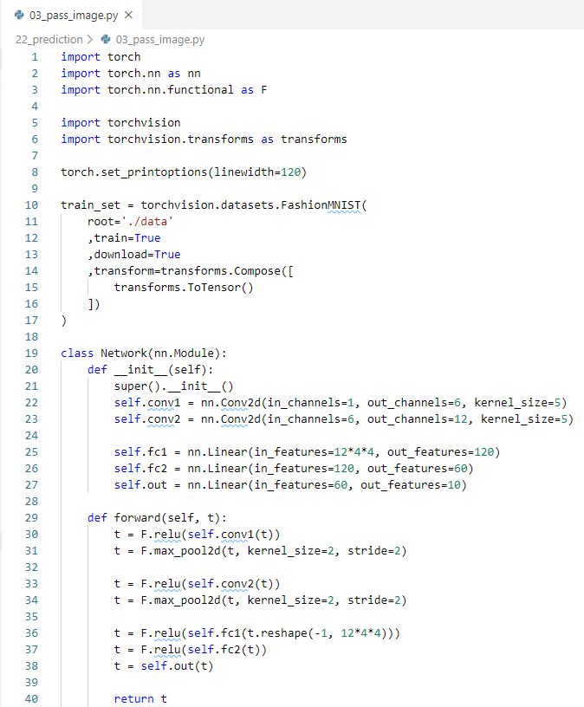
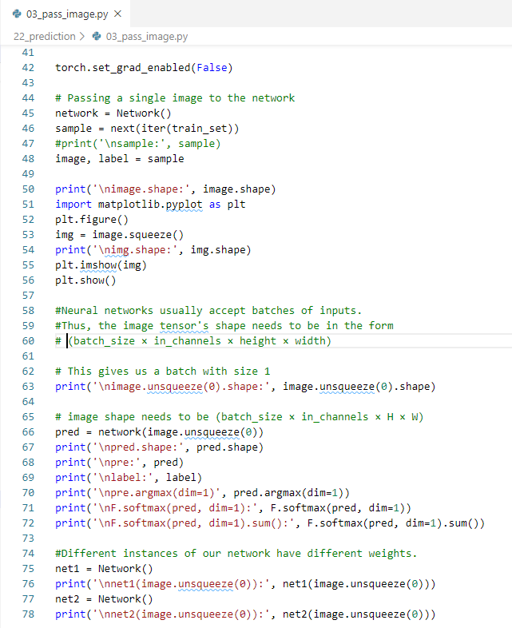
22.3 Pass Image to Network
https://www.youtube.com/watch?v=6vweQjouLEE&list=PLZbbT5o_s2xrfNyHZsM6ufI0iZENK9xgG&index=22
Passing A Single Image to The Network: Code

Slide 29
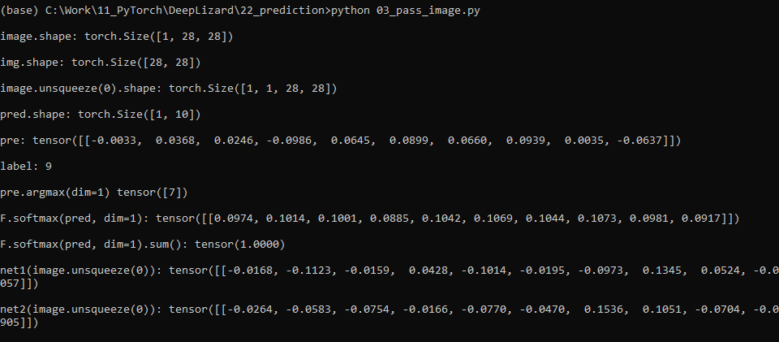
22.3 Pass Image to Network
https://www.youtube.com/watch?v=6vweQjouLEE&list=PLZbbT5o_s2xrfNyHZsM6ufI0iZENK9xgG&index=22
Passing A Single Image to The Network

Slide 30
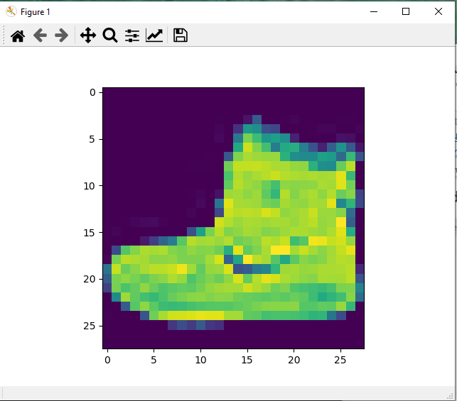
22.3 Pass Image to Network
https://www.youtube.com/watch?v=6vweQjouLEE&list=PLZbbT5o_s2xrfNyHZsM6ufI0iZENK9xgG&index=22
Passing A Single Image to The Network

Slide 31
22.4 Random Weight

Slide 32
22.4 Random Weight
https://www.youtube.com/watch?v=6vweQjouLEE&list=PLZbbT5o_s2xrfNyHZsM6ufI0iZENK9xgG&index=22
Network Weights Are Randomly Generated
There are a couple of important things we need to point out about these results.
Most of the probabilities came in close to 10%, and this makes sense because our network is guessing and we have ten prediction classes coming from a balanced dataset.
Another implication of the randomly generated weights is that each time we create a new instance of our network, the weights within the network will be different.
This means that the predictions we get will be different if we create different networks.
Keep this in mind.

Slide 33
22.4 Random Weight
https://www.youtube.com/watch?v=6vweQjouLEE&list=PLZbbT5o_s2xrfNyHZsM6ufI0iZENK9xgG&index=22
Network Weights Are Randomly Generated
Your predictions will be different from what we see here.
> net1 = Network()
> net2 = Network()
> net1(image.unsqueeze(0))
tensor([[ 0.0855, 0.1123, -0.0290, -0.1411, -0.1293, -0.0688, 0.0149, 0.1410, -0.0936, -0.1157]])
> net2(image.unsqueeze(0))
tensor([[-0.0408, -0.0696, -0.1022, -0.0316, -0.0986, -0.0123, 0.0463, 0.0248, 0.0157, -0.1251]])

Slide 34
22.4 Random Weight
https://www.youtube.com/watch?v=6vweQjouLEE&list=PLZbbT5o_s2xrfNyHZsM6ufI0iZENK9xgG&index=22
Network Weights Are Randomly Generated
Your predictions will be different from what we see here.
> net1 = Network()
> net2 = Network()
> net1(image.unsqueeze(0))
tensor([[ 0.0855, 0.1123, -0.0290, -0.1411, -0.1293, -0.0688, 0.0149, 0.1410, -0.0936, -0.1157]])
> net2(image.unsqueeze(0))
tensor([[-0.0408, -0.0696, -0.1022, -0.0316, -0.0986, -0.0123, 0.0463, 0.0248, 0.0157, -0.1251]])

Slide 35

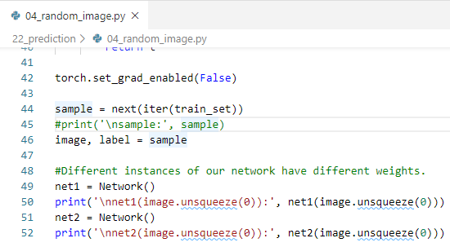
22.4 Random Weight
https://www.youtube.com/watch?v=6vweQjouLEE&list=PLZbbT5o_s2xrfNyHZsM6ufI0iZENK9xgG&index=22
Network Weights Are Randomly Generated: Code

Slide 36
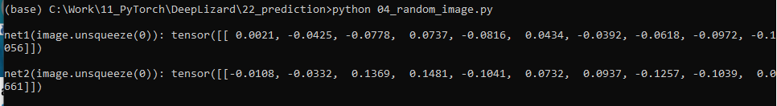
22.4 Random Weight
https://www.youtube.com/watch?v=6vweQjouLEE&list=PLZbbT5o_s2xrfNyHZsM6ufI0iZENK9xgG&index=22
Network Weights Are Randomly Generated:
print prediction results for different pass in images.

Slide 37
22.5 Pass Batch by Data Loader

Slide 38
22.5 Pass Batch by Data Loader
https://www.youtube.com/watch?v=6vweQjouLEE&list=PLZbbT5o_s2xrfNyHZsM6ufI0iZENK9xgG&index=22
Pass Batch by Data Loader
We now ready to pass a batches of data to our network and interpret the results.
We should now have a good understanding of what forward propagation is and how we can pass a single image tensor to a convolutional neural network in PyTorch. In the next post, we will see how to use the data loader to pass a batch to our network. I’ll see you there!

Slide 39
22.6 Quiz

Slide 40
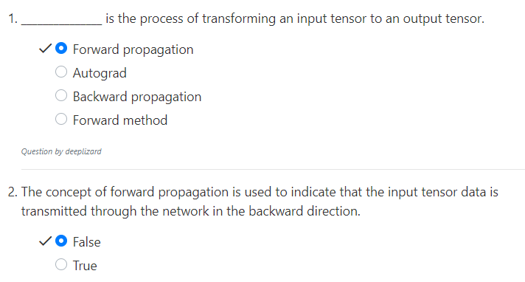
22.6 Quiz
https://www.youtube.com/watch?v=6vweQjouLEE&list=PLZbbT5o_s2xrfNyHZsM6ufI0iZENK9xgG&index=22
Quiz
2. Forward propagation is for Forward Direction, not backward direction

Slide 41
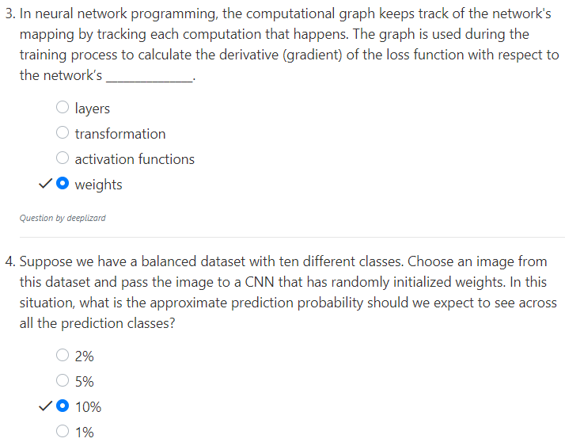
22.6 Quiz
https://www.youtube.com/watch?v=6vweQjouLEE&list=PLZbbT5o_s2xrfNyHZsM6ufI0iZENK9xgG&index=22
Quiz

Slide 42
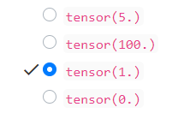
22.6 Quiz
https://www.youtube.com/watch?v=6vweQjouLEE&list=PLZbbT5o_s2xrfNyHZsM6ufI0iZENK9xgG&index=22
Quiz
> pred
tensor([[0.0991, 0.0916, 0.0907, 0.0949, 0.1013, 0.0922, 0.0990, 0.1130, 0.1107, 0.1074]])
> F.softmax(pred, dim=1).sum()

Slide 43
End of Chapter

