Slide 1

17 Build CNN (Part 2)
Peter H. Chen

Slide 2
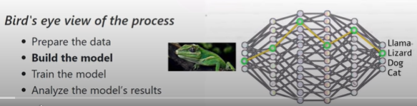
17 Build CNN (Part 2)
https://www.youtube.com/watch?v=k4jY9L8H89U&list=PLZbbT5o_s2xrfNyHZsM6ufI0iZENK9xgG&index=17
Build CNN
We discussed how to build model by CNN.
From the high level perspective, we are in Build the Model.
Prepare the Data
Build the Model
Train the Model
Analyze the Model result
We are ready to build the model. When we say model, we mean the network. The words model and network refer the same thing.
What we want the network do is model or approximate a function that maps an image input to the correct output class.

Slide 3
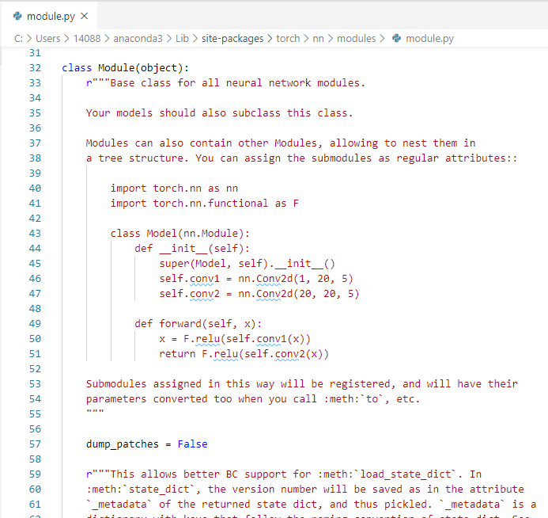
17 Build CNN (Part 2)
https://www.youtube.com/watch?v=k4jY9L8H89U&list=PLZbbT5o_s2xrfNyHZsM6ufI0iZENK9xgG&index=17
Build CNN
Object Oriented Programming view of PyTroch:
Open C:\Users\14088\anaconda3\Lin\site-packages\torch\nn\modules\modules.py

Slide 4
17 Build CNN (Part 2)
https://www.youtube.com/watch?v=k4jY9L8H89U&list=PLZbbT5o_s2xrfNyHZsM6ufI0iZENK9xgG&index=17
Build CNN
When we extend torch.nn.Module pyTorch class. This mean we need to utilize the Object-Oriented Programming in Python.

Slide 5
17 Build CNN (Part 2)
https://www.youtube.com/watch?v=k4jY9L8H89U&list=PLZbbT5o_s2xrfNyHZsM6ufI0iZENK9xgG&index=17
Build CNN
Why is data scientist care about the Object-Oriented Programming?
Every instances in PyTorch are created by OOP.
When we write the program, there are two key components, code and data.
With Object-Oriented Programming, our grogram design and structure around the objects.
Objects are designed in code using classes.
A class defines the object’s specification.
It specifies what data and code each object of the class should have.
When we create an object of a class, we call the object an instance of the class. All instances of a given class have two components: Method and attributes.
The methods represent the code and attributes represent the data.
These methods and attributes are defined by the class.

Slide 6
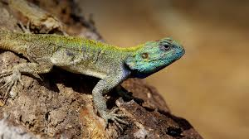
17 Build CNN (Part 2)
https://www.youtube.com/watch?v=k4jY9L8H89U&list=PLZbbT5o_s2xrfNyHZsM6ufI0iZENK9xgG&index=17
Build CNN
We can think about the attributes are describing the characteristics of an object and methods are behaviors of the object.
For example, if we have a Lizard object, some attributes may have the color and length. Some methods may have run, jump, and catch a bug.
In other words, the attributes are the properties of the object that let us know th1e object’s characteristics and methods let’s us know what the object can do.
In a given programs, many objects, a.k.a., instances of a class, can existed simultaneously.
All the instances of a particular class will have the same available attributes in the same available methods. They are uniformed from this perspective.

Slide 7


17 Build CNN (Part 2)
https://www.youtube.com/watch?v=k4jY9L8H89U&list=PLZbbT5o_s2xrfNyHZsM6ufI0iZENK9xgG&index=17
Build CNN
Think in this way, the lizard class let’s us know that a lizard object have a color and has length, but it does not tell us what the color or what is the length is because the class only describes the object.
The class is a blueprint of the object. We can make as many object as we like from the same class.
For example, the green lizard is 20 cm, the other lizard made from the same class maybe blue with length of 10 cm.
The difference of objects of the same class is in the values for each attribute.
Each object has its own attribute values.

Slide 8
17 Build CNN (Part 2)
https://www.youtube.com/watch?v=k4jY9L8H89U&list=PLZbbT5o_s2xrfNyHZsM6ufI0iZENK9xgG&index=17
Build CNN
These values determine the internal state of the object.
The code and data of each object is encapsulated within the object.

Slide 9
17.1 Class Lizard

Slide 10
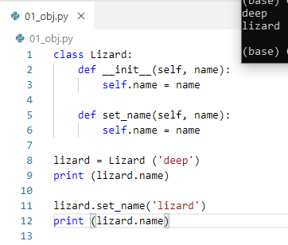
17.1 Class Lizard
https://www.youtube.com/watch?v=k4jY9L8H89U&list=PLZbbT5o_s2xrfNyHZsM6ufI0iZENK9xgG&index=17
Build CNN
OOP Class and Object.

Slide 11
17.2 Class Network

Slide 12
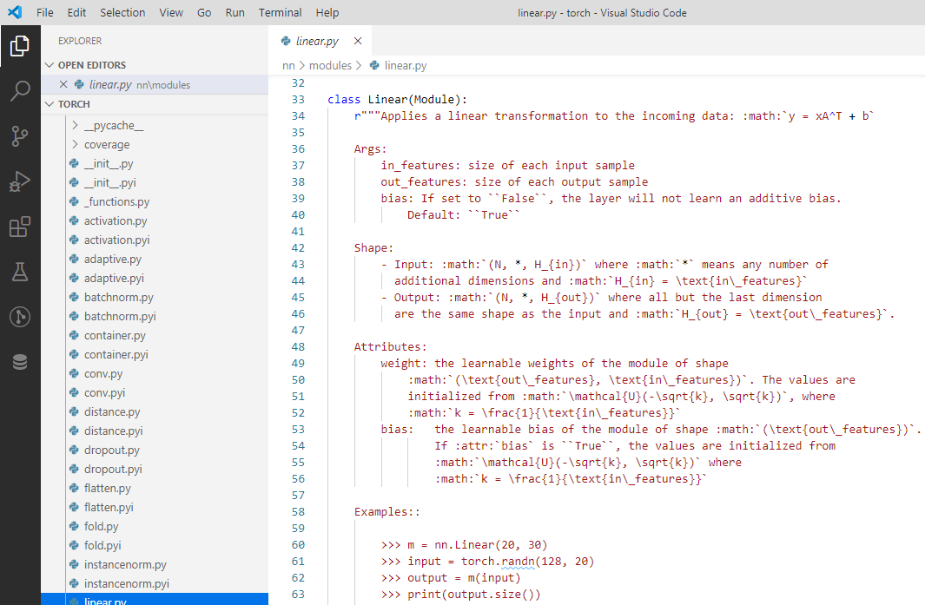
17.2 Class Network
https://www.youtube.com/watch?v=k4jY9L8H89U&list=PLZbbT5o_s2xrfNyHZsM6ufI0iZENK9xgG&index=17
PyTorch’s torch.nn Packagae
To build neural networks in PyTorch, we use torch.nn package.
The torch.nn psckage is PyTorch’s nn (Neural Network) library.
We import the package:
> import torch.nn as nn

Slide 13
17.2 Class Network
https://www.youtube.com/watch?v=k4jY9L8H89U&list=PLZbbT5o_s2xrfNyHZsM6ufI0iZENK9xgG&index=17
PyTorch’s torch.nn Packagae
PyTorch neural network Library contains all the typically components typically needed to build neural networks.
The primary components we need to build a neural network is a layer.
The PyTorch neural network library contains classes that help us in constructing layers. Each layer in the neural network has two primary components.
Number one, a transformation
Number two, a collection of weights.

Slide 14
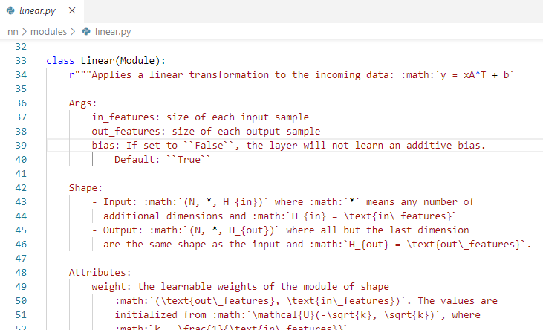
17.2 Class Network
https://www.youtube.com/watch?v=k4jY9L8H89U&list=PLZbbT5o_s2xrfNyHZsM6ufI0iZENK9xgG&index=17
PyTorch’s torch.nn Packagae
Now, if we think back to object programming.
The transformation is code. A collection of weights is data.
Code
Data

Slide 15
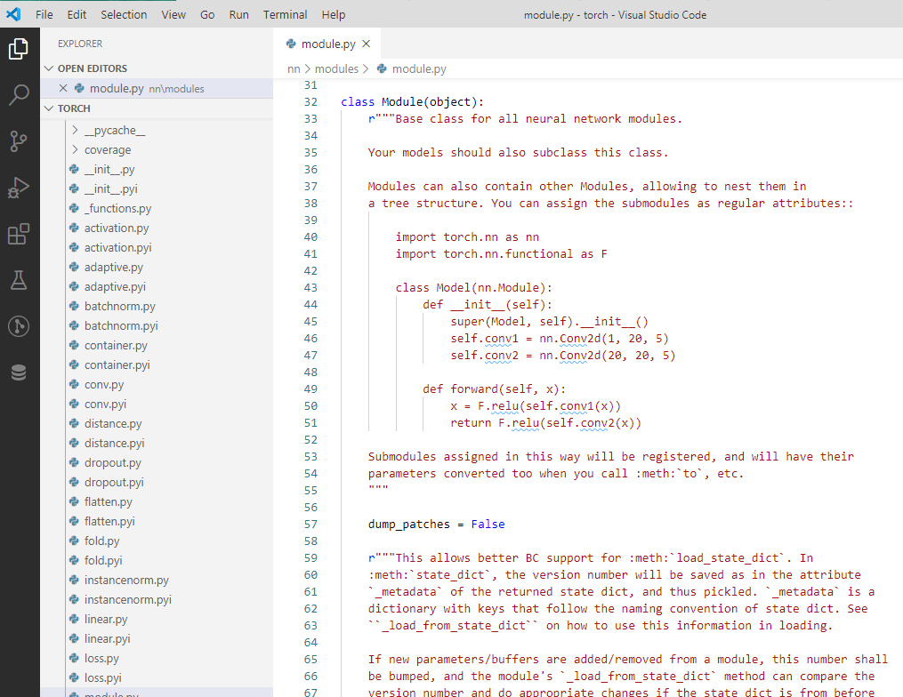
17.2 Class Network
https://www.youtube.com/watch?v=k4jY9L8H89U&list=PLZbbT5o_s2xrfNyHZsM6ufI0iZENK9xgG&index=17
PyTorch’s torch.nn Packagae
The layer is represented as a classes. PyTorch is defined by classes.
Our layer will be objects. Within the neural network package, there us a special class called module.
The module is a base class for all neural network. This means that all the layers in PyTorch extend the nn.module class and inherit all of PyTorch built-in functionality that comes with the nn.modules class.
In OOP, this is called as inheritance. You extends the class nn.modules and you get all of the nn.modules functionalities.

Slide 16
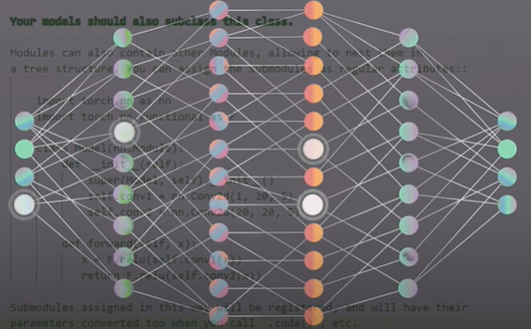
17.2 Class Network
https://www.youtube.com/watch?v=k4jY9L8H89U&list=PLZbbT5o_s2xrfNyHZsM6ufI0iZENK9xgG&index=17
PyTorch’s torch.nn Packagae
This inheritance includes layers and neural networks.
The layers and neural network should inherit the same functionality.
The neural network can be though of sort of as one large layer.
Layers are functions and neural network are composed of layers.
The layer and neural network are same type of object.
We can extend the module based class anytime we are creating a custom layer or a PyTorch neural network.

Slide 17
17.2 Class Network
https://www.youtube.com/watch?v=k4jY9L8H89U&list=PLZbbT5o_s2xrfNyHZsM6ufI0iZENK9xgG&index=17
PyTorch’s torch.nn Packagae
When we pass a tensor to out network as input, the tensor flows forward each layer transformation until the tensor reaches the output layer.
This process of a tensor flowing through the network is called a forward pass.
Each layer has its own transformation and the tensor passes forward through each layer’s transformation.
The composition of all the individual layer forward passes defines the overall forward pass transformation for the network itself.
What this all means for PyTorch is that every PyTorch nn.Module has a forward () method to represent its forward pass, and so when we are building layers and networks, we must provide an implementation of the forward () method.
The forward method is the actual transformation whether it is a layer or for a network.

Slide 18
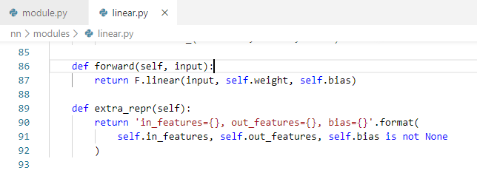
17.2 Class Network
https://www.youtube.com/watch?v=k4jY9L8H89U&list=PLZbbT5o_s2xrfNyHZsM6ufI0iZENK9xgG&index=17
PyTorch’s torch.nn Packagae
When we implement the forward() method of our nn.Module subclass, we typically use the functions from nn.functional package.
This package provides us with many neural network operations that we use when we are implementing our forward function.
This give us three key pieces of information we need to create a neural network class and PyTorch.
Module nn.functional
Functional interface

Slide 19
17 Build CNN (Part 2)
https://www.youtube.com/watch?v=k4jY9L8H89U&list=PLZbbT5o_s2xrfNyHZsM6ufI0iZENK9xgG&index=17
Summary of PyTroch
Building a neural network in PyTorch
Three key pieces of information:
Create a neural network that extend the nn.Module base class.
In the class constructor, define network layers as class attributes.
Use network layer attributes as well as operations from nn.functional API to define network forward() method.

Slide 20
17.2 Class Network
https://www.youtube.com/watch?v=k4jY9L8H89U&list=PLZbbT5o_s2xrfNyHZsM6ufI0iZENK9xgG&index=17
Create a Simple class to represent a neural network
> class Network:
> def __init__ (self):
> self.layer = None
> def forward (self, t):
> t = self.layer(t)
> return t
This give us a simple Network class.
class Network has
a single dummy layer inside the constructor and
a dummy implementation for the forward function.
The implementation for the forward function takes in a tensor t and transforms it using a dummy layer after the tensor is transformed. The new tensor is returned.
This class Network does not extend the nn.Module class.

Slide 21
17.2 Class Network)
https://www.youtube.com/watch?v=k4jY9L8H89U&list=PLZbbT5o_s2xrfNyHZsM6ufI0iZENK9xgG&index=17
Create a Simple class to represent a neural network
> class Network:
> def __init__ (self):
> self.layer = None
> def forward (self, t):
> t = self.layer(t)
> return t
This give us a simple Network class.
class Network has
a single dummy layer inside the constructor and
a dummy implementation for the forward function.
The implementation for the forward function takes in a tensor t and transforms it using a dummy layer after the tensor is transformed. The new tensor is returned.
This is a good start but this Network class does not extend the nn.Module class.

Slide 22
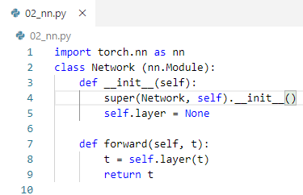
17.2 Class Network
https://www.youtube.com/watch?v=k4jY9L8H89U&list=PLZbbT5o_s2xrfNyHZsM6ufI0iZENK9xgG&index=17
To make the class Network do this, we need two additional things:
We need to inherit nn.Module class. i.e., class Network (nn.Module).
We need to insert a call to the superclass constructor.
> import torch.nn as nn
> class Network (nn.Module): # inherit nn.Module
> def __init__ (self):
> super (Network, self).__init__()
> self.layer = None
> def forward (self, t):
> t = self.layer(t)
> return t

Slide 23
17.3 Deep Learning Network

Slide 24
17.3 Deep Learning Network
https://www.youtube.com/watch?v=k4jY9L8H89U&list=PLZbbT5o_s2xrfNyHZsM6ufI0iZENK9xgG&index=17
We build CNN, we need to build linear layer and convolutional layers > import torch.nn as nn
> class Network (nn.Module): # inherit nn.Module
> def __init__ (self):
> super (Network, self).__init()
> self.conv1 = nn.Conv2d(in_channels=1, out_channels=6, kernel_size=5)
> self.conv2 = nn.Conv2d (in_channels=6, out_channels=12, kernel_size=5)
> self.fc1 = nn.Linear(in_features*12*4*4, out_featues=120)
> self.fc2 = nn.Linear(in_features = 120, out_fearures=60)
> self.out = nn.Linear(in_features=60, out_features=10)
> def forward (self, t):
> # implement the forward pass
> return t

Slide 25
17.3 Deep Learning Network
https://www.youtube.com/watch?v=k4jY9L8H89U&list=PLZbbT5o_s2xrfNyHZsM6ufI0iZENK9xgG&index=17
The following 5 layers are defined as attributes.
Each layer has two components, a set of weights, and a transformation
> self.conv1 = nn.Conv2d(in_channels=1, out_channels=6, kernel_size=5)
> self.conv2 = nn.Conv2d (in_channels=6, out_channels=12, kernel_size=5)
> self.fc1 = nn.Linear(in_features*12*4*4, out_featues=120)
> self.fc2 = nn.Linear(in_features = 120, out_fearures=60)
> self.out = nn.Linear(in_features=60, out_features=10)
> def forward (self, t):
> # implement the forward pass
> return t
Note: Chapter 21: input feature 12 * 4 * 4 is output channel of conv2 (12) and 4 * 4 is height and width of the filter.

Slide 26
17.3 Deep Learning Network
https://www.youtube.com/watch?v=k4jY9L8H89U&list=PLZbbT5o_s2xrfNyHZsM6ufI0iZENK9xgG&index=17
The following Two convolutional layers, conv1 and conv2.
> self.conv1 = nn.Conv2d(in_channels=1, out_channels=6, kernel_size=5)
> self.conv2 = nn.Conv2d (in_channels=6, out_channels=12, kernel_size=5)
The followings are three linear layers: fc1, fc2, and out.
The fc is abbreviation for fully connected because linear layers also called fully connected layers. Linear layer has the third name Dense.
Linear, fully connected, and Dense are always refer to the same type of layer.
> self.fc1 = nn.Linear(in_features*12*4*4, out_featues=120)
> self.fc2 = nn.Linear(in_features = 120, out_fearures=60)
> self.out = nn.Linear(in_features=60, out_features=10)
> def forward (self, t):
> # implement the forward pass
> return t

Slide 27
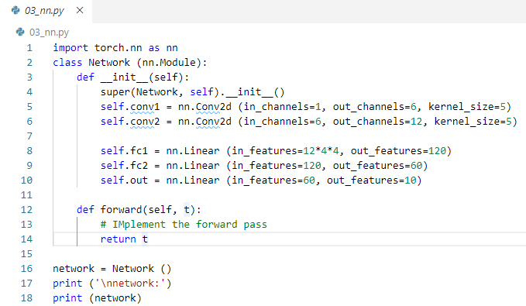
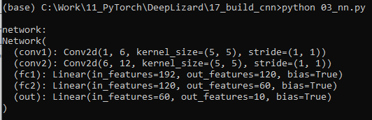
17.3 Deep Learning Network
https://www.youtube.com/watch?v=k4jY9L8H89U&list=PLZbbT5o_s2xrfNyHZsM6ufI0iZENK9xgG&index=17
5 layers:

Slide 28
17.4 Summary

Slide 29
17.4 Summary
https://www.youtube.com/watch?v=k4jY9L8H89U&list=PLZbbT5o_s2xrfNyHZsM6ufI0iZENK9xgG&index=17
Summary
We discussed how to build model by CNN.
From the high level perspective, we are in Build the Model.
Prepare the Data
Build the Model
Train the Model
Analyze the Model result
We are ready to build the model. When we say model, we mean the network. The words model and network refer the same thing.
What we want the network do is model or approximate a function that maps an image input to the correct output class.

Slide 30
17.5 Quiz

Slide 31
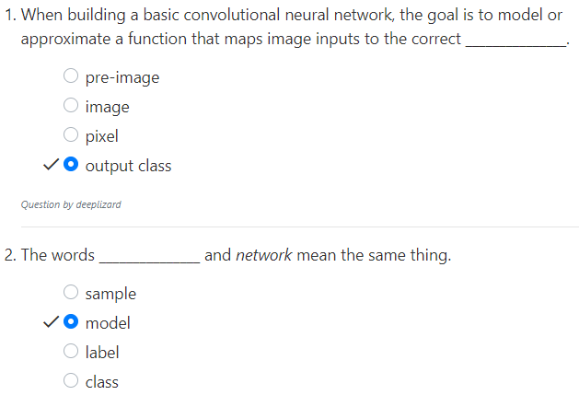
17.5 Quiz
https://www.youtube.com/watch?v=k4jY9L8H89U&list=PLZbbT5o_s2xrfNyHZsM6ufI0iZENK9xgG&index=17
Quiz

Slide 32
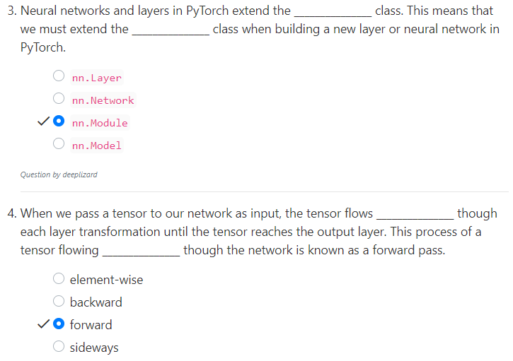
17.5 Quiz
https://www.youtube.com/watch?v=k4jY9L8H89U&list=PLZbbT5o_s2xrfNyHZsM6ufI0iZENK9xgG&index=17
Quiz

Slide 33

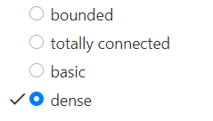
17.5 Quiz
https://www.youtube.com/watch?v=k4jY9L8H89U&list=PLZbbT5o_s2xrfNyHZsM6ufI0iZENK9xgG&index=17
Quiz
class Network(nn.Module):
def __init__(self):
super().__init__()
self.conv1 = nn.Conv2d(in_channels=1, out_channels=6, kernel_size=5)
self.conv2 = nn.Conv2d(in_channels=6, out_channels=12, kernel_size=5)
self.fc1 = nn.Linear(in_features=12 * 4 * 4, out_features=120)
self.fc2 = nn.Linear(in_features=120, out_features=60)
self.out = nn.Linear(in_features=60, out_features=10)
def forward(self, t):
# implement the forward pass
return t

Slide 34
End of Chapter

