Slide 1

99 CNN Handwriting Recognition
Peter H. Chen

Slide 2
99 CNN Handwriting Recognition
https://github.com/peterhchen/930_Python_ML_DS_DL
CNN Handwriting Recognition
We discuss Keras on the MNIST data set again.
This time, we use CNN (Convolutional Neural Network) that is better suited for image processing.
CNN's are less sensitive to the pattern in image. That is we are looking for.
With a multi-layer perceptron, we achieved around 97% accuracy.
Let’s see if CNN can beat that.
> conda activate tensorflow
> cd [Work-folder]
Start “jupyter notebook”.
Open “Keras-CNN.ipynb”

Slide 3
99.1 Import Keras API

Slide 4
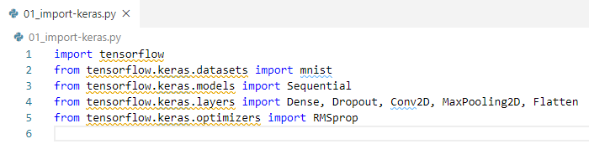
99.1 Import Keras API
https://github.com/peterhchen/930_Python_ML_DS_DL
Import Keras API

Slide 5
99.2 Load Data

Slide 6
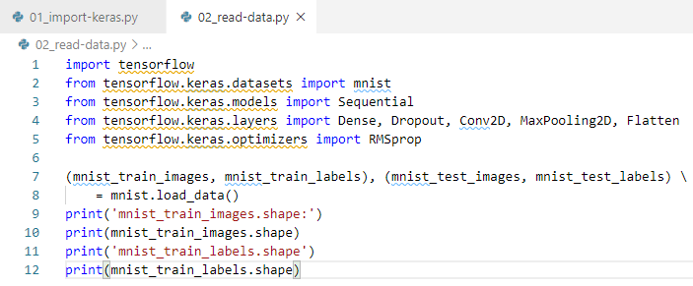

99.2 Load Data
https://github.com/peterhchen/930_Python_ML_DS_DL
Load Data

Slide 7
99.2 Load Data
https://github.com/peterhchen/930_Python_ML_DS_DL
Load Data
We need to know the shape the of data.
Before, we use flatten 784 (28 x 28) pixels.
The read in image data is 2D images of 28 x 28 pixels instead of a flattened stream of 784 pixels. We need to reshape image accordingly.
Depending on the setup data format Keras, the shape can be 1 x 28 x 28 or 28 x 28 x 1. Here, the "1" indicates a single color channel, as this is just grayscale. If we were dealing with color images, it would be 3 instead of 1.
In color channel, since we have RGB (Red, Green, and Blue) for color channels.

Slide 8
99.3 Reshape and Normalization

Slide 9
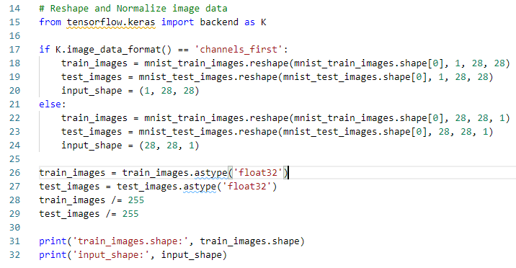
99.3 Reshape and Normalization
https://github.com/peterhchen/930_Python_ML_DS_DL
Reshape and Normalize Data

Slide 10
99.4 Label to One-Hot-Code

Slide 11
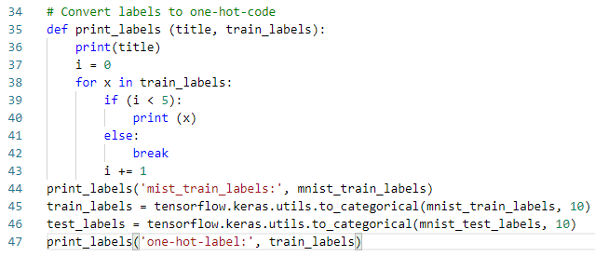
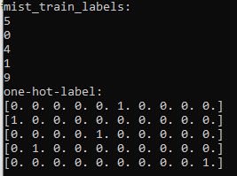
99.4 Label to One-Hot-Code
https://github.com/peterhchen/930_Python_ML_DS_DL
Label to One-Hot-Code

Slide 12
99.5 Display Sample Image

Slide 13
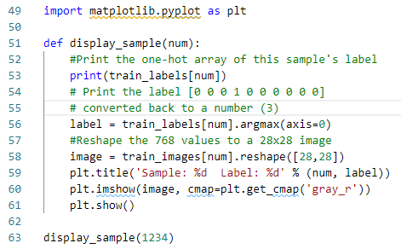
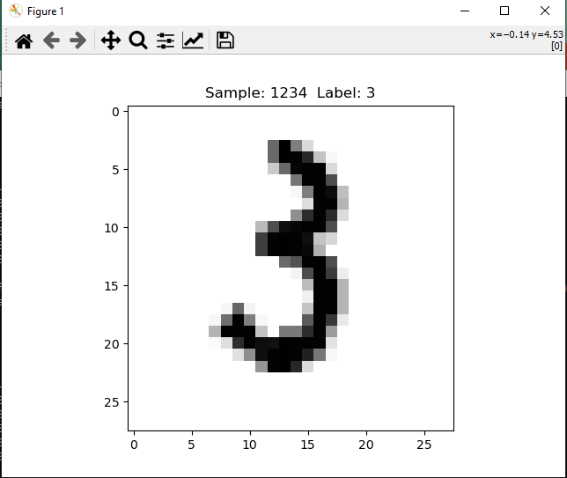

99.5 Display Sample Image
https://github.com/peterhchen/930_Python_ML_DS_DL
Display Sample Image

Slide 14
99.6 Setup CNN

Slide 15
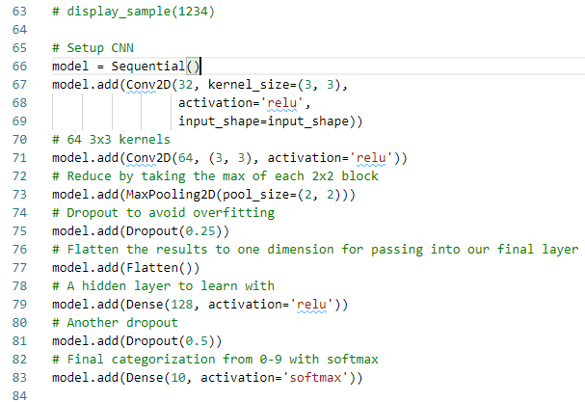
99.6 Setup CNN
https://github.com/peterhchen/930_Python_ML_DS_DL
Setup CNN
Setting up a CNN (Convolutional Neural Network) involves more layers.
Not all of the setup are necessary.
We can run without pooling and dropout, but those extra setup help avoid overfitting and help CNN run faster.

Slide 16
99.6 Setup CNN
https://github.com/peterhchen/930_Python_ML_DS_DL
Setup CNN (Explanation)
We use Keras Sequential Model to build up layers.

Slide 17
99.6 Setup CNN
https://github.com/peterhchen/930_Python_ML_DS_DL
Setup CNN (Explanation)
Setup 2D convolution of the image: Set up to 32 windows (filters) of each image, each filter being 3 x 3 kernel size.

Slide 18
99.6 Setup CNN
https://github.com/peterhchen/930_Python_ML_DS_DL
Setup CNN (Explanation)
We setup a second convolution for higher level neurons with 64 3x3 windows: this topology comes from the recommendation from Keras.
We use recommendation from CNN.

Slide 19
99.6 Setup CNN
https://github.com/peterhchen/930_Python_ML_DS_DL
Setup CNN (Explanation)
Next, we apply a MaxPooling2D layer that takes the maximum of each 2x2 result to extract the results down into something more manageable.

Slide 20
99.6 Setup CNN
https://github.com/peterhchen/930_Python_ML_DS_DL
Setup CNN (Explanation)
A dropout filter is then applied to prevent overfitting.

Slide 21
99.6 Setup CNN
https://github.com/peterhchen/930_Python_ML_DS_DL
Setup CNN (Explanation)
Next, we flatten the 2D layer we have at this stage into a 1D layer. We have a traditional multi-layer perceptron. Feed that into a hidden, flat layer of 128 units.
We then apply dropout again to further prevent overfitting.

Slide 22
99.6 Setup CNN
https://github.com/peterhchen/930_Python_ML_DS_DL
Setup CNN (Explanation)
And finally, we feed that into our final 10 units where softmax is applied to choose our category of 0-9.

Slide 23
99.7 Model Summary

Slide 24

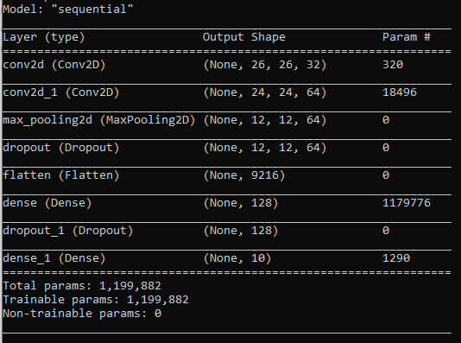
99.7 Model Summary
https://github.com/peterhchen/930_Python_ML_DS_DL
Model Summary

Slide 25
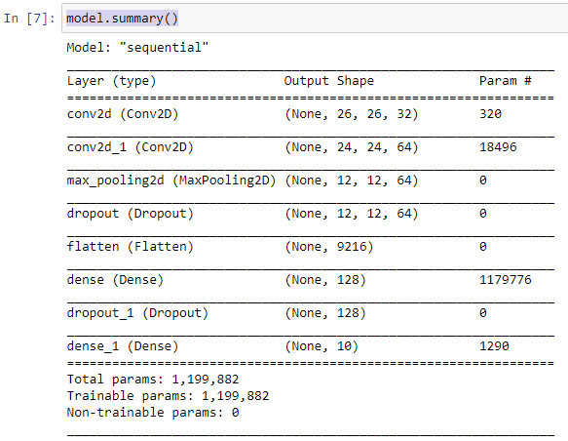
99.7 Model Summary
https://github.com/peterhchen/930_Python_ML_DS_DL
Model Summary (Explanation)
We can do a model.summary to double check that everything is the way that we intended it to be.
1. We can see that we have two convolution layers.
2. We have followed by a pooling layer, a dropout, and a flatten.
3. We have a dense, a dropout, and a dense layer of multi-layer perceptron to do final classification.
1
2
3

Slide 26
99.8 Compile Model

Slide 27
99.8 Compile Model
https://github.com/peterhchen/930_Python_ML_DS_DL
Compile Model
We are doing multiple categorization, therefore, categorical_crossentropy is still the right loss function to use.
We use the Adam optimizer.
Note:
The example provided with Keras uses RMSProp. You can try both Adam and RMSProp.

Slide 28
99.9 Train Model

Slide 29
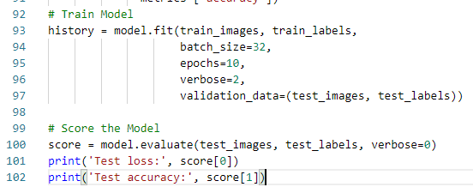
99.9 Train Model
https://github.com/peterhchen/930_Python_ML_DS_DL
Train Model
And now we train our model. To make CNN faster, we setup batches of 32.
Warning:
This could take hours to run, and your computer's CPU will be maxed (maximized) during the run.
Do not run the next block unless you can tie up your computer for a long time.
It will print progress as each epoch is run, but each epoch can take around 20 minutes.

Slide 30
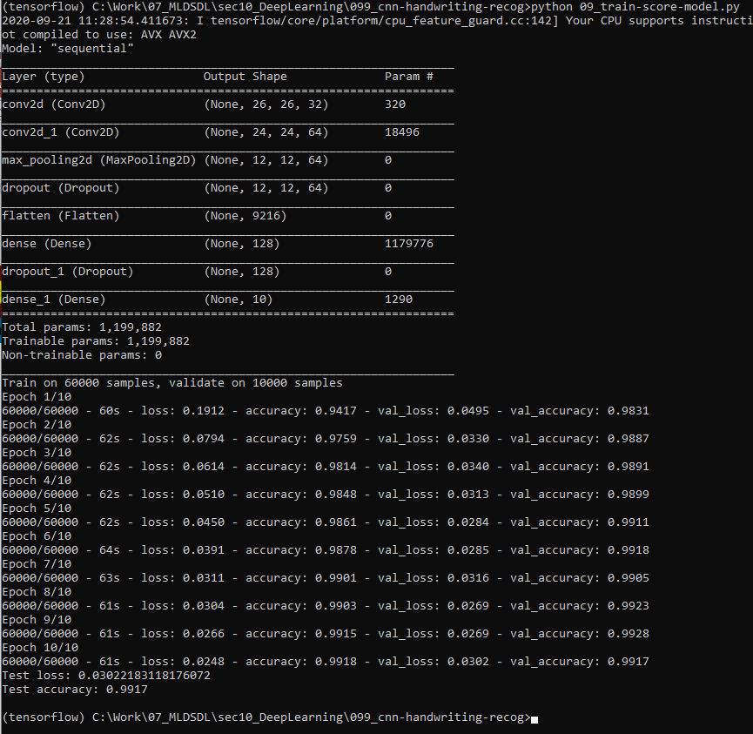
99.9 Train Model
https://github.com/peterhchen/930_Python_ML_DS_DL
Train Model

Slide 31
99.10 Score Model

Slide 32
99.10 Score Model
https://github.com/peterhchen/930_Python_ML_DS_DL
Score Model
We have over 99% accuracy and with just 10 epochs.
From print out, the looks of it, 5 or 6 would have been enough.
It came at a significant cost in terms of computing power, but when you start distributing things over multiple computers each with multiple GPU's, that cost starts to feel less bad.
If you are building model where life and death is a concern, for example, a self-driving car, accuracy is very important and worth to do.

Slide 33
99.10 Score Model
https://github.com/peterhchen/930_Python_ML_DS_DL
Score Model

Slide 34
End of Chapter

