Slide 1

70 Spark
Peter H. Chen

Slide 2

70 Spark
https://www.udemy.com/course/data-science-and-machine-learning-with-python-hands-on/learn/lecture/8063332#overview
Spark 3
Warning about Java 11 and Spark 3!
IMPORTANT SETUP NOTE
You're about to install Apache Spark, a powerful technology for analyzing big data!
When you are installing a Java Development Kit (JDK) for Spark, do not install Java 9 or 10 or 11. Instead, scroll down a little and install the JDK for Java 8 instead.
Java 9 and 10 just came out recently, and Spark is not yet compatible with it.

Slide 3
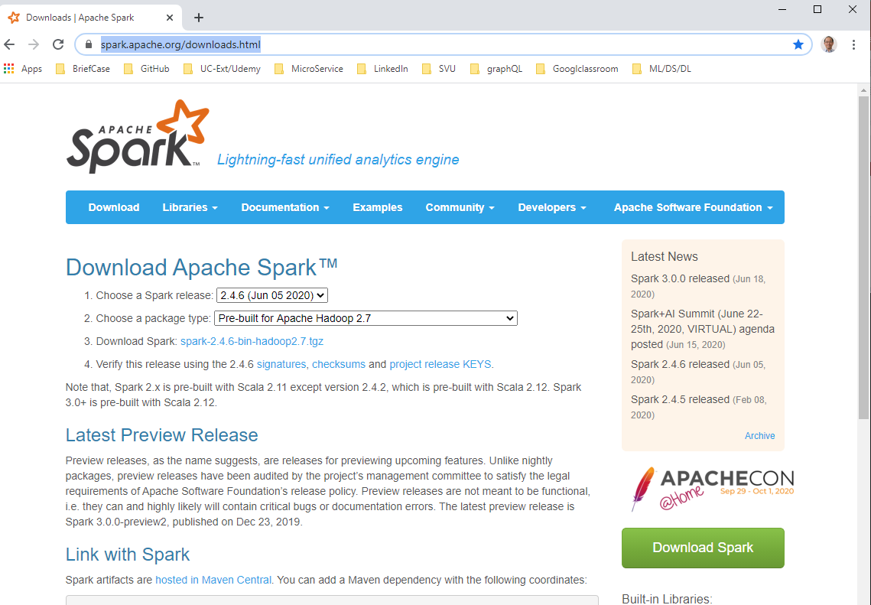
70 Spark
https://www.udemy.com/course/data-science-and-machine-learning-with-python-hands-on/learn/lecture/8063332#overview
Spark 3
ALSO
Select Spark 2.4.6 when downloading Spark.
We use Spark 2.4.6 (June 05, 2020) and Java 8.
A preview release of Spark 3 recently came out, but it isn't ready for prime time yet.
https://spark.apache.org/downloads.html

Slide 4
End of Chapter

